Slide 1
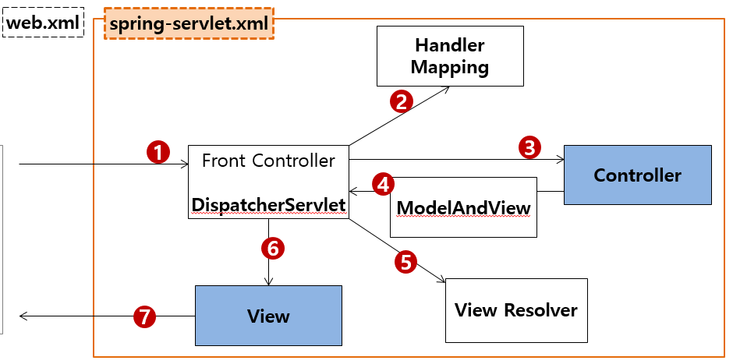
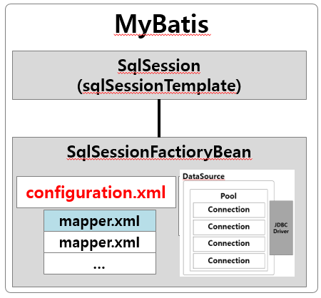
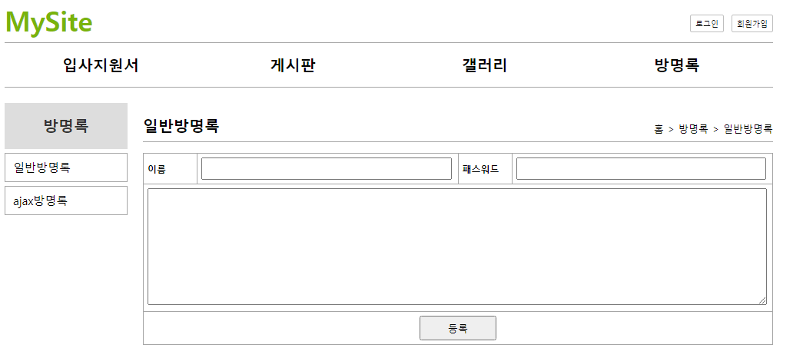
Handler Mapping
”/guestbook/ajaxMain” get post → GuestbookController.ajaxMain()
”/api/guestbook/list” get post → ApiGuestbookController.list()
”/api/guestbook/write” get post → ApiGuestbookController.write()
이름 패스워드 내용
Rqeust(요청)
DI
DI
DI
Request header
[파라미터]
name
password
conent
Request body
Tomcat
-버튼을 클릭했을때
-url창 변화없고 내부적으로만 요청이 됨
mysite5
@AutoWired
@AutoWired
rquest
[파라미터]
name
password
conent
[어트리뷰트]
Service 객체
Dao 객체
ajax방식: 응답시 데이터만 보내줘
@AutoWired
http://localhost:8088/api/guestbook/write
0x888
0x888
0x888
이름, 패스워드, 내용
wrtieResultVo(vo)
insertGuestbookKey(vo)
0x774
response
no
no
selectGuestbook(no)
vo
0x774
0x774
js ← JSON
Response(응답)
번호, 이름 패스워드, 시간, 내용
Response header
Response body
guestVo 번호 이름 패스워드 시간 내용
JSON←자바
0x888
0x774
JSON(문자열)
no=9
name=이효리
password=1234
content=본문…
regDate
no=9
name=이효리
password=1234
content=본문…
regDate=2021-08-02
DB
json 공통포멧
guestbookVo
guestbookVo

Slide 2
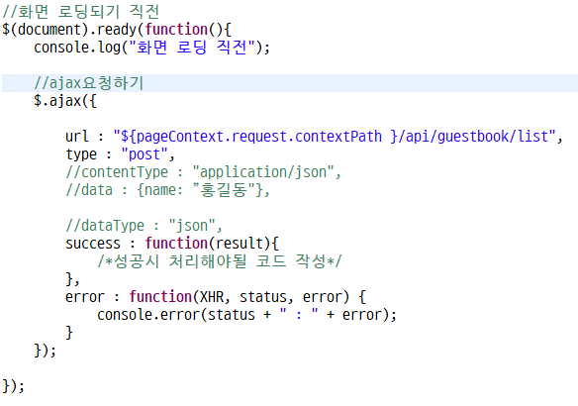
Handler Mapping
”/guestbook/ajaxMain” get post → GuestbookController.ajaxMain()
”/api/guestbook/list” get post → ApiGuestbookController.list()
js ← JSON
Rqeust(요청)
DI
DI
DI
Request header
[파라미터]
Request body
Tomcat
-로딩 직전에 요청들어감
-url창 변화없고 내부적으로만 요청이 됨
mysite5
@AutoWired
@AutoWired
ajax방식: 응답시 데이터만 보내줘
rquest
[파라미터]
[어트리뷰트]
Service 객체
Dao 객체
@ResponseBody
0x999
@AutoWired
http://localhost:8088/api/guestbook/list
getList()
selectList()
response
JSON←자바
Response(응답)
Response header
Response body
DB
JSON(문자열)
0x999
List<GuestbookVo>
json 공통포멧
guestbookVo
guestbookVo
guestbookVo

Slide 3
Handler Mapping
”/guestbook/ajaxMain” get post → GuestbookController.ajaxMain()
Rqeust(요청)
DI
DI
DI
Request header
[파라미터]
Request body
Tomcat
mysite5
@AutoWired
@AutoWired
url방식
rquest
[파라미터]
[어트리뷰트]
Service 객체
Dao 객체
@AutoWired
http://localhost:8088/guestbook/ajaxMain
response
ajaxMain.jsp
Response(응답)
Response header
Response body
<html>
DB
ajax방식: 응답시 데이터만 보내줘
http://localhost:8088/api/guestbook/list
로딩 직전에 요청들어감

Slide 4
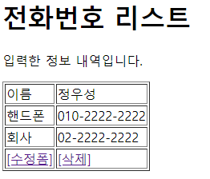
phonebook
Handler Mapping
”/phonebook3/list” get post → PhoneController.list()
”/phonebook3/writeForm” get post → PhoneController.writeForm()
”/phonebook3/write” get post → PhoneController.write()
”/phonebook3/delete” get post → PhoneController.delete()
”/phonebook3/updateForm” get post → PhoneController.updateForm()
”/phonebook3/update” get post → PhoneController.update ()
01
update
http://localhost:8088/phonebook3/update?
no=3&
name=정우성&
hp=010-2222-2222&
company=02-2222-2222
Tomcat
phonebook3
rquest
[파라미터]
no=3&
name=정우성&
hp=010-2222-2222&
company=02-2222-2222
[어트리뷰트]
PhoneDao 객체
/updateForm
PhoneController
personVo
빈화면
리다이렉트 list
personUpdate(vo)
count
jdbc → pom.xml
response
리다이렉트
view
return "redirect:/list"
DB

