Slide 1
AWS
AMAZON WEB SERVICES

Slide 2
Agenda
Cloud Concepts
AWS Core Services
AWS Security and Compliance
AWS Billing and Pricing
AWS Support
AWS Architecting Basics
Bonus

Slide 3
Cloud Concepts
Define cloud computing and its benefits
Differentiate between the various cloud deployment models (public, private, hybrid)
Differentiate between the various cloud service models (IaaS, PaaS, SaaS)
Define the basic principles of cloud security

Slide 4
AWS Core Services
Understand the major AWS services (IAM, EC2, S3, RDS, DynamoDB, Lambda, etc.) and their use cases
Understand the different types of storage available in AWS
Understand the different types of databases available in AWS
Understand the different types of compute services available in AWS

Slide 5
AWS Security and Compliance
Understand the shared responsibility model for security in AWS
Understand the different security and compliance measures available in AWS
Understand the different compliance frameworks available in AWS

Slide 6
AWS Billing and Pricing
Understand the AWS billing and pricing models
Understand the different pricing structures for different AWS services
Understand how to estimate and manage AWS costs

Slide 7
AWS Support
Understand the different AWS support plans and their features
Understand how to access AWS support resources

Slide 8
AWS Architecting Basics
Knowing where to start with AWS can feel overwhelming, so let's explore some fundamental concepts and resources to build our understanding of AWS Architecting Basics with Core AWS Services
Compute
Explore services like EC2 (virtual machines), Lambda (serverless functions), and ECS/Fargate (container orchestration).
Storage
Understand object storage (S3), block storage (EBS), and file storage (EFS) options.
Databases
Choose between managed databases like RDS (relational) and DynamoDB (NoSQL) or host your own databases on EC2 instances.
Networking
Utilize VPCs (virtual private clouds) for secure network isolation and resources like Route 53 for domain name management.
Identity & Access Management (IAM)
Control access to resources using identities and roles.

Slide 9
Bonus
Deployment of FULL Stack Application in EC2

Slide 10
Cloud Concepts
AMAZON WEB SERVICES

Slide 11
Cloud Concepts
Define cloud computing and its benefits
Differentiate between the various cloud deployment models (public, private, hybrid)
Differentiate between the various cloud service models (IaaS, PaaS, SaaS)
Define the basic principles of cloud security

Slide 12

Cloud computing
Cloud computing refers to the on-demand delivery of computing resources (such as storage, servers, databases, networking, software, and analytics) over the internet, with pay-as-you-go pricing.
Instead of buying, owning, and maintaining your own physical infrastructure, you access these resources via the internet from a cloud provider like Amazon Web Services (AWS), Microsoft Azure, or Google Cloud Platform.

Slide 13
Cloud computing
Scalability
Users can easily scale up or down their computing resources based on demand, ensuring they have the right amount of resources at any given time.
Cost-effectiveness
Cloud computing eliminates the need for upfront infrastructure investment and allows users to pay only for the resources they use on a pay-as-you-go basis, reducing capital expenses.
Flexibility
Cloud computing offers the flexibility to choose the type and size of computing resources needed, as well as the ability to quickly deploy new applications and services.
Reliability
Cloud providers typically offer high availability and uptime guarantees, with built-in redundancy and backup systems to ensure data is safe and accessible.
Security
Cloud providers invest heavily in security measures, including data encryption, access controls, and compliance certifications, to protect sensitive data and applications.
Global reach
Cloud computing enables users to access resources from anywhere in the world with an internet connection, allowing for distributed teams and global expansion.
Automatic updates and maintenance
Cloud providers handle software updates, patches, and maintenance tasks, freeing up IT staff to focus on strategic initiatives rather than routine tasks.
Disaster recovery
Cloud providers offer robust backup and disaster recovery solutions, allowing businesses to quickly recover data and applications in the event of a disaster or outage.

Slide 14
Cloud Concepts
Define cloud computing and its benefits
Differentiate between the various cloud deployment models (public, private, hybrid)
Differentiate between the various cloud service models (IaaS, PaaS, SaaS)
Define the basic principles of cloud security

Slide 15
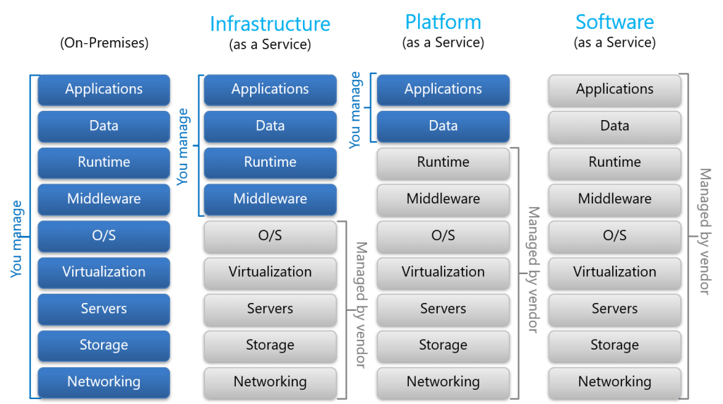
Cloud Deployment Models
Deployment models define how cloud resources are delivered and accessed.
Public cloud
Private cloud
Hybrid cloud

Slide 16
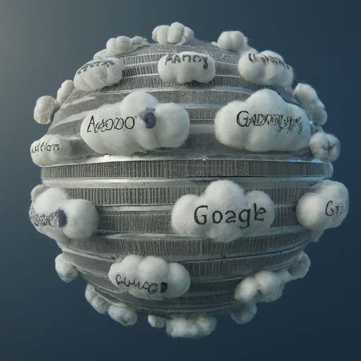
Public Cloud
Characteristics
Resources are shared across multiple organizations via the public internet.
Example
Amazon Web Services (AWS), Microsoft Azure, Google Cloud Platform.
Pros
Cost-effective, highly scalable, readily available resources.
Cons
Security concerns due to shared resources, less control over infrastructure.*

Slide 17

Private Cloud
Characteristics
Dedicated infrastructure reserved for a single organization, hosted on-premises or by a managed service provider.
Example
Dedicated cloud environment within a company's data center.
Pros
High security and control, flexibility, customization.
Cons
Higher costs, requires internal expertise for management.

Slide 18

Hybrid Cloud
Characteristics
Combines public and private clouds, allowing data and applications to flow between them.
Example
Using AWS for public resources and a private cloud for sensitive data.
Pros
Balances cost, security, and flexibility.
Cons
More complex to manage, requires integration between different environments.

Slide 19
Choosing the Right Model
The best cloud deployment model depends on your specific needs and priorities.
Security requirements
For highly sensitive data, a private cloud might be best.
Scalability needs
If you need to rapidly scale resources, a public cloud offers flexibility.
Cost considerations
Compare the cost of managing your own infrastructure vs. using a public cloud provider.
Compliance regulations
Some industries have specific regulations that might influence your choice.

Slide 20
Cloud Concepts
Define cloud computing and its benefits
Differentiate between the various cloud deployment models (public, private, hybrid)
Differentiate between the various cloud service models (IaaS, PaaS, SaaS)
Define the basic principles of cloud security

Slide 21
IaaS vs PaaS vs SaaS

Slide 22
Cloud Concepts
Define cloud computing and its benefits
Differentiate between the various cloud deployment models (public, private, hybrid)
Differentiate between the various cloud service models (IaaS, PaaS, SaaS)
Define the basic principles of cloud security

Slide 23
Basic principles of cloud security
The basic principles of cloud security revolve around ensuring the confidentiality, integrity, and availability of data and resources in a cloud computing environment.

Slide 24
Basic principles of cloud security
Data Encryption
Encrypting data
Access Control
Role-based access control (RBAC), multi-factor authentication (MFA), and least privilege principles.
Identity and Authentication
Strong authentication mechanisms, such as passwords, biometrics, or cryptographic tokens.
Network Security
Securing the network infrastructure, including firewalls, intrusion detection and prevention systems (IDPS), and virtual private networks (VPNs), helps prevent unauthorized access and network-based attacks.
Vulnerability Management
Regularly scanning for and patching vulnerabilities in cloud infrastructure, applications, and services helps mitigate the risk of exploitation by attackers.
Logging and Monitoring
Collecting and analyzing logs and monitoring data from cloud resources can help detect and respond to security incidents in a timely manner.
Incident Response
Establishing a well-defined incident response plan helps organizations respond effectively to security incidents in the cloud, minimizing their impact and restoring normal operations as quickly as possible.
Data Loss Prevention (DLP)
Implementing DLP measures helps prevent the unauthorized transmission or leakage of sensitive data from cloud environments.
Compliance and Governance
Ensuring compliance with relevant regulations and industry standards, as well as implementing strong governance practices, helps maintain the security and integrity of cloud environments.
Resilience and Disaster Recovery
Implementing resilience and disaster recovery measures, such as backups, replication, and failover systems, helps ensure the availability and continuity of cloud services in the event of outages or disasters.

Slide 25
Core Services
AMAZON WEB SERVICES

Slide 26
AWS Core Services
Understand the major AWS services (IAM, EC2, S3, RDS, DynamoDB, Lambda, etc.) and their use cases
Understand the different types of storage available in AWS
Understand the different types of databases available in AWS
Understand the different types of compute services available in AWS

Slide 27
AWS identity and Access management (IAM)
What is AWS IAM?
It is a core security service that allows you to securely control who and what can access your AWS resources. It provides two main functions:
Authentication: Verifying the identity of users or applications requesting access.
Authorization: Granting specific permissions to users or applications based on their identities and roles.

Slide 28
Key Concepts in IAM
Principals
Identities that can request access to AWS resources, including users, groups, roles, and applications.
Access keys
Secret credentials used by users and applications to authenticate with AWS.
Policies
Documents that define what permissions a principal has to access and perform actions on AWS resources.
Roles
Temporary security credentials that can be assumed by users or applications to grant them specific permissions.

Slide 29
Benefits of Using IAM
Improved security
Granular control over access reduces the risk of unauthorized activity.
Compliance
Meets regulatory requirements for access control and data privacy.
Cost management
Avoids unnecessary resource usage by granting only the necessary permissions.
Auditing
Tracks and logs user and application activity for enhanced accountability.

Slide 30
Getting Started with IAM
Create an IAM user
This is your initial identity for accessing AWS resources.
Set up multi-factor authentication (MFA)
Adds an extra layer of security to your account.
https://docs.aws.amazon.com/IAM/latest/UserGuide/id_credentials_mfa.html
Create IAM roles
Grant specific permissions to users or applications without sharing long-term credentials.
Attach IAM policies to users, groups, and roles
Define the specific actions they can perform.
Review and update IAM policies regularly
Ensure they align with your evolving needs.

Slide 31
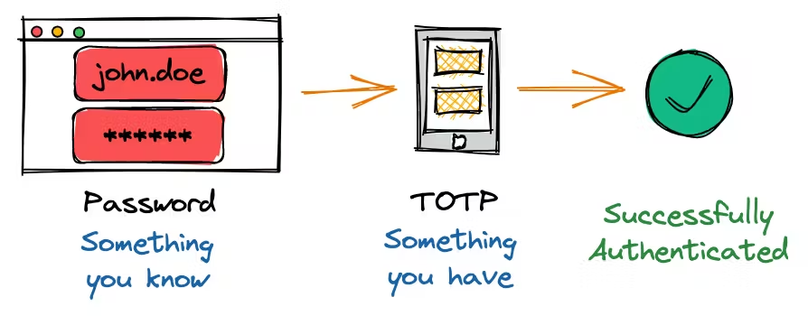
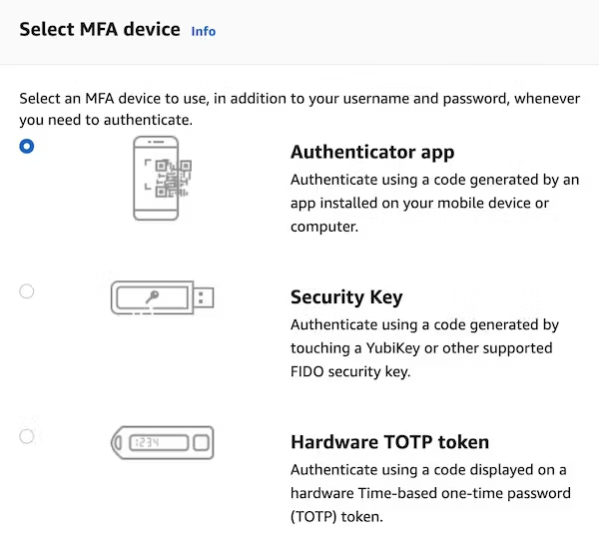
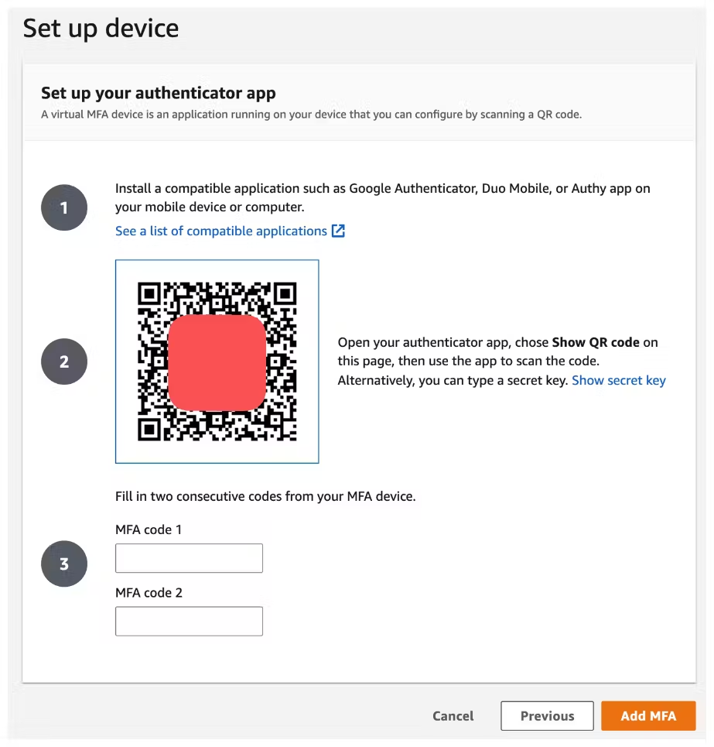
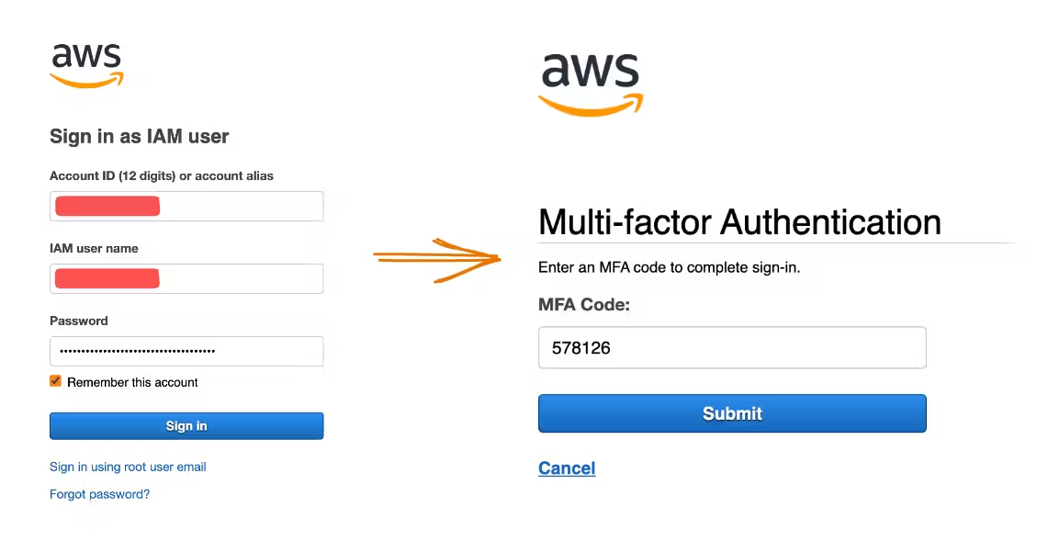
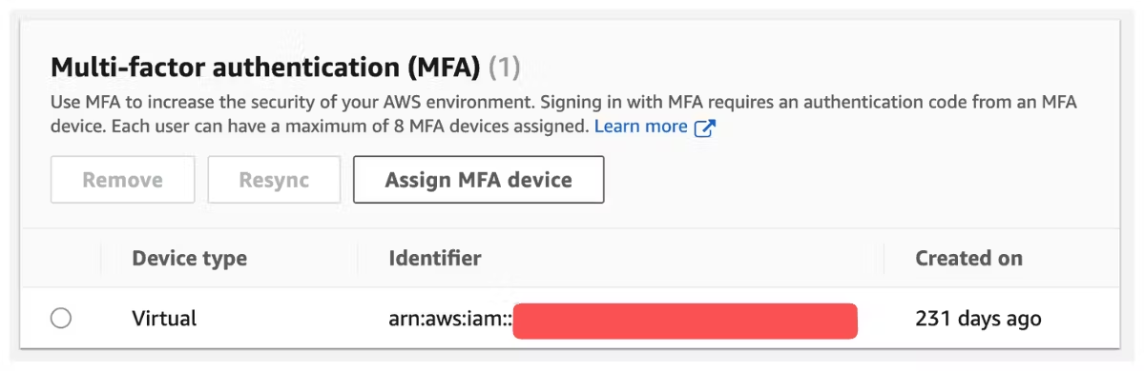
MFA

Slide 32
IAM Summary
Users: mapped to a physical user, has a password for AWS Console
Groups: contains users only
Policies: JSON document that outlines permissions for users or groups
Roles: for EC2 instances or AWS services
Security: MFA + Password Policy
AWS CLI: manage your AWS services using the command-line
AWS SDK: manage your AWS services using a programming language
Access Keys: access AWS using the CLI or SDK
Audit: IAM Credential Reports & IAM Access Advisor

Slide 33
AWS Core Services
Understand the major AWS services (IAM, EC2, S3, RDS, DynamoDB, Lambda, etc.) and their use cases
Understand the different types of storage available in AWS
Understand the different types of databases available in AWS
Understand the different types of compute services available in AWS

Slide 34
AWS Core Services
Understand the major AWS services (IAM, EC2, S3, RDS, DynamoDB, Lambda, etc.) and their use cases
Understand the different types of storage available in AWS
Understand the different types of databases available in AWS
Understand the different types of compute services available in AWS

Slide 35
AWS Core Services
Understand the major AWS services (IAM, EC2, S3, RDS, DynamoDB, Lambda, etc.) and their use cases
Understand the different types of storage available in AWS
Understand the different types of databases available in AWS
Understand the different types of compute services available in AWS

Slide 36
Q&A

