Slide 1

Introduction to Google Sheets and Power BI for Data Science
A Guide for Freshers
Brain Mentors Pvt Ltd
LOGO HERE

Slide 2



Importance of Spreadsheet Tools and BI Platforms for Data Science
Why Spreadsheet and BI Tools are Essential for Data Science
Key Points:
Simplify data analysis and manipulation.
Provide a user-friendly interface for exploring and cleaning data.
Facilitate data visualization and reporting.
Enable collaborative work on data projects.

Slide 3

Comparing Google Sheets, Power BI, and MS Excel
Feature | Google Sheets | MS Excel | Power BI
Cloud-based Access | Yes | Limited (with 365) | Yes
Data Analysis Tools | Basic | Advanced | Advanced
Visualization Options | Basic | Good | Excellent
Real-Time Collaboration | Yes | Limited | Yes
DAX Support | No | Limited | Yes
Logo

Slide 4
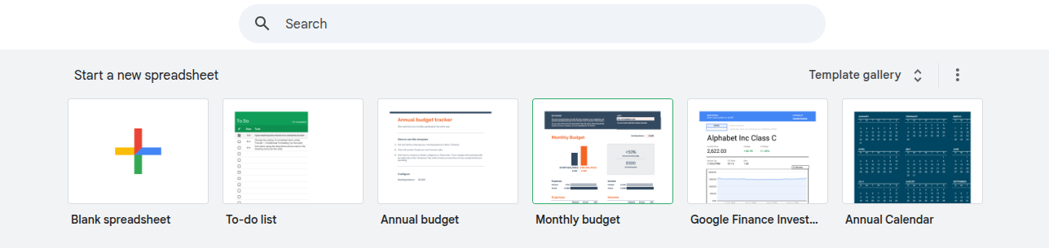
Accessing Google Sheets
Google Sheets is free to use with a Google account.
No installation is required.
Open a web browser.
Go to sheets.google.com.
Sign in with your Google account.
Click on the "+" icon to create a new spreadsheet.

Slide 5
Formatting Rows
Select/Highlight the entire row.
Select multiple rows
Resize the row height:
Right-click on the selected row number(s).
Click on "Resize row" in the context menu.

Slide 6
Formatting Columns
Select the column(s):
Select multiple columns
Resize the column width:
Right-click on the selected column letter(s).
Click on "Resize column" in the context menu.

Slide 7
Formatting Cells
Select the cell
Change the font, size, or style
Change text color and cell background
Text alignment
Wrap text (for long content in cells)

Slide 8
More
Borders & Gridlines
Add borders to cells to make your data stand out.
You can choose to add borders to all sides, only the outer border, or any combination of sides.
Number Formatting
Format the data in your cells to show as currency, dates, percentages, etc.
Freeze Rows/Columns
If you want to keep a row or column visible as you scroll, you can freeze it.
Conditional Formatting
Use this to automatically format cells based on their value.
Go to Format > Conditional formatting to set rules, like turning negative numbers red.

Slide 9
Essential Formulas
IF Function
AND Function
OR Function
Combining IF, AND, and OR
Use Cases

Slide 10
IF Function
The IF function returns one value if a condition is true and another value if the condition is false.
Syntax:
=IF(condition, value_if_true, value_if_false)
Example:
If you want to check if a number in cell A1 is greater than 50 and return "Yes" if true, or "No" if false:
=IF(A1 > 50, "Yes", "No")

Slide 11
AND Function
The AND function allows you to check multiple conditions at the same time.
It returns TRUE if all conditions are true and FALSE if any of the conditions are false.
Syntax:
=AND(condition1, condition2, ...)
Example:
If you want to check if a number in cell A1 is greater than 10 and less than 50, use the following formula:
=AND(A1 > 10, A1 < 50)

Slide 12
OR Function
The OR function checks if at least one of multiple conditions is true. It returns TRUE if any condition is true, and FALSE if all conditions are false.
Syntax:
=OR(condition1, condition2, ...)
Example:
If you want to check if a number in cell A1 is either greater than 100 or less than 10, use the following formula:
=OR(A1 > 100, A1 < 10)

Slide 13
Combining IF, AND and OR
You can combine these logical functions to make more complex conditions.
Check if a number in cell A1 is greater than 50 and less than 100.
If this is true, return "In Range"; otherwise, return "Out of Range":
=IF(AND(A1 > 50, A1 < 100), "In Range", "Out of Range")
Example: Combining IF and OR
If you want to check if a number in cell A1 is either greater than 100 or less than 10, and return "Out of Range" if true, otherwise "In Range":
=IF(OR(A1 > 100, A1 < 10), "Out of Range", "In Range")

Slide 14
Use Case
Grading System
If you have a score in cell A1 and you want to assign grades (A, B, C, etc.), you can use:
=IF(A1 >= 90, "A", IF(A1 >= 80, "B", IF(A1 >= 70, "C", "D")))
Sales Targets: Check if a sales representative met their target by using the AND function:
=AND(A1 >= 1000, B1 >= 200)
Event Attendance
Use OR to check if someone attended either an online or in-person event:
=OR(A1 = "Online", A1 = "In-Person")

Slide 15
Math Functions
SUM Function
AVERAGE Function
COUNT Function
MIN Function
MAX Function
Combining Math Functions

Slide 16
SUM Functions
The SUM function adds up all the numbers in a selected range of cells.
Syntax:
=SUM(value1, value2, ...)
Example:
To add the values in cells A1 through A5, use the following formula:
=SUM(A1:A5)

Slide 17
AVERAGE Functions
The AVERAGE function calculates the average (or mean) of a set of numbers.
Syntax:
=AVERAGE(value1, value2, ...)
Example:
To calculate the average of the values in cells A1 through A5, use the following formula:
=AVERAGE(A1:A5)

Slide 18
COUNT Functions
The COUNT function counts how many cells in a range contain numbers.
It only counts cells that contain numerical data, not text or empty cells.
Syntax:
=COUNT(value1, value2, ...)
Example:
To count how many cells in the range A1:A5 contain numbers, use the following formula:
=COUNT(A1:A5)

Slide 19
MIN Functions
The MIN function returns the smallest number in a range of cells.
Syntax:
=MIN(value1, value2, ...)
Example:
To find the smallest number in the range A1:A5, use the following formula:
=MIN(A1:A5)

Slide 20
MAX Functions
The MAX function returns the largest number in a range of cells.
Syntax:
=MAX(value1, value2, ...)
Example:
To find the largest number in the range A1:A5, use the following formula:
=MAX(A1:A5)

Slide 21
Combining Math Functions
Combining SUM and AVERAGE
Calculate the sum and average of the range A1:A5
=SUM(A1:A5) // In one cell to get the total sum
=AVERAGE(A1:A5) // In another cell to get the average
Using COUNT with IF
Count how many cells in the range A1:A5 are greater than 10
=COUNTIF(A1:A5, ">10")

Slide 22
Use Case
Sales Data
To calculate total sales and average sales for the month, use SUM and AVERAGE:
=SUM(B1:B31) // Total sales for the month
=AVERAGE(B1:B31) // Average sales for the month
Test Scores
To analyze student performance, find the MIN and MAX scores:
=MIN(C1:C10) // Lowest test score
=MAX(C1:C10) // Highest test score
Employee Performance
To count how many employees achieved a performance score above a threshold, you can combine COUNTIF:
=COUNTIF(D1:D10, ">75") // Count of employees with a score greater than 75

Slide 23
Text Functions
CONCATENATE Function
TRIM Function
LEFT Function
RIGHT Function
Combining Text Functions
Use Cases

Slide 24
CONCATENATE Functions
The CONCATENATE function joins multiple text strings into one continuous string.
Syntax:
=CONCATENATE(text1, text2, ...)
Example
Given first name in cell A1 (e.g., "John") and the last name in cell B1 (e.g., "Doe")
Combine them into a full name in cell C1, you would use:
=CONCATENATE(A1, " ", B1)

Slide 25
TRIM Functions
The TRIM function removes extra spaces from a text string, except for single spaces between words.
This is useful when dealing with data that may have unnecessary leading, trailing, or multiple spaces.
Syntax:
=TRIM(text)
Example:
If cell A1 contains the text " Hello World ", using the formula:
=TRIM(A1)

Slide 26
LEFT Functions
The LEFT function extracts a specified number of characters from the beginning (left side) of a text string. (substring in languages)
Syntax:
=LEFT(text, num_chars)
Example:
If cell A1 contains "Hello World", and you want to extract the first 5 characters (i.e., "Hello"):
=LEFT(A1, 5)

Slide 27
RIGHT Functions
The RIGHT function extracts a specified number of characters from the end (right side) of a text string.
Syntax:
=RIGHT(text, num_chars)
Example:
If cell A1 contains "Hello World", and you want to extract the last 5 characters (i.e., "World"):
=RIGHT(A1, 5)

Slide 28
Combining Text Functions
Using CONCATENATE with LEFT and RIGHT
If you want to combine the first 3 characters from cell A1 and the last 4 characters from cell B1, you can use:
=CONCATENATE(LEFT(A1, 3), RIGHT(B1, 4))
Cleaning and Joining Text
Let’s say you have a name in cell A1 with unwanted spaces, and you want to clean it and then combine it with another text in B1. You can use:
=CONCATENATE(TRIM(A1), " ", B1)

Slide 29
Use Cases
Full Name Creation
You can use CONCATENATE to merge first names and last names:
=CONCATENATE(A1, " ", B1)
Date Formatting
If you have a date in cell A1 (e.g., "2025-01-26") and you want to extract the month, you can use LEFT:
=LEFT(A1, 7) // Extracts "2025-01"
Extract Domain from Email
If you have an email in cell A1 (e.g., "user@example.com") and want to extract the domain (e.g., "example.com"), use RIGHT and FIND:
=RIGHT(A1, LEN(A1) - FIND("@", A1))

Slide 30
Lookup Functions
VLOOKUP
HLOOKUP
INDEX
MATCH

Slide 31
VLookup Functions
The VLOOKUP (Vertical Lookup) function searches for a value in the first column of a table and returns a value in the same row from a specified column.
Syntax:
=VLOOKUP(search_key, range, index, [is_sorted])
search_key: The value you want to search for.
range: The table range where you want to search. The first column of this range will be searched.
index: The column number (from the left of the range) from which to return a value. For example, 2 means the second column.
is_sorted: Optional. Set to TRUE (default) if the range is sorted in ascending order. Set to FALSE if it's not sorted.
Example:
Let’s say you have a table with employee IDs in column A and employee names in column B (A1:B5). If you want to find the name of the employee with the ID 102, you’d use:
=VLOOKUP(102, A1:B5, 2, FALSE)
This will search for 102 in column A, and return the corresponding name from column B.

Slide 32
HLookup Functions
The HLOOKUP (Horizontal Lookup) function works the same way as VLOOKUP, but it searches for the value in the first row of a table and returns a value from the specified row below.
Syntax:
=HLOOKUP(search_key, range, index, [is_sorted])
search_key: The value you want to search for.
range: The table range where you want to search. The first row of this range will be searched.
index: The row number (from the top of the range) from which to return a value.
is_sorted: Optional. Set to TRUE (default) if the first row is sorted in ascending order. Set to FALSE if it’s not sorted.
Example:
If you have a table where the first row contains months (e.g., January, February, etc.) and the second row contains sales figures, you can use HLOOKUP to find the sales figure for February (row 2):
=HLOOKUP("February", A1:D2, 2, FALSE)
This will search for "February" in the first row (A1:D1) and return the corresponding sales figure from the second row (A2:D2).

Slide 33
Index
The INDEX function returns the value of a cell in a specific row and column from a given range.
Syntax:
=INDEX(range, row, column)
range: The range of cells to return a value from.
row: The row number from which to return a value.
column: The column number from which to return a value (optional if the range is a single column).
Example:
If you have a table in range A1:C5 and you want to return the value from the 3rd row and 2nd column (e.g., value in cell B3), you would use:
=INDEX(A1:C5, 3, 2)
This will return the value in cell B3.

Slide 34
Match
The MATCH function searches for a value within a range and returns the position of the value within that range.
This can be useful in combination with INDEX for dynamic lookups.
Syntax:
=MATCH(search_key, range, [match_type])
search_key: The value you want to search for.
range: The range of cells to search within.
match_type: Optional. Set to 1 for the nearest match (sorted in ascending order), 0 for an exact match, and -1 for the nearest match (sorted in descending order).
Example:
If you want to find the position of the value "102" in column A (e.g., A1:A5), use:
=MATCH(102, A1:A5, 0)

Slide 35
Combining
You can combine INDEX and MATCH to perform more flexible lookups. INDEX will return a value, while MATCH provides the row/column number.
Example:
If you have a table with employee IDs in column A and names in column B (A1:B5), and you want to find the name of the employee with ID 102, use:
=INDEX(B1:B5, MATCH(102, A1:A5, 0))
This is often more versatile than using VLOOKUP, as INDEX/MATCH allows for lookups in any direction (both horizontal and vertical).

Slide 36
Use Case
Sales Data Lookup (VLOOKUP)
If you have a sales table with product IDs in column A and sales figures in column B, you can use VLOOKUP to find the sales figure for a specific product:
=VLOOKUP("Product123", A2:B100, 2, FALSE)
Finding Month Sales (HLOOKUP)
If you have months listed in row 1 and sales figures in row 2, use HLOOKUP to find sales for a specific month:
=HLOOKUP("March", A1:D2, 2, FALSE)
Find Product Sales (INDEX/MATCH)
If you have product names in column A and sales figures in column B, use INDEX and MATCH to find sales for a product by its name:
=INDEX(B2:B10, MATCH("Product123", A2:A10, 0))

Slide 37
DATE and TIME
NOW
TODAY
DATEDIF

Slide 38
NOW
The NOW function returns the current date and time based on your system’s local time zone.
Syntax:
=NOW()
Notes:
NOW updates every time the sheet is recalculated (like when you make a change or open the sheet).
You can format the result to show only the date or only the time by adjusting the cell format:
To show only the date, go to Format > Number > Date.
To show only the time, go to Format > Number > Time.

Slide 39
TODAY
The TODAY function returns the current date (without the time) based on your system’s local time zone.
Syntax:
=TODAY() // MM/DD/YYYY
Example:
If you enter =TODAY() in a cell, it will display the current date (e.g., "01/26/2025").
Notes:
TODAY updates automatically whenever the sheet is recalculated, but it doesn't include the time—only the date.
You can format the result to show the date in different formats by going to Format > Number > Date and selecting your preferred format.

Slide 40
DATEDIF
The DATEDIF function calculates the difference between two dates.
It allows you to return the result in various units (e.g., days, months, years).
Syntax:
=DATEDIF(start_date, end_date, unit)
start_date: The starting date of the period you’re calculating.
end_date: The ending date of the period you’re calculating.
unit: The unit of time in which you want the result. Possible values include:
"Y": The number of complete years between the dates.
"M": The number of complete months between the dates.
"D": The number of days between the dates.
"YM": The number of months between the dates, excluding complete years.
"YD": The number of days between the dates, excluding complete years.
“MD": The number of days between the dates, excluding complete months.

Slide 41
DATEDIF
Let’s say cell A1 contains the date 01/01/2020 (start date) and cell B1 contains 01/26/2025 (end date). To find the number of complete years between the two dates, you would use:
=DATEDIF(A1, B1, "Y")
Months: To find the number of complete months between the two dates:
=DATEDIF(A1, B1, "M")
Days: To find the number of days between the two dates:
=DATEDIF(A1, B1, "D")
Months excluding complete years: If you want the number of months between two dates, excluding the complete years, use "YM":
=DATEDIF(A1, B1, "YM")
Days excluding complete months: To calculate the number of days between two dates, excluding full months, use "MD":
=DATEDIF(A1, B1, "MD")

Slide 42
Use Case
Age Calculation: To calculate someone's age based on their birthdate and the current date, use DATEDIF. If their birthdate is in cell A1, you can use:
=DATEDIF(A1, TODAY(), "Y")
Contract Expiration: If you have a contract start date in A1 and the expiration date in B1, you can use DATEDIF to calculate how many months are left:
=DATEDIF(TODAY(), B1, "M")
Days Remaining: If you want to calculate the number of days left until an event (e.g., a birthday or deadline), use:
=DATEDIF(TODAY(), A1, "D")

Slide 43
Data Cleaning
Data cleaning is an essential part of working with data. It helps ensure that your data is accurate, consistent, and ready for analysis.
Removing Duplicates
Splitting Text to Columns
Using Filters for Data Exploration

Slide 44
Removing Duplicates
Duplicate entries can distort your analysis by inflating certain values or leading to incorrect conclusions.
It’s crucial to remove them to maintain data integrity.
Open your Google Sheet.
Select the data range that you want to check for duplicates (click and drag over the cells).
Go to the Data menu at the top.
Select Data cleanup, then click on Remove duplicates.
A pop-up will appear. You can choose to check all columns (if duplicates across all columns matter) or specific columns (if you only want to remove duplicates based on certain columns).
Click Remove duplicates.
Google Sheets will tell you how many duplicates were removed.
Click OK to finish.

Slide 45
Splitting Text
Sometimes, data is combined into one column (e.g., a full name in one cell), but it’s easier to work with if the data is separated into multiple columns (e.g., first name and last name).
Select the column that contains the text you want to split.
Go to the Data menu.
Select Split text to columns.
A small box will appear at the bottom of the selected column with a drop-down menu.
Choose the delimiter:
Comma if the text is separated by commas (e.g., "First, Last").
Space if the text is separated by spaces (e.g., "John Cena").
Custom if the delimiter is something specific, like a hyphen or semicolon.
Google Sheets will automatically split the text into separate columns.

Slide 46
Filters
Filters help you to view specific parts of your data without altering the actual data.
This is useful when you're exploring large datasets to find patterns or anomalies.
Select the range of your data (make sure to include the column headers).
Go to the Data menu.
Click Create a filter.
Small filter icons will appear next to each column header.
To filter by a column, click on the filter icon next to that column header:
Sort data in ascending or descending order.
Filter by condition (e.g., greater than, less than, text contains, etc.).
Filter by values (select specific values to include or exclude).
Once you have applied the filter, your sheet will only show rows that meet the filter criteria.
To remove the filter, click the filter icon again and select Remove filter.

Slide 47
Data Visualization
Data visualization is a key skill for data scientists.
By creating basic charts, formatting them for clarity, and using sparklines for trend analysis, you can gain valuable insights from your data.
Visuals help present your findings more effectively and communicate your analysis with others.

Slide 48
Data Visualization
Data visualization is a powerful tool for analyzing and presenting data.
It allows you to identify trends, patterns, and outliers quickly.
Key aspects of data visualization in Google Sheets:
Creating Basic Charts: Bar, Line, Pie
Formatting Charts
Sparkline for Trend Analysis

Slide 49
Creating Charts
Charts allow you to represent your data visually, making it easier to communicate insights. Whether you need to compare values, show trends over time, or display proportions, different types of charts are suited for different data.
Bar chart
Line chart
Pie chart

Slide 50
Creating Charts - Bar
A bar chart is great for comparing different categories.
Create chart
Select the data range you want to use for the chart (make sure to include the column headers).
Go to the Insert menu.
Select Chart.
Google Sheets will automatically create a chart. If it doesn’t select a bar chart, click on the Chart type drop-down in the chart editor.
Choose Bar Chart (you can select either "Horizontal Bar" or "Vertical Bar").
Your bar chart will appear on the sheet.

Slide 51
Creating Charts - Line
A line chart is ideal for showing trends over time.
Create chart
Select the data range (time-based data works best, such as dates or months in one column and values in the other).
Go to the Insert menu.
Select Chart.
In the chart editor, change the Chart type to Line chart.
Your line chart will appear, displaying the trend over the selected time periods.

Slide 52
Creating Charts - Pie
A pie chart is useful for showing proportions of a whole.
Create chart
Select the data (ensure the data represents categories and their corresponding values).
Go to the Insert menu.
Select Chart.
In the chart editor, select Pie chart.
Google Sheets will generate the pie chart to display the proportions of your data.

Slide 53
Formatting Charts
Formatting makes your charts clearer and more visually appealing. It also helps highlight key data points for better communication.
Format Charts:
Click on the chart to select it.
The Chart editor will appear on the right. Here, you can make several adjustments:
Chart Style: Choose a color scheme or style that suits your presentation.
Customize: Click the Customize tab to access advanced options:
Chart & Axis Titles: Add titles to your chart and axes for clarity.
Series: Adjust the colors or line thickness of your chart series.
Legend: Adjust the position of the legend or remove it if unnecessary.
Gridlines: Modify or remove gridlines for a cleaner look.
Data Labels: Show data labels on your chart for precise values.
Play around with these options to make your chart more informative and visually appealing.
Once you are happy with the formatting, you can resize the chart or move it around the sheet to fit your layout.

Slide 54
Sparkline for Trend Analysis
A sparkline is a mini chart inside a cell, allowing you to visualize trends in a compact space.
It is perfect for showing trends in a column of data without taking up much space.
Create Sparklines:
Select the cell where you want the sparkline to appear.
To replace A2:A10 with the range of your data, yype the following formula:
=SPARKLINE(A2:A10)
Press Enter. A small chart will appear in the selected cell.
To customize the sparkline, you can add arguments to the formula, such as:
charttype (line, column, or winloss)
color (for the line or bars) Example:
=SPARKLINE(A2:A10, {"charttype", "line"; "color", "blue"})

Slide 55
Use Cases
Bar Chart - Sales Comparison
Imagine you have data about the monthly sales of a company over the last year. A bar chart can visually show which months had the highest and lowest sales, making it easy to compare performance across months.
Use case: A sales manager can use a bar chart to quickly identify months with lower-than-expected sales and take corrective actions.
Line Chart - Website Traffic
If you have website traffic data over time (e.g., daily visits over a month), a line chart will help you see trends—whether traffic is growing, declining, or fluctuating.
Use case: A digital marketer can use a line chart to monitor the effectiveness of a new marketing campaign by tracking the rise or fall in traffic after launch.

Slide 56
Use Cases
Pie Chart - Market Share
A pie chart can show the market share distribution between different competitors. For example, if you have data on market share percentages for several companies, a pie chart visually represents how each competitor contributes to the total.
Use case: A business analyst can use a pie chart to present to management how their company’s market share compares to competitors in a particular sector.
Sparkline - Stock Price Trend
Use sparklines to show the trend of stock prices in a compact format, especially when dealing with multiple stocks in a portfolio. You could place a sparkline next to each stock ticker to visualize performance at a glance.
Use case: A stock trader can use sparklines in a portfolio tracker to quickly spot which stocks are performing well or poorly over time.

Slide 57
Collaboration and Automation
Collaboration and automation are key components of effective data management.
You can easily collaborate with others in real-time and automate repetitive tasks, saving you time and reducing errors.
This section will walk you through sharing and collaborating in real time, and using macros to automate tasks.

Slide 58
Sharing and Collaborating in Real Time
Collaboration allows multiple people to work on the same document at the same time, which is especially helpful in team environments.
Share and Collaborate:
Open your Google Sheet.
Click on the Share button in the upper-right corner of the screen.
In the "Share with people and groups" box, enter the email addresses of the people you want to share the document with.
Choose the access level for each person:
Viewer: They can only view the document.
Commenter: They can view and comment, but not edit.
Editor: They can view, comment, and edit the document.
Optionally, check the box "Notify people" to send an email notification to those you’re sharing with.
Click Send.

Slide 59
Sharing and Collaborating in Real Time
Collaborating in Real Time:
Once shared, your collaborators can open the Sheet and work simultaneously.
Google Sheets shows real-time updates as everyone makes changes, with their names or profile pictures displayed in the document.
You can communicate directly in the sheet by using comments. To add a comment, right-click a cell and select Comment. Type your message, and click Comment to send.
You can also use @mentions to tag someone and notify them directly within the comment.

Slide 60
Using Macros to Automate Repetitive Tasks
Automation saves time and reduces human error, especially when you need to repeat tasks frequently.
Macros let you record a series of actions (like formatting, data entry, or calculations) and run them with a single click.

Slide 61
Using Macros to Automate Repetitive Tasks
Create a Macro:
Open your Google Sheet.
Go to the Extensions menu.
Select Macros, then click Record macro.
Perform the task you want to automate. This could include formatting cells, entering data, or applying formulas.
Once you've finished, click Save in the macro recorder at the bottom of the screen.
Name your macro and choose whether to use absolute references (to apply the same action to the exact cells every time) or relative references (which allows the macro to work on different cells each time).
Click Save to finish.
Your macro will now be listed under the Macros menu, and you can run it anytime by clicking on it.

Slide 62
Using Macros to Automate Repetitive Tasks
Running and Managing Macros:
To run a macro, go to the Extensions menu > Macros, and select the macro you want to run.
You can also assign a shortcut key for your macro by going to Extensions > Macros > Manage macros and clicking the Add shortcut button next to your macro.
Editing or Deleting Macros:
To edit a macro, click on Manage macros and click on the pencil icon next to the macro name.
If you want to delete a macro, click the trash icon next to the macro in the Manage macros menu.

Slide 63
Use Cases
Sharing and Collaborating in Real Time - Team Data Analysis
Suppose you are working on a data science project with multiple team members. You might have raw data in one Google Sheet, and each team member is responsible for analyzing a different part of the dataset. By sharing the Google Sheet, everyone can work in real-time without having to send files back and forth.
Use case: A data science team working on a predictive model can analyze different features of the data at the same time and comment directly on the sheet to suggest improvements or share insights.
Sharing and Collaborating in Real Time - Client Reporting
If you’re a data analyst who regularly shares reports with clients, you can use Google Sheets to share live dashboards and get client feedback in real-time. Clients can comment on the document, and you can address their concerns immediately.
Use case: A business analyst working with a marketing team can use Google Sheets to share weekly performance reports with the team, enabling everyone to track metrics and collaborate on future strategies.

Slide 64
Use Cases
Using Macros to Automate Repetitive Tasks - Data Preprocessing
As a data scientist, you often need to perform repetitive data cleaning tasks, such as removing empty rows, formatting columns, or applying the same formulas across different sheets. Recording a macro to do these tasks automatically can save you hours of work.
Use case: A data scientist could create a macro to automatically clean raw data files by applying consistent formatting, removing unnecessary rows, and inserting basic formulas.
Using Macros to Automate Repetitive Tasks - Generating Reports
If you're generating monthly reports based on similar data inputs, you can use macros to automate tasks like formatting tables, generating summaries, or creating charts. This way, you only need to input the new data, and the rest of the report gets generated automatically.
Use case: A financial analyst could create a macro to generate monthly budget reports by automating the steps of summarizing income and expenses, formatting tables, and creating pie charts of expense categories.

Slide 65
POWER BI

Slide 66
Power BI Desktop
Power BI stands for "Business Intelligence."
It is a business analytics tool developed by Microsoft to visualize data and share insights.

Slide 67
Problems Before Power BI
Before tools like Power BI, organizations faced several challenges in data analysis
Complexity of data: Analyzing large volumes of data manually or using traditional tools like Excel was difficult and error-prone.
Limited collaboration: Sharing reports was cumbersome and not real-time.
No interactive dashboards: Reports were static, and users couldn’t drill down or interact with data dynamically.
Disconnected tools: Data processing, analysis, and visualization required multiple tools, increasing complexity and cost.

Slide 68
What Power BI Solved
Ease of use: Power BI has a user-friendly interface, allowing non-technical users to create and interact with reports.
Real-time insights: Provides real-time data dashboards connected to live data sources.
Unified platform: Combines data preparation, data visualization, and reporting in a single tool.
Cost-effectiveness: Freemium model for individuals and scalable options for enterprises.
Cloud-based sharing: Reports and dashboards can be easily shared and accessed via the cloud.

Slide 69
Why Is Power BI Used?
Enables better decision-making through data visualization.
Provides actionable insights from structured and unstructured data.
Integrates with various data sources like Excel, SQL, Azure, Google Analytics, etc.
Allows collaboration via Power BI service or Power BI apps.
Offers advanced features like AI insights, natural language queries, and data modeling.

Slide 70
Requirements to Use Power BI
A computer with a Windows OS (Power BI Desktop doesn't run on macOS natively but can use virtual machines or browser-based Power BI service).
Microsoft Power BI Desktop application (free to download).
Data sources (Excel, databases, cloud services, etc.).
Basic understanding of data (structured data and relationships).

Slide 71
How to Use Power BI
Download and install Power BI Desktop.
Connect to data sources (Excel, databases, online services, etc.).
Clean and transform data using Power Query Editor.
Build visualizations using charts, graphs, and maps.
Create relationships between data tables (data modeling).
Publish your reports to Power BI Service for sharing.
Collaborate and interact with dashboards on the cloud or mobile.

Slide 72
The Power BI Ecosystem
Power BI is not just a desktop tool; it has a complete ecosystem:
Power BI Desktop: For building reports and dashboards locally (free to use).
Power BI Service: A cloud platform where you publish and share your reports (requires a license).
Power BI Mobile: Lets you access and interact with reports on your phone or tablet.
Power BI Embedded: For developers to embed Power BI visuals into their applications.
Power BI Gateway: Connects on-premises data sources to Power BI Service.

Slide 73
The Data Journey in Power BI
When using Power BI, you go through these steps:
Get Data: Import from Excel, SQL Server, Google Sheets, APIs, or even live streaming sources.
Transform Data: Clean, filter, or reshape it using Power Query.
Model Data: Establish relationships between tables (like SQL’s foreign keys).
Visualize Data: Choose appropriate charts or graphs.
Share Reports: Publish to Power BI Service or export to PowerPoint, PDF, or Excel.

Slide 74
Power BI Is Fun to Learn
It’s Like a Game: You’re solving a puzzle, starting with messy data and creating clean, interactive dashboards.
No Code Needed (But Optional): Basic tasks require no coding, but advanced users can unleash the power of DAX (Data Analysis Expressions) and M (Power Query language).
Instant Results: Build a report, and you can immediately see the impact of your analysis.
Creative Visuals: You can make stunning dashboards that are not just functional but also visually appealing.

Slide 75
Installing Power BI Desktop
Power BI Desktop is free to download and use.
Requires a Windows operating system (not available for Linux/Mac).
Go to powerbi.microsoft.com.
Click on "Products" > "Power BI Desktop."
Download the installer for your operating system.
Follow the on-screen instructions to install Power BI.
Open Power BI Desktop and sign in with a Microsoft account.

Slide 76
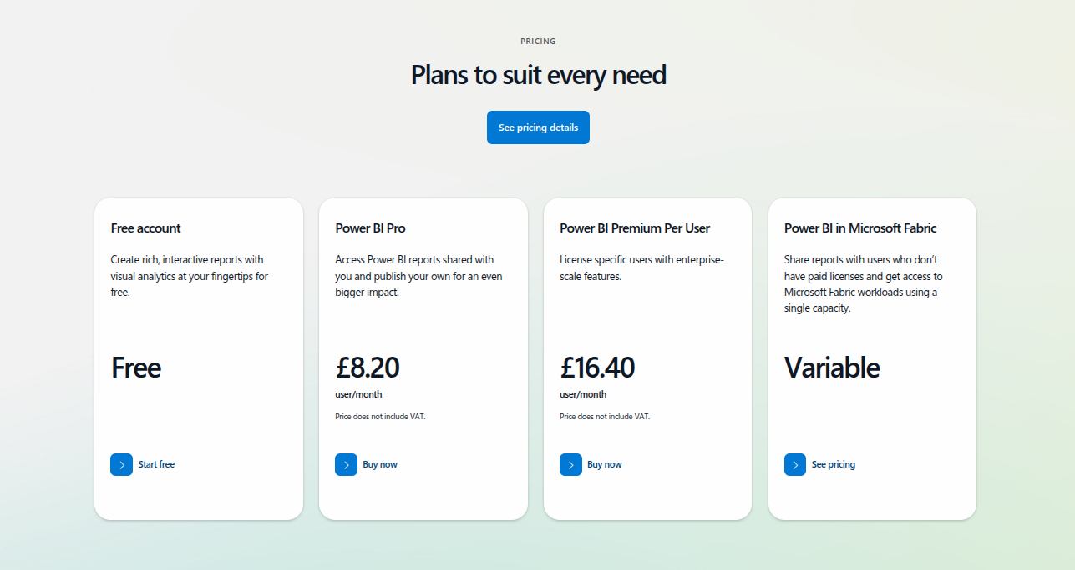
Power BI Pricing

Slide 77
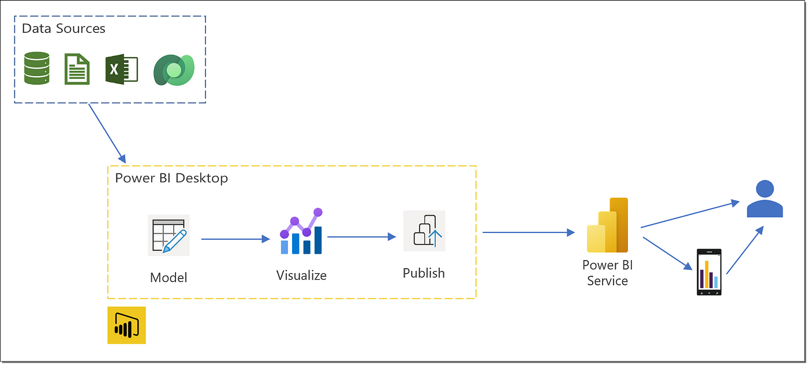
Power Bi Flow
Power BI Query (Part of Power BI Desktop):
Extract, Load, Transform (ELT) process
Power BI Desktop:
Data Modeling
DAX
Report Building
Publish
Power BI Service:
Dashboard Creation
Share and Collaborate

Slide 78
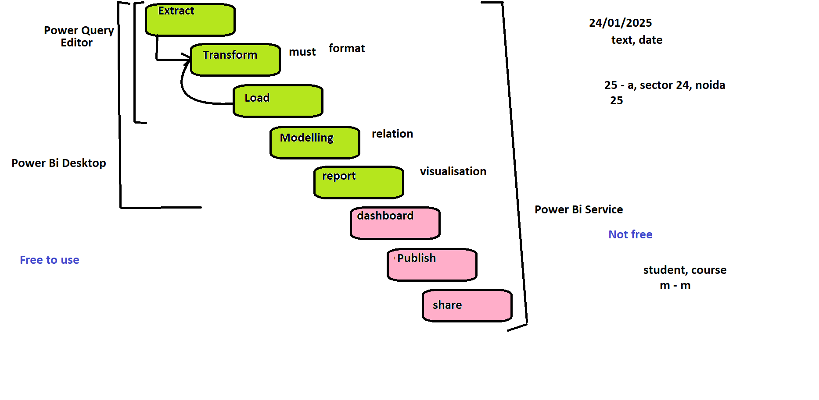
Power Bi Flow

Slide 79
Read Data from MySQL Database
Download the MySQL Connector/Net from the MySQL official website.
https://dev.mysql.com/downloads/
Launch the Power BI Desktop
Click Get Data
Select MySQL database from the options and click Connect
Enter host details
Enter Database Credentials
Select Tables

Slide 80
Data
Open Power BI Desktop
Select "Get Data"
Search for source
Clean and Transform Data
Build Visualizations

Slide 81
Relationships in Power BI
Customers → Orders: CustomerID
Orders → OrderDetails: OrderID
Products → OrderDetails: ProductID

Slide 82
Model Connections
Open Power BI Desktop
Model View
Understand Your Tables
Customers Table: CustomerID (primary key)
Orders Table: CustomerID (foreign key)
Drag and Drop to Create Relationships
Configure the Relationship
Cardinality:
One-to-One
One-to-Many
Many-to-Many
Avoid Many-to-Many Relationships
They can cause ambiguity and performance issues. Instead, try to normalize your data.

Slide 83
Tables for Mysql
CREATE TABLE Customers (
CustomerID INT PRIMARY KEY,
CustomerName VARCHAR(50),
Email VARCHAR(100),
Phone VARCHAR(15),
City VARCHAR(50),
Country VARCHAR(50)
);
CREATE TABLE OrderDetails (
OrderDetailID INT PRIMARY KEY,
OrderID INT,
ProductID INT,
Quantity INT,
LineTotal DECIMAL(10, 2),
FOREIGN KEY (OrderID) REFERENCES Orders(OrderID),
FOREIGN KEY (ProductID) REFERENCES Products(ProductID)
);
CREATE TABLE Orders (
OrderID INT PRIMARY KEY,
CustomerID INT,
OrderDate DATE,
TotalAmount DECIMAL(10, 2),
FOREIGN KEY (CustomerID) REFERENCES Customers(CustomerID)
);
CREATE TABLE Products (
ProductID INT PRIMARY KEY,
ProductName VARCHAR(50),
Category VARCHAR(50),
Price DECIMAL(10, 2)
);

Slide 84
MySql Insert Data
Customers
Products
Orders
OrderDetails
INSERT INTO Customers (CustomerID, CustomerName, Email, Phone, City, Country) VALUES
(1, 'Amit Kumar', 'amit.kumar@example.com', '9876543210', 'Delhi', 'India'),
(2, 'Priya Sharma', 'priya.sharma@example.com', '9876543211', 'Mumbai', 'India'),
(3, 'Rahul Verma', 'rahul.verma@example.com', '9876543212', 'Bangalore', 'India'),
(4, 'Neha Gupta', 'neha.gupta@example.com', '9876543213', 'Chennai', 'India'),
(5, 'Vikram Reddy', 'vikram.reddy@example.com', '9876543214', 'Hyderabad', 'India'),
(6, 'Rita Mehta', 'rita.mehta@example.com', '9876543215', 'Pune', 'India'),
(7, 'Arvind Patel', 'arvind.patel@example.com', '9876543216', 'Ahmedabad', 'India'),
(8, 'Simran Kaur', 'simran.kaur@example.com', '9876543217', 'Amritsar', 'India'),
(9, 'Ravi Singh', 'ravi.singh@example.com', '9876543218', 'Lucknow', 'India'),
(10, 'Kavita Iyer', 'kavita.iyer@example.com', '9876543219', 'Kolkata', 'India'),
(11, 'Manoj Joshi', 'manoj.joshi@example.com', '9876543220', 'Indore', 'India'),
(12, 'Sushmita Das', 'sushmita.das@example.com', '9876543221', 'Bhubaneswar', 'India'),
(13, 'Sandeep Rawat', 'sandeep.rawat@example.com', '9876543222', 'Dehradun', 'India'),
(14, 'Anjali Bhatt', 'anjali.bhatt@example.com', '9876543223', 'Jaipur', 'India'),
(15, 'Ashok Kumar', 'ashok.kumar@example.com', '9876543224', 'Chandigarh', 'India'),
(16, 'Pooja Verma', 'pooja.verma@example.com', '9876543225', 'Nagpur', 'India'),
(17, 'Deepak Yadav', 'deepak.yadav@example.com', '9876543226', 'Faridabad', 'India'),
(18, 'Vandana Dubey', 'vandana.dubey@example.com', '9876543227', 'Varanasi', 'India'),
(19, 'Rohit Soni', 'rohit.soni@example.com', '9876543228', 'Surat', 'India'),
(20, 'Gurpreet Singh', 'gurpreet.singh@example.com', '9876543229', 'Patiala', 'India'),
(21, 'Nisha Jain', 'nisha.jain@example.com', '9876543230', 'Delhi', 'India'),
(22, 'Siddharth Kapoor', 'siddharth.kapoor@example.com', '9876543231', 'Mumbai', 'India'),
(23, 'Chandni Nair', 'chandni.nair@example.com', '9876543232', 'Bangalore', 'India'),
(24, 'Karan Desai', 'karan.desai@example.com', '9876543233', 'Chennai', 'India'),
(25, 'Pranav Bhaskar', 'pranav.bhaskar@example.com', '9876543234', 'Hyderabad', 'India'),
(26, 'Aarti Bhatia', 'aarti.bhatia@example.com', '9876543235', 'Pune', 'India'),
(27, 'Tanvi Shah', 'tanvi.shah@example.com', '9876543236', 'Ahmedabad', 'India'),
(28, 'Shivendra Singh', 'shivendra.singh@example.com', '9876543237', 'Amritsar', 'India'),
(29, 'Manish Mehta', 'manish.mehta@example.com', '9876543238', 'Lucknow', 'India'),
(30, 'Rupal Joshi', 'rupal.joshi@example.com', '9876543239', 'Kolkata', 'India'),
(31, 'Suman Rawat', 'suman.rawat@example.com', '9876543240', 'Indore', 'India'),
(32, 'Vikas Sharma', 'vikas.sharma@example.com', '9876543241', 'Bhubaneswar', 'India'),
(33, 'Madhuri Kapoor', 'madhuri.kapoor@example.com', '9876543242', 'Dehradun', 'India'),
(34, 'Raghav Bhatt', 'raghav.bhatt@example.com', '9876543243', 'Jaipur', 'India'),
(35, 'Akash Yadav', 'akash.yadav@example.com', '9876543244', 'Chandigarh', 'India'),
(36, 'Swati Soni', 'swati.soni@example.com', '9876543245', 'Nagpur', 'India'),
(37, 'Deepali Mehta', 'deepali.mehta@example.com', '9876543246', 'Faridabad', 'India'),
(38, 'Pradeep Dubey', 'pradeep.dubey@example.com', '9876543247', 'Varanasi', 'India'),
(39, 'Mohit Jain', 'mohit.jain@example.com', '9876543248', 'Surat', 'India'),
(40, 'Amandeep Singh', 'amandeep.singh@example.com', '9876543249', 'Patiala', 'India'),
(41, 'Jaspreet Kaur', 'jaspreet.kaur@example.com', '9876543250', 'Delhi', 'India'),
(42, 'Raghavendra Rao', 'raghavendra.rao@example.com', '9876543251', 'Mumbai', 'India'),
(43, 'Shikha Bhatia', 'shikha.bhatia@example.com', '9876543252', 'Bangalore', 'India'),
(44, 'Tarun Soni', 'tarun.soni@example.com', '9876543253', 'Chennai', 'India'),
(45, 'Nandini Desai', 'nandini.desai@example.com', '9876543254', 'Hyderabad', 'India'),
(46, 'Divya Shah', 'divya.shah@example.com', '9876543255', 'Pune', 'India'),
(47, 'Kiran Joshi', 'kiran.joshi@example.com', '9876543256', 'Ahmedabad', 'India'),
(48, 'Rishi Patel', 'rishi.patel@example.com', '9876543257', 'Amritsar', 'India'),
(49, 'Vidya Sharma', 'vidya.sharma@example.com', '9876543258', 'Lucknow', 'India'),
(50, 'Ajay Gupta', 'ajay.gupta@example.com', '9876543259', 'Kolkata', 'India');
INSERT INTO Products (ProductID, ProductName, Category, Price) VALUES
(1, 'Smartphone', 'Electronics', 12000.00),
(2, 'Laptop', 'Electronics', 45000.00),
(3, 'Tablet', 'Electronics', 20000.00),
(4, 'LED TV', 'Electronics', 25000.00),
(5, 'Headphones', 'Electronics', 2000.00),
(6, 'Washing Machine', 'Appliances', 15000.00),
(7, 'Refrigerator', 'Appliances', 25000.00),
(8, 'Microwave', 'Appliances', 8000.00),
(9, 'Fan', 'Appliances', 1500.00),
(10, 'Air Conditioner', 'Appliances', 35000.00),
(11, 'Sofa', 'Furniture', 25000.00),
(12, 'Bed', 'Furniture', 35000.00),
(13, 'Office Chair', 'Furniture', 5000.00),
(14, 'Dining Table', 'Furniture', 15000.00),
(15, 'Wardrobe', 'Furniture', 10000.00),
(16, 'Shirt', 'Clothing', 1000.00),
(17, 'Jeans', 'Clothing', 1500.00),
(18, 'Jacket', 'Clothing', 2500.00),
(19, 'T-Shirt', 'Clothing', 800.00),
(20, 'Shoes', 'Footwear', 2000.00),
(21, 'Smartwatch', 'Electronics', 5000.00),
(22, 'Fitness Band', 'Electronics', 2000.00),
(23, 'Bluetooth Speaker', 'Electronics', 1500.00),
(24, 'Gaming Console', 'Electronics', 25000.00),
(25, 'Air Fryer', 'Appliances', 6000.00),
(26, 'Toaster', 'Appliances', 1200.00),
(27, 'Coffee Maker', 'Appliances', 2500.00),
(28, 'Curtains', 'Home Decor', 1500.00),
(29, 'Wall Clock', 'Home Decor', 1000.00),
(30, 'Mirror', 'Home Decor', 2500.00),
(31, 'Painting', 'Home Decor', 3500.00),
(32, 'Carpet', 'Home Decor', 5000.00),
(33, 'Laptop Bag', 'Accessories', 1500.00),
(34, 'Smartphone Case', 'Accessories', 500.00),
(35, 'Backpack', 'Accessories', 1000.00),
(36, 'Earphones', 'Accessories', 800.00),
(37, 'Charger', 'Accessories', 500.00),
(38, 'Kitchen Set', 'Kitchenware', 3500.00),
(39, 'Cutlery Set', 'Kitchenware', 1000.00),
(40, 'Dinner Set', 'Kitchenware', 2500.00),
(41, 'Cookware Set', 'Kitchenware', 3000.00),
(42, 'Pressure Cooker', 'Kitchenware', 1500.00),
(43, 'Water Purifier', 'Appliances', 10000.00),
(44, 'Electric Kettle', 'Appliances', 2000.00),
(45, 'Juicer', 'Appliances', 2500.00),
(46, 'Blender', 'Appliances', 3000.00),
(47, 'Hand Blender', 'Appliances', 1200.00),
(48, 'Stand Fan', 'Appliances', 2500.00),
(49, 'Fridge', 'Appliances', 35000.00),
(50, 'Dishwasher', 'Appliances', 25000.00);
INSERT INTO Orders (OrderID, CustomerID, OrderDate, TotalAmount) VALUES
(1, 1, '2024-01-10', 32000.00),
(2, 2, '2024-01-12', 17000.00),
(3, 3, '2024-01-14', 21000.00),
(4, 4, '2024-01-15', 50000.00),
(5, 5, '2024-01-16', 13000.00),
(6, 6, '2024-01-18', 9000.00),
(7, 7, '2024-01-20', 38000.00),
(8, 8, '2024-01-22', 25000.00),
(9, 9, '2024-01-23', 15000.00),
(10, 10, '2024-01-24', 22000.00),
(11, 11, '2024-01-25', 35000.00),
(12, 12, '2024-01-26', 42000.00),
(13, 13, '2024-01-27', 27000.00),
(14, 14, '2024-01-28', 33000.00),
(15, 15, '2024-01-30', 18000.00),
(16, 16, '2024-02-01', 15000.00),
(17, 17, '2024-02-02', 25000.00),
(18, 18, '2024-02-03', 19000.00),
(19, 19, '2024-02-05', 22000.00),
(20, 20, '2024-02-06', 12000.00),
(21, 21, '2024-02-07', 20000.00),
(22, 22, '2024-02-08', 25000.00),
(23, 23, '2024-02-10', 30000.00),
(24, 24, '2024-02-11', 13000.00),
(25, 25, '2024-02-12', 20000.00),
(26, 26, '2024-02-13', 25000.00),
(27, 27, '2024-02-14', 5000.00),
(28, 28, '2024-02-15', 15000.00),
(29, 29, '2024-02-17', 35000.00),
(30, 30, '2024-02-18', 27000.00),
(31, 31, '2024-02-19', 20000.00),
(32, 32, '2024-02-20', 40000.00),
(33, 33, '2024-02-21', 19000.00),
(34, 34, '2024-02-22', 31000.00),
(35, 35, '2024-02-23', 25000.00),
(36, 36, '2024-02-25', 15000.00),
(37, 37, '2024-02-26', 23000.00),
(38, 38, '2024-02-27', 28000.00),
(39, 39, '2024-02-28', 32000.00),
(40, 40, '2024-03-01', 16000.00),
(41, 41, '2024-03-03', 21000.00),
(42, 42, '2024-03-05', 35000.00),
(43, 43, '2024-03-06', 22000.00),
(44, 44, '2024-03-08', 18000.00),
(45, 45, '2024-03-10', 15000.00),
(46, 46, '2024-03-11', 20000.00),
(47, 47, '2024-03-12', 25000.00),
(48, 48, '2024-03-14', 30000.00),
(49, 49, '2024-03-15', 22000.00),
(50, 50, '2024-03-17', 28000.00);
INSERT INTO OrderDetails (OrderDetailID, OrderID, ProductID, Quantity, LineTotal) VALUES
(1, 1, 1, 1, 12000.00),
(2, 1, 2, 1, 45000.00),
(3, 1, 3, 1, 20000.00),
(4, 2, 4, 1, 25000.00),
(5, 2, 5, 1, 2000.00),
(6, 3, 6, 1, 15000.00),
(7, 3, 7, 1, 25000.00),
(8, 4, 8, 1, 8000.00),
(9, 4, 9, 1, 1500.00),
(10, 4, 10, 1, 35000.00),
(11, 5, 11, 1, 25000.00),
(12, 5, 12, 1, 35000.00),
(13, 6, 13, 1, 5000.00),
(14, 7, 14, 1, 15000.00),
(15, 8, 15, 1, 10000.00),
(16, 9, 16, 1, 1000.00),
(17, 10, 17, 1, 1500.00),
(18, 11, 18, 1, 2500.00),
(19, 12, 19, 1, 800.00),
(20, 13, 20, 1, 2000.00),
(21, 14, 21, 1, 5000.00),
(22, 15, 22, 1, 2000.00),
(23, 16, 23, 1, 1500.00),
(24, 17, 24, 1, 25000.00),
(25, 18, 25, 1, 6000.00),
(26, 19, 26, 1, 1200.00),
(27, 20, 27, 1, 2500.00),
(28, 21, 28, 1, 1500.00),
(29, 22, 29, 1, 2500.00),
(30, 23, 30, 1, 3500.00),
(31, 24, 31, 1, 5000.00),
(32, 25, 32, 1, 2500.00),
(33, 26, 33, 1, 1500.00),
(34, 27, 34, 1, 1000.00),
(35, 28, 35, 1, 800.00),
(36, 29, 36, 1, 500.00),
(37, 30, 37, 1, 2500.00),
(38, 31, 38, 1, 3500.00),
(39, 32, 39, 1, 10000.00),
(40, 33, 40, 1, 1500.00),
(41, 34, 41, 1, 3000.00),
(42, 35, 42, 1, 1500.00),
(43, 36, 43, 1, 10000.00),
(44, 37, 44, 1, 2000.00),
(45, 38, 45, 1, 2500.00),
(46, 39, 46, 1, 3000.00),
(47, 40, 47, 1, 1200.00),
(48, 41, 48, 1, 2500.00),
(49, 42, 49, 1, 35000.00),
(50, 43, 50, 1, 25000.00);

Slide 85
Profit Margin
Load Your Data into Power BI
Create a Calculated Column
Create the ProfitMargin calculated column in the OrderDetails table.
Go to the Data View:
Click on the Data View icon on the left (it looks like a table).
Select the OrderDetails Table:
In the Fields pane, click on OrderDetails.
Add a New Column:
Go to the Modeling tab in the ribbon.
Click New Column.
Enter the Formula:
ProfitMargin = OrderDetails[LineTotal] - (RELATED(Products[Price]) * OrderDetails[Quantity])

Slide 86
Charts and Features
Bar Chart (Sales by Product Category):
Use Products.Category and OrderDetails.LineTotal.
Pie Chart (Sales by Country):
Use Customers.Country and Orders.TotalAmount.
Line Chart (Sales Over Time):
Use Orders.OrderDate and Orders.TotalAmount.
Table Visualization (Detailed Orders):
Combine fields from Orders, Customers, and OrderDetails.
Relationships View:
Show connections between Customers, Orders, Products, and OrderDetails.
Calculated Field (Profit Margin):
Create a calculated column in Power BI:
ProfitMargin = LineTotal - (Price * Quantity)
Slicers (Dynamic Filtering):
Add slicers for Products.Category and Customers.City.

Slide 87
Tutorial Database in MySql
students.id → scores.student_id
1:M
subjects.id → scores.subject_id
1:M

Slide 88
Students, Subjects, Scores
drop database tutorial;
create database tutorial;
use tutorial;
CREATE TABLE students (
id INT AUTO_INCREMENT PRIMARY KEY,
name VARCHAR(100) NOT NULL,
age INT,
dob DATE
);
CREATE TABLE subjects (
id INT AUTO_INCREMENT PRIMARY KEY,
subject_name VARCHAR(100),
teacher_name VARCHAR(100)
);
CREATE TABLE scores (
student_id INT NOT NULL,
subject_id INT NOT NULL,
marks INT,
FOREIGN KEY (student_id) REFERENCES students(id),
FOREIGN KEY (subject_id) REFERENCES subjects(id)
);
-- Inserting data into students table
INSERT INTO students (name, age, dob) VALUES
('Arjun Sharma', 20, '2003-05-12'),
('Priya Verma', 22, '2001-08-15'),
('Ravi Kumar', 19, '2004-10-25'),
('Simran Kaur', 21, '2002-02-05'),
('Anjali Yadav', 23, '2000-11-17');
-- Inserting data into subjects table
INSERT INTO subjects (subject_name, teacher_name) VALUES
('Mathematics', 'Dr. Neelam Sharma'),
('Physics', 'Mr. Rajesh Kumar'),
('Chemistry', 'Ms. Anu Gupta'),
('Biology', 'Dr. Poonam Singh'),
('English', 'Mr. Arun Mishra');
-- Inserting data into scores table
INSERT INTO scores (student_id, subject_id, marks) VALUES
(1, 1, 88), (1, 2, 75), (1, 3, 92), (1, 4, 80), (1, 5, 85),
(2, 1, 72), (2, 2, 68), (2, 3, 78), (2, 4, 64), (2, 5, 74),
(3, 1, 95), (3, 2, 89), (3, 3, 94), (3, 4, 90), (3, 5, 92),
(4, 1, 55), (4, 2, 62), (4, 3, 58), (4, 4, 65), (4, 5, 60),
(5, 1, 80), (5, 2, 77), (5, 3, 85), (5, 4, 79), (5, 5, 88);

Slide 89
DAX
Create Calculated Column for Student Total Marks and Grade
Go to the Modeling tab and click on New Column.
Enter the following DAX expression to calculate the total marks for each student
student_total_marks = CALCULATE(SUM('scores'[marks]), ALLEXCEPT(scores, scores[student_id]))
grade = IF(
'scores'[student_total_marks]/5 > 85, "A",
IF('scores'[student_total_marks]/5 > 70, "B", "C"))

Slide 90
Measures

Slide 91
Measures
Measures in Power BI are dynamic calculations performed at runtime (unlike calculated columns, which store values in a table).
They are created using DAX (Data Analysis Expressions) and can be used for aggregations, ratios, time intelligence, and other advanced calculations.

Slide 92
Measures
Aggregated calculations like Total Sales, Average Price, or Sum of Revenue.
Applied to entire tables or filtered data dynamically.
Example:
Total Sales = SUM(Orders[TotalAmount])

Slide 93
Measures - Netflix
Measure | Chart | Axis/Details
Total Duration (Hours) | Bar Chart | Axis: Category, Value: Total Duration (Hours)
Average IMDb Rating | Line Chart | Axis: Year, Value: Average IMDb Rating
Count of Movies | Tree Map | Group: Category, Value: Count of Movies
Percentage of Hits | Pie Chart | Slices: Movie Category, Value: Percentage of Hits
Average Duration (Hours) | Bar Chart | Axis: Category, Value: Average Duration (Hours)
Movies by Year | Stacked Column Chart | Axis: Year, Value: Movies by Year, Legend: Movie Category

Slide 94
Measures - Netflix
Measure Name: Total Duration (Hours)
Total Duration (Hours) = SUM(Netflix[Duration]) / 60
Purpose: Calculates the total runtime of all movies in hours.
Best Chart to Use:
Column Chart or Bar Chart: Compare total durations for different categories (Category).
Pie Chart: Show the percentage contribution of total durations by category (e.g., Action, Comedy).

Slide 95
Measures - Netflix
Measure Name: Average IMDb Rating
Average IMDb Rating = AVERAGE(Netflix[IMDb Rating])
Purpose: Computes the average IMDb rating for all movies.
Best Chart to Use:
Line Chart: Show trends of average IMDb rating over Year.
Clustered Column Chart: Compare average IMDb ratings across Category or Age.

Slide 96
Measures - Netflix
Measure Name: Count of Movies
Count of Movies = COUNTROWS(Netflix)
Purpose: Counts the total number of movies in the dataset.
Best Chart to Use:
Stacked Bar Chart: Break down counts by Category or Age.
Tree Map: Visualize the count of movies across categories for better distribution.

Slide 97
Measures - Netflix
Measure Name: Percentage of Hits
Percentage of Hits =
DIVIDE(
COUNTROWS(FILTER(Netflix, Netflix[Movie Category] = "Hit")),
COUNTROWS(Netflix),
0
)
Purpose: Calculates the percentage of movies classified as "Hit."
Best Chart to Use:
Pie Chart: Show the distribution of Hits, Averages, and Flops.
Donut Chart: Add a stylish representation of categories.

Slide 98
Measures - Netflix
Measure Name: Average Duration (Hours)
Average Duration (Hours) = AVERAGE(Netflix[Duration]) / 60
Purpose: Computes the average runtime of movies in hours.
Best Chart to Use:
Bar Chart: Compare average durations across Category.
Scatter Chart: Plot average duration against IMDb Rating.

Slide 99
Measures - Netflix
Measure Name: Movies by Year
Movies by Year = COUNTROWS(Netflix)
Purpose: Count the number of movies released per year.
Best Chart to Use:
Line Chart: Show how movie production fluctuates over time.
Stacked Column Chart: Breakdown the count by Movie Category (Hit, Average, Flop).

Slide 100
Measures - Sales Data
f_Sales
Sales_ID | Date | Product_ID | Customer_ID | Store_ID | Sales_Amount | Quantity | Discount | Profit
1 | 2024-01-10 | P101 | C001 | S01 | 100 | 2 | 5 | 20
2 | 2024-02-12 | P102 | C002 | S02 | 150 | 1 | 10 | 30
d_Products
Product_ID | Product_Name | Category | Cost_Price | Retail_Price
P101 | Laptop | Electronics | 500 | 800
P102 | Smartphone | Electronics | 300 | 600
d_Customers
d_Stores
Customer_ID | Customer_Name | Gender | City | Country
C001 | Ramesh Kapoor | Male | Punjab | India
C002 | Rajesh Khanna | Female | Tokyo | Japan
Store_ID | Store_Name | Location | Region
S01 | Store A | Punjab | North
S02 | Store B | Tokyo | Asia

Slide 101
Measures - Sales Data
A single customer can place multiple orders.
A single product can be purchased by multiple customers.
A single store can have multiple sales.
Modeling View and relationships:
f_Sales[Product_ID] → d_Products[Product_ID]
f_Sales[Customer_ID] → d_Customers[Customer_ID]
f_Sales[Store_ID] → d_Stores[Store_ID]
Notes:
Table: f_Sales (Fact Table)
Sales_ID,Date,Product_ID,Customer_ID,Store_ID,Sales_Amount,Quantity,Discount,Profit
1,2024-01-10,P101,C001,S01,100,2,5,20
2,2024-01-15,P102,C001,S01,150,1,10,30
3,2024-02-05,P101,C002,S02,200,3,15,40
4,2024-02-10,P103,C002,S02,250,4,20,50
5,2024-03-01,P102,C003,S03,300,5,25,60
6,2024-03-05,P104,C003,S03,350,6,30,70
7,2024-04-12,P101,C004,S04,400,7,35,80
8,2024-04-18,P105,C004,S04,450,8,40,90
9,2024-05-20,P103,C005,S05,500,9,45,100
10,2024-05-25,P106,C005,S05,550,10,50,110
11,2024-06-10,P102,C006,S06,600,11,55,120
12,2024-06-15,P107,C006,S06,650,12,60,130
13,2024-07-01,P104,C007,S07,700,13,65,140
14,2024-07-05,P108,C007,S07,750,14,70,150
15,2024-08-10,P105,C008,S08,800,15,75,160
16,2024-08-15,P109,C008,S08,850,16,80,170
17,2024-09-01,P106,C009,S09,900,17,85,180
18,2024-09-05,P110,C009,S09,950,18,90,190
19,2024-10-10,P107,C010,S10,1000,19,95,200
20,2024-10-15,P111,C010,S10,1050,20,100,210
Table: d_Products (Dimension Table)
Product_ID,Product_Name,Category,Cost_Price,Retail_Price
P101,Laptop,Electronics,500,800
P102,Smartphone,Electronics,300,600
P103,Tablet,Electronics,200,400
P104,Headphones,Electronics,50,100
P105,Smartwatch,Electronics,150,300
P106,Printer,Electronics,250,500
P107,Keyboard,Electronics,20,50
P108,Mouse,Electronics,10,30
P109,Monitor,Electronics,300,600
P110,Speaker,Electronics,40,80
P111,Charger,Electronics,15,25
Table: d_Customers (Dimension Table)
Customer_ID,Customer_Name,Gender,City,Country
C001,Rahul Sharma,Male,Mumbai,India
C002,Neha Patel,Female,Delhi,India
C003,Anil Gupta,Male,Bangalore,India
C004,Priya Singh,Female,Chennai,India
C005,Vikram Rao,Male,Hyderabad,India
C006,Sunita Reddy,Female,Pune,India
C007,Rajesh Kumar,Male,Kolkata,India
C008,Anjali Mehta,Female,Ahmedabad,India
C009,Sanjay Verma,Male,Jaipur,India
C010,Kavita Joshi,Female,Lucknow,India
Table: d_Stores (Dimension Table)
Store_ID,Store_Name,Location,Region
S01,ElectroWorld Mumbai,Mumbai,West
S02,ElectroWorld Delhi,Delhi,North
S03,ElectroWorld Bangalore,Bangalore,South
S04,ElectroWorld Chennai,Chennai,South
S05,ElectroWorld Hyderabad,Hyderabad,South
S06,ElectroWorld Pune,Pune,West
S07,ElectroWorld Kolkata,Kolkata,East
S08,ElectroWorld Ahmedabad,Ahmedabad,West
S09,ElectroWorld Jaipur,Jaipur,North
S10,ElectroWorld Lucknow,Lucknow,North

Slide 102
Measures - Sales Data
Total Sales Amount
Total Quantity Sold
Average Sales per Order
Total Profit Calculation
Profit Margin % Calculation
Sales by Category
Sales Growth Year over Year (YoY)
Running Total (Cumulative Sales)

Slide 103
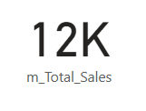
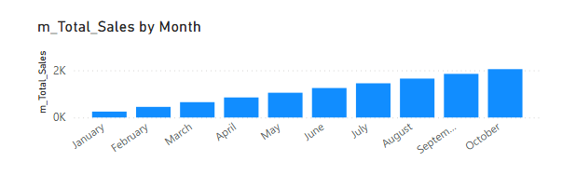
Measures - Sales Data
Total Sales Amount
m_Total_Sales = SUM(f_Sales[Sales_Amount])
Card Visual, Column Chart (Total Sales by Store)

Slide 104
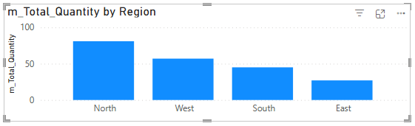
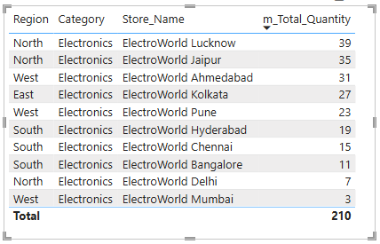
Measures - Sales Data
Total Quantity Sold
m_Total_Quantity = SUM(f_Sales[Quantity])
Bar Chart, Table Visual (Quantity Sold by Product)

Slide 105
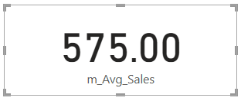
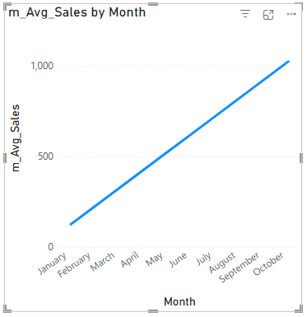
Measures - Sales Data
Average Sales per Order
m_Avg_Sales = AVERAGE(f_Sales[Sales_Amount])
Card Visual, Line Chart

Slide 106
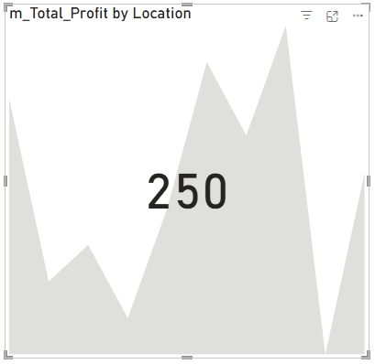
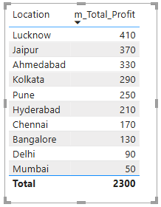
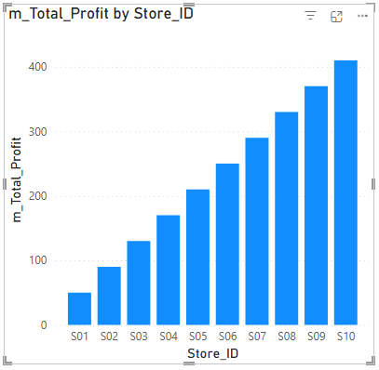
Measures - Sales Data
Total Profit Calculation
m_Total_Profit = SUM(f_Sales[Profit])
Stacked Column Chart, KPI Visual

Slide 107
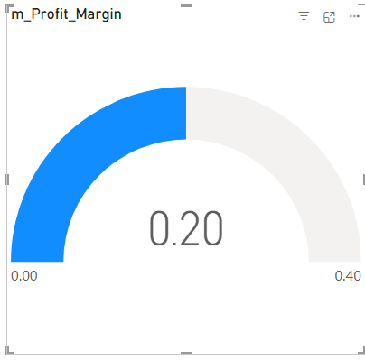
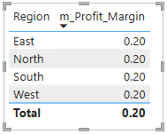
Measures - Sales Data
Profit Margin % Calculation
m_Profit_Margin = DIVIDE(SUM(f_Sales[Profit]), SUM(f_Sales[Sales_Amount]), 0)
Gauge Chart, KPI Visual

Slide 108
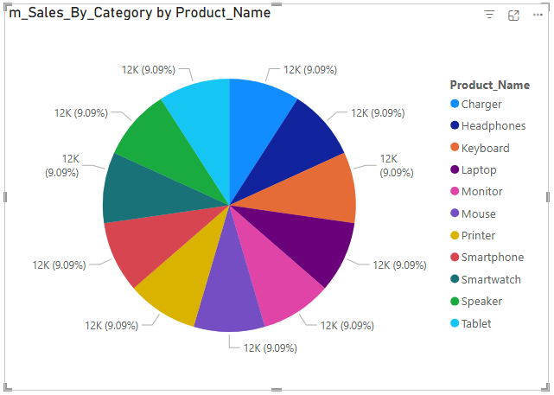
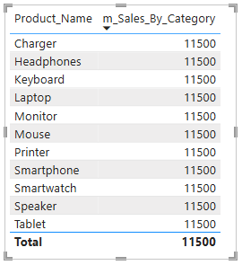
Measures - Sales Data
Sales by Category
m_Sales_By_Category = CALCULATE(SUM(f_Sales[Sales_Amount]), ALLEXCEPT(d_Products, d_Products[Category]))
Pie Chart (Sales by Product Category)

Slide 109
Measures - Sales Data
Sales Growth Year over Year (YoY)
m_Sales_YoY =
CALCULATE(
SUM(f_Sales[Sales_Amount]),
SAMEPERIODLASTYEAR(f_Sales[Date])
)
Line Chart (Sales Trend Over Years)

Slide 110
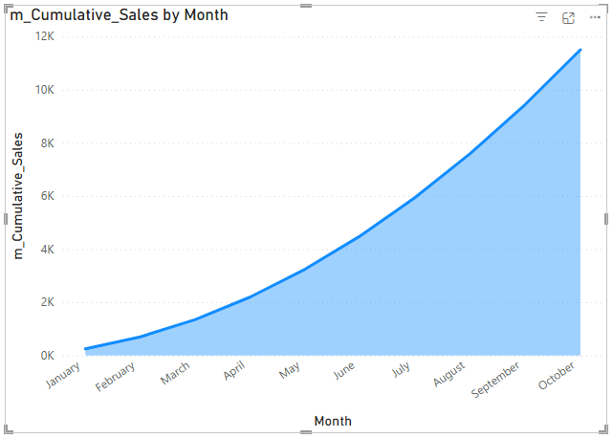
Measures - Sales Data
Running Total (Cumulative Sales)
m_Cumulative_Sales =
CALCULATE(
SUM(f_Sales[Sales_Amount]),
FILTER(ALL(f_Sales), f_Sales[Date] <= MAX(f_Sales[Date]))
)
Area Chart (Cumulative Sales Trend)

Slide 111
All
Measures
Aggregated calculations like Total Sales, Average Price, or Sum of Revenue.
Applied to entire tables or filtered data dynamically.
Total Sales = SUM(Orders[TotalAmount])
Calculated Columns
Add custom columns to your data model.
Calculated row by row during data import or refresh.
ProfitMargin = Orders[TotalAmount] - Orders[Cost]
Calculated Tables
Generate new tables derived from existing tables.
HighValueCustomers = FILTER(Customers, Customers[TotalSpent] > 10000)
Row-Level Calculations
DAX can apply row-by-row logic using IF, SWITCH, and FILTER functions.
Movie Category = IF(Netflix[IMDb Rating] >= 8, "Hit", IF(Netflix[IMDb Rating] >= 5, "Average", "Flop"))

