Slide 1
MPI
Message Passing Interface

Slide 2
Outline
Background
Message Passing
MPI
  Group and Context
  Communication Modes
  Blocking/Non-blocking
  Features
  Programming / issues
Tutorial

Slide 3
Distributed Computing Paradigms
Communication Models:
  Message Passing
  Shared Memory
Computation Models:
  Functional Parallel
  Data Parallel

Slide 4
Message Passing
A process is a program counter and address space.
Message passing is used for communication among processes.
Inter-process communication:
  Type:
  Synchronous / Asynchronous
  Movement of data from one process’s address space to another’s

Slide 5
Synchronous Vs. Asynchronous
A synchronous communication is not complete until the message has been received.
An asynchronous communication completes as soon as the message is on the way.

Slide 6
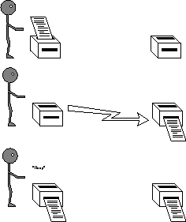
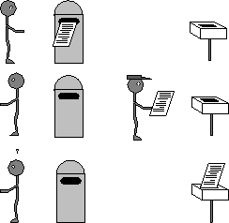
Synchronous Vs. Asynchronous
( cont. )

Slide 7
What is message passing?
Data transfer.
Requires cooperation of sender and receiver
Cooperation not always apparent in code

Slide 8
What is MPI?
A message-passing library specifications:
    Extended message-passing model
    Not a language or compiler specification
    Not a specific implementation or product
For parallel computers, clusters, and heterogeneous networks.
Communication modes: standard, synchronous, buffered, and ready.
Designed to permit the development of parallel software libraries.
Designed to provide access to advanced parallel hardware for
    End users
    Library writers
    Tool developers

Slide 9
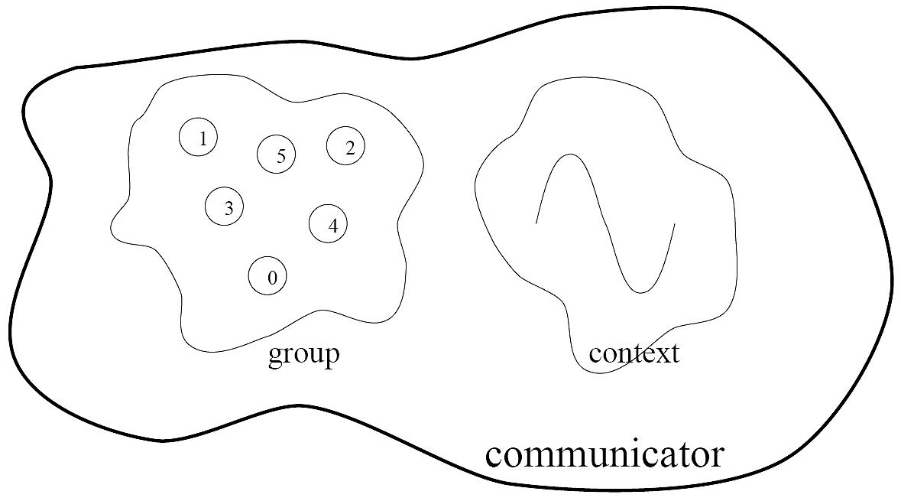
Group and Context
This image is captured from:
Writing Message Passing Parallel Programs with MPI
A Two Day Course on MPI Usage
Course Notes
Edinburgh Parallel Computing Centre
The University of Edinburgh

Slide 10
Group and Context (cont.)
Are two important and indivisible concepts of MPI.
Group: is the set of processes that communicate with one another.
Context: it is somehow similar to the frequency in radio communications.
Communicator: is the central object for communication in MPI. Each communicator is associated with a group and a context.

Slide 11
Communication Modes
Based on the type of send:
  Synchronous: Completes once the acknowledgement is received by the sender.
  Buffered send: completes immediately, unless if an error occurs.
  Standard send: completes once the message has been sent, which may or may not imply that the message has arrived at its destination.
  Ready send: completes immediately, if the receiver is ready for the message it will get it, otherwise the message is dropped silently.

Slide 12
Blocking vs. Non-Blocking
Blocking, means the program will not continue until the communication is completed.
Non-Blocking, means the program will continue, without waiting for the communication to be completed.

Slide 13
Features of MPI
General
  Communications combine context and group for message security.
  Thread safety can’t be assumed for MPI programs.

Slide 14
Features that are NOT part of MPI
Process Management
Remote memory transfer
Threads
Virtual shared memory

Slide 15
Why to use MPI?
MPI provides a powerful, efficient, and portable way to express parallel programs.
MPI was explicitly designed to enable libraries which may eliminate the need for many users to learn (much of) MPI.
Portable !!!!!!!!!!!!!!!!!!!!!!!!!!
Good way to learn about subtle issues in parallel computing

Slide 16
How big is the MPI library?
Huge ( 125 Functions ).
Basic ( 6 Functions ).

Slide 17
Basic Commands
Standard with blocking

Slide 18
Skeleton MPI Program
#include <mpi.h>
main( int argc, char** argv )
{
MPI_Init( &argc, &argv );
/* main part of the program */
/*
Use MPI function call depend on your data partitioning and the parallelization architecture
*/
MPI_Finalize();
}

Slide 19
Initializing MPI
The initialization routine MPI_INIT is the first MPI routine called.
MPI_INIT is called once
int mpi_Init( int *argc, char **argv );

Slide 20
A minimal MPI program(c)
  #include “mpi.h”
  #include <stdio.h>
  int main(int argc, char *argv[])
  {
  MPI_Init(&argc, &argv);
  printf(“Hello, world!\n”);
  MPI_Finalize();
  Return 0;
  }

Slide 21
A minimal MPI program(c)
(cont.)
#include “mpi.h” provides basic MPI definitions and types.
MPI_Init starts MPI
MPI_Finalize exits MPI
Note that all non-MPI routines are local; thus “printf” run on each process
Note: MPI functions return error codes or MPI_SUCCESS

Slide 22
Error handling
By default, an error causes all processes to abort.
The user can have his/her own error handling routines.
Some custom error handlers are available for downloading from the net.

Slide 23
Improved Hello (c)
#include <mpi.h>
#include <stdio.h>
int main(int argc, char *argv[])
{
  int rank, size;
  MPI_Init(&argc, &argv);
  MPI_Comm_rank(MPI_COMM_WORLD, &rank);
  MPI_Comm_size(MPI_COMM_WORLD, &size);
  printf("I am %d of %d\n", rank, size);
  MPI_Finalize();
  return 0;
}

Slide 24
Some concepts
The default communicator is the MPI_COMM_WORLD
A process is identified by its rank in the group associated with a communicator.

Slide 25
Data Types
The data message which is sent or received is described by a triple (address, count, datatype).
The following data types are supported by MPI:
  Predefined data types that are corresponding to data types from the programming language.
  Arrays.
  Sub blocks of a matrix
  User defined data structure.
  A set of predefined data types

Slide 26
Basic MPI types
MPI datatype C datatype
MPI_CHAR signed char
MPI_SIGNED_CHAR signed char
MPI_UNSIGNED_CHAR unsigned char
MPI_SHORT signed short
MPI_UNSIGNED_SHORT unsigned short
MPI_INT signed int
MPI_UNSIGNED unsigned int
MPI_LONG signed long
MPI_UNSIGNED_LONG unsigned long
MPI_FLOAT float
MPI_DOUBLE double
MPI_LONG_DOUBLE long double

Slide 27
Why defining the data types during the send of a message?
Because communications take place between heterogeneous machines. Which may have different data representation and length in the memory.

Slide 28
MPI blocking send
MPI_SEND(void *start, int count,MPI_DATATYPE datatype, int dest, int tag, MPI_COMM comm)
The message buffer is described by (start, count, datatype).
dest is the rank of the target process in the defined communicator.
tag is the message identification number.

Slide 29
MPI blocking receive
MPI_RECV(void *start, int count, MPI_DATATYPE datatype, int source, int tag, MPI_COMM comm, MPI_STATUS *status)
Source is the rank of the sender in the communicator.
The receiver can specify a wildcard value for souce (MPI_ANY_SOURCE) and/or a wildcard value for tag (MPI_ANY_TAG), indicating that any source and/or tag are acceptable
Status is used for exrtra information about the received message if a wildcard receive mode is used.
If the count of the message received is less than or equal to that described by the MPI receive command, then the message is successfully received. Else it is considered as a buffer overflow error.

Slide 30
MPI_STATUS
Status is a data structure
In C:
  int recvd_tag, recvd_from, recvd_count;
  MPI_Status status;
  MPI_Recv(…, MPI_ANY_SOURCE, MPI_ANY_TAG, …, &status)
  recvd_tag = status.MPI_TAG;
  recvd_from = status.MPI_SOURCE;
  MPI_Get_count(&status, datatype, &recvd_count);

Slide 31
More info
A receive operation may accept messages from an arbitrary sender, but a send operation must specify a unique receiver.
Source equals destination is allowed, that is, a process can send a message to itself.

Slide 32
Why MPI is simple?
Many parallel programs can be written using just these six functions, only two of which are non-trivial;
    MPI_INIT
    MPI_FINALIZE
    MPI_COMM_SIZE
    MPI_COMM_RANK
    MPI_SEND
    MPI_RECV

Slide 33
Simple full example
#include <stdio.h>
#include <mpi.h>
int main(int argc, char *argv[])
{
const int tag = 42; /* Message tag */
int id, ntasks, source_id, dest_id, err, i;
MPI_Status status;
int msg[2]; /* Message array */
err = MPI_Init(&argc, &argv); /* Initialize MPI */
if (err != MPI_SUCCESS) {
printf("MPI initialization failed!\n");
exit(1);
}
err = MPI_Comm_size(MPI_COMM_WORLD, &ntasks); /* Get nr of tasks */
err = MPI_Comm_rank(MPI_COMM_WORLD, &id); /* Get id of this process */
if (ntasks < 2) {
printf("You have to use at least 2 processors to run this program\n");
MPI_Finalize(); /* Quit if there is only one processor */
exit(0);
}

Slide 34
Simple full example (Cont.)
if (id == 0) { /* Process 0 (the receiver) does this */
for (i=1; i<ntasks; i++) {
err = MPI_Recv(msg, 2, MPI_INT, MPI_ANY_SOURCE, tag, MPI_COMM_WORLD, \
&status); /* Receive a message */
source_id = status.MPI_SOURCE; /* Get id of sender */
printf("Received message %d %d from process %d\n", msg[0], msg[1], \
source_id);
}
}
else { /* Processes 1 to N-1 (the senders) do this */
msg[0] = id; /* Put own identifier in the message */
msg[1] = ntasks; /* and total number of processes */
dest_id = 0; /* Destination address */
err = MPI_Send(msg, 2, MPI_INT, dest_id, tag, MPI_COMM_WORLD);
}
err = MPI_Finalize(); /* Terminate MPI */
if (id==0) printf("Ready\n");
exit(0);
return 0;
}

Slide 35
Standard with Non-blocking

Slide 36
Non-Blocking Send and Receive
MPI_ISEND(buf, count, datatype, dest, tag, comm, request)
MPI_IRECV(buf, count, datatype, dest, tag, comm, request)
request is a request handle which can be used to query the status of the communication or wait for its completion.

Slide 37
Non-Blocking Send and Receive (Cont.)
A non-blocking send call indicates that the system may start copying data out of the send buffer. The sender must not access any part of the send buffer after a non-blocking send operation is posted, until the complete-send returns.
A non-blocking receive indicates that the system may start writing data into the receive buffer. The receiver must not access any part of the receive buffer after a non-blocking receive operation is posted, until the complete-receive returns.

Slide 38
Non-Blocking Send and Receive (Cont.)
MPI_WAIT (request, status)
MPI_TEST (request, flag, status)
The MPI_WAIT will block your program until the non-blocking send/receive with the desired request is done.
The MPI_TEST is simply queried to see if the communication has completed and the result of the query (TRUE or FALSE) is returned immediately in flag.

Slide 39
Deadlocks in blocking operations
What happens with
    Process 0 Process 1
    Send(1) Send(0)
    Recv(1) Recv(0)
Send a large message from process 0 to process 1
    If there is insufficient storage at the destination, the send must wait for the user to provide the memory space(through a receive)
This is called “unsafe” because it depends on the availability of system buffers.

Slide 40
Some solutions to the “unsafe” problem
Order the operations more carefully
    Process 0 Process 1
    Send(1) Recv(0)
    Recv(1) Send(0)
Use non-blocking operations:
    Process 0 Process 1
    ISend(1) ISend(0)
    IRecv(1) IRecv(0)
Waitall Waitall

Slide 41
Collective Operations

Slide 42
Introduction to collective operations in MPI
Collective operations are called by all processes in a communicator
MPI_Bcast distributes data from one process(the root) to all others in a communicator.
    Syntax:
    MPI_Bcast(void *message, int count, MPI_Datatype datatype, int root, MPI_Comm comm)
MPI_Reduce combines data from all processes in communicator or and returns it to one process
  Syntax:
  MPI_Reduce(void *message, void *recvbuf, int count, MPI_Datatype datatype, MPI_Op op, int root, MPI_Comm comm)
In many numerical algorithm, send/receive can be replaced by Bcast/Reduce, improving both simplicity and efficiency.

Slide 43
Collective Operations
    MPI_MAX, MPI_MIN, MPI_SUM, MPI_PROD, MPI_LAND, MPI_BAND, MPI_LOR, MPI_BOR, MPI_LXOR, MPI_BXOR, MPI_MAXLOC, MPI_MINLOC

Slide 44

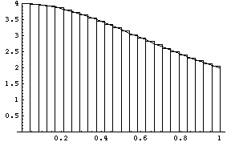
Example: Compute PI (0)

Slide 45
Example: Compute PI (1)
#include “mpi.h”
#include <math.h>
int main(int argc, char *argv[])
{
int done = 0, n, myid, numprocs, I, rc;
double PI25DT = 3.141592653589793238462643;
double mypi, pi, h, sum, x, a;
MPI_INIT(&argc, &argv);
MPI_COMM_SIZE(MPI_COMM_WORLD, &numprocs);
MPI_COMM_RANK(MPI_COMM_WORLD, &myid);
while (!done)
{
if (myid == 0)
{
printf(“Enter the number of intervals: (0 quits) “);
scanf(“%d”, &n);
}
MPI_BCAST(&n, 1, MPI_INT, 0, MPI_COMM_WORLD);
if (n == 0)
}

Slide 46
Example: Compute PI (2)
h = 1.0 / (double)n;
sum = 0.0;
for (i = myid + 1; i <= n; i += numprocs)
{
x = h * ((double)i – 0.5);
sum += 4.0 / (1.0 + x * x);
}
mypi = h * sum;
MPI_Reduce(&mypi, &pi, 1, MPI_DOUBLE, MPI_SUM, 0, MPI_COMM_WORLD);
if (myid == 0) printf(“pi is approximately %.16f, Error is %.16f\n”, pi, fabs(pi – PI25DT));
MPI_Finalize();
return 0;
}

Slide 47
When to use MPI
Portability and Performance
Irregular data structure
Building tools for others
Need to manage memory on a per processor basis

Slide 48
Programming with MPI

Slide 49
Compile and run the code
Compile using:
    mpicc –o pi pi.c
    Or
    mpic++ –o pi pi.cpp
mpirun –np # of procs –machinefile XXX pi
-machinefile tells MPI to run the program on the machines of XXX.

Slide 50
MPI on ECE Solaris Machines (1)
Log in to draco.ece.arizona.edu
From outside the UofA first log in to shell.ece.arizona.edu
Create a Text file and name it. For example ML, and have the following lines:
150.135.221.71
150.135.221.72
150.135.221.73
150.135.221.74
150.135.221.75
150.135.221.76
150.135.221.77
150.135.221.78

Slide 51
MPI on ECE Solaris Machines (2) ex2.c
#include "mpi.h"
#include <math.h>
#include <stdio.h>
int main(argc,argv)
int argc; char *argv[];
{
int done = 0, n, myid, numprocs, i, rc;
double PI25DT = 3.141592653589793238462643;
double mypi, pi, h, sum, x, a;
MPI_Init(&argc,&argv);
MPI_Comm_size(MPI_COMM_WORLD,&numprocs);
MPI_Comm_rank(MPI_COMM_WORLD,&myid);
while (!done)
{
if (myid == 0) {
printf("Enter the number of intervals: (0 quits) ");
scanf("%d",&n);
}
MPI_Bcast(&n, 1, MPI_INT, 0, MPI_COMM_WORLD);
if (n == 0) break;
h = 1.0 / (double) n;
sum = 0.0;
for (i = myid + 1; i <= n; i += numprocs)
{
x = h * ((double)i - 0.5);
sum += 4.0 / (1.0 + x*x);
}
mypi = h * sum;
MPI_Reduce(&mypi, &pi, 1, MPI_DOUBLE, MPI_SUM, 0, MPI_COMM_WORLD);
if (myid == 0) printf("pi is approximately %.16f, Error is %.16f\n", pi, fabs(pi - PI25DT));
}
MPI_Finalize();
}

Slide 52
MPI on ECE Solaris Machines (3)
How to compile:
mpicc ex2.c -o ex2 –lm
How to run:
mpirun -np 4 -machinefile ml ex2

Slide 53
Where to get MPI library?
MPICH ( WINDOWS / UNICES )
  http://www-unix.mcs.anl.gov/mpi/mpich/
Open MPI (UNICES)
  http://www.open-mpi.org/

Slide 54
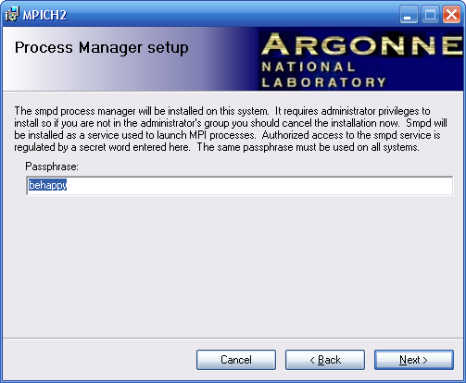
Step By Step Installation of MPICH on windows XP(1)

Slide 55
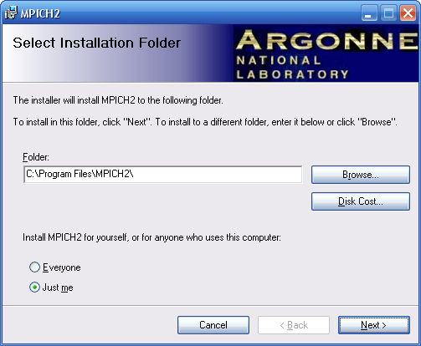
Step By Step Installation of MPICH on windows XP(2)

Slide 56
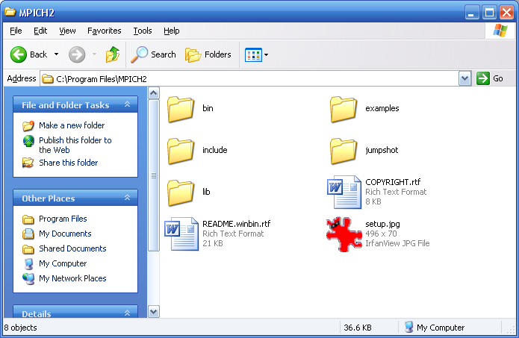
Step By Step Installation of MPICH on windows XP(3)

Slide 57
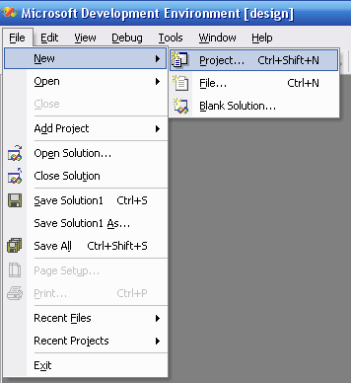
Step By Step Installation of MPICH on windows XP(4)

Slide 58
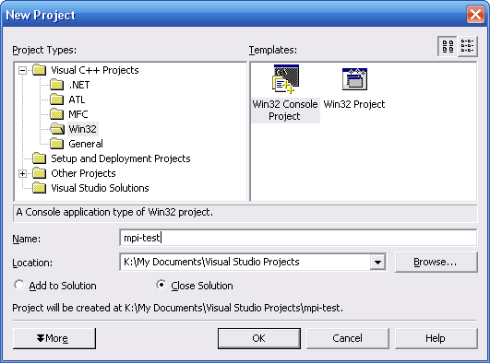
Step By Step Installation of MPICH on windows XP(5)

Slide 59
Step By Step Installation of MPICH on windows XP(6)
// mpi-test.cpp : Defines the entry point for the console application.
//
#include "stdafx.h"
#include <mpi.h>
#include <stdio.h>
int _tmain(int argc, _TCHAR* argv[])
{
int rank, size;
MPI_Init(&argc, &argv);
MPI_Comm_rank(MPI_COMM_WORLD, &rank);
MPI_Comm_size(MPI_COMM_WORLD, &size);
printf("I am %d of\n", rank, size);
MPI_Finalize();
return 0;
}

Slide 60
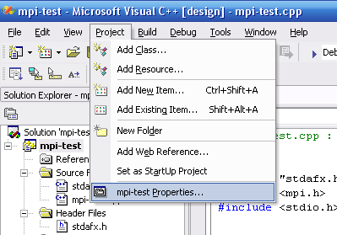
Step By Step Installation of MPICH on windows XP(7)

Slide 61
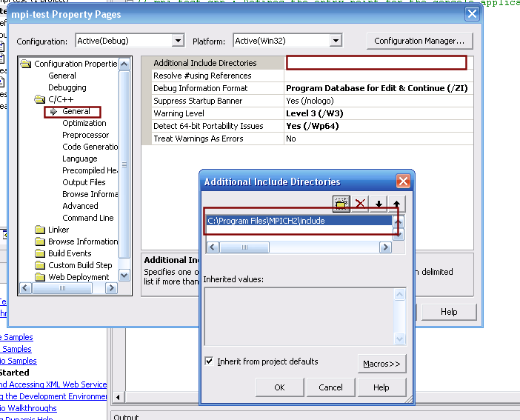
Step By Step Installation of MPICH on windows XP(8)

Slide 62
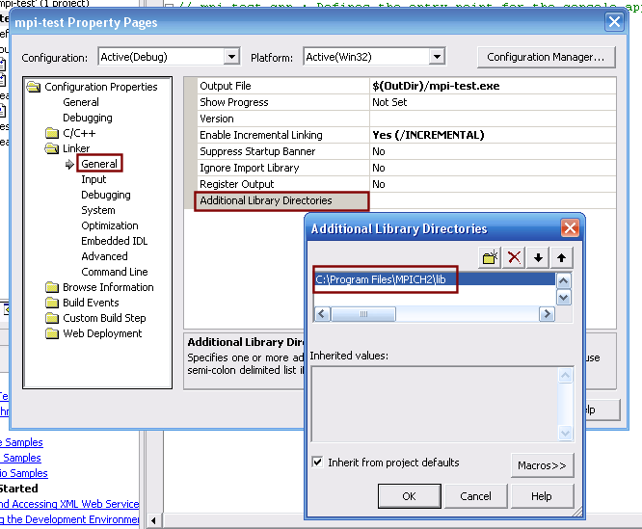
Step By Step Installation of MPICH on windows XP(9)

Slide 63
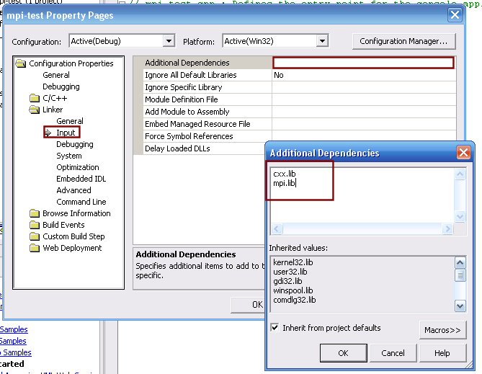
Step By Step Installation of MPICH on windows XP(10)

Slide 64
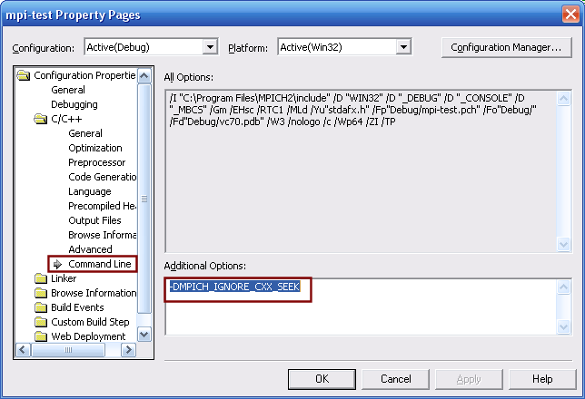
Step By Step Installation of MPICH on windows XP(11)

Slide 65
Step By Step Installation of MPICH on windows XP(12)
Copy executable file to the bin directory
Execute using:
mpiexec.exe –localonly <# of procs> exe_file_name.exe

