Slide 1
Chapter 5: Syntax Directed Translation
Prof. Steven A. Demurjian
Computer Science & Engineering Department
The University of Connecticut
371 Fairfield Way, Unit 2155
Storrs, CT 06269-3155
steve@engr.uconn.edu
http://www.engr.uconn.edu/~steve
(860) 486 - 4818
Material for course thanks to:
Laurent Michel
Aggelos Kiayias
Robert LeBarre

Slide 2
Overview
Review Supporting Concepts
  (Extended) Backus Naur Form
  Parse Tree and Schedule
Explore Basic Concepts/Examples of Attribute Grammars
  Synthesized and Inherited Attributes
  Actions as Direct Effect of Parsing
Examine more Complex Examples
Attribute Grammars and Yacc – Jump to Slide Set
Constructing Syntax Trees During Parsing Translation is Two-Pass:
  First Pass: Construct Tree using Attribute Grammar
  Second Pass: Evaluate Tree (Perform Translation)
Concluding Remarks

Slide 3
BNF and EBNF
Essentially Backus Naur Form for Regular Expressions that we have Utilized to Date
Extension - Reminiscent of regular expressions
EBNF
  Extended
  Backus
  Naur
  Form
What is it?
  A way to specify a high-level grammar
  Grammar is
    Independent of parsing algorithm
    Richer than “plain grammars”
    Human friendly [highly readable]

Slide 4
Optional and Alternative Sections
E → id ( A )
→ id
A → integer
→ id
E → id [ ( A ) ]
A → integer
→ id
Optional Part!
Simplifying for Alternatives
E → id [ ( A ) ]
A → integer
→ id
E → id [ ( A ) ]
A → { integer | id }

Slide 5
Kleene Closure
Simplifies Grammar by Eliminating Epsilon Rules
E → id [ ( Args ) ]
Args → E Rest
→ ε
Rest → , E Rest
→ ε
E → id [ ( [Args] ) ]
Args → E [ , Args ]*
foo()
foo(x)
foo(x,y)
foo(x,y,z)
foo(w,x,y,z)

Slide 6
Positive Closure
For having at least 1 occurrence
L → S L’
L’ → S L’
→ ε
S → if ....
→ while ....
→ repeat ....
L → S+
S → if ....
→ while ....
→ repeat ....

Slide 7
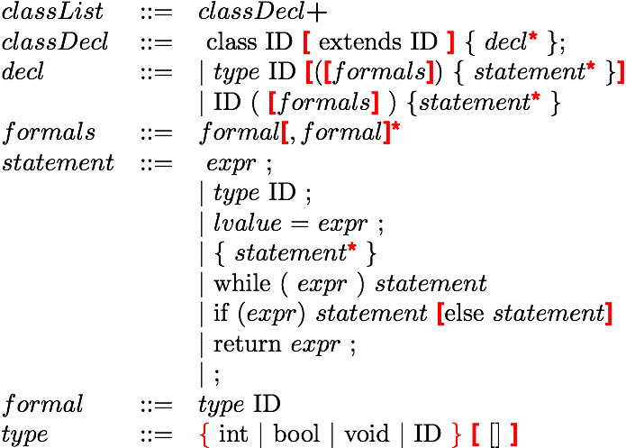
C-- EBNF Style

Slide 8
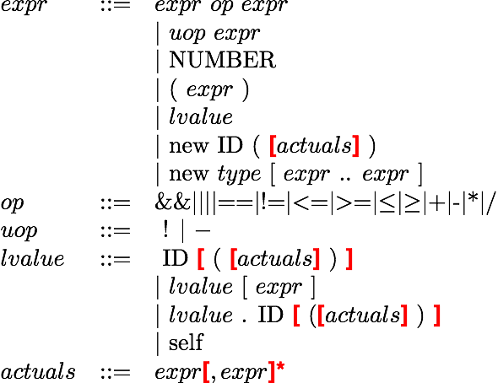
C-- EBNF Style

Slide 9

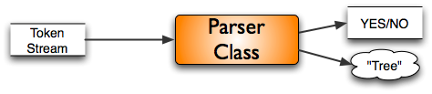
Parse Trees - The Problem
In TDP or BUP, the Token Stream (from Lex) is Supplied to Parser
  Parser Produces Yes/No Answer if Successful
However, this is Not Sufficient for Code Generation, Optimization, etc.
  Desired Outcome from Parsing is:

Slide 10
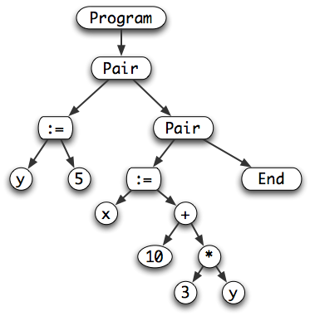
What is a Parse Tree ?
Two Options for a Parse Tree:
    A true physical parse tree that contains the program structure and associated relevant tokens
    A schedule of operations that must be performed
Base example
y := 5;
x := 10 + 3 * y

Slide 11
Physical Tree
Positive
  Depicts the grammatical structure
  Should be easy to create while parsing
  Unambiguous
  Easy to manipulate
Negative
  Not “Operational”
  Not closer to final product (code)
  Compilation requires multiple passes

Slide 12
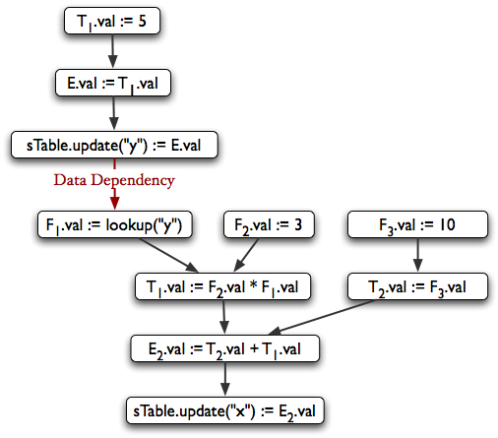
What is a Schedule?
Schedule is a
Sequence of Operations
Not only Structure
(Parse Tree), but
way to Evaluate it
Sequence of Steps
Leading to “Code”
Ability to “Evaluate”
Tokens as Parsed
Result:
Value or “Code”
y := 5;
x := 10 + 3 * y

Slide 13
Schedule [a.k.a. Dependency Graph]
Positive
  This is almost runnable code !
  It give the sequence of step to follow
  We bypassed the parse tree altogether (so this is lightweight)
  Compilation doable in a single pass
Negative
  Harder to manipulate
  Can it always be created ?
  What is the connection with the
  grammar ?

Slide 14
What is the Trade-Off ?
Physical Parse Tree
  Requires multiple pass for compilation
  Very flexible
  This is what we will use
Schedule [Dependency Graph]
  Requires a single pass for compilation
  Less flexible
Bottom-line
  The construction of both rely on the same technique
    Attributed Grammars

Slide 15
What is the Desired Goal?
Change the parser or the grammar
  To automatically build the parse tree
Facts
  We have three parsing techniques
    Recursive Descent
    LL(k)
    LR(k) (and LALR(1))
Corollary
  Find a way to instrument each technique to get the tree
Pre-requisite
  You must understand what the trees look like.

Slide 16
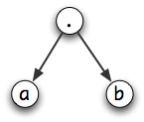
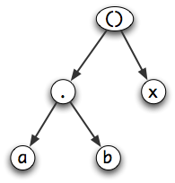
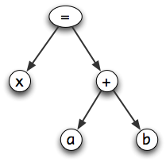
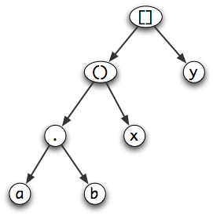
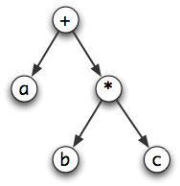
Examples of Trees
a.b
a.b(x)
x = a + b
a + b * c
a.b(x)[y]

Slide 17
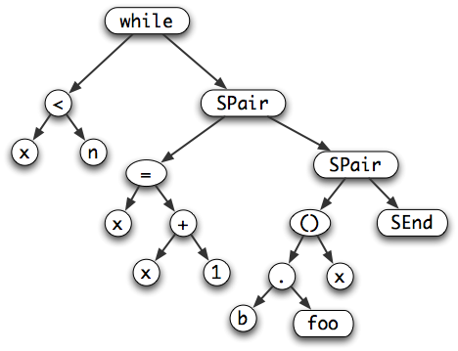
Tree for a Code Segment
while x<n {
x = x + 1;
b.foo(x);
}

Slide 18



Key Issue
How to build the tree while parsing ?
Idea
  Use the grammar
E → E + T
→ T
T → Id
E ⇒ E + T ⇒ Id + T ⇒ Id + Id
T ⇒ Id
Sites where
we must
Take an action

Slide 19
Action
What is the nature of the action?
Answer
  It depends on the production!
E → E + T
Here we know that
On top of the stack we must have two operands
So....
Action =
a = pop();
b = pop();
c = new Addition(a,b);
push(c);

Slide 20
What is Going On
We synthesize the tree
  While parsing
  In a bottom-up fashion
What we need
  A stack to hold the synthesized “values”
  Actions inserted in the grammar
Issues to approach
  Where do we attach the actions in productions ?
  How do we attach the actions ?
  How can we automate the process ?
  It this always bottom-up ?

Slide 21
Attribute Grammars
A Language Specification Technique for Translation
Attribute Grammar Contains:
  Attributes (for Each NT in Grammar)
  Evaluation (Action) Rules (AKA: Semantic Rules)
  Conditions (Optional) for Evaluation
Main Concepts:
  Each Attributed Define with Set of Values
  Values Augment Syntax/Parse Tree of Input String
  Attributes Associated with Non-Terminals
  Evaluation Rules Associated with Grammar Rules
  Conditions Constrain Attribute Values
Objective: 1. Compute attributes automatically and
2. Trigger rules when the production is used

Slide 22
A First Example
Consider Grammar for Unsigned Integers
Objective:
  Develop Attribute Grammar that Generates Actual Unsigned Integers from 0 to 32,767
  Recall Tokens for Lexical Analyzer are Strings, Namely “2” and “7”
  Begin by Augmenting Grammar with U → N
N
N → D
N → N D
D → 0 | 1 | …. | 8 | 9
N
D
D
7
N ⇒ ND ⇒ DD ⇒ 2D ⇒ 27
2

Slide 23
Define Attribute
Attribute “val” Tracks Actual Value of Unsigned Integer as Input is Scanned and Parsed
How is 27 Evaluated?
Production Rules
U → N
N → N₁ D
N → D
D → digit
Evaluation/Semantic Rules
Print(N.val)
N.val 10 * N₁.val + D.val
N.val D.val
D.val digit.lexeme
→
→
→
N
N₁
D
D
7
2

Slide 24
Evaluation/Semantic Rules into Grammar
U → N
{ U.val := N.val }
N → N₁ D
{ N.val := 10 * N₁.val + D.val
Condition: N.val ≤ 32,767 }
N → D
{ N.val := D.val }
D → digit
{D.val := digit.lexeme }
N
N₁
D
3
N₁
D
2
D
1

Slide 25
Two Types of Attributes
Synthesized Attributes
  Information (Values) move Up Tree from Leaves towards Root
  Value (Node) is Synthesized (Calculated) form Subset of its Children
  Previous Example had “val” as Synthesized
val1 val2 val3

Slide 26
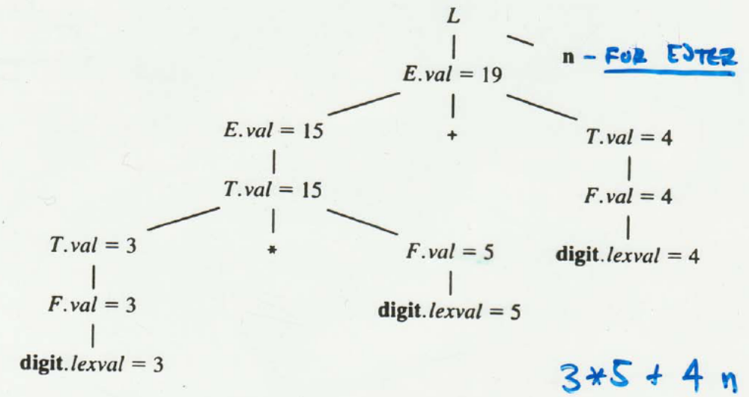
Second Example of Synthesized Attributes
L → E n { print (E.val)}
E → E₁ + T { E.val := E₁ + T.val}
E → T { E.val := T.val }
T → T₁ * F { T.val := T₁ * F.val}
T → F { T.val := F.val }
F → (E) { F.val := E.val }
F → U {F.val := U.val}

Slide 27
Combining First Two Examples
L → E n { print (E.val)}
E → E₁ + T { E.val := E₁ + T.val}
E → T { E.val := T.val }
T → T₁ * F { T.val := T₁ * F.val}
T → F { T.val := F.val }
F → (E) { F.val := E.val }
F → digit {F.val := digit.lexeme }
U → N { U.val := N.val }
N → N₁ D { N.val := 10 * N₁.val + D.val
Condition: N.val ≤ 32,767 }
N → D { N.val := D.val }
D → digit {D.val := digit.lexeme }

Slide 28
Two Types of Attributes
Inherited Attributes
  Information for Node Obtained from Node’s Parent and/or Siblings
  Used to Keep Track of Context Dependencies
    Location of Identifier on RHS vs. LHS of Assignment
    Type Information for Expression
  These are Context Sensitive Issues!
val

Slide 29
Example of Inherited Attributes
Production Rules
D → T L
T → int
T → real
L → L , id
L → id
D ⇒ TL ⇒ int L
⇒ int L , id
⇒ int L , id , id
⇒ int id , id , id
D
D
T
L
T
L
real
id
,
“int”
L
id
Where is Type Information
With respect to Identifiers?
id

Slide 30
Example of Inherited Attributes
D → T L { L.in := T.type }
T → int {T.type := integer }
T → real {T.type := real }
L → L₁ , id {L₁.in := L.in ; addtype (id.entry, L.in)}
L → id {addtype (id.entry, L.in)}
D
type is a synthesized attribute
in is an inherited attribute
T.type = real
L.in = real
,
L.in = real
id₂
real
id₁

Slide 31
Formal Definitions of Attributes
Given a production A → α
We can write a semantic rule b := f(c1,c2,...,ck)
There are Two possibilities
  Synthesis
    b is a synthesized attribute for A
    ci are attributes from non-terminals appearing in α
    Information flows up – hence Bottom-up computation
  Inheritance
    b is an inherited attribute for a non-terminal appearing in α
    ci are attributes from non-terminals appearing in α or an attribute of A
    Information flows down - hence Top-down computation

Slide 32
Inherited Attributes
Summary
  These attributes are computed while going down
  The same could be achieved with post-processing
Fact
  Inherited attributes exist for one reason only
    A FASTER compilation
      Avoid a “pass” over the tree to decorate
      Everything happens during the parsing
        Parse
        Construct the tree
        Decorate the tree
    This is an OPTIMIZATION of the compilation process
    The truly important bit is synthesized attributes

Slide 33
Other Attribute Grammar Concepts
L-Attributed Definitions: Attribute Grammars that can always be Evaluated in a Depth-First Fashion
Consider the Rule: A → X1 X2 … Xn
A Syntax-Directed Definition (AG) is L-Attributed if Every Inherited Attribute Xj in Rule Depends on:
  Attributes of X1 X2 … Xj-1 which are to the Left of Xj in the Parse Tree
  The Inherited Attributes of A
Every Synthesized Attribute Grammar is L-Attributed
L-Attributed Definitions are True for each Production Rule and the Entire Grammar

Slide 34
Translation Schemes
Combining Attribute Grammars and Grammar Rules to Translate During the Parse (One-Pass)
Evaluating Attribute Grammar for an Input String as We’re Parsing
Translations can Take Many Different Forms
What is the Grammar Below For?
What Can we Do as Scan Input?
  Convert Infix to Postfix!
E → T R
R → addop T R
R → ε
T → num

Slide 35
Infix to Postfix Translation Scheme
A Translation Scheme Embeds Actions (Semantic Rules) into Right Hand Side of Production Rules
E → T R
R → addop T {print(addop.lexeme)} R₁
R → ε
T → num {print(num.val)}
E
Input: 9-5+2
Why is print(addop)
embedded within rule?
T
R
R₁
print(‘9’)
-
T
print(‘-’)
R₁
9
+
T
print(‘+’)
5
print(‘5’)
ε
2
print(‘2’)

Slide 36
What’s Key Issue with Translation Schemes?
Placement!
Consider:
Where is Semantic Rule Placed in Production Rule?
What about:
Is this OK?
What is the Correct Placement?
T → T₁ * F T.val = T₁.val * F.val
T → T₁ * {T.val = T₁.val * F.val} F

Slide 37
Placement Rules
An Inherited Attribute for Symbol on Right Hand Side of a Production Rule Must be Computed in an Action BEFORE the Symbol
  This Implies that the Evaluation/Semantic Rule is Placed at Differing Positions in the Right Hand Side of a Production Rule
An Action Can’t Refer to a Synthesized Attribute of a Symbol to the Right of an Action in a Production Rule
A Synthesized Attribute of a Non-Terminal on the Left-Hand Side of a Production Rule can Only be Computed After ALL Attributes it References has Been Computed:
  This Implies that the Evaluation/Semantic Rule is Placed (Usually) at the End of the Right Hand Side of a Production Rule

Slide 38
Consider a More Complex Example
Consider a Grammar for Subscripts: E sub 1 means E₁
Focus on Relationship Between E and 1
  Point Size – ps (Inherited)– Size of Characters
  Displacement – disp – Up/Down Offset
S → B B.ps = 10
S.ht = B.ht
B → B₁ B₂ B₁.ps = B.ps
B₂.ps = B.ps
B.ht = max(B₁.ht, B₂.ht)
B → B₁ sub B₂ B₁.ps = B.ps
B₂.ps = shrink (B.ps)
B.ht = disp(B₁.ht, B₂.ht)
T → text B.ht = text.h * B.ps

Slide 39
Where are Semantic Rules Placed?
Placement Across Multiple Lines Clearly Identifies Evaluations/Actions that are Performed and When they are Performed!
S → {B.ps = 10 }
B {S.ht = B.ht}
B → {B₁.ps = B.ps}
B₁ {B₂.ps = B.ps}
B₂ {B.ht = max(B₁.ht, B₂.ht)}
B → {B₁.ps = B.ps}
B₁
sub {B₂.ps = shrink (B.ps)}
B₂ {B.ht = disp(B₁.ht, B₂.ht)}
T → text {B.ht = text.h * B.ps}

Slide 40
Another Example: Pascal to C Conversion
Consider Pascal Grammar for Declarations, Example, and C Equivalent
V → var D;
D → D ; D
D → id T
T → integer
T → real
T → char
T → array[num .. num] of T
Let’s Construct
the Parse Tree
and Attribute Grammar
Pascal:
var i: integer;
x: real;
y: array[2..10] of char;
C:
int i;
float x;
char y[9];

Slide 41
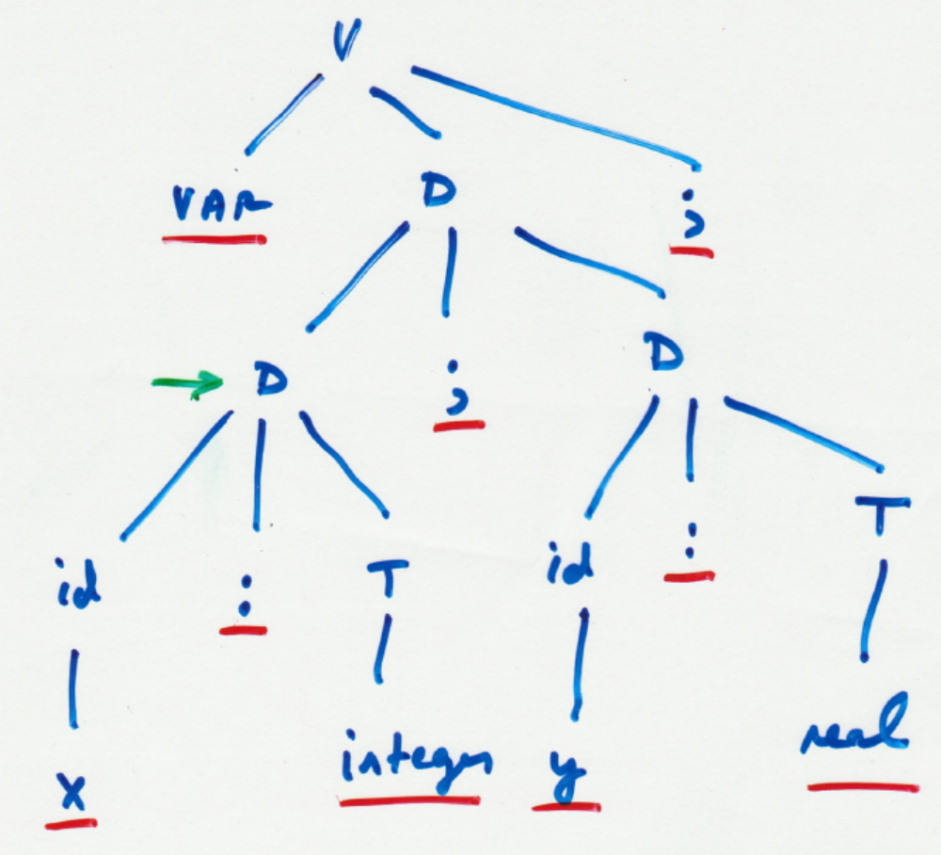
Consider Sample Parse Tree

Slide 42
Grammar and Rules
V → var D; {V.decl = D.decl}
D → D₁ ; D₂ {D.decl = D₁.decl || D₂.decl}
D → id T
{D.decl = T.type || ‘b’ || id.lexeme || T.array || ‘;’}
T → integer { T.type = “int” ; T.array = “” }
T → real { T.type = “float” ; T.array = “” }
T → char { T.type = “char” ; T.array = “” }
T → array[num₁ .. num₂] of T
{ T.type = “char” ;
T.array = ‘[’ || string(num₂ – num₁ + 1) || ‘]’ }

Slide 43
Consider Database Language Translation
SQL:
ABDL
SELECT column-name-list
FROM relation-list
[WHERE boolean-expression]
[ORDER BY column-name]
RETRIEVE boolean-expression (target-list)
[BY column-name]

Slide 44
Consider Database Language Translation
SQL:
ABDL
Note: Similarities and Differences …
Very Straightforward to Translate!
SELECT Course#, PCourse#
FROM Prereq
WHERE Course#=CSE4100
ORDER BY PCourse#
RETRIEVE ((File = Prereq) and (Course# =CSE4100))
(Course#, PCourse#) BY PCourse#

Slide 45
Syntax Tree Construction/Evaluation
Recall: Parse Tree Contains Non-Terminals and Terminals that Corresponds to Derivation
For Simplistic Grammars and Input Streams, the Parse Tree can be Very Large
Solution:
  Replace “Parse Tree” with Syntax Tree which is an Abridged Version
Two-Fold Objective:
  Construction of Syntax Tree via Attribute Grammar as a Side Effect of Parsing Process
  Evaluating Syntax Trees

Slide 46
Typical Example
Parse Tree for a – 4 + c
E → E + T | E – T | T
T → ( E ) | id | num
E
E
T
+
Syntax Tree:
-
id=c
E
-
T
+
num=4
T
id=a
-
id
to entry for c
id
num 4
Where does this go?
to entry for a

Slide 47
How is Syntax Tree Constructed?
Introduce a Number of Functions:
  mknode (op, left, right)
  mkleaf (id, entry)
  mkleaf (num, entry)
  All Functions Return Pointers to Syntax Tree Nodes
For Syntax Tree on Prior Slide:
  p1 := mkleaf (id, entry a)
  p2 := mkleaf (num, 4)
  p3 := mknode (‘-’, p1, p2)
  p4 := mkleaf (id, entry b)
  p5 := mknode (‘+’, p3, p4)
What are Semantic Rules for this?

Slide 48
Attribute Grammar for Syntax Tree
The Attribute nptr is Synthesized
All Semantic Rules Occur after Right Hand Side of Grammar Rule
What Does this Attribute Grammar Assume?
  Lexical Analysis is Inserting ids into Symbol Table
Approach is Generalizable!
E → E₁ + T
E → E₁ - T
E → T
T → ( E )
T → id
T → num
E.nptr := mknode(‘+’, E1.nptr,T.nptr)
E.nptr := mknode(‘-’, E1.nptr,T.nptr)
E.nptr := T.nptr
T.nptr := E.nptr
T.nptr := mkleaf(id, id.entry)
T.nptr := mkleaf(num, num.val)

Slide 49
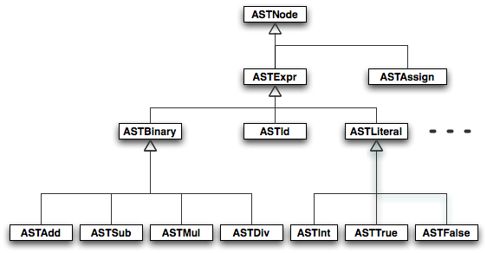

Abstract Syntax Tree [AST]
An instance of the Composite Design Pattern
  Abstract Node
  Concrete Node
  Combined in a class hierarchy

Slide 50
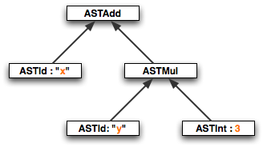
An AST Instance
Example
  x + y * 3

Slide 51
Building Physical Syntax Trees
Straightforward
  Write adequate semantic rules!
  Semantic attribute (val) is a pointer to a tree node
S → E $
E → E + T
E → T
T → T * F
T → F
F → ( E )
F → integer
print(E.val)
E.val := new ASTAdd(E1.val,T.val)
E.val := T.val
T.val := new ASTMul(T1.val,F.val)
T.val := F.val
F.val := E.val
F.val := new ASTInt(integer.val)

Slide 52
Concluding Remarks/Looking Ahead
Attribute Grammars are a Powerful Tool for Specifying Translation Schemes
Parse-Translator one of the Most Practical Compiler Applications
Remainder of the Semester Highlights Other Critical Issues in Compilers
  Typing and Type Checking
  Runtime Environment
  Optimization
  Code Generation

