Slide 1

CS 3240 - Chapter 2

Slide 2

Language | Machine | Grammar
Regular | Finite Automaton | Regular Expression, Regular Grammar
Context-Free | Pushdown Automaton | Context-Free Grammar
Recursively Enumerable | Turing Machine | Unrestricted Phrase-Structure Grammar
CS 3240 - Introduction

Slide 3

2.1: Deterministic Finite Automata
2.2: Non-deterministic Finite Automata
2.3: Equivalence of DFAs and NFAs
2.4: State Minimization
  Removing redundant states
CS 3240 - Finite Automata

Slide 4

A Finite State Machine
Determinism: Always traverses the same path and yields the same result for the same input
Consists of:
  A finite set of states
    Exactly one “start state”
    One or more final (“accepting”) states
  An input alphabet
  A transition function
CS 3240 - Finite Automata

Slide 5
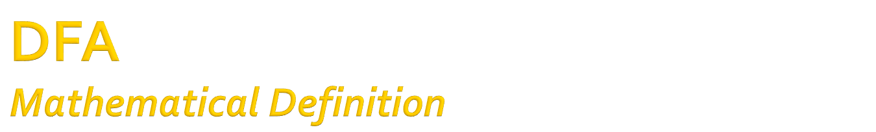
A Quintuple:
1) A set of states, Q
2) An input alphabet, Σ
3) A transition function, δ: Q x Σ -> Q
4) An initial state, q₀
5) A set of final states, F ⊆ Q
CS 3240 - Finite Automata

Slide 6

M = ({q₀,q₁,q₂}, {0,1} , δ, q₀, {q₁})
δ is defined as:
δ(q₀,0) = q₀ δ(q₀,1) = q₁
δ(q₁,0) = q₀ δ(q₁,1) = q₂
δ(q₂,0) = q₂ δ(q₂,1) = q₁
CS 3240 - Finite Automata

Slide 7

 | 0 | 1
-q₀ | q₀ | q₁
+q₁ | q₀ | q₂
q₂ | q₂ | q₁
CS 3240 - Finite Automata
Notes:
Useful for programming

Slide 8

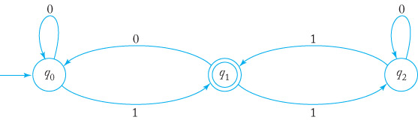
Each state has exactly 2 out-edges (1 for each letter)
What language is this?
CS 3240 - Finite Automata
Notes:
All strings that end in an odd number of 1’s

Slide 9

Strings that have an even number of a’s
Strings that end in ab
Strings that contain aba
Strings over {0, 1} that end in 001
CS 3240 - Finite Automata

Slide 10

Each state is a case in a switch statement
Each state’s code examines a character and changes state accordingly
All of this is in a read-loop
  See fa1.cpp
Advantage:
  Easy to code
Disadvantage:
  Hard-codes the machine
CS 3240 - Finite Automata

Slide 11

Transition table is stored in a 2-d array
  See fa2.cpp
Advantage:
  Even easier to code
Disadvantage:
  Hard-codes the table
CS 3240 - Finite Automata

Slide 12

Transition table is read at runtime
  See fa3.py (with input file fa3.dat)
Advantage:
  Can process any DFA
Disadvantage:
  Hard to code in a static language
  Not so bad in Python, etc.
CS 3240 - Finite Automata

Slide 13

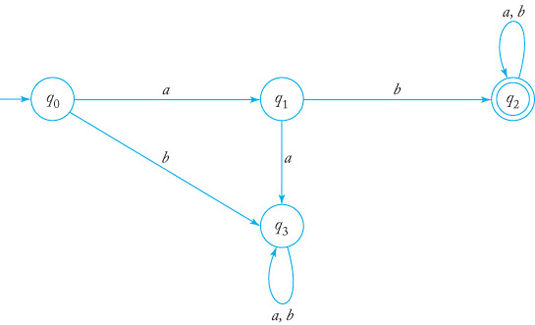
Sometimes a state can never be exited
  A “black hole” :-)
What language is this?
CS 3240 - Finite Automata

Slide 14

If we have a DFA for a language, L, how can we form a DFA for its complement?
  Σ* - L
Think of the roles of final states in recognizing strings…
CS 3240 - Finite Automata

Slide 15

Find a DFA for the set of all strings except those that contain “001” as a substring
First build a DFA that accepts strings containing “001”
Then invert the “acceptability” of each state
  Now all other strings will be accepted
CS 3240 - Finite Automata

Slide 16

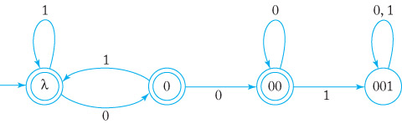
Note that the empty string (λ) is accepted
CS 3240 - Finite Automata

Slide 17

A regular language is one that has a DFA that accepts it
We just proved that the complement of a regular language is also regular!
To show that a language is regular, we find a DFA for it
If it isn’t regular, well, that’s another story
  Wait for Section 4.3
CS 3240 - Finite Automata

Slide 18

Build a DFA that accepts all strings over {a, b} that start and end in the letter a (but not just “a”)
  This one needs a jail
Build a DFA for the language over {a, b} containing an even number of both a’s and b’s
CS 3240 - Finite Automata

Slide 19

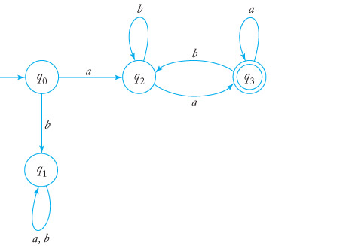
CS 3240 - Finite Automata
Notes:
Often helpful to consider the smallest accepted string. Draw straight through to an accepting state.

Slide 20

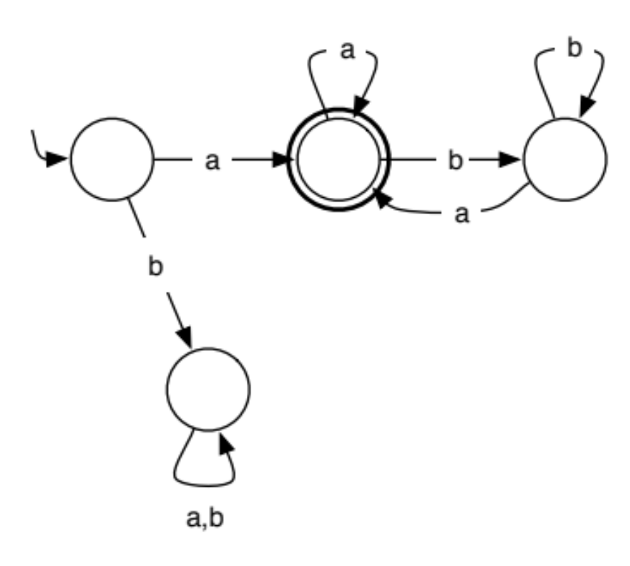
CS 3240 - Finite Automata

Slide 21

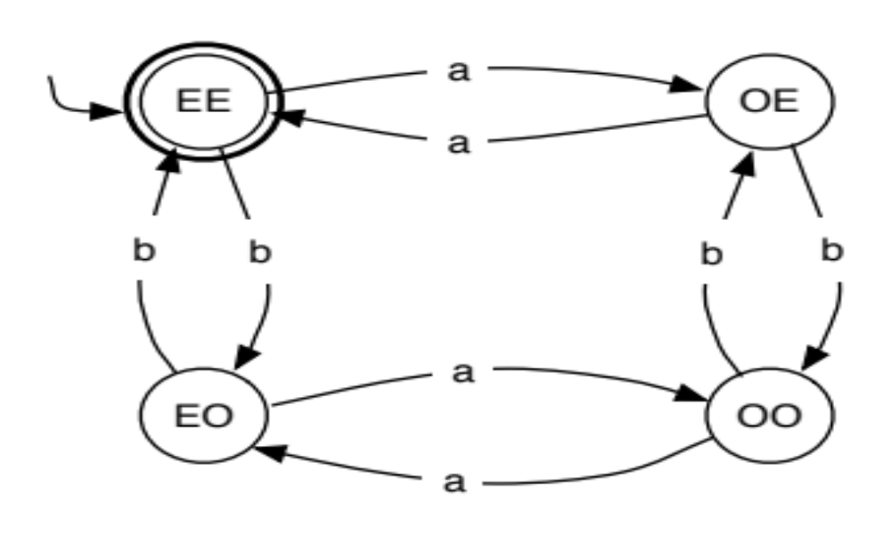
CS 3240 - Finite Automata

Slide 22
Consider binary numbers as input strings:
  Construct a DFA where each state represents the remainder of the number mod 2
    2 states representing 0 and 1, respectively
    Making the 0–state final accepts even numbers
    Making the 1–state final accepts odd numbers
  Pretty easy
    the last digit read determines the remainder
CS 3240 - Finite Automata

Slide 23

Consider binary numbers as input strings:
  Construct a DFA where each state represents the remainder of the number mod 3
    Need 3 states representing 0, 1 and 2, respectively
    Making the 0–state final accepts numbers ≡ 0 mod 3
    Making the 1–state final accepts numbers ≡ 1 mod 3
    Making the 2–state final accepts numbers ≡ 2 mod 3
  Must consider that reading the next bit, b, forms the number 2n+b, where n is the numeric value of the string processed so far before reading b
    Remember: n ≡ m mod 3 ⇒ n = 3k+m, 0≤m<3
CS 3240 - Finite Automata
Notes:
mod 4 is even more fun! See the homework.

Slide 24

Design a DFA for all strings over {0, 1} that have a 1 in the third position from the end:
  For example, 00100, 110, …
CS 3240 - Finite Automata
Notes:
The trick is to track the last three characters whenever the third-to-last is 1. See 1xx.graffle/eps. This is a segue to NFAs.

Slide 25

A Non-Deterministic Finite Automaton (NFA) differs from a DFA in that it may have:
  Zero or more out-edges from a state for the same character
    A “Choice” (multiple edges or even leave them out)
  A move between states can consume no input
    Moves “on a whim” (“λ-transitions”)
As long as there exists at least one path to a final state, the corresponding string is accepted
CS 3240 - Finite Automata

Slide 26

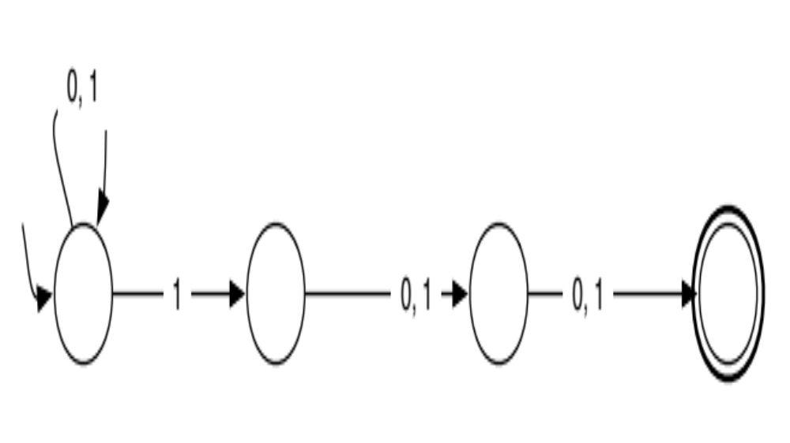
Note: 2 out-edges for a
Note: no out-edges.
Not required in an NFA.
Any subsequent input
crashes the system.
CS 3240 - Finite Automata

Slide 27

It is easier to design solutions
They can be converted to an equivalent DFA!
  Rabin-Scott algorithm
CS 3240 - Finite Automata

Slide 28

A Quintuple:
1) A set of states, Q
2) An input alphabet, Σ
3) A transition function, δ: Q x (Σ∪{λ}) -> 2^{Q}
4) An initial state, q₀
5) A set of final states, F ⊆ Q
Note: DFAs are a special case of NFAs
CS 3240 - Finite Automata

Slide 29

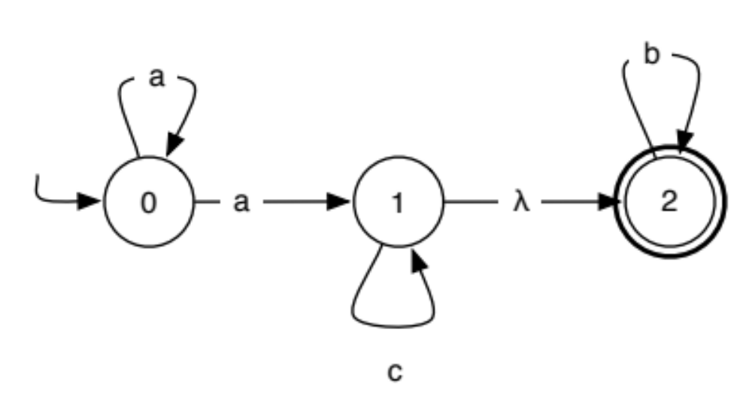
“Free ride” from 1 to 2
CS 3240 - Finite Automata

Slide 30

Strings that contain aa
Strings that contain aa or bb
Strings that begin and end with the same letter
(ab + aba)*
CS 3240 - Finite Automata

Slide 31

Start with the start state
  Could be a composite
    Out-going λ-transitions give a “free ride”!
See where each character takes you
  May be a set of states (we track all simultaneously)
  May be nowhere (this will be the jail in the DFA)
Repeat until there’s no place to go!
I find it easier to use transition tables
  vs. transition graphs
CS 3240 - Finite Automata

Slide 32

The lambda closure of a state in a NFA is the set of states containing:
  The state itself
  All states reachable from the state by a lambda transition
When you enter a state in an NFA, you can clearly reach any state in its lambda closure
CS 3240 - Finite Automata

Slide 33

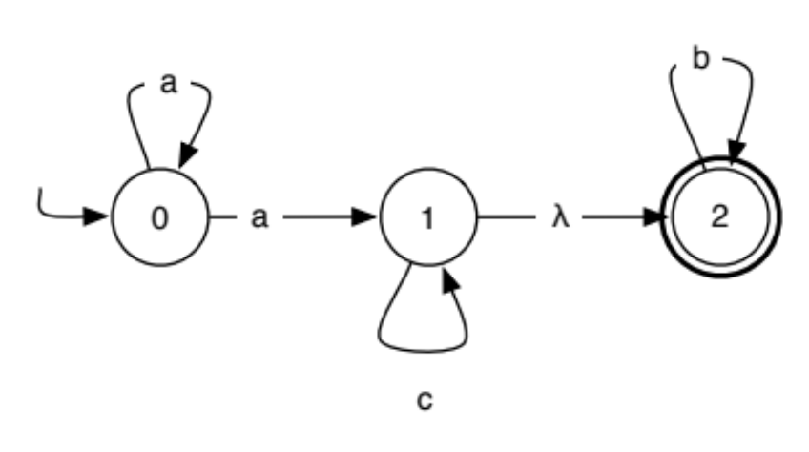
 | a | b | c
0 | {0,1,2} | ∅ | ∅
CS 3240 - Finite Automata

Slide 34

 | a | b | c
0 | {0,1,2} | ∅ | ∅
{0,1,2} | {0,1,2} | 2 | {1,2}
CS 3240 - Finite Automata

Slide 35

 | a | b | c
0 | {0,1,2} | ∅ | ∅
 | a | b | c
0 | {0,1,2} | ∅ | ∅
{0,1,2} | {0,1,2} | 2 | {1,2}
2 | ∅ | 2 | ∅
{1,2} | ∅ | 2 | {1,2}
CS 3240 - Finite Automata

Slide 36

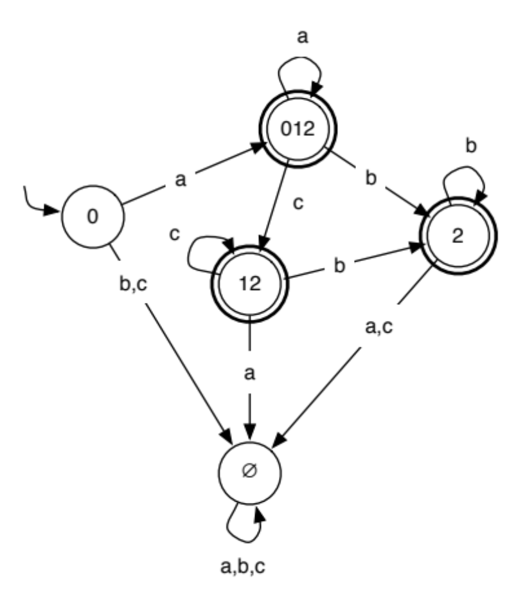
 | a | b | c
0 | {0,1,2} | ∅ | ∅
 | a | b | c
- 0 | {0,1,2} | ∅ | ∅
+ {0,1,2} | {0,1,2} | 2 | {1,2}
+ 2 | ∅ | 2 | ∅
+ {1,2} | ∅ | 2 | {1,2}
CS 3240 - Finite Automata

Slide 37

Begin with the lambda closure of the original start state as the new start state
  This is your initial “current state”
For each state in the current (composite) state:
  For each original transition leaving the current original state, add the states in the lambda closure of the corresponding target state to the result state
  Continue until no more new (composite) states emerge
Any transitions that go “nowhere” go to the jail state
Final states are those with any original final state
CS 3240 - Finite Automata

Slide 38

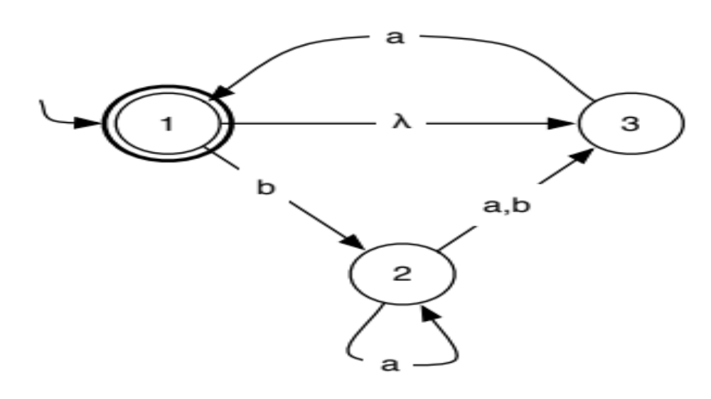
We’ll do this “by hand”…
CS 3240 - Finite Automata
Notes:
Language: (a+ba*(a+b))*

Slide 39

NFAs leave out states and edges that don’t contribute to the language
When taking a complement, you need those missing things!
  The non-determinism complicates matters as well
Only DFAs can be complemented by inverting the acceptability of each state
  So convert the NFA to a DFA first
CS 3240 - Finite Automata

Slide 40

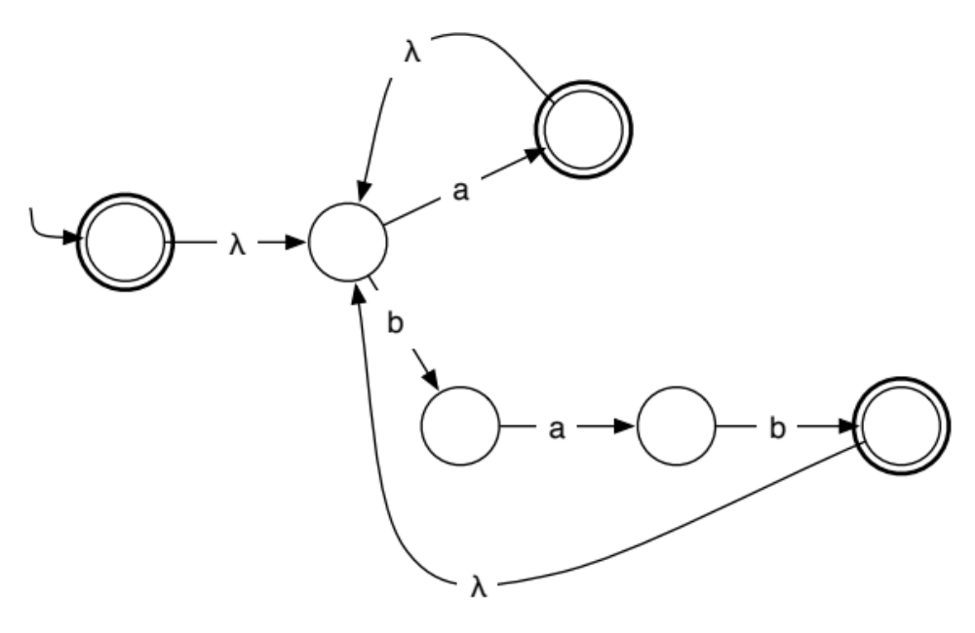
CS 3240 - Finite Automata

Slide 41

A DFA can have redundant states
  Often happens when converting from an NFA
Sometimes it’s easy to remove/combine them by inspection
  Sometimes it’s not!
There is an algorithm to determine whether states are distinguishable
CS 3240 - Finite Automata

Slide 42

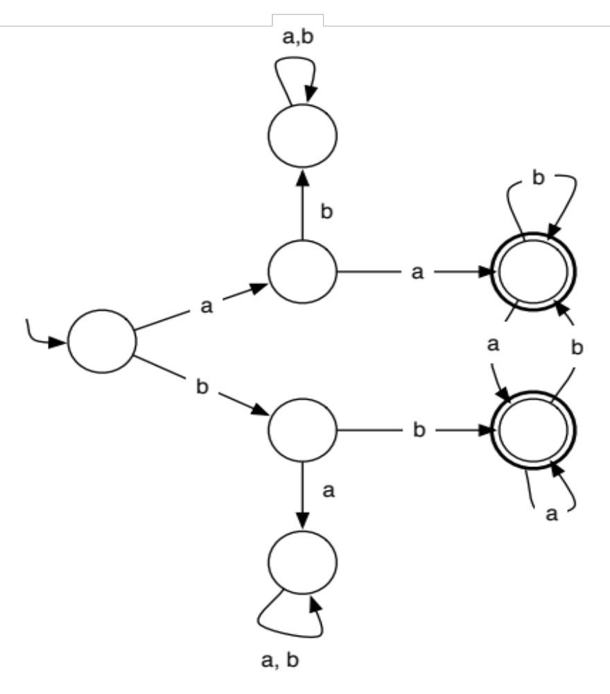
CS 3240 - Finite Automata

Slide 43

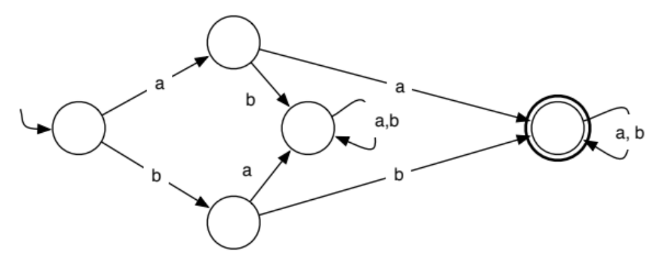
CS 3240 - Finite Automata

Slide 44

States p and q are indistinguishable if, starting in p and q, every string leads to the same state of “finality” (i.e., the strings fail or succeed together)
  δ*(p,w) ∈ F ➯ δ*(q,w) ∈ F, and
  δ*(p,w) ∉ F ➯ δ*(q,w) ∉ F
  for all strings w
So we start with strings of length 0
  then length 1, length 2…
  We stop if any string shows p and q distinguishable
CS 3240 - Finite Automata

Slide 45

Mark all final states distinguishable from non-final states (strings of length 0 distinguish these states, obviously)
Repeat until no new unmarked pairs are marked distinguishable:
  For all unmarked pairs of states, (p,q):
    For each letter, c, of the alphabet Σ:
      If δ(p,c) and δ(q,c) are distinguishable, mark p and q distinguishable
Combine each group of remaining mutually indistinguishable states into a single state
CS 3240 - Finite Automata
Notes:
The first step is an optimization. The algorithm combines jails for you if you don’t. Distinguishability is an equivalence relation.

Slide 46

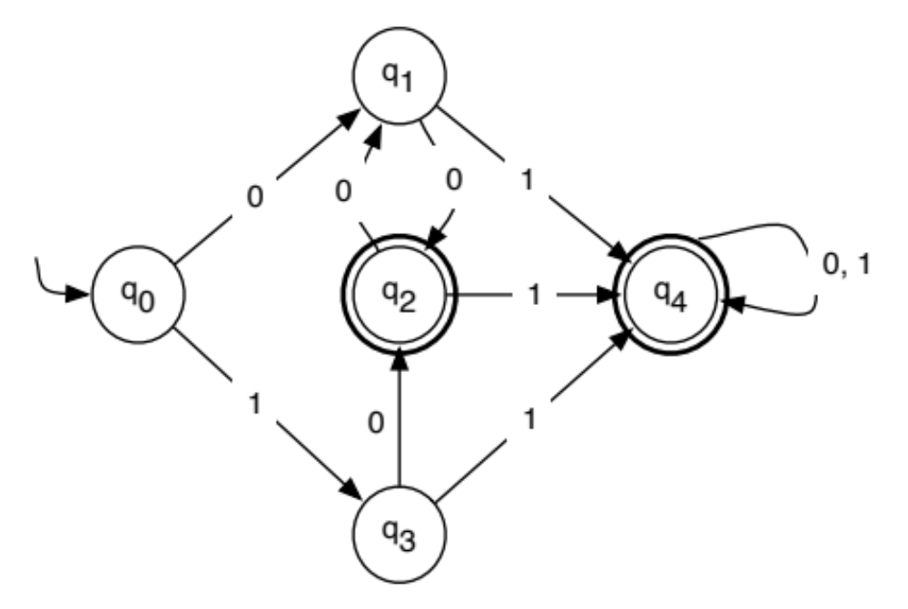
CS 3240 - Finite Automata

Slide 47

Start by grouping final vs. non-final states:
  {q₂, q₄} vs. {q₀, q₁, q₃}
  Mark all 6 pairings between these groups distinguishable:
 | q₀ | q₁ | q₂ | q₃ | q₄
q₀ |  |  | x |  | x
q₁ |  |  | x |  | x
q₂ |  |  |  | x
q₃ |  |  |  |  | x
q₄
CS 3240 - Finite Automata

Slide 48
Check remaining unmarked pairs:
  (q₂,q₄): δ(q₂,0) = q₁, δ(q₄,0) = q₄, => distinguishable
  (q₀,q₁): δ(q₀,0) = q₁, δ(q₁,0) = q₂, => distinguishable
  (q₀,q₃): δ(q₀,0) = q₁, δ(q₃,0) = q₂, => distinguishable
  (q₁,q₃): δ(q₁,0) = δ(q₃,0) and δ(q₁,1) = δ(q₃,1) , => indistinguishable
 | q₀ | q₁ | q₂ | q₃ | q₄
q₀ |  | x | x | x | x
q₁ |  |  | x |  | x
q₂ |  |  |  | x | x
q₃ |  |  |  |  | x
q₄
CS 3240 - Finite Automata

Slide 49

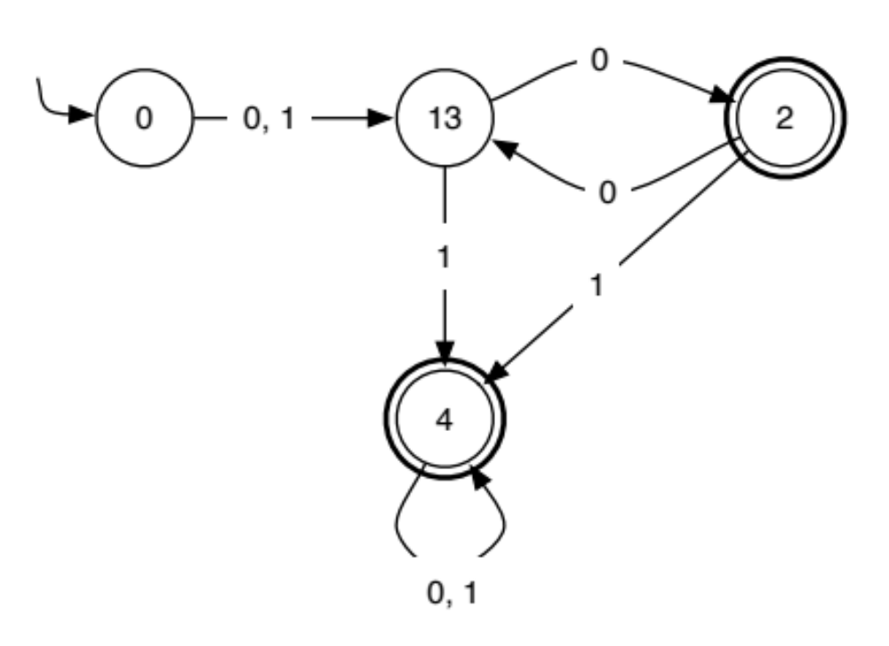
CS 3240 - Finite Automata

Slide 50

Minimize the machine on slide 44
  don’t combine the jails ahead of time, just for fun
CS 3240 - Finite Automata

Slide 51

What if two states, p and q, say, are indistinguishable, and also states q and r are indistinguishable?
CS 3240 - Finite Automata
Notes:
Its transitive (all the states combine into one automatically).

