Slide 1
Object orientation and
traits

Slide 2
Annotations – not marker interfaces
@serializable class Person
@SerialVersionUID(1) class Person
@cloneable class Person
@remote class Service

Slide 3
object
object is a “singleton” class
  Call may look like static method calls in Java
  Can inherit from other classes and traits
  Can be passed as a reference
object MyObject {
def foo = "bar"
}
var baz = MyObject.foo
val personObject = MyObject
baz = personObject.foo

Slide 4
Companion object
Can read the companion class' private fields
Has to be in the same source file
class Person(private val age: Int)
object Person {
def getPersonAge(p: Person) = p.age
}
val personInstance = new Person(30)
val age = Person.getPersonAge(personInstance)

Slide 5
Magical apply
class Person private(val age: Int)
object Person {
def apply(age: Int) = new Person(age)
}
var personInstance = Person.apply(30)
personInstance = Person(30)

Slide 6
Not built in, clever use of apply
val myList = List(1, 2, 3)
val mySet = Set(1, 2, 3)
val myMap = Map(1 -> "one", 2 -> "two")

Slide 7
Constructors
Always one primary constructor
Parameters are automatically instance variables
Class “body” is the primary constructors content
Auxiliary constructors MUST call or chain to primary constructor
class MyClass(myString: String, myInt: Int)
val myOtherInt = 10
println("In main body")
}

Slide 8
Auxiliary constructors
class MyClass(myString: String, myInt: Int) {
def this(myString: String) = this(myString, 0)
def this() = {
this("foo")
println("In default constructor")
}
}

Slide 9
Inheritance
class MyClass(myString: String)
class MySubClass(myString: String, myInt: Int)
extends MyClass(myString) {
println("MyString: '" + myString + "', MyInt: '" + myInt + "'")
}

Slide 10
Inheritance
Single class inheritance
Multiple trait mixins

Slide 11
Syntax
class Person extends AnyRef with java.io.Serializable with java.rmi.Remote
class Person extends java.io.Serializable
with java.rmi.Remote

Slide 12
Traits
“Multiple inheritance done right”
Implement methods
Initialized fields
Abstract methods
Abstract fields
Abstract types
Does not have constructors
Call to super -> strict semantics

Slide 13
scala.Ordered trait
trait Ordered[A] {
def compare(that: A): Int
def < (that: A): Boolean = (this compare that) < 0
def > (that: A): Boolean = (this compare that) > 0
def <= (that: A): Boolean = (this compare that) <= 0
def >= (that: A): Boolean = (this compare that) >= 0
}

Slide 14
The Ordered trait
class Person(private val age: Int) extends Ordered[Person]{
def compare(other: Person) = this.age - other.age
}
val person1 = new Person(21)
val person2 = new Person(31)
person1 < person2 // true
person1 <= person2 // true
person1 >= person2 // false

Slide 15
“Dynamic mixins”
class Person(age: Int) {
override def toString = "my age is " + age
}
trait MyTrait {
override def toString = "I am sure " + super.toString
}
val person = new Person(30) with MyTrait
println(person)
=> I am sure my age is 30

Slide 16
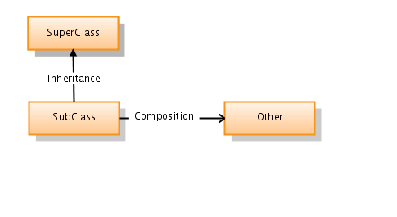
is-a vs has-a
Inheritance as usual
Easier to implement has-a
Inheritance vs composition

Slide 17
Tasks (30 min)
Open 'oo-traits' project
Tests under scalaexamples
  companionobject
  inheritance
  traits
Addl @Test to one and one method
Follow instructions in code
Make tests pass

