Slide 1
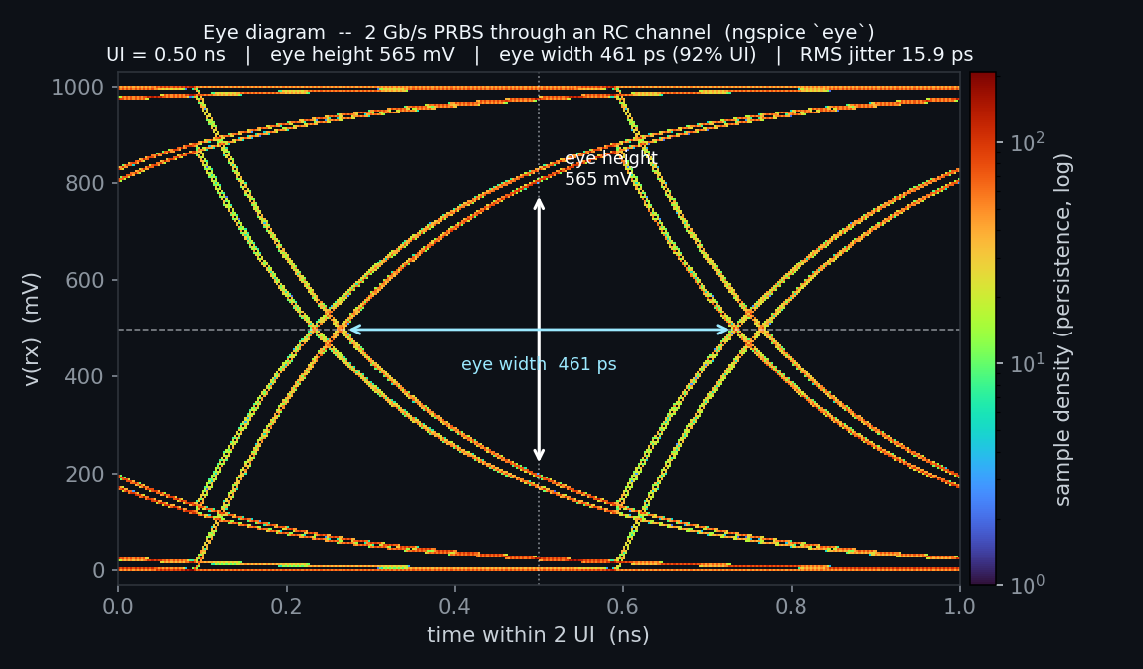
Enhanced ngspice + openvaf-r
A Verilog-A compiler and a circuit simulator, extended as a pair
A 2 Gb/s PRBS through an RC channel, drawn by ngspice's eye command (examples/eye_examples)
Every feature of 908 enhancements · October 2026
Dr. Meisam Bahadori
Notes:
A tour of every feature of the toolchain: the openvaf-r Verilog-A compiler and the ngspice-46 simulator, as extended by 908 enhancements. Each feature slide carries E-number chips; clicking a chip opens that enhancement's write-up on GitHub.

Slide 2
Two tools that work as one
THE TOOLCHAIN
model.va
openvaf-r
model.osdi
ngspice-46
results
Verilog-A source: the analog subset of Verilog-AMS (LRM 2023, Annex C)
parse, HIR, MIR, automatic differentiation, LLVM
a shared object with analytic Jacobians, OSDI 0.7
pre_osdi loads it; N devices sit beside built-in ones
vectors, .meas, plots, Touchstone and raw files
Use them as a pair
Built on
The goals
A .osdi from this compiler needs this ngspice: stock ngspice rejects OSDI 0.7, and original OpenVAF 0.3 objects get a recompile message.
OpenVAF by Pascal Kuthe, OpenVAF-Reloaded by Árpád Bűrmen, and ngspice-46. The combined work is GPL-3.0.
Make ngspice the most capable open SPICE simulator, and openvaf-r the most complete Verilog-A compiler.
Notes:
openvaf-r compiles a Verilog-A file into an OSDI shared object whose residuals and Jacobians come from automatic differentiation. ngspice loads the object at run time with pre_osdi and simulates its instances, N devices, beside its built-in devices in every analysis. The two are a pair: this ngspice reads only openvaf-r objects (OSDI 0.7), and stock ngspice rejects them.

Slide 3
The project by the numbers
AT A GLANCE
908
19
596
enhancements numbered, with 903 detailed write-ups
feature areas in the live, searchable catalog
verify suites in the regression sweep, all passing
92
5
49
standalone industry compact models compile: BSIM, PSP, HiCUM, MEXTRAM, EKV…
platforms built by CI: Linux x86-64 and ARM64, macOS Apple Silicon and Intel, Windows
bug-hunt and correctness-campaign pages: what was probed, found and fixed
Notes:
908 is the latest enhancement number; 903 write-ups exist because a few enhancements were written up together. The regression sweep has 596 verify suites, all passing at E-908. VA_TEST holds 124 .va files, of which 92 are standalone models; all compile.

Slide 4
Where the work went
ENHANCEMENTS PER FEATURE AREA
489
enhancements in the nine compiler areas
424
enhancements in the ten simulator areas
Notes:
Enhancements per feature area, from the live catalog (docs/index.html). Teal bars are compiler areas, orange bars simulator areas. An enhancement can sit in two areas, so the bars sum to 913 for 903 write-ups. Compiler correctness and robustness is the largest area by far: crash and hang fixes, wrong-answer fixes, corpus and LRM sweeps.

Slide 5
Four parts
AGENDA
1
openvaf-r, the compiler
Language coverage, analog operators, hierarchy, buses and arrays, tables and noise, system tasks, robustness
2
ngspice-46, the simulator
OSDI devices, analyses, the RF suite, S-parameters, signal integrity, convergence, KLU, statistics, optimization, reliability, workflow
3
Verification
The verify-suite pipeline, physics validation, campaigns, the timeline, platforms
4
Using it
Getting started in four steps, scope and known limits, the documentation map
Notes:
Part 1 covers the compiler area by area, Part 2 the simulator, Part 3 how every feature is verified, and Part 4 how to start, what is out of scope and where to read more.

Slide 6
openvaf-r: the Verilog-A compiler
489
enhancements across nine compiler feature areas
Part 1 · Annex C of the Verilog-AMS LRM 2023, clause by clause. A construct counts as supported only when its values and its derivatives are right.
Notes:
The compiler targets Annex C of the Verilog-AMS LRM 2023, the analog-only subset. Because derivatives come from automatic differentiation, a construct only counts as supported when it produces correct derivatives as well as correct values.

Slide 7
Language coverage at a glance
LRM 2023 COMPLIANCE
LRM clause | Status | What it covers
2 · Lexical conventions | Full | escaped identifiers, based literals, SI suffixes, attributes
3 · Data types and parameters | Full | ranges, localparam, aliasparam, arrays, paramsets, block scope
3.5–3.13 · Natures, disciplines, nets | Full | buses, implicit nets, nodesets, derived natures
4.1–4.4 · Operators and functions | Full | Table 4-2 precedence, string relations, $clog2, ln1p, expm1
4.5 · Analog operators | Full | every operator, audited clause by clause (E-514)
4.6 · Noise | Full | white, flicker, noise_table(_log), correlation per call site
5 · Analog behaviour | Full | analog blocks, contributions, events, loops, analog functions
6 · Hierarchy | Full | instantiation, generate, defparam, paramsets, $mfactor
9 · System tasks | Full | display, file and string I/O, random, simulation control
10 · Compiler directives | Full | `include, `define, `__FILE__, `__LINE__, `begin_keywords
casex, casez, <<<, >>> | Extension | beyond Annex C, accepted and warned
Annex E · SPICE primitives | Refused | a clean error: instantiate SPICE devices in the netlist
Digital and mixed signal | Out of scope | outside Annex C; rejected with located diagnostics
Notes:
Summary of docs/compliance/OpenVAF_Verilog-A_LRM_Compliance.md. Every entry is backed by a committed verify suite. Extensions beyond Annex C are warned; SPICE primitives cannot be instantiated from Verilog-A source (instantiate them in the netlist); digital and mixed-signal constructs are outside Annex C and are rejected with located diagnostics.

Slide 8
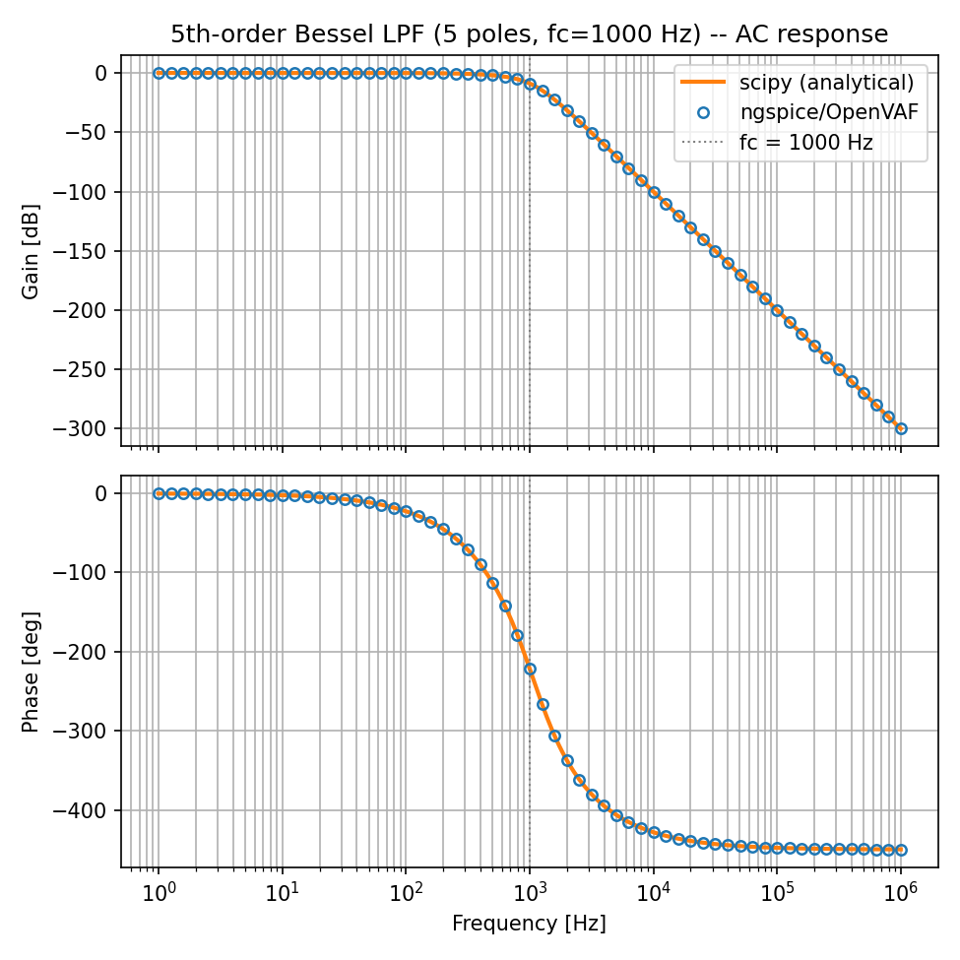
Analog operators and dynamics
COMPILER · 32 ENHANCEMENTS
Delays & filters
Integrators
absdelay as a synthetic-node DAE; laplace_* and zi_* in every form, complex poles and zeros
idt with initial conditions and assert/reset forms, idtmod, ddt, ddx; summed ddt terms all count
E-1
E-4
E-31
E-28
E-52
Ramps & limiters
Events
transition and slew per LRM 4.5.8–4.5.9: rise time, breakpoints, the interruption rule; $limit
cross, above, timer, last_crossing; the time step lands on the crossing, not the step grid
E-698
E-61
E-8
E-759
Step events
Step control
@(initial_step), @(final_step) with phase lists; once per sens run, state carried across .dc
$discontinuity restarts the integration or rejects the step; $bound_step, smallest wins
A 5th-order Bessel low-pass built with laplace_* matches scipy over six decades (examples/bessel_filter_examples)
E-53
E-789
E-24
E-55
Notes:
The continuous-time operators of LRM 4.5 and the events of LRM 5.10. absdelay is solved as a synthetic-node DAE. transition and slew are the simulator's own ramps, scheduled from accepted changes of the input. A cross or above event now lands the time step on the interpolated crossing instead of the step grid (E-759).

Slide 9
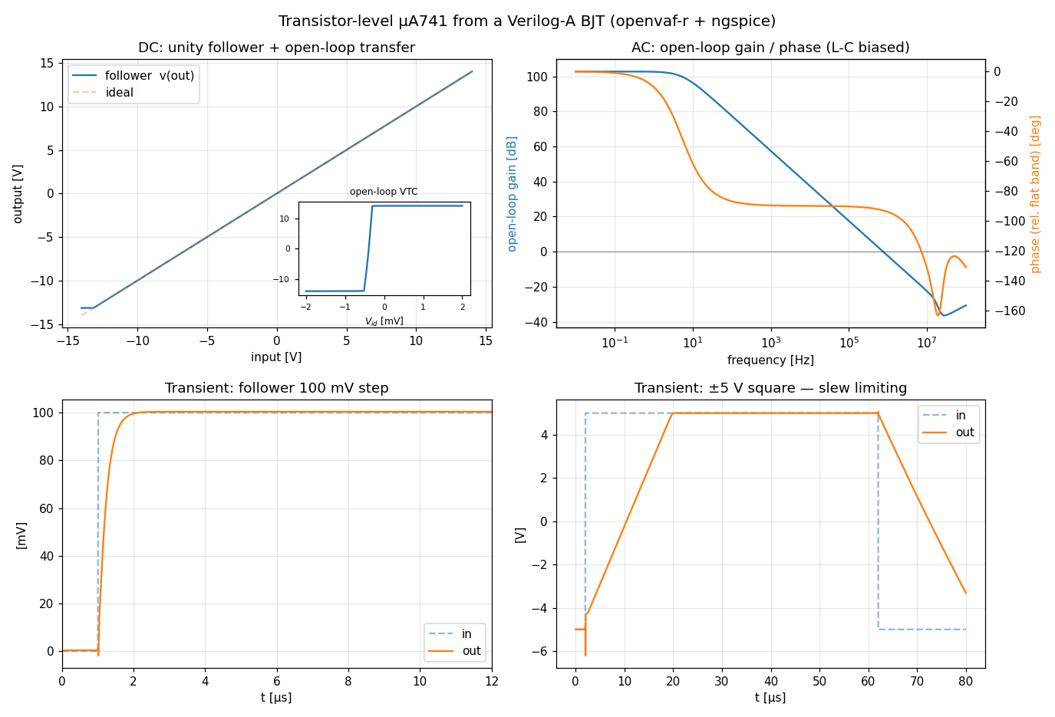
Modules, parameters and hierarchy
COMPILER · 56 ENHANCEMENTS
Instantiation
generate
Hierarchy flattened at compile time; a child's unnamed branches stay the child's own
for, if and case generate with genvars, legacy and bare blocks; genvar loops in analog blocks
E-5
E-757
E-67
E-407
Parameters
paramset
Ranges, localparam, aliasparam, defparam, block-scoped and array parameters, freeze
Overloaded families picked per instance from the card's and the instance's values
E-58
E-87
E-21
E-644
A transistor-level µA741 built from a Verilog-A BJT: follower, open-loop AC and slew limiting (examples/opamp741_examples)
Natures
Libraries & state
Structure binds at compile time: hierarchy, generate, defparam, paramsets, bus widths. Behaviour binds at run time: loop counts and if arms may follow the parameters.
Derived natures, nature attributes, domain-binding checks per LRM 3.6.2.2
Several modules in one .osdi; persistent variables; several analog blocks
E-39
E-50
E-76
E-60
Notes:
Hierarchy is resolved by a compile-time elaboration pass, after which the pipeline sees one flat module. Structure binds at compile time (generate, genvars, defparam, paramsets, bus widths); behaviour binds at simulation time. A paramset's own parameters are instance parameters, and an overloaded family is selected per instance (E-644).

Slide 10
Buses, branches, ports and arrays
COMPILER · 18 + 11 ENHANCEMENTS
Buses
Implicit nets
A 4-bit bus and one genvar loop
Vectored nets and ports, bit-selects and ranges a[0:1]; v(a[0]) in print and plot
An undeclared net takes the discipline of the port it connects
`include "disciplines.vams"
module bank(a, b);
inout [0:3] a;
electrical [0:3] a;
inout b; electrical b;
parameter real g = 1m
from (0:inf);
genvar i;
analog begin
for (i = 0; i < 4; i = i + 1)
I(a[i], b) <+
g * (1 << i) * V(a[i], b);
end
endmodule
// ngspice op, 1 V on each bit:
// 1, 2, 4, 8 mA
E-3
E-221
E-41
E-340
Flow probes
Indirect assignment
I(<port>), probe-only branches as ideal ammeters, hierarchical branch probes
V(out) : V(x) == 0 writes an ideal op-amp; placement rules enforced
E-29
E-36
E-2
Array values
Arrays in functions
Literals, aggregates and dynamic indexing; N-D arrays with per-element overrides
Array arguments in, out and inout; arrays returned from analog functions
E-14
E-15
E-20
E-23
Notes:
Topology beyond scalar electrical nodes, and arrays everywhere a value can go. The code on the right is checked: compiled with the committed openvaf-r and run in ngspice, it draws 1, 2, 4 and 8 mA from four 1 V sources. A genvar loop inside an analog block is unrolled at elaboration (E-407), which is how the LRM writes 'contribute to every bit'.

Slide 11
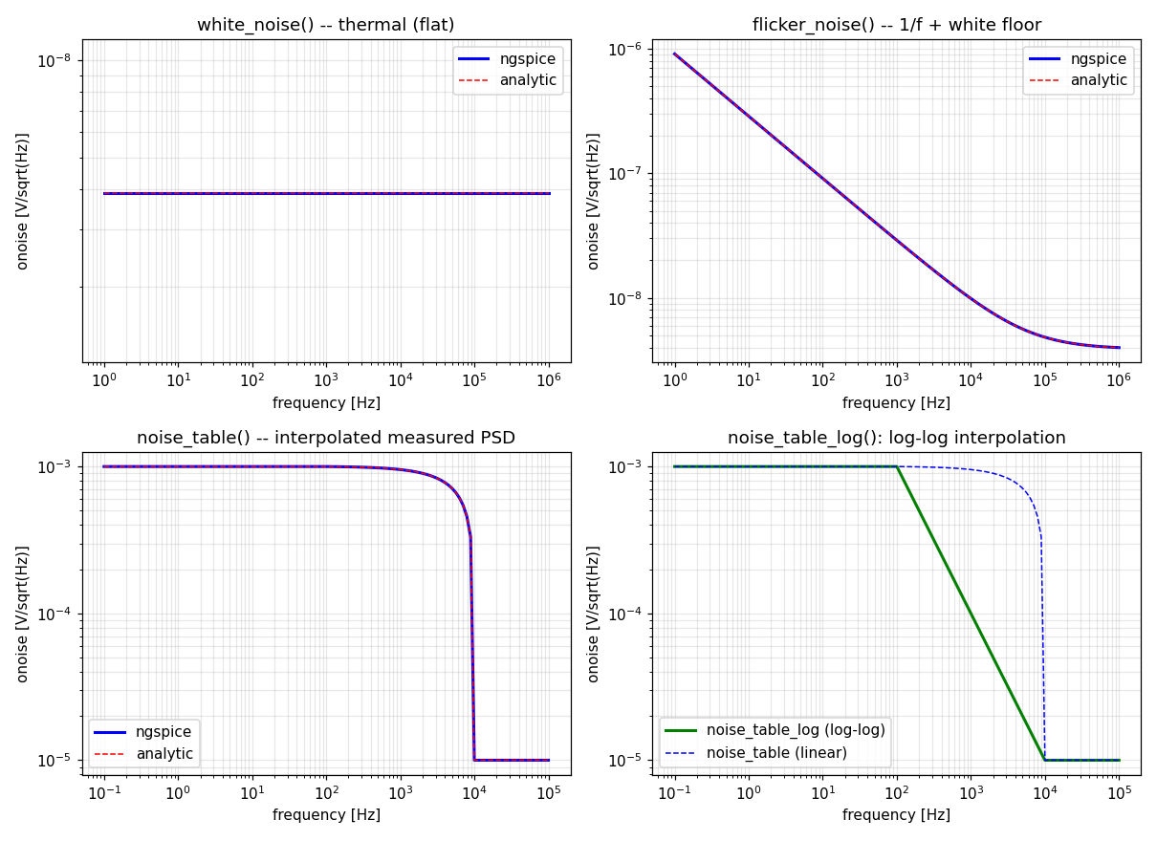
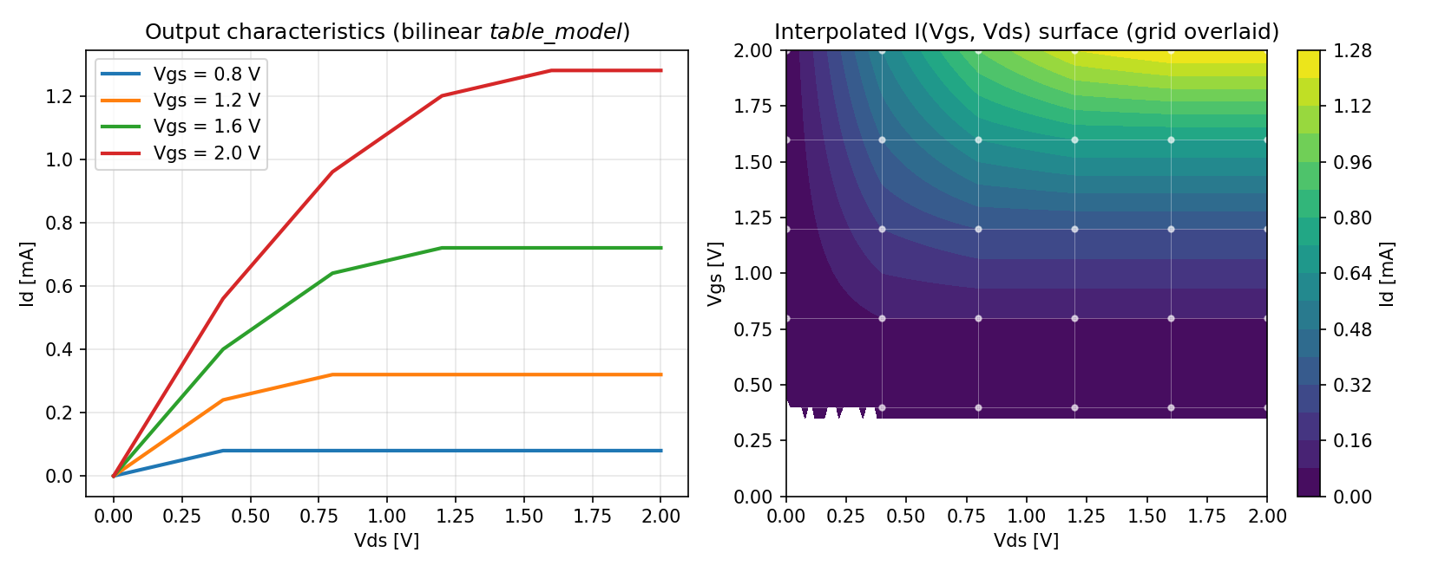
Lookup tables and noise models
COMPILER · 6 + 5 ENHANCEMENTS
Lookup tables
E-16
E-17
E-22
E-40
Noise models
E-9
E-42
E-54
E-364
$table_model in any number of dimensions: linear, cubic spline, isoline files
Lowered to differentiable MIR: an exact Jacobian, no finite differences
Data inline, from arrays or from files; extrapolation per dimension
white_noise, flicker_noise, noise_table and noise_table_log
Same-named sources correlate and sum coherently; op-dependent factors
Node-free noise factors (OSDI 0.7); device noise also in .tran
A bilinear 2-D I(Vgs, Vds) table as a transistor (examples/mdtable_examples)
Each noise source against its analytic spectrum (examples/noise_examples)
Notes:
$table_model is lowered to differentiable MIR, so its Jacobian is exact rather than finite-differenced; it works in any number of dimensions with linear or cubic-spline interpolation. On the noise side, same-named sources are correlated and sum coherently, and since E-364 a device's white and flicker noise also enters a transient.

Slide 12
System tasks and functions
COMPILER · 35 ENHANCEMENTS
$random
$fopen
$sscanf
$display
Random
File I/O
Strings
Display
$random, every $dist_* and $rdist_*; reproducible per instance
$fopen, $fwrite, $fscanf, $fgetc, $ungetc, append mode
$sformat and $sscanf in every base; string compare and returns
$display, $strobe, $monitor, $write: the full format surface
E-10
E-376
E-11
E-107
E-105
E-106
E-71
$fatal
$simparam
$test$plusargs
$clog2
Simulation control
Environment
Plusargs
Math
$finish, $stop, $fatal and $error at the accepted iteration
$simparam, $simparam$str, analysis(), $temperature, $vt
$test$plusargs and $value$plusargs read the simulator's arguments
$clog2, $rtoi, $itor, ln1p, expm1; hypot and atan2 derivatives fixed
E-55
E-378
E-25
E-30
E-215
E-101
E-185
Notes:
LRM chapter 9. Random draws are reproducible per instance and stable across Newton iterations. Display and severity tasks defer to the accepted iteration (LRM 9.4.6, 9.7.3), so a message prints once per accepted point rather than once per Newton step. $dist_* returns integers and $rdist_* reals, as the LRM says (E-376).

Slide 13
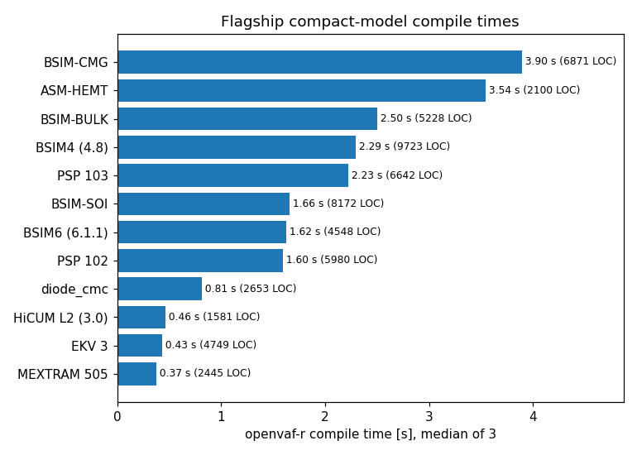
Operators, control flow and compile time
COMPILER · 16 ENHANCEMENTS
Operators
Control flow
Table 4-2 precedence; {…} concatenation, {n{…}} replication; <<< and >>>
do…while, repeat, disable, break, continue, return; casex and casez
E-37
E-38
E-34
E-19
E-78
Literals & directives
Compile cost
Escaped identifiers, based integers; `__FILE__`, `__LINE__`; recursion guard
Nested ?: from O(2^N) to O(N); wide buses and instance arrays elaborate in linear time
E-46
E-85
E-147
E-404
Flagship compile times, median of 3: BSIM-CMG 3.9 s, MEXTRAM 505 0.37 s. About 70 % of the time is LLVM optimizing one eval function.
Strings
Domain errors
Escape sequences read in one pass; string relational operators and string returns
A constant outside a builtin's domain is a compile error naming the value
E-48
E-106
E-396
E-509
Notes:
Operator semantics were audited against the LRM (E-37, E-38). About 70 % of compile time goes to LLVM optimizing one eval function (docs/internals/openvaf_internals/OpenVAF_compile_time_analysis.md). Elaboration and expression handling were made linear where they had been exponential or quadratic.

Slide 14
Correctness and robustness
COMPILER · 310 ENHANCEMENTS
310
92 / 92
496
4,000
standalone VA-Models compile: BSIM4/6/CMG/SOI, PSP, HiCUM, MEXTRAM, EKV
corpus files compile with no assertion failure in an assertions build
mutation-fuzz iterations and ~50 adversarial inputs; crash paths fixed
enhancements in the largest area: crash and hang fixes, wrong-answer fixes, corpus and LRM sweeps, physics checks, lints that name silent mistakes
E-56
E-159
E-347
E-147
E-148
2,089
LRM 2023
Lints
constant-folded expressions fuzzed; two library calls fixed
every code example in the standard extracted and compiled
silent mistakes named: L022 discarded contribution, L031 input-port write
E-510
E-84
E-400
E-639
Notes:
The largest single area. Evidence: the public VA-Models corpus (92 standalone models) compiles; the 496-file corpus compiles with no assertion failure in an assertions-enabled build (E-347); the robustness campaign used the production corpus, about 50 adversarial inputs and 4,000 mutation-fuzzing iterations (E-147, E-148); 2,089 constant-folded expressions found ln1p and expm1 crashing for every non-literal argument (E-510); every code example in the LRM 2023 is a compliance case (E-84).

Slide 15
ngspice-46: the simulator
424
enhancements across ten simulator feature areas
Part 2 · Compiled Verilog-A devices as first-class citizens, a complete RF periodic suite, statistics, optimization and convergence aids.
Notes:
The simulator side: compiled Verilog-A devices take part in every analysis, and the simulator gains a complete RF periodic suite, statistics, optimization, convergence aids, a KLU solver at parity, post-layout reduction, reliability and workflow tooling.

Slide 16
Compiled devices in ngspice
SIMULATOR · THE OSDI DEVICE PATH
divider.cir
Instances & cards
Multiplicity
* divider from a Verilog-A resistor
vin in 0 dc 2
n1 in mid ra
n2 mid 0 rb
.model ra myres(r=1k)
.model rb myres(r=1k)
.control
pre_osdi myres.osdi
op
print v(mid)
.endc
.end
$ ngspice -b divider.cir
v(mid) = 1.000000e+00
N devices; the card names the module; (* type="instance" *) parameters on the line
m and $mfactor scale currents, charges and noise; temp and dtemp reach the model
E-644
E-336
E-755
Op-point variables
Change in session
print @n1[ids], .save, .meas and show n1 for every desc variable
alter and altermod; pre_osdi -f reloads a recompiled .osdi without a restart
E-69
E-229
Terminal currents
Exact numbers
@n1[i_p] is the device's total current, complex in ac and sp
A netlist number is the double its text names, so 1.2 meets from [0:1.2]
E-394
E-835
E-643
Notes:
The deck is the handbook's first example (docs/handbook/01-getting-started.md): pre_osdi loads the compiled model before the circuit is parsed, instances use the N letter, and the model card's type is the Verilog-A module name. Variables with a desc attribute are operating-point variables, readable as @n1[name] wherever ngspice vectors are.

Slide 17
Every analysis takes compiled devices
SIMULATOR · ANALYSIS COVERAGE
Analysis | With compiled Verilog-A devices | Enhancements
op, .dc, .ac, .tran | Full; autodiff Jacobians match numeric derivatives on PSP103 to ~1e-5 | E-57, E-62
.noise | All source types, correlated sources, op-dependent and shaped factors | E-42, E-54
Transient noise | A device's white and flicker noise enters .tran when the deck uses trnoise | E-364
.tf, .sens | Exact; .sens restores models and instances byte for byte | E-179, E-440
.pz | Exact for linear devices, bit-identical to built-in twins; pzeig mode | E-171, E-173
.disto | Taylor tensors from the analytic Jacobian, no variable-count limit | E-352, E-359
.sp | Any port count; noise figure and noise parameters for 2-ports | E-63, E-202
PSS, PAC, Pnoise, PXF, HB, QPSS | The whole RF suite runs on OSDI devices | E-117 to E-154
Notes:
The audited status of each analysis with OSDI devices (handbook section 3.4, updated for later enhancements). Jacobians come from automatic differentiation and are cross-checked against numeric derivatives on PSP103 in examples/physcheck_examples.

Slide 18
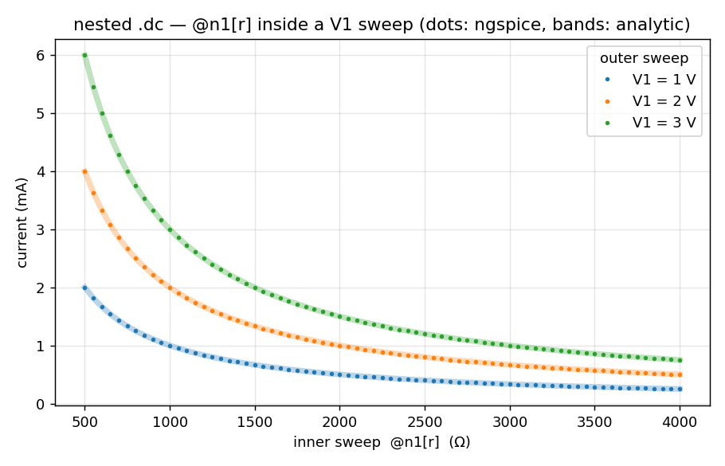
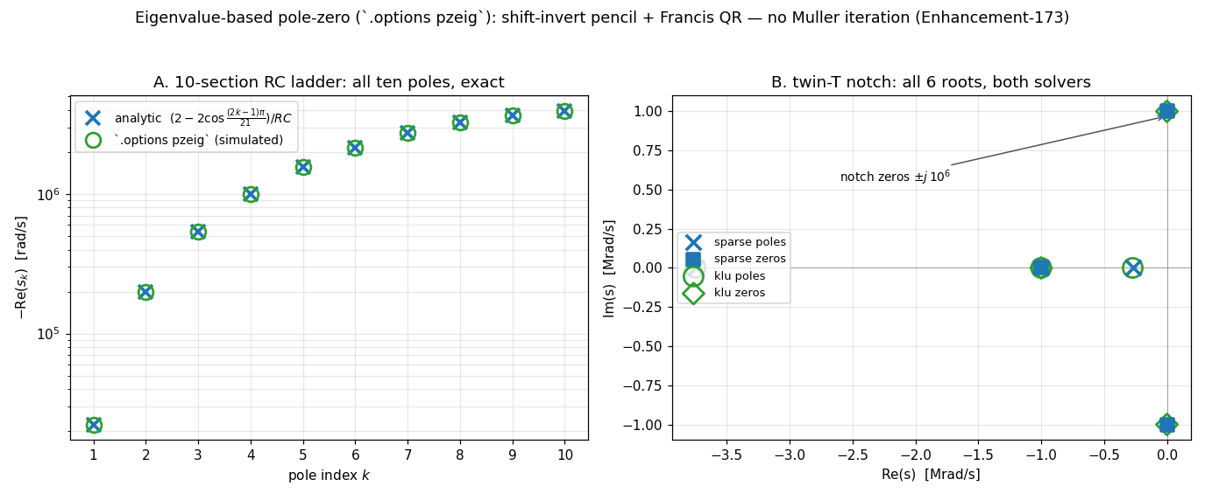
Standard analyses, extended
SIMULATOR · 84 ENHANCEMENTS
Device sweeps
.tf and .sens
.dc over @n1[r], model parameters @mm[g] and wildcards @*[p]; lin, dec, oct
Exact against analytic derivatives; the circuit is left as found
E-62
E-534
E-179
E-685
.pz
.disto
Exact for linear devices; eigenvalue pole-zero pzeig; KLU complex determinant
Verilog-A distortion via Taylor tensors; proven exact against harmonic balance
.dc over an OSDI instance parameter inside a source sweep (examples/analyses_examples)
E-173
E-171
E-352
E-255
stb
Measurements
Loop gain with phase and gain margins; .meas ac margins and batch vdb
.meas param and expr in control blocks; avg, integ and rms windows clipped
E-198
E-203
E-311
E-302
pzeig: all poles of a 10-section RC ladder, exact (examples/pzeig_examples)
Notes:
A .dc sweep over a device or model parameter refreshes the device per point as alter would and restores the value afterwards. Since E-534 every sweep knob kind takes lin, dec and oct scales. .sens leaves the circuit as it found it (E-440, E-685). .disto for Verilog-A devices differences Taylor tensors from the analytic Jacobian inside ngspice (E-359).

Slide 19
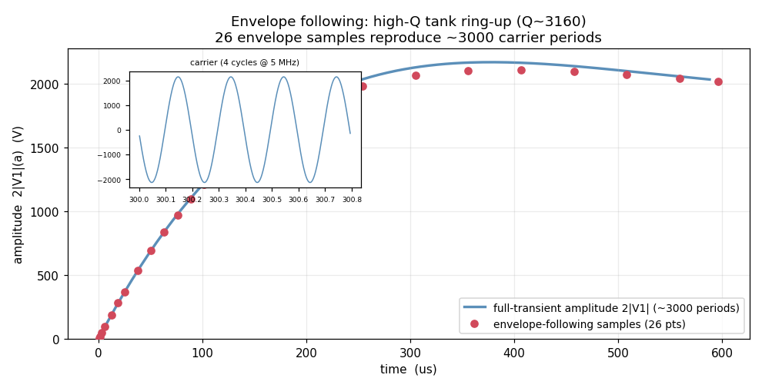
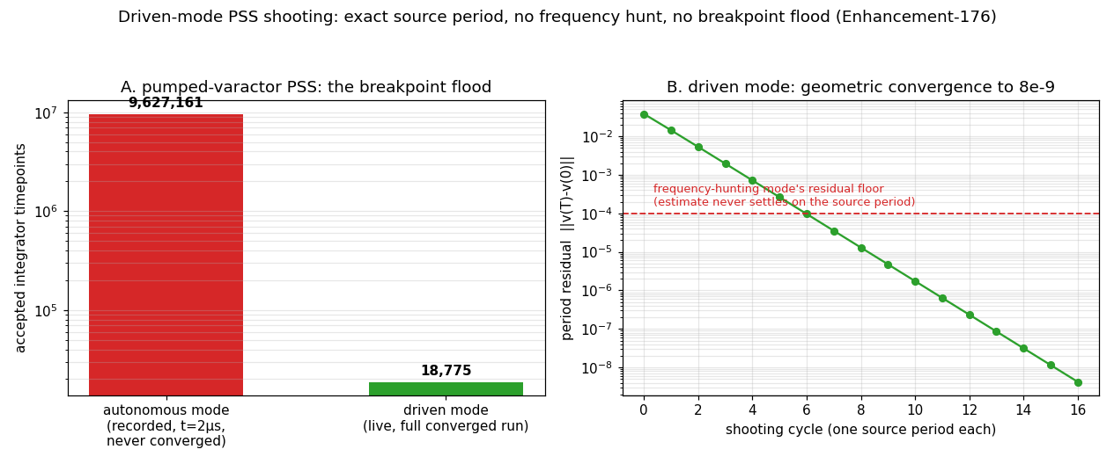
The RF periodic steady-state suite
SIMULATOR · 62 ENHANCEMENTS
PSS
PAC
Pnoise
PXF
PSP
shooting, driven mode
E-117
E-176
HB
QPSS
QPAC
QPnoise
QPXF
harmonic balance
Envelope following: 26 samples reproduce ~3000 carrier periods (examples/envelope_examples)
E-134
E-902
Oscillators
Envelope following
hbosc, phasenoise
E-140
E-154
Every analysis has a dot card and runs on built-in and OSDI devices.
Driven-mode PSS: geometric convergence (examples/pssdriven_examples)
Notes:
PSS by shooting (driven mode avoids the frequency hunt and is about 1000x cheaper on a pumped varactor, E-176) feeds PAC, Pnoise with cyclostationary folding, PXF and PSP. Harmonic balance (exact row-form Jacobian since E-902) feeds the two-tone QP set. Oscillators have hbosc and phase noise; envelope following jumps whole periods with an implicit monodromy. Each has a dot card: .pss .pac .pnoise .pxf .psp .hb .qpss .hbosc .phasenoise.

Slide 20
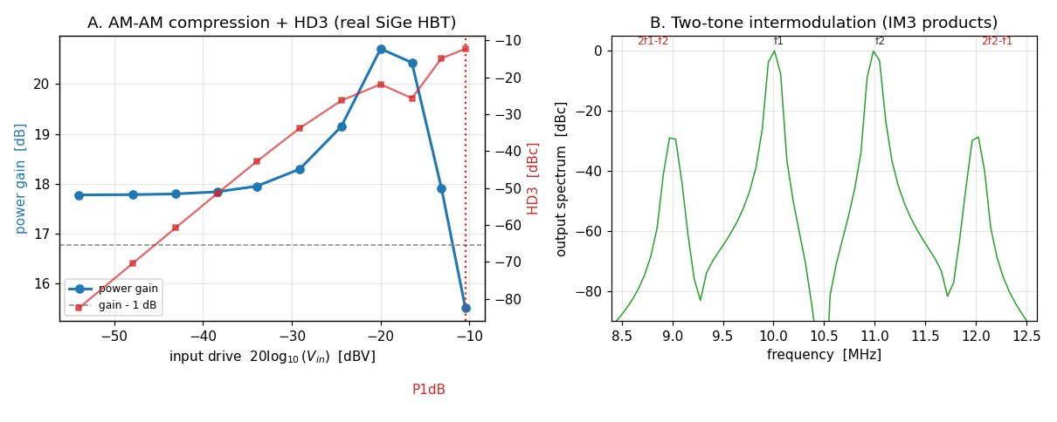
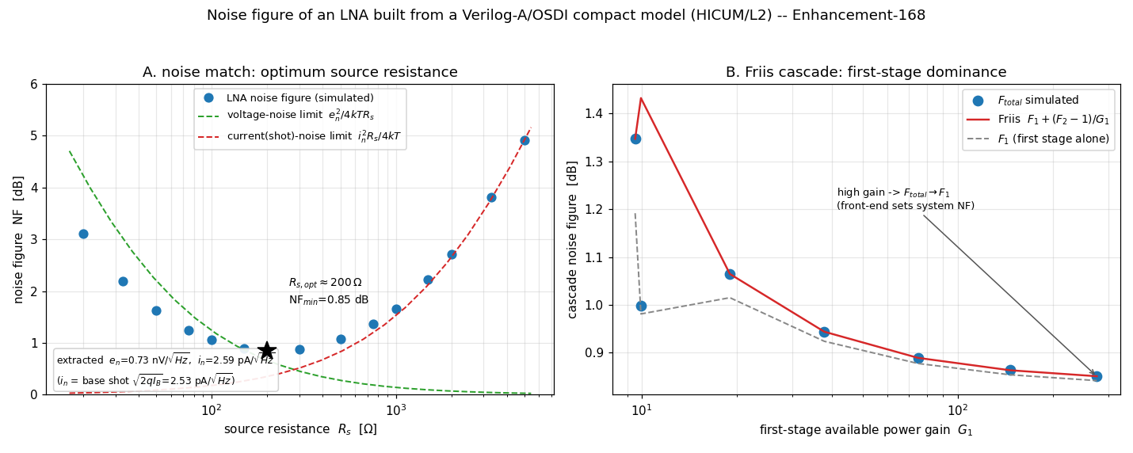
S-parameters, Touchstone and RF measures
SIMULATOR · RF
.sp
Touchstone I/O
Any port count; S, Y, Z vectors; NF and noise parameters; an O(N³) inverse
wrsnp writes ri, ma or db as S, Y or Z; rdsnp reads, noise rows too
E-63
E-202
E-72
E-749
AM-AM compression and two-tone IM3 of a SiGe HBT (examples/rfpa_examples)
pre_snp
Stability & load-pull
Touchstone to a vector-fitted model: an OSDI device or a native N-port
rfstab: K, Δ, μ, MSG and MAG; loadpull contours on a Smith chart
E-200
E-242
E-253
E-234
Large-signal RF
Smith views
P1dB and IP3; LNA noise figure with noise match and the Friis cascade
pyplot -smith draws S-parameters on a Smith chart
LNA noise figure: noise match and Friis cascade (examples/noisefigure_examples)
E-164
E-168
E-254
Notes:
Ports for .sp are voltage sources tagged with portnum and z0. wrsnp writes Touchstone v1 for any port count. pre_snp vector-fits a Touchstone file into a model, either compiled through openvaf-r or stamped directly by a native N-port device (E-242) that removes the compile step at high port counts.

Slide 21
Signal integrity: PRBS, PAM4 and eyes
SIMULATOR · SERDES
A PRBS7, a PRBS13Q and an eye
Vtx tx 0 PRBS(0 1 1n 0 50p 50p 7)
Vp4 tq 0 PAM4(-0.6 0.6 100p 0 10p 10p 13)
.control
tran 5p 2u
eye v(rx) -ui 1n -tstart 3n
.endc
PRBS and PAM4
eye and pyplot -eye
Orders 7, 9, 11, 15, 23 and 31 on V and I sources; PAM4 Gray coded, PRBS13Q and PRBS31Q; every transition a breakpoint; the stream a pure function of time
eye measures eye height, eye width and RMS jitter of any waveform; pyplot -eye draws persistence-shaded eyes
A 2 Gb/s PRBS through an RC channel: eye height 565 mV, eye width 461 ps, RMS jitter 15.9 ps (examples/eye_examples)
E-752
E-207
E-208
Notes:
PRBS(v1 v2 tbit [td [tr [tf [order [seed]]]]]) on voltage and current sources is a Fibonacci shift register with the standard maximal-length taps; orders 7, 9, 11, 15, 23 and 31 are what pattern generators send. PAM4 reads two bits per symbol, Gray coded, which at orders 13 and 31 is IEEE 802.3's PRBS13Q and PRBS31Q (E-752). eye measures height, width and RMS jitter (E-207).

Slide 22
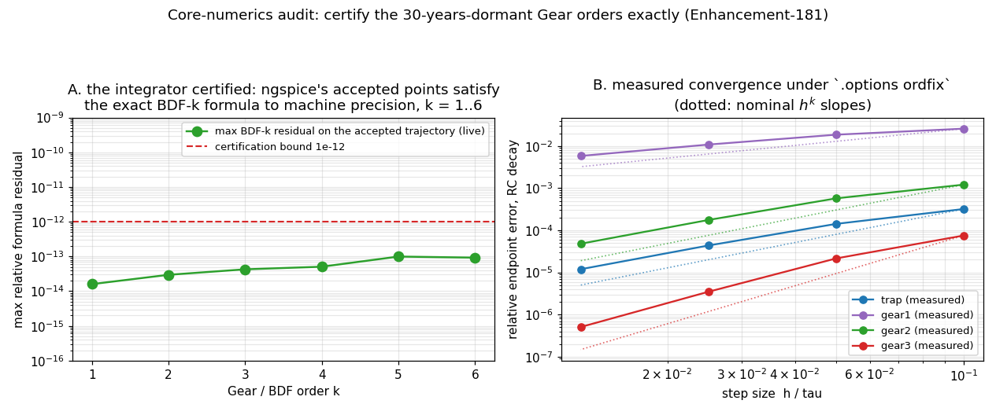
Convergence and integration
SIMULATOR · 43 ENHANCEMENTS
Newton
gmin stepping
source stepping
line search
pseudo-transient
.option convhelp climbs the whole ladder itself and reports which aid found the operating point
Accuracy presets
Five integrators
.option errpreset sets the tolerances together: conservative, moderate, liberal
trap and gear 1–6, plus trbdf2, sdirk and adams; ordfix pins the order
E-110
E-419
E-181
Order control
Guards
The integrator certified: accepted points satisfy the exact BDF formula to machine precision, and ordfix converges at h^k (examples/corenum_examples)
.option dynorder picks the Gear order from the local truncation error
False convergence on singular B-sources caught; device convergence tests honoured
E-128
E-256
E-889
Notes:
ngspice's operating point already escalates through gmin and source stepping. .option convhelp adds the globalized Newton line search (E-111) and pseudo-transient continuation (E-127) to the ladder, reaches for them without being asked, and reports which aid produced the point (E-204). Five integration methods were measured against each other in E-419, and the results that overturned expectations are recorded there.

Slide 23
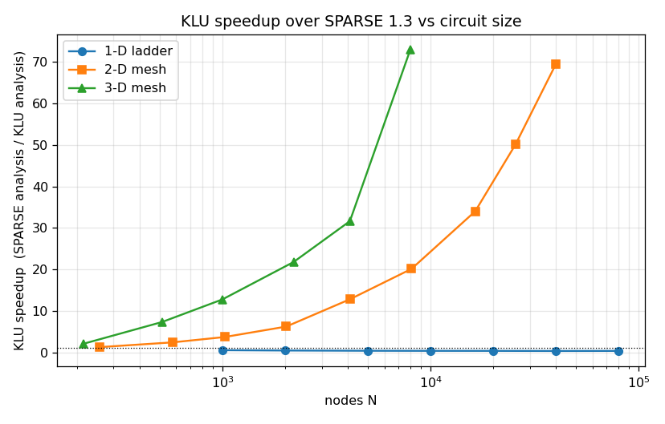
KLU, at parity with Sparse
SIMULATOR · 16 ENHANCEMENTS
Every analysis
Periodic & restart
KLU runs noise, pole-zero, sensitivity and distortion as Sparse does
PSS under KLU; a checkpoint resumes under the other solver
E-113
E-114
E-115
E-118
E-180
Tuning
Accuracy
Ordering, scaling and BTF controls for KLU
Iterative refinement of real solves; the residual measured per row
KLU speedup over Sparse 1.3 against circuit size (examples/solver_stress)
E-152
E-867
E-868
Hardening
Differential campaign
≈70x
37/37
Solver glue: null checks, collapse maps and bounds fixed
37 of 37 against a numpy third opinion and each deck's condition
faster than Sparse on large meshes
differential checks, no solver defect
E-232
E-233
Notes:
Sparse 1.3 stays the default; .option klu selects KLU, which now runs every analysis. The Sparse-versus-KLU differential campaign (examples/solverdiff_examples) uses numpy as a third opinion and asserts against eps times each deck's condition number: 37 of 37, no solver defect. KLU's advantage grows with circuit size.

Slide 24
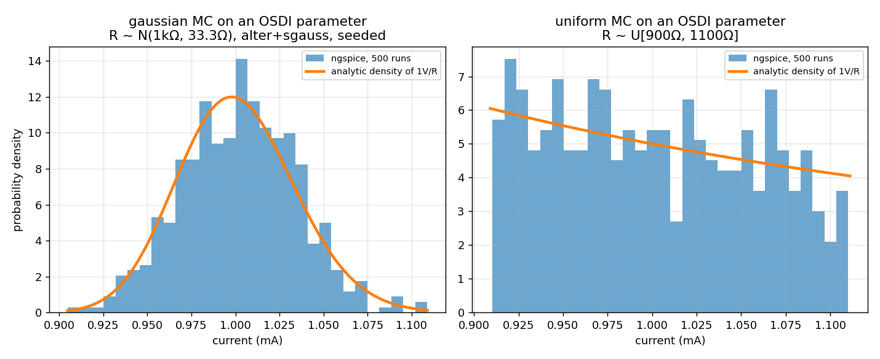
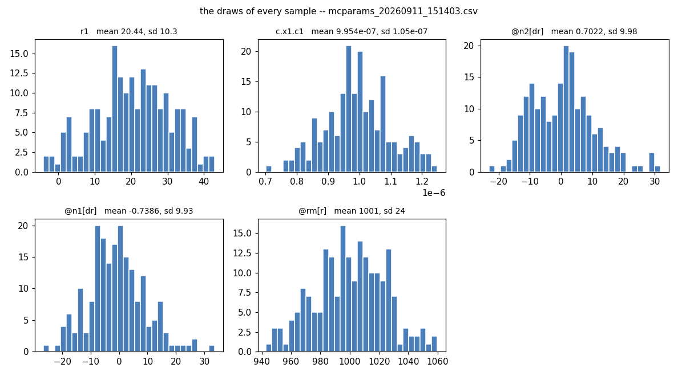
Statistics, variability and yield
SIMULATOR · 63 ENHANCEMENTS
Monte Carlo on OSDI
Latin hypercube
reset loops re-draw .param values into OSDI cards; warm-started trials
mcsample lhs: about 130x lower estimator variance at the same N
E-66
E-188
E-149
High sigma
Correlations & yield
Gaussian and uniform Monte Carlo on an OSDI parameter against the analytic density, 500 runs each (examples/montecarlo_examples)
highsigma reaches 4–6σ in a few thousand runs; wcd finds the worst case
mccorr and mvnorm correlations; montecarlo -expr -track packages yield
E-150
E-305
E-151
Design centring
Records
optimize -center maximizes yield or Cpk against -spec limits
.option savemc and writemc keep every draw and every result
E-206
E-742
Draws recorded by .option savemc (examples/savemc_examples)
Notes:
Monte Carlo reaches OSDI parameters through both ngspice idioms. Latin-hypercube sampling measured about 130x lower estimator variance at the same N (E-149). highsigma scales the sigmas for importance sampling, reaching 4 to 6 sigma from a few thousand runs (E-150); wcd finds the worst-case distance and most probable failure point (E-305). docs/internals/ngspice_internals/ngspice_statistics.md is the complete guide.

Slide 25
Statistics declared in the model
SIMULATOR · FROM VERILOG-A ATTRIBUTES
rstat.va
No reset loop
`include "disciplines.vams"
module rstat(p, n);
inout p, n; electrical p, n;
(* std_rel=0.05 *) parameter real r = 1k;
(* dist="uniform", std=2e-4 *) parameter real tc = 1e-3;
(* corner="ss=+10%, ff=-10%" *) parameter real k = 1.0;
analog I(p, n) <+ V(p, n) /
(k * r * (1 + tc * ($temperature - 300.15)));
endmodule
std, std_rel and dist travel in an OSDI side table; osdimc makes each run a trial
E-530
Corners in the source
A value, a % of nominal or ±kσ per corner; .option corner selects one
The deck side
E-654
.option osdimc mcseed=7 ; each run a fresh trial
op → i = 1.000 mA ; first run: nominal
op → i = 0.945 mA ; a trial
.option corner=ss ; k = 1.1
op → i = 0.909 mA
All corners at once
.option autocorner runs nominal and every declared corner, side by side
E-656
Notes:
Attributes on Verilog-A parameters carry the statistics in an OSDI side table. With .option osdimc (alias automc) every run-class command is a fresh trial: no reset, no netlist re-expansion, no agauss in the deck; the first run after sourcing is the nominal baseline. The corner attribute gives each parameter's value per corner. Both decks were run with the committed binaries: 1.000 mA then 0.945 mA under osdimc, 0.909 mA at corner ss.

Slide 26
Optimization and sweeps
SIMULATOR · 49 ENHANCEMENTS
-method | Kind | Reach for it when
nm | simplex | the default for a scalar -minimize
lm | least squares | the default for -target fits, up to 100 knobs
tr | trust region | smooth objectives: 2–7x fewer evaluations
pso de sa | global | the whole knob box has to be searched
cmaes | adaptive global | knobs over decades or correlated
bayes | GP surrogate | slow decks: the basin in 10–20 runs
nsga2 | multi-objective | a Pareto front of several objectives
Knobs & constraints
-param, -mparam, -dparam; -constrain; -polish and -starts
E-766
E-764
sweep
One sweep command and .sweep card for every knob kind; -overlay, -vs
E-146
E-190
Fast paths
Sweeps in linear time, 87x at 64k points; .param changed in place
Scripts read the outcome: optimize_status, optimize_converged, optimize_cost, optimize_evals
E-345
E-320
Notes:
optimize varies knobs, re-runs analyses and drives an objective to a minimum. Knobs are -param (alter), -mparam (altermod) and -dparam (.param; the optimum is written into the deck, E-767). -constrain adds bounds held by an augmented Lagrangian (E-766); -polish finishes a global method locally and -starts adds Latin-hypercube restarts (E-764). The outcome is published as optimize_status, optimize_converged, optimize_cost and optimize_evals (E-762).

Slide 27
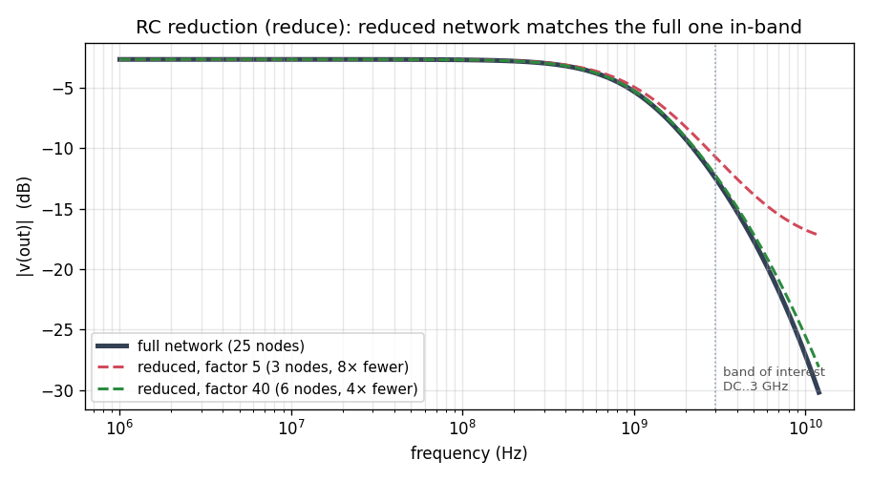
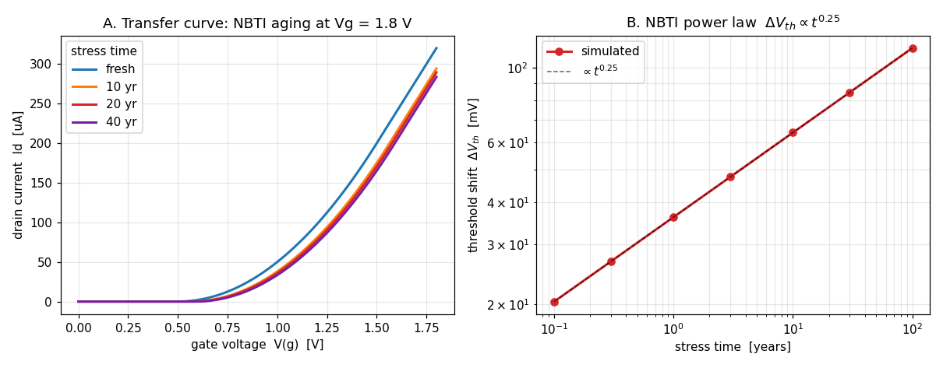
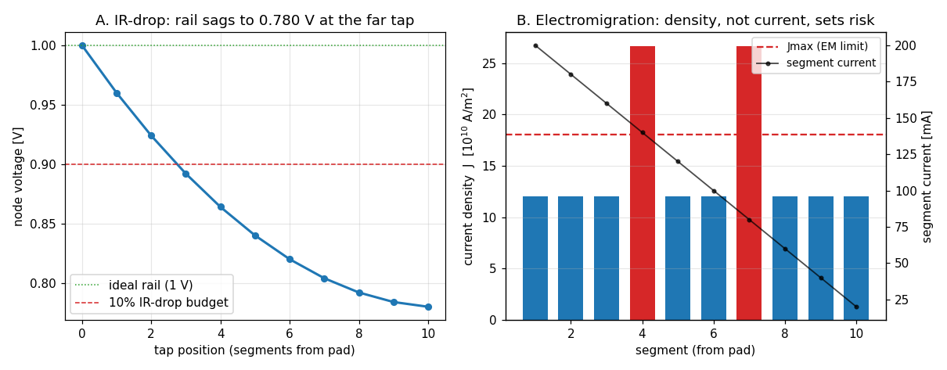
Post-layout parasitics and reliability
SIMULATOR · 5 ENHANCEMENTS
reduce · TICER
aging
emir
E-155
E-156
E-157
E-158
Extracted RC networks reduced to small equivalents; the sparse version scales to millions of nodes
Stress, degrade, re-simulate: HCI, NBTI and TDDB aging to a target lifetime
Power-grid IR drop and electromigration sign-off on the rail's segments
NBTI shifts the transfer curve over 40 years; ΔVth ∝ t^0.25
The rail sags to 0.780 V at the far tap; current density sets EM risk
A 25-node network and its 3- and 6-node reductions agree in band
reduce <fmax> [factor <f>]
[keep <node> ...]
aging <t_target> [rate <opvar>]
[dynamic <tstop>]
emir [rail <V>] [jmax <A/m2>]
[top <k>]
Notes:
reduce is TICER model-order reduction for extracted RC networks; its sparse version scales to millions of nodes (E-155, E-156). aging runs the industry flow stress, degrade, re-simulate for HCI, NBTI and TDDB (E-157). emir reports power-grid IR drop and electromigration risk (E-158).

Slide 28
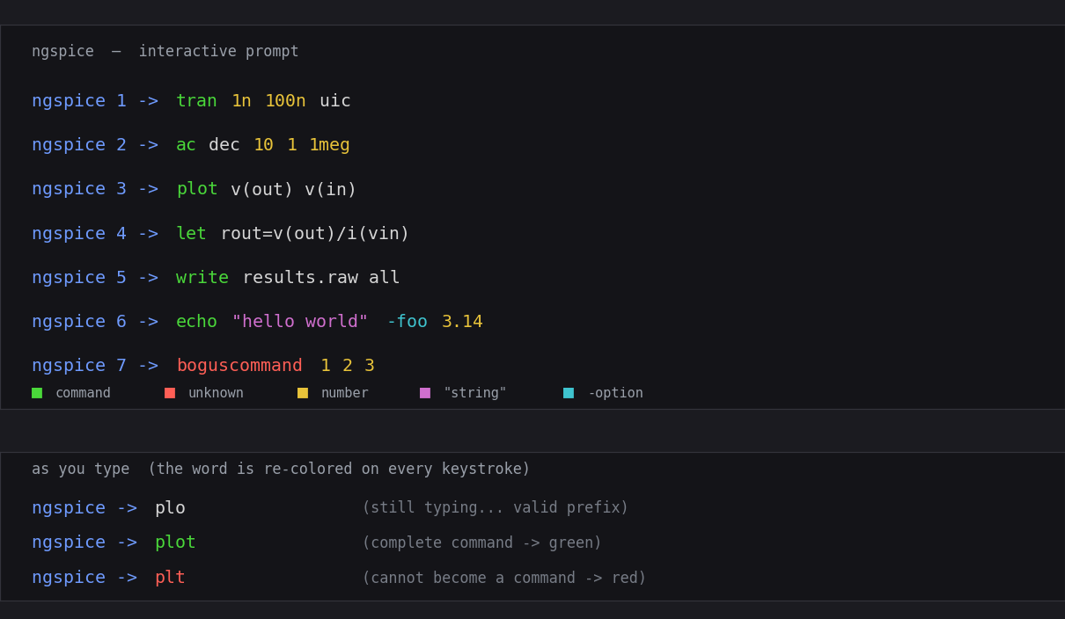
Workflow and usability
SIMULATOR · 91 ENHANCEMENTS
Checkpoint & restart
pyplot
savestate and loadstate resume a transient in a new process; autosave on Ctrl-C
matplotlib from the prompt: subplots, bode, smith, eye, hist, contour, fft
E-131
E-192
E-94
E-298
Control language
Large decks
Raw strings, f-strings; help all and a full help optimize
.option saveused keeps only what is read; autobus, autoadapt wire buses
Syntax highlighting at the ngspice prompt, re-colored on every keystroke (E-169, E-170)
E-553
E-753
E-469
E-444
A checkpoint and an f-string
Output
XSPICE
run
savestate run.ckpt
* later, in a fresh process:
loadstate run.ckpt
echo f"fc {mean(fc):.4g} Hz"
wrdata CSV, clean rawfile round trips, a sweep progress bar
Code models bundled per platform: gain, summer, oscillators, ADC/DAC bridges
E-231
E-129
E-223
Notes:
savestate and loadstate serialize a transient's integration state and resume it in a fresh process (E-131); set autosave saves on Ctrl-C (E-192). pyplot sends any vector to matplotlib. Raw strings and f-strings work in control scripts (E-553). help all lists every command (E-753). .option saveused, autobus and autoadapt keep large decks small and wired. XSPICE code models are bundled with every prebuilt binary.

Slide 29
How it is verified
596/596
verify suites passing in the regression sweep at E-908
Part 3 · Every claim has a script that computes its own expected number, on both linear solvers, on five platforms.
Notes:
Every feature claimed in the handbook is guarded by a verify script that compiles the Verilog-A model with the committed compiler, runs it through the committed ngspice, and checks the numbers against closed-form or independent expectations.

Slide 30
From a change to a release
THE VERIFICATION PIPELINE
1
2
3
4
5
6
Fold
Verify
Both solvers
Full sweep
CI
Release
the change, its write-up and the change logs, together
a verify_*.py checks closed-form or independent references
each suite runs under Sparse 1.3 and under KLU
596 suites, eight at a time, all passing
five platforms build and test, and the binaries are committed
a tagged GitHub release with the write-up as its notes
“A pass means the number is right, not that a run finished.”
Notes:
Each enhancement follows the same path. The suite answers 'did anything change?' on every fold; the campaigns on the following slides answer 'is it correct?'. A pass means the number is right, not that a run finished.

Slide 31
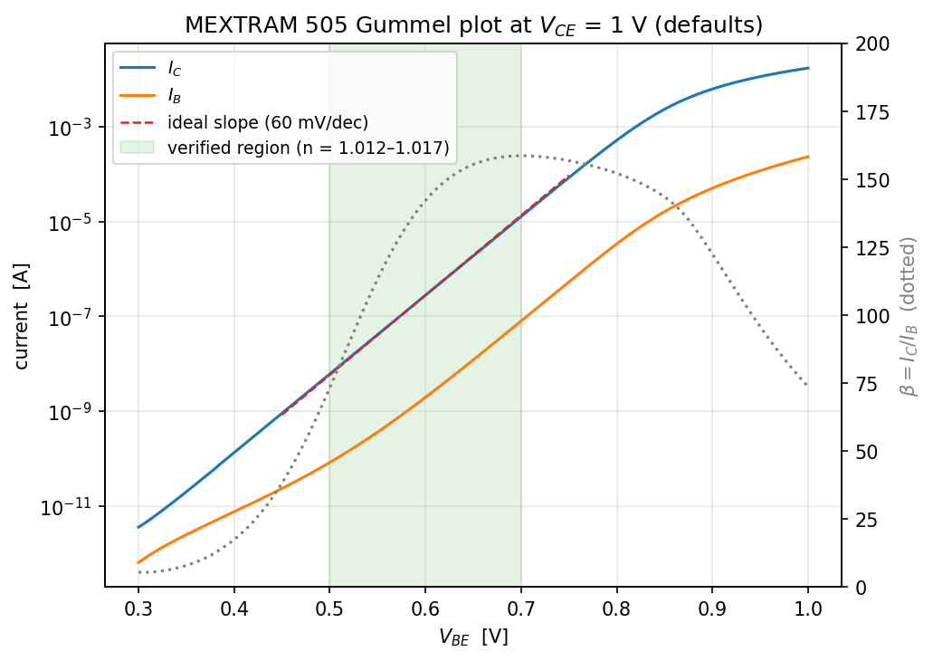
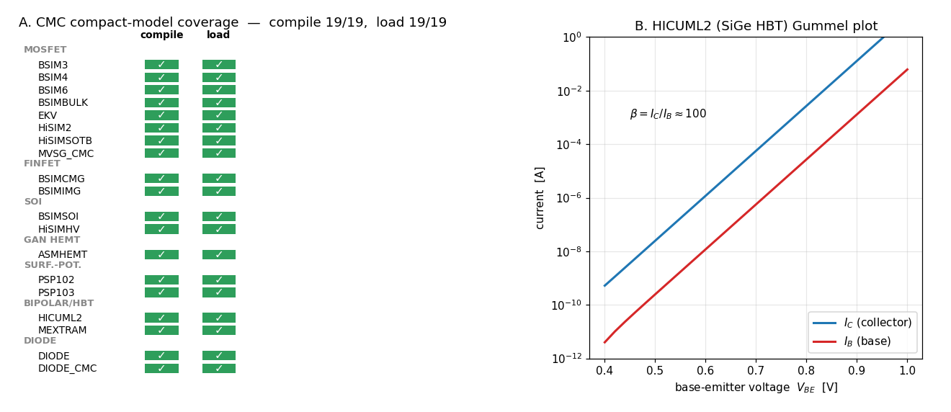
Physics validation
SIMULATOR · 11 ENHANCEMENTS
Junction law
Noise identity
60 mV/decade slopes recovered through the full pipeline
Thermal noise matches 4kT/R
E-57
E-57
Jacobians
Dynamic charge
AC against numeric derivatives on PSP103 to ~1e-5
Cgg from AC equals Cgg from the transient
MEXTRAM 505 Gummel plot: the ideal 60 mV/decade slope (examples/physcheck_examples)
E-57
E-75
Temperature
CMC suite
A band gap of ≈1.25 eV extracted from a compiled MEXTRAM
19 of 19 models compile and load; C-V and fT against built-in twins
E-80
E-160
E-161
CMC coverage: 19 of 19 compile and load (examples/cmcsweep_examples)
Notes:
examples/physcheck_examples checks industry models against analytic device laws through the whole toolchain; dynphys and tempphys extend it to charge and temperature. The CMC sweep compiles and loads 19 of 19 compact models and compares C-V and fT against ngspice's built-in twins.

Slide 32
Campaigns beyond the suite
INDEPENDENT REFERENCES
Campaign | Instrument | Result
OSDI correctness | 83 oracle checks: analyses, sweeps, optimizers, Monte Carlo, RF | 83 / 83
Sparse vs KLU | numpy as a third opinion; assert within eps · cond | 37 / 37
Compiler robustness | production corpus, ~50 adversarial inputs, 4,000 mutants | 4 crash paths fixed
LRM 2023 examples | every code example in the standard, compiled | a compliance suite
Correctness hunts | 49 pages: OSDI, solvers, transient, nonlinear, analyses | each fix an enhancement
OSDI devices come out bit-identical to ngspice's built-in R, C, L and G through op, ac, tran, tf, pz and sens.
Notes:
The OSDI and solver campaigns sit outside run_regression.py on purpose (run_campaign.py, run_solverdiff.py). The bug-hunt pages in docs/bug_hunts record each campaign's harnesses, findings and the enhancement that fixed each finding; the most recent, the analyses correctness campaign of October 2026, produced E-895 to E-908.

Slide 33
Milestones by enhancement number
TIMELINE
E-1
E-110
E-154
E-364
E-654
E-765
absdelay, the first operator
accuracy presets, line search
envelope following completes the RF suite
transient noise for OSDI devices
corners in the source
Bayesian optimization
E-62
E-134
E-200
E-530
E-752
E-908
.dc @inst sweeps
harmonic balance
pre_snp: Touchstone to OSDI
statistics in Verilog-A
PRBS and PAM4 sources
TXL and CPL lossy lines
compiler
simulator
Notes:
A selection of milestones in the order the work happened; the enhancement number is the axis. The full one-line index is docs/handbook/05-enhancement-index.md, and the catalog groups every enhancement by area.

Slide 34
Five platforms, prebuilt
BUILDS
Platform | Directory | Notes
Linux x86-64 | bin/linux/intel/ | X11 and readline
Linux ARM64 | bin/linux/arm/ | X11 and readline
macOS Apple Silicon | bin/macos/apple-silicon/ | XQuartz, Homebrew readline
macOS Intel | bin/macos/intel/ | XQuartz, Homebrew readline
Windows x86-64 | bin/windows/intel/ | DLLs bundled; MSVC link.exe to compile Verilog-A
From source
openvaf-r: Rust and exactly LLVM 18. ngspice-46: configure and make, handbook section 1.3.
XSPICE
Code models under codemodels/ with a portable spinit; set SPICE_LIB_DIR to load them.
E-223
Windows linking
In every platform directory
Every model links with MSVC on COFF since the weak-symbol fix.
ngspice openvaf-r codemodels/*.cm scripts/spinit
E-769
Notes:
CI builds both tools for five platforms and commits them under bin/. Each platform directory also ships XSPICE code models under codemodels/ with a portable scripts/spinit; export SPICE_LIB_DIR to load them. Building from source needs a Rust toolchain and exactly LLVM 18 for openvaf-r.

Slide 35
Using it
609
example folders, each a working reference for a feature
Part 4 · Getting started in four steps, the scope and known limits, and the documentation.
Notes:
How to start, what is out of scope, and where the documentation lives.

Slide 36
Getting started in four steps
QUICK START
1
Get the binaries
2
Compile a model
3
Load it in a deck
4
Run and explore
bin/<os>/<arch>/
ngspice
openvaf-r
codemodels/
openvaf-r myres.va \
-o myres.osdi
n1 in mid ra
.model ra myres(r=1k)
.control
pre_osdi myres.osdi
.endc
ngspice -b divider.cir
python3 examples/
dowhile_examples/
verify_dowhile.py
Prebuilt for five platforms, or build from source
-I adds include paths and -D defines a macro
N devices; the card names the module
Each verify script checks exact numbers
myres.va, the model the steps use
What the run prints
`include "disciplines.vams"
module myres(p, n);
inout p, n; electrical p, n;
parameter real r = 1k from (0:inf);
analog I(p, n) <+ V(p, n) / r;
endmodule
$ ngspice -b divider.cir
v(mid) = 1.000000e+00
Notes:
From a fresh clone: take the prebuilt binaries for your platform, compile a Verilog-A model, load it in a deck with pre_osdi, and run. Every example folder's verify script is a complete, tested reference; examples/analyses_examples is a tutorial with one commented deck per analysis.

Slide 37
Scope and known limits
WHAT IT DOES NOT DO
Out of scope by design
Design decisions
Open findings, stock devices
Digital and mixed-signal Verilog-AMS: the Annex C boundary
SPICE primitives instantiated from Verilog-A: put them in the netlist
Vector branches over whole buses: declare per-bit branches
`default_discipline and out-of-module discipline declarations
Structure binds at compile time: a generate bound cannot read a parameter
An untyped parameter takes its default's type
limexp is stateless, a documented decision
$simprobe returns its default; node aliases return 0
.disto gives zeros for devices without a distortion routine
The built-in BJT's .disto with rb or tr
TXL has no AC model; CPL loses its resistance below its RC corner
LTRA can stop with 'timestep too small' on a long lossy line
Notes:
From docs/handbook/04-limitations-and-gotchas.md and the open findings of the analyses correctness campaign (docs/bug_hunts/2026-10-16_...). The open findings are in stock ngspice devices, not in the OSDI path: .disto treats a device without a distortion routine as linear, the built-in BJT's .disto is wrong with rb or tr, TXL has no AC model, and CPL loses its resistance below its RC corner (both lines now say so, E-908).

Slide 38
Where to read more
DOCUMENTATION
Feature catalog
User handbook
LRM compliance
Change reports
docs/index.html
docs/handbook/
docs/compliance/
docs/change_log/
every enhancement in 19 areas, searchable
start, language matrix, workflows, limits; PDF too
clause by clause, with verified code examples
every change to either tool, by subsystem
Compiler internals
Simulator internals
Topic guides
Hunts & proposals
docs/internals/
openvaf_internals/
docs/internals/
ngspice_internals/
docs/internals/
ngspice_internals/
docs/bug_hunts/
docs/proposals/
lexing to OSDI, robustness, compile time
parser to Newton loop; the gap analysis
statistics, transient noise, temperature
49 campaign pages, 7 proposals
Notes:
Every tile links to the document on GitHub. The handbook is also one linked PDF with the complete text of every enhancement write-up: docs/Ngspice-OpenVAF-Handbook.pdf.

Slide 39
One toolchain, verified end to end
openvaf-r
compiles the Verilog-A language: values and derivatives
ngspice-46
runs those models through every analysis, RF and statistics included
github.com/javaNoviceProgrammer/
Ngspice_OpenVAF_Enhancements
596 suites
and five CI platforms check every change; each change has a write-up
Notes:
openvaf-r compiles the Verilog-A language with correct values and derivatives; ngspice-46 runs those models through every analysis, the RF suite, statistics and optimization included; 596 verify suites and five CI platforms check every change, and every change has a write-up.

