Slide 1

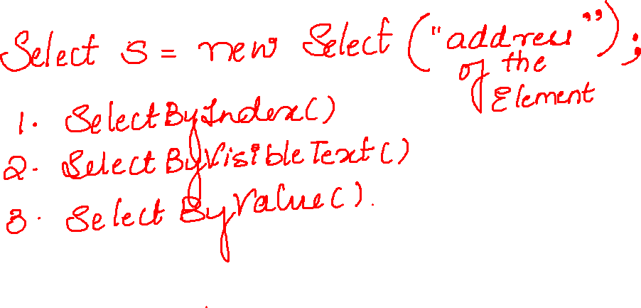

Slide 2
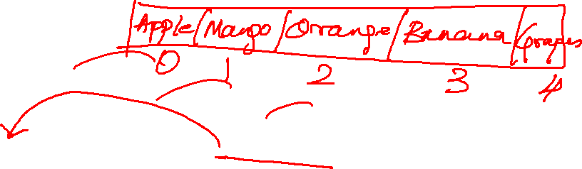
List<WebElement> allOption = s.getOptions();
System.out.println(allOption.size());
for(WebElement option:allOption) {
System.out.println(option.getText());
}

Slide 3
