Slide 1
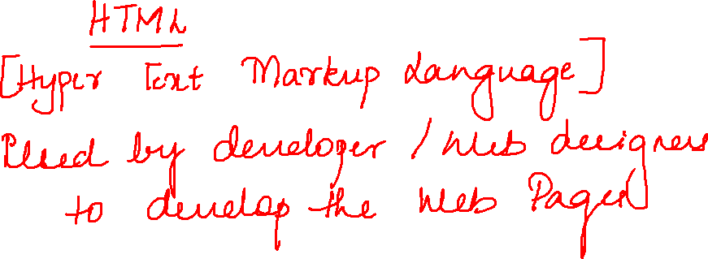

Slide 2
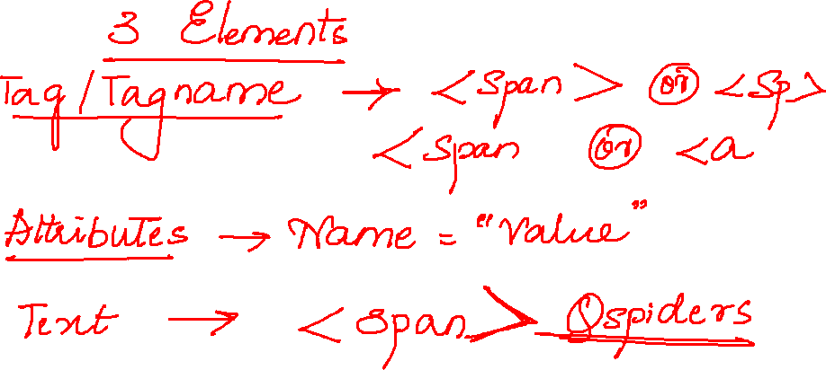

Slide 3

<input type="text" name="username" value="" id="username" class="textField" placeholder="Username">

Slide 4
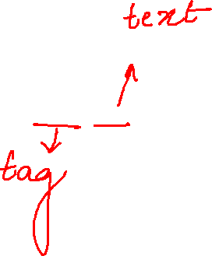
<div>Login </div>

Slide 5

<td id="headerContainer" class="header">Please identify yourself</td>

Slide 6
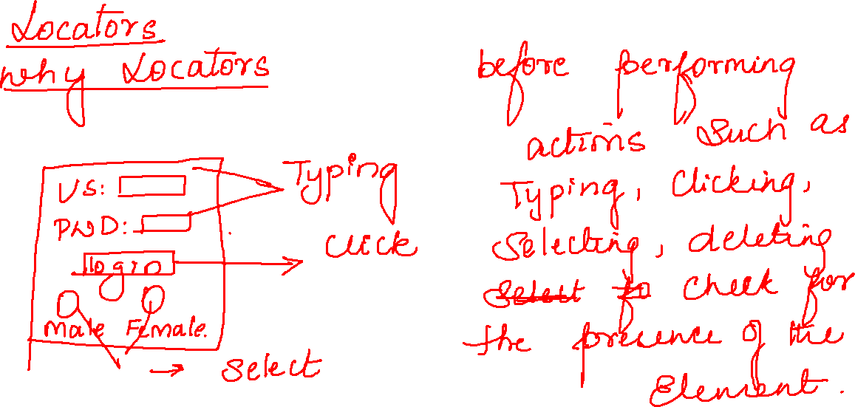

Slide 7


