Slide 1
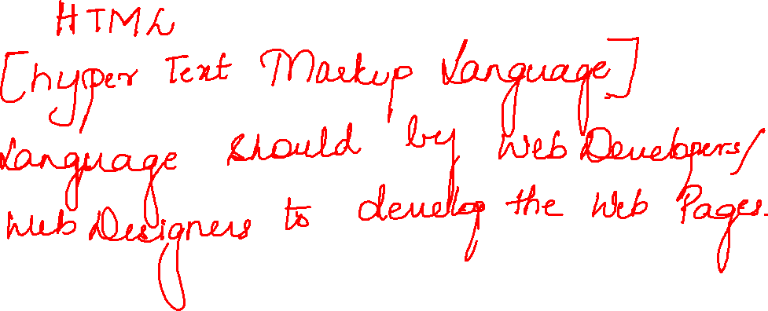

Slide 2
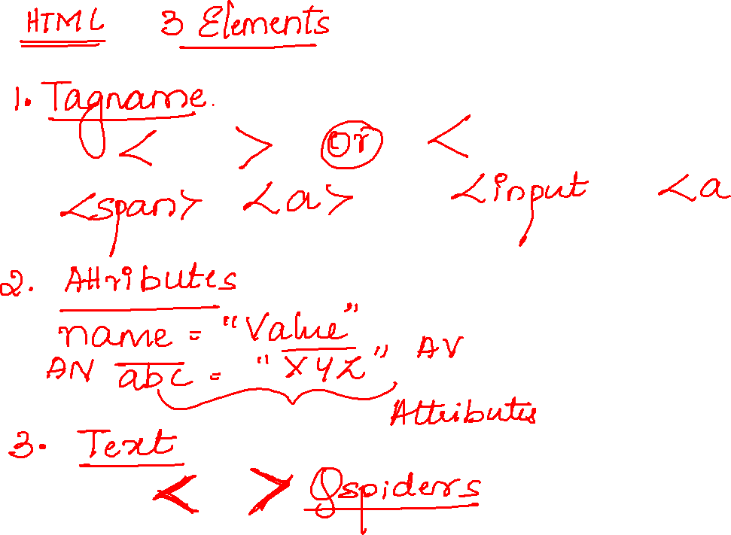

Slide 3
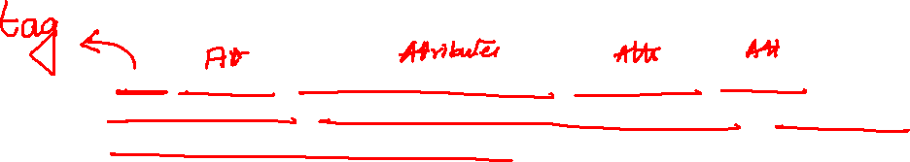
<input type="text" class="inputtext _55r1 _6luy" name="email" id="email" data-testid="royal_email" placeholder="Email address or phone number" autofocus="1" aria-label="Email address or phone number">

Slide 4
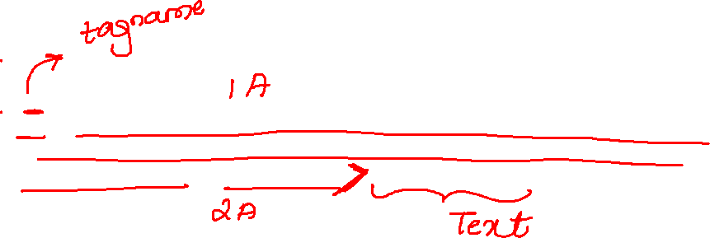
<a href="https://www.facebook.com/recover/initiate/?privacy_mutation_token=eyJ0eXBlIjowLCJjcmVhdGlvbl90aW1lIjoxNjM4Nzg3NjYyLCJjYWxsc2l0ZV9pZCI6MzgxMjI5MDc5NTc1OTQ2fQ%3D%3D&amp;ars=facebook_login">Forgotten password?</a>

Slide 5
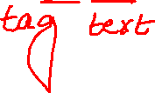
<div>Login </div>

Slide 6
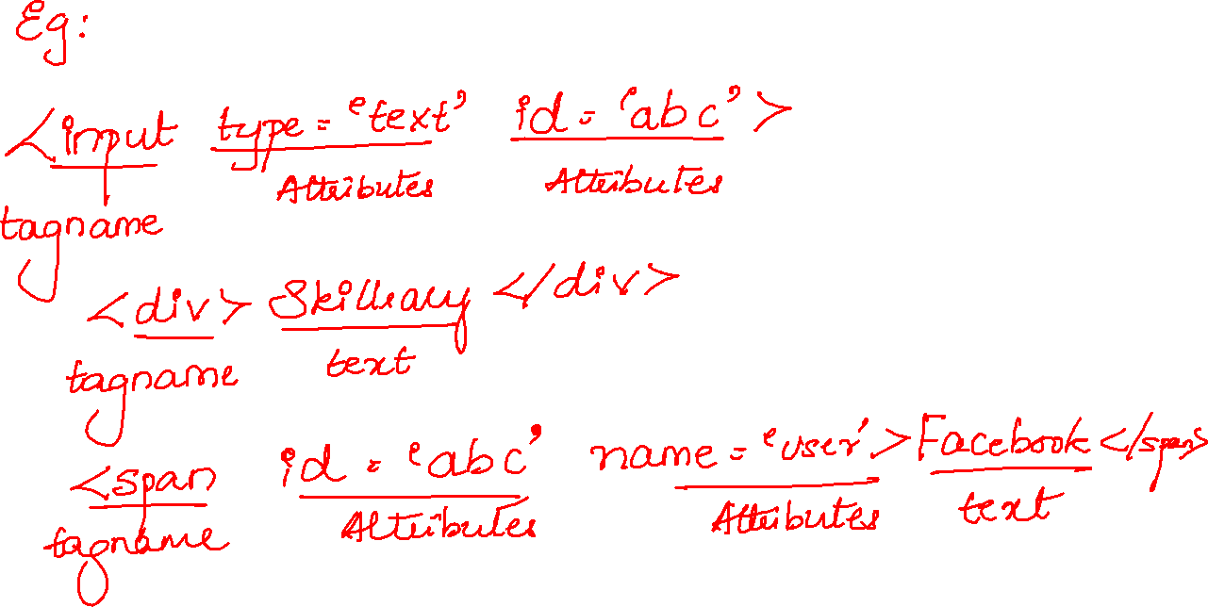

Slide 7
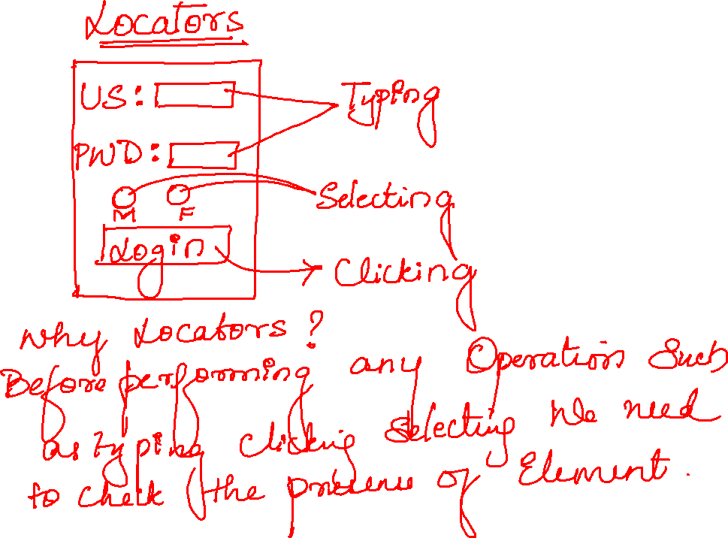

Slide 8
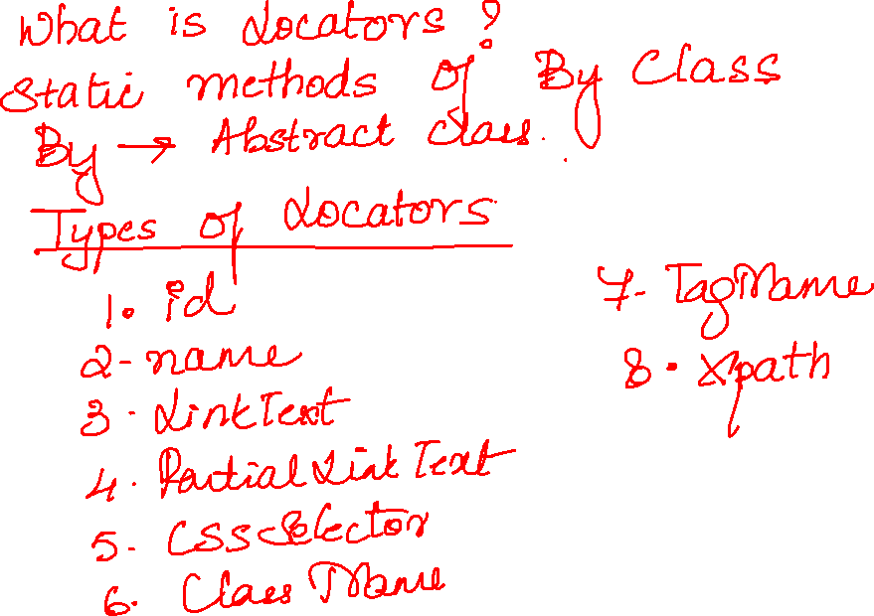


Slide 9
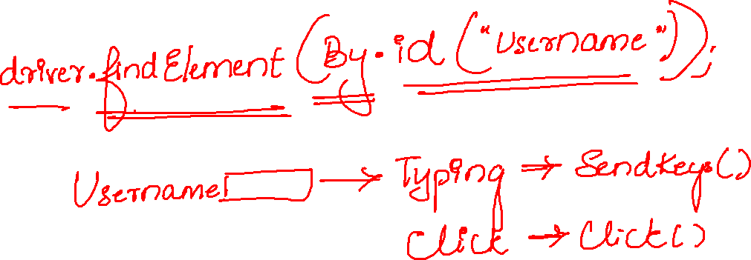

Slide 11
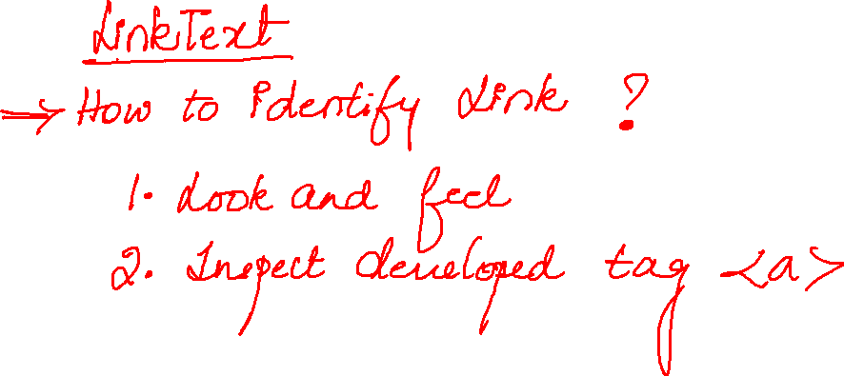
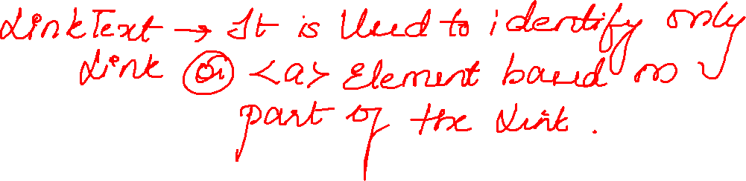


Slide 12
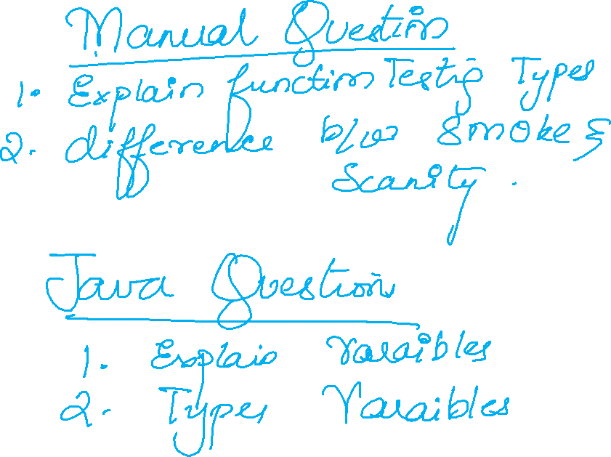

Slide 13
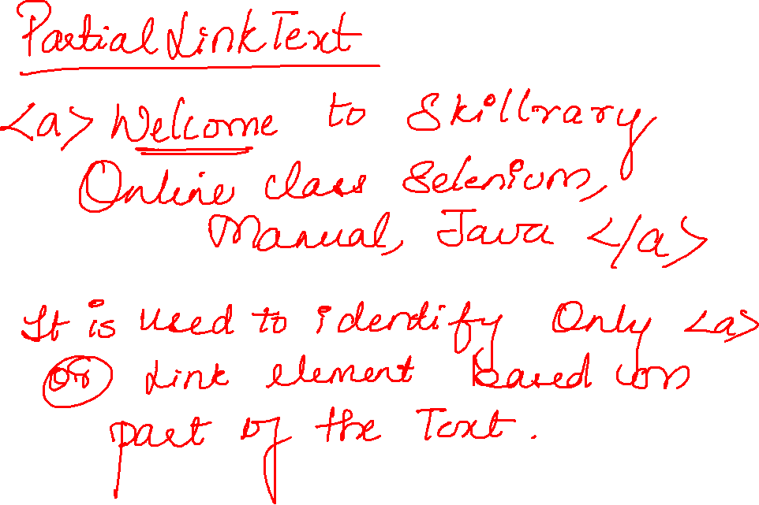

Slide 14
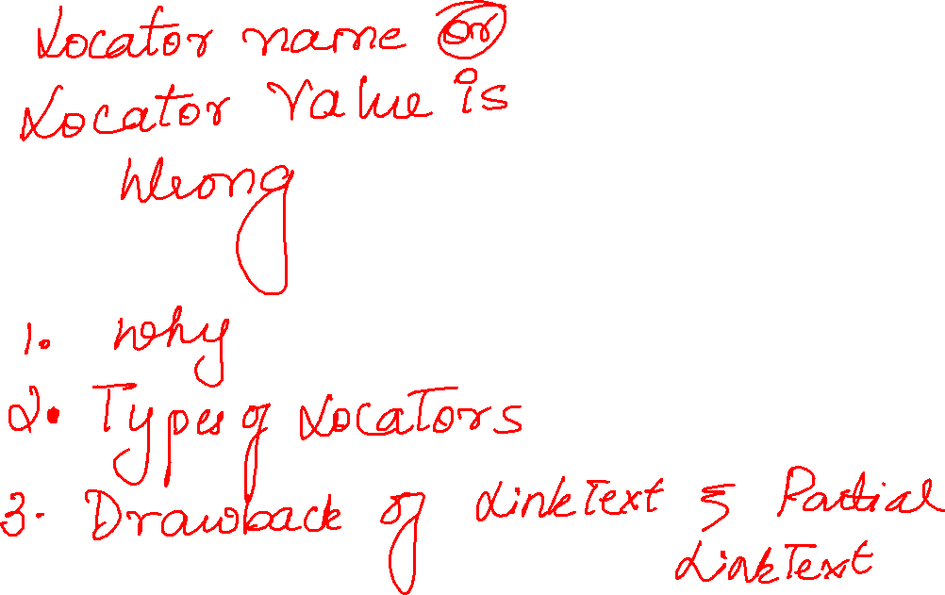

Slide 15
