Slide 1
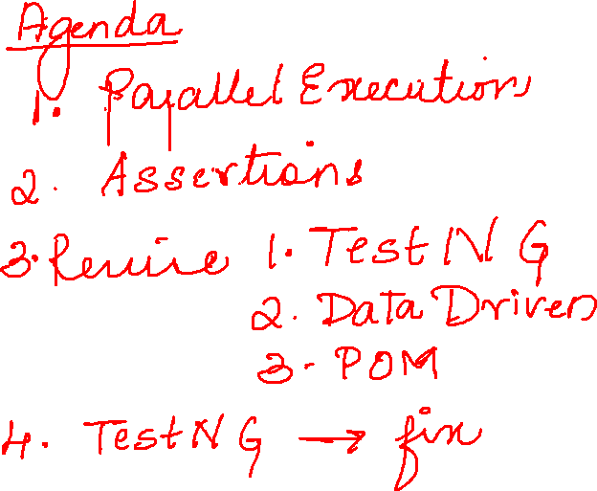

Slide 2
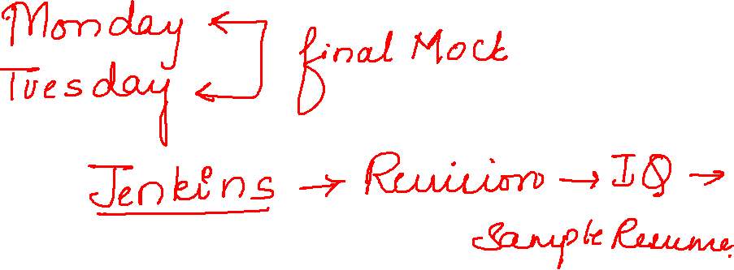

Slide 3
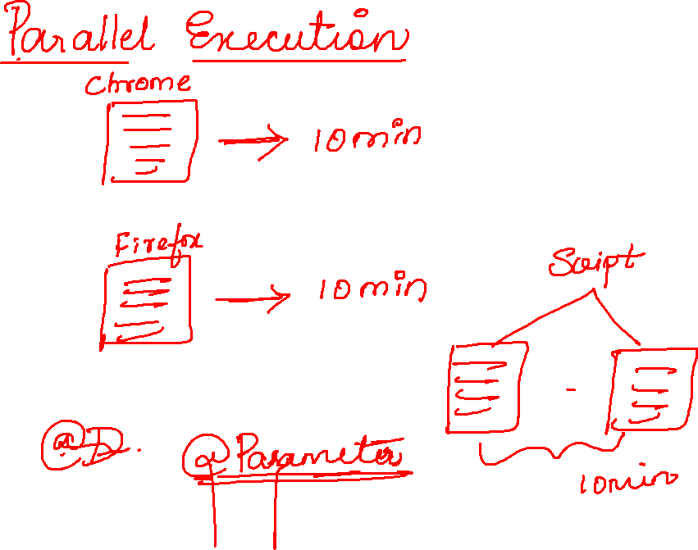

Slide 4
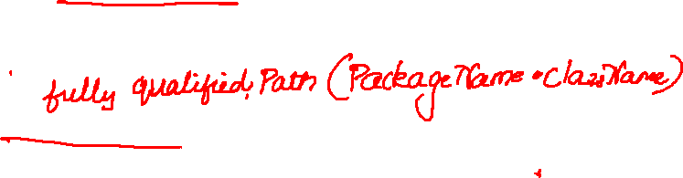
<suite name="Suite" parallel="tests">
<test thread-count="5" name="Test1">
<parameter name="BrowserName" value="chrome"/>
<classes>
<class name="testng.Parallel"/>
</classes>
</test> <!-- Test -->
<test thread-count="5" name="Test2">
<parameter name="BrowserName" value="Firefox"/>
<classes>
<class name="testng.Parallel"/>
</classes>
</test> <!-- Test -->
</suite> <!-- Suite -->

Slide 5


Slide 6
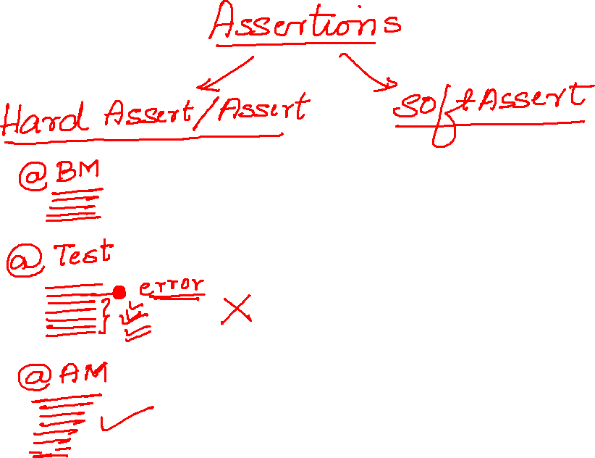
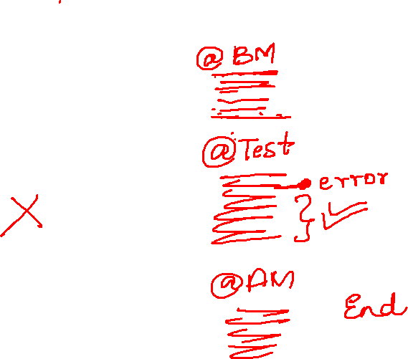

Slide 7


Slide 8
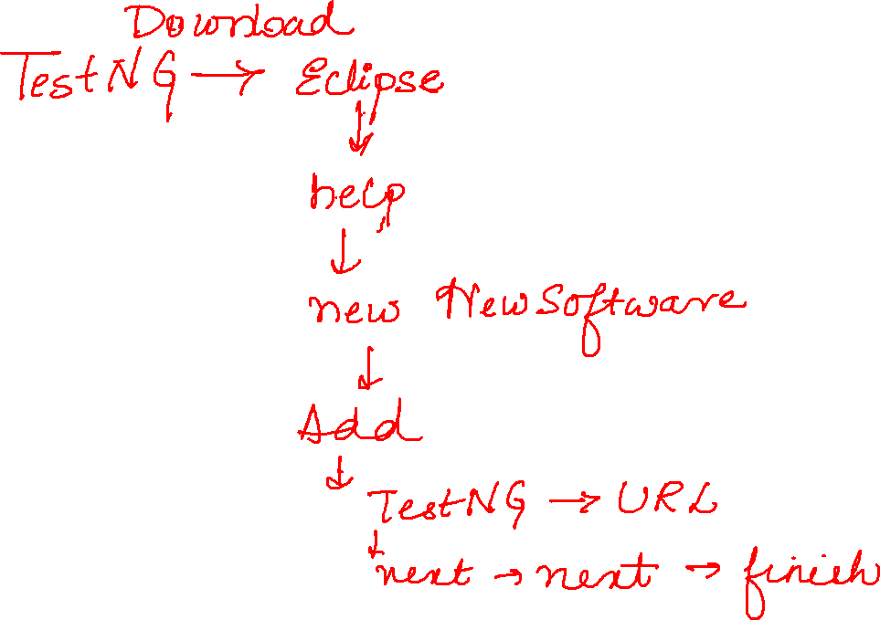

Slide 9
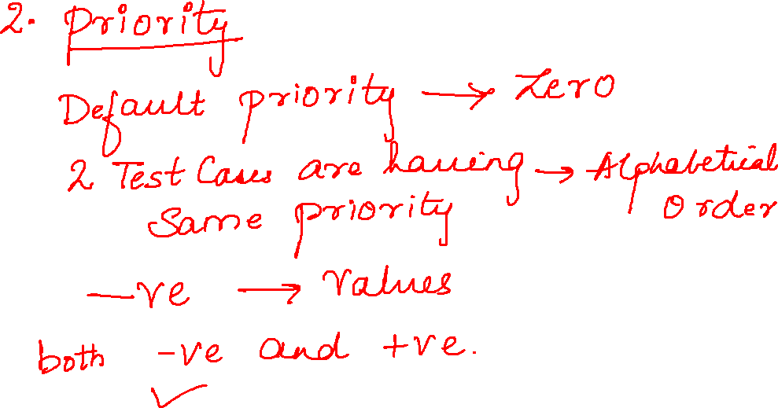

Slide 10
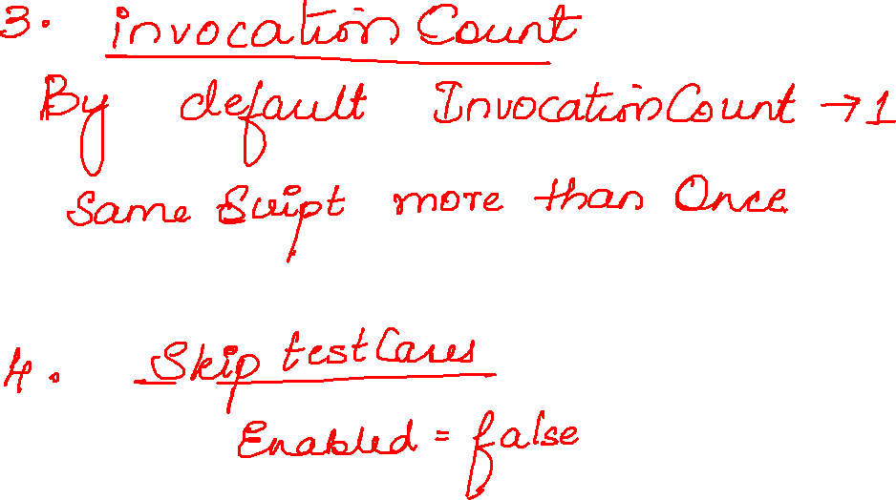

Slide 11
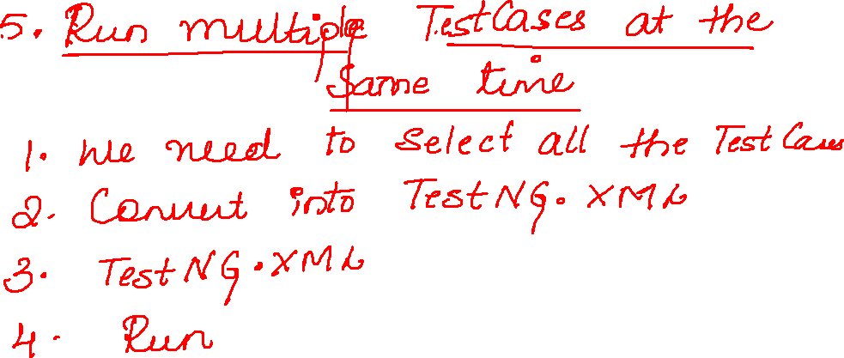

Slide 12
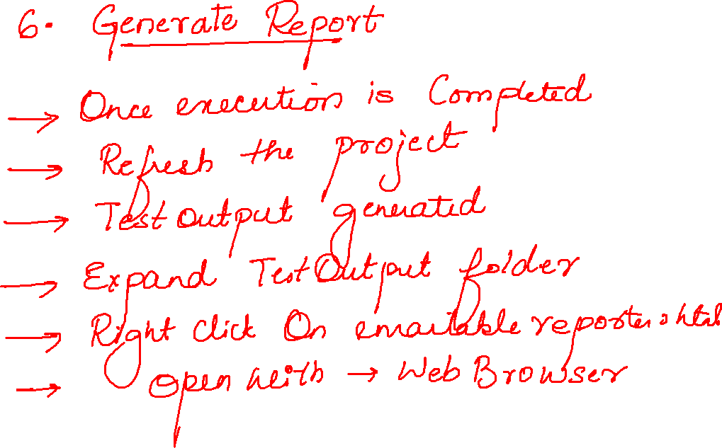

Slide 13
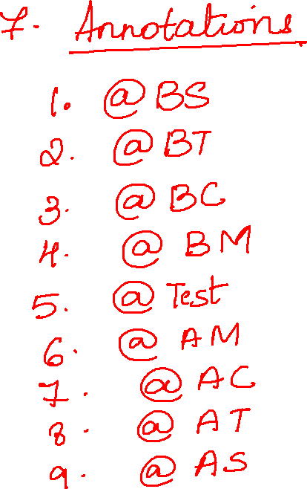

Slide 14
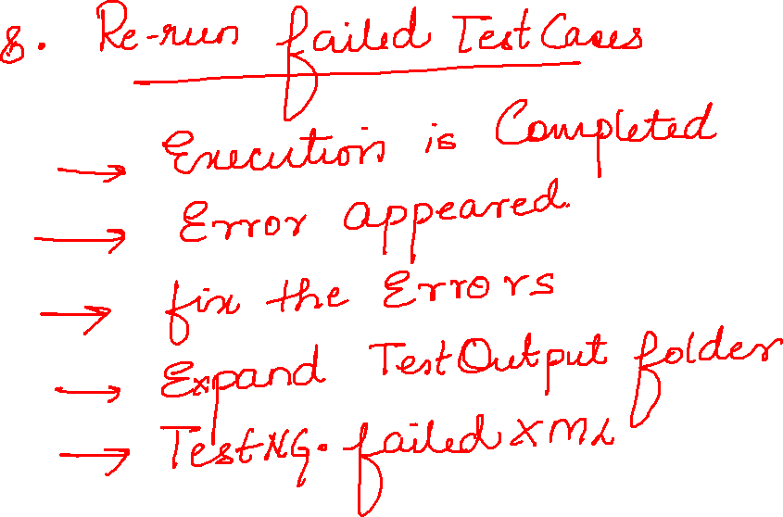

Slide 15
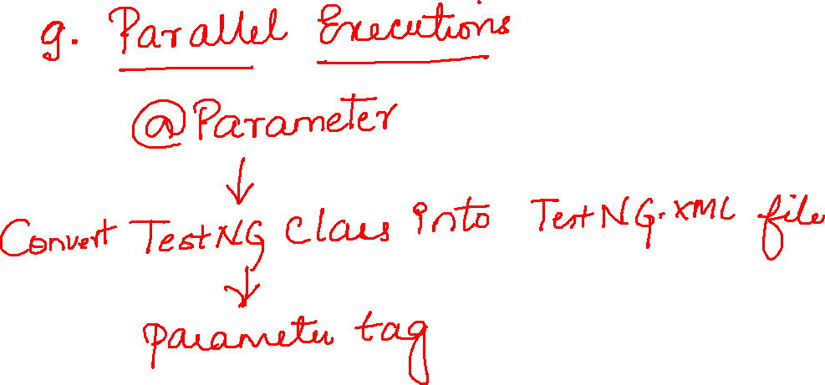

Slide 16
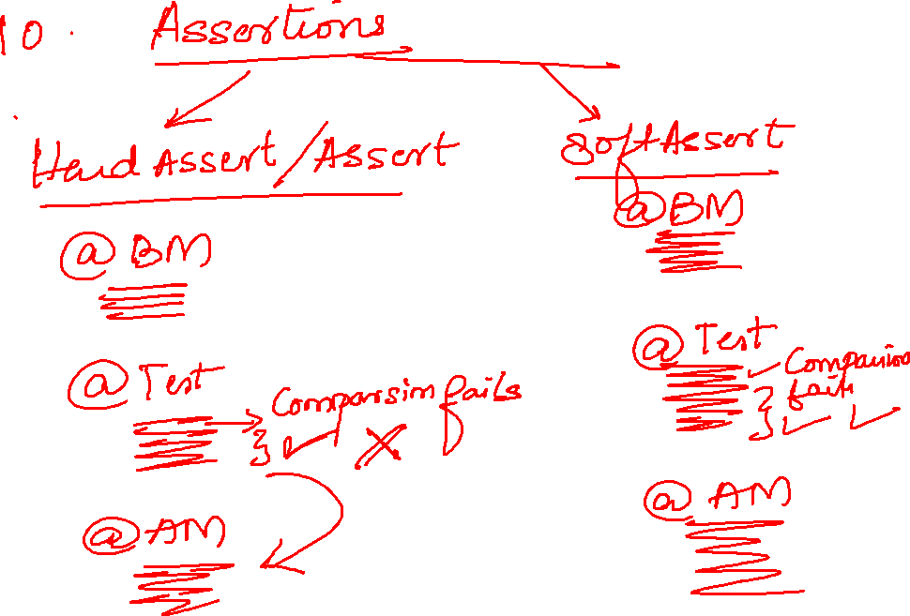

Slide 17
