Slide 1
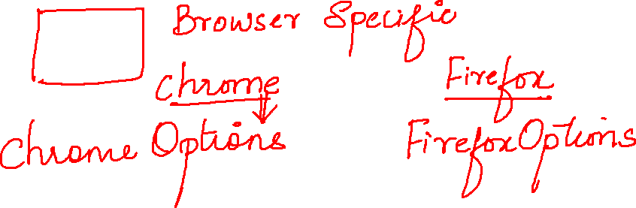

Slide 2
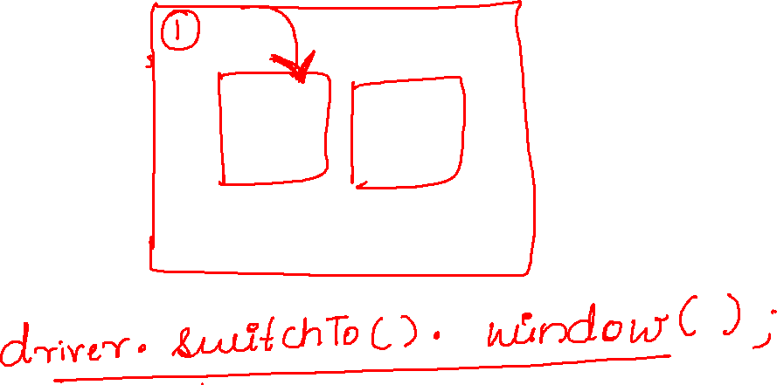

Slide 3
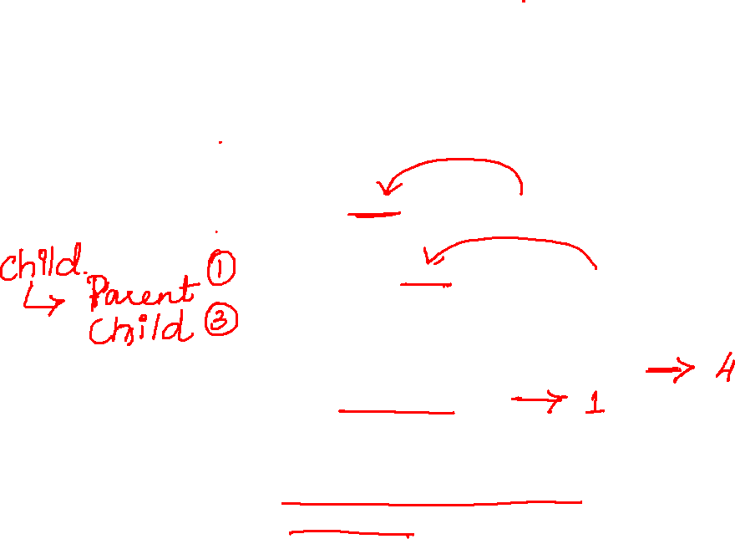
WebDriver driver=new ChromeDriver();
driver.manage().window().maximize();
driver.get("https://www.naukri.com/");
driver.manage().timeouts().implicitlyWait(10,TimeUnit.SECONDS);
String parent = driver.getWindowHandle();
System.out.println(parent);
Set<String> child = driver.getWindowHandles();
System.out.println(child);
System.out.println(child.size());
child.remove(parent);
for(String popup:child)
{
driver.switchTo().window(popup);
driver.close();
}

Slide 4
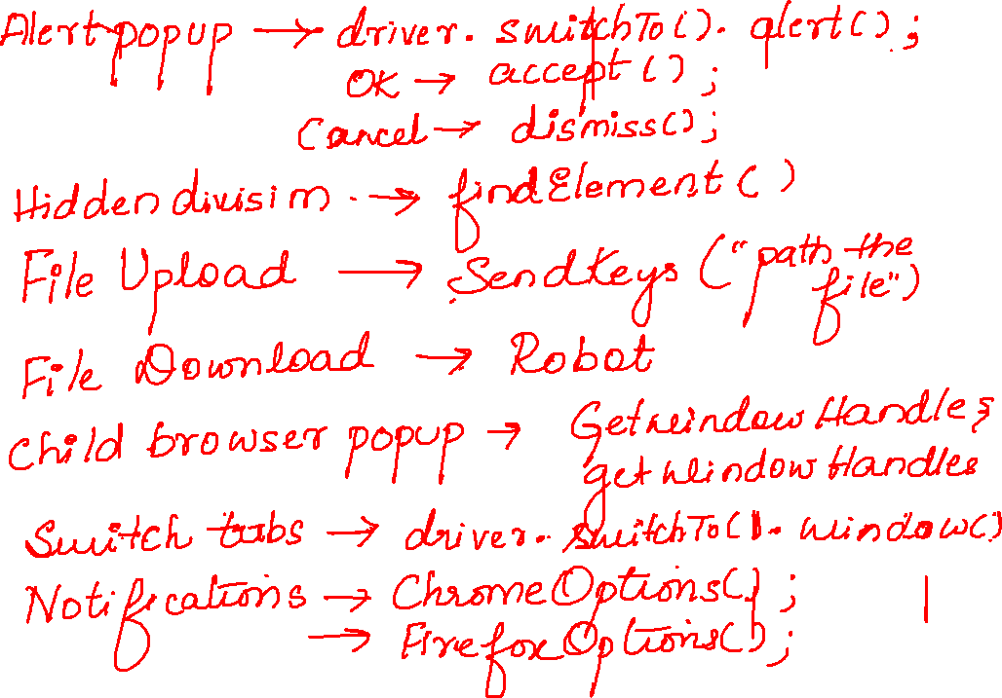

Slide 5
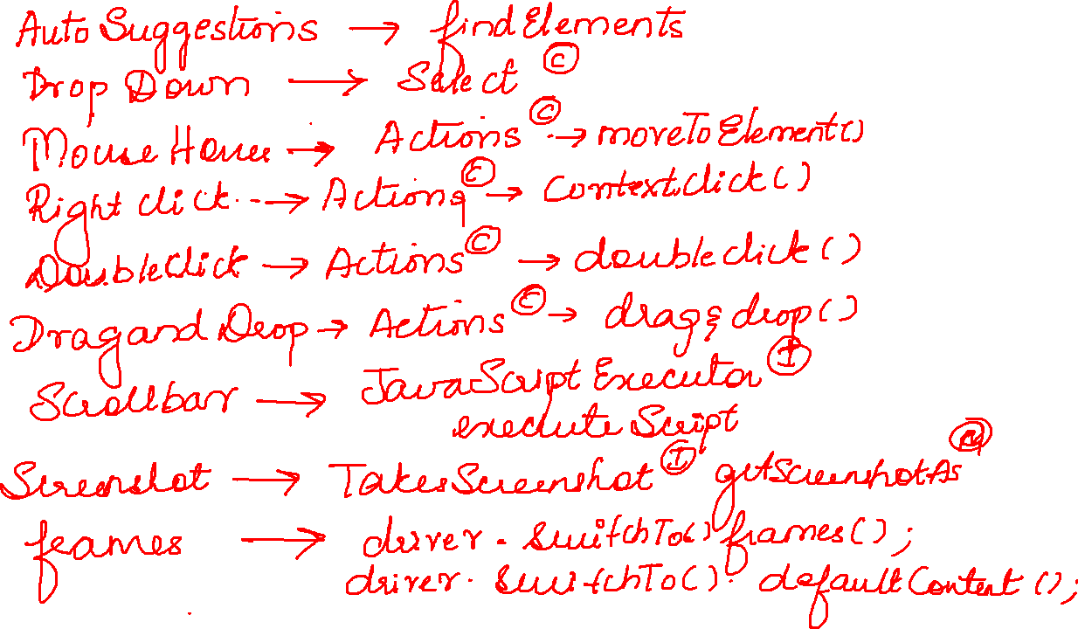

Slide 6
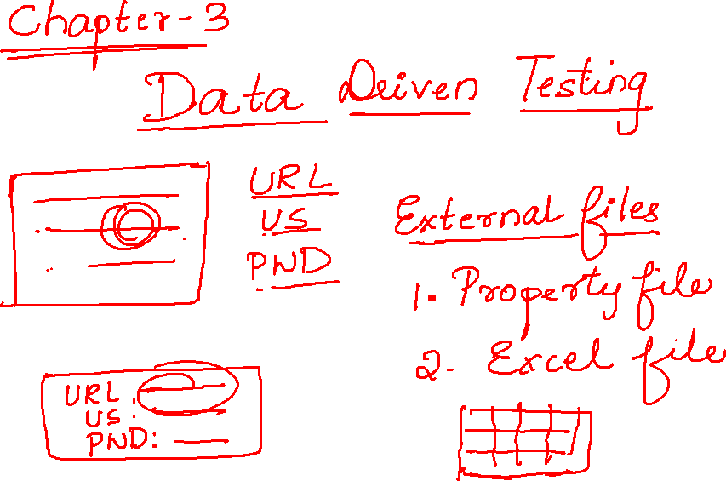

Slide 7
