Slide 1
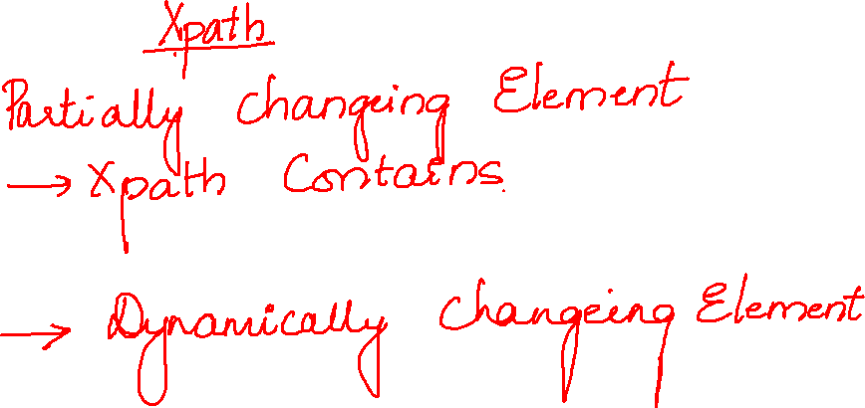

Slide 2

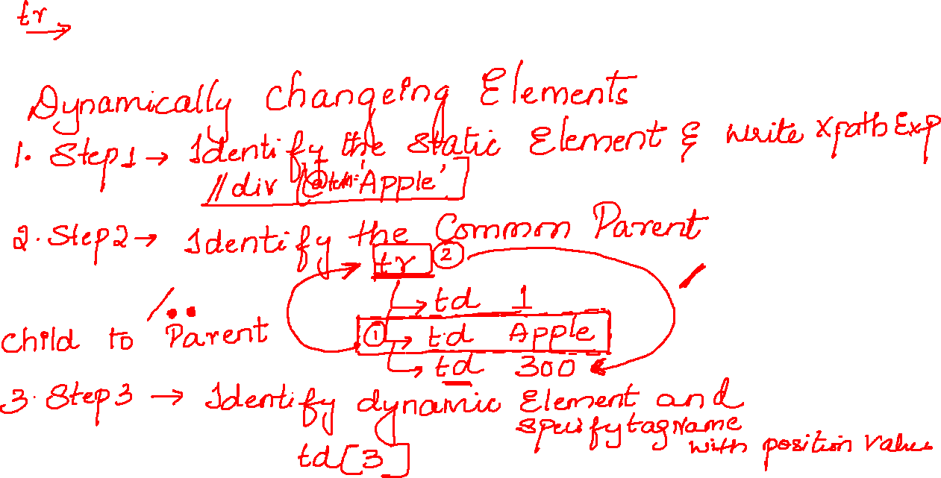

Slide 3
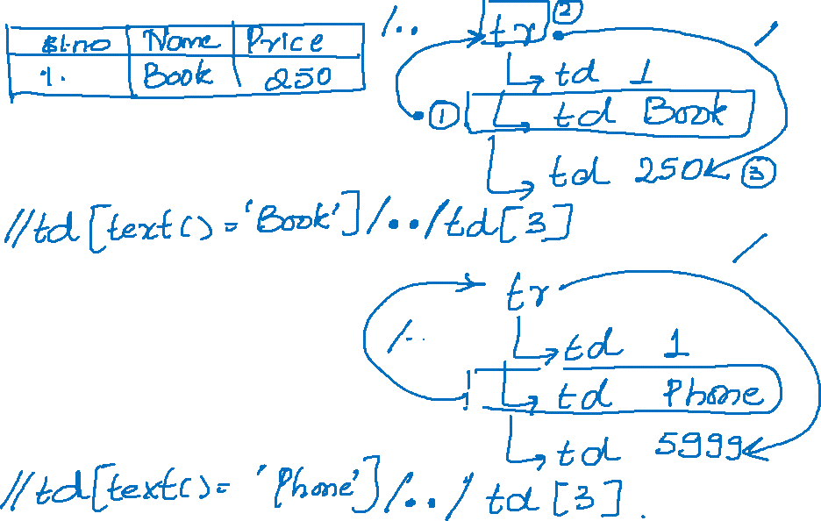

Slide 4


Slide 5

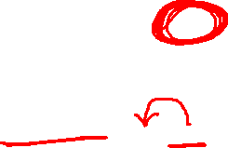
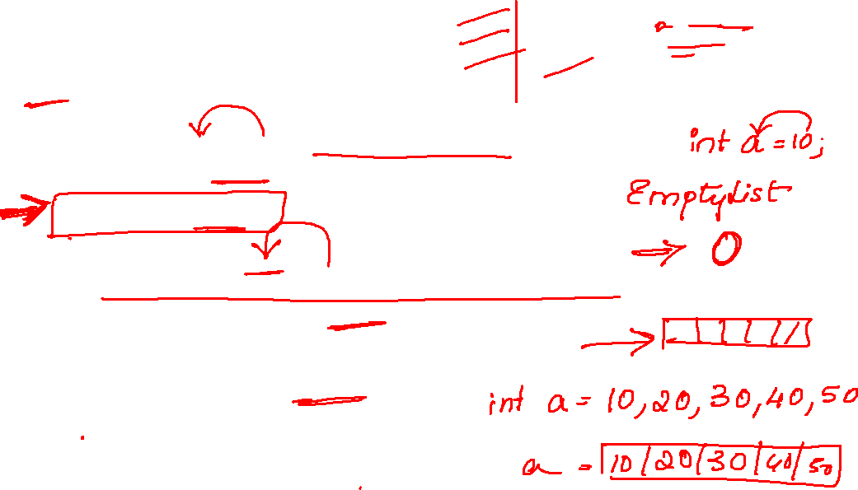
WebDriver driver=new ChromeDriver();
driver.manage().window().maximize();
driver.get("https://www.google.com/");
driver.manage().timeouts().implicitlyWait(10,TimeUnit.SECONDS);
WebElement ele = driver.findElement(By.name("q"));
ele.sendKeys("seleni");
Thread.sleep(3000);
List<WebElement> ele1 = driver.findElements(By.xpath("//li[@class='sbct']"));
System.out.println(ele1.size());
for(WebElement b:ele1) {
System.out.println(b.getText());
}

Slide 6
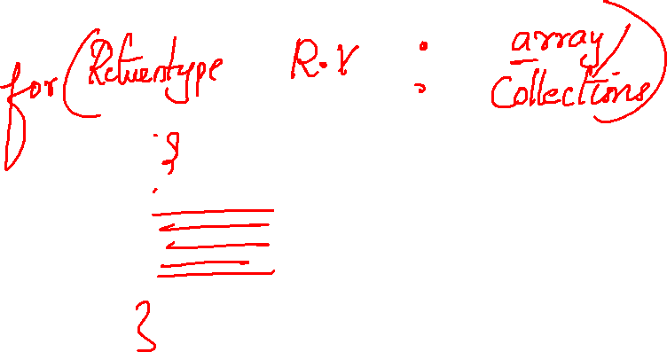

Slide 7
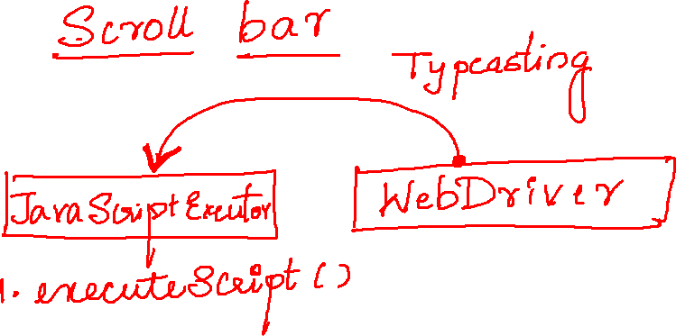

Slide 8
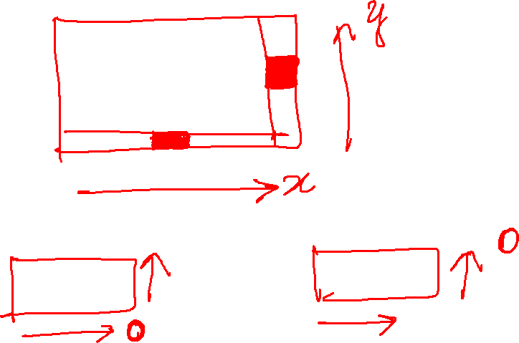

Slide 9
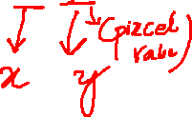
JavascriptExecutor js=(JavascriptExecutor)driver; js.executeScript("window.scrollBy(0,6000)");

Slide 10
JavascriptExecutor js=(JavascriptExecutor)driver; js.executeScript("arguments[0].click();",ele);

