Slide 1
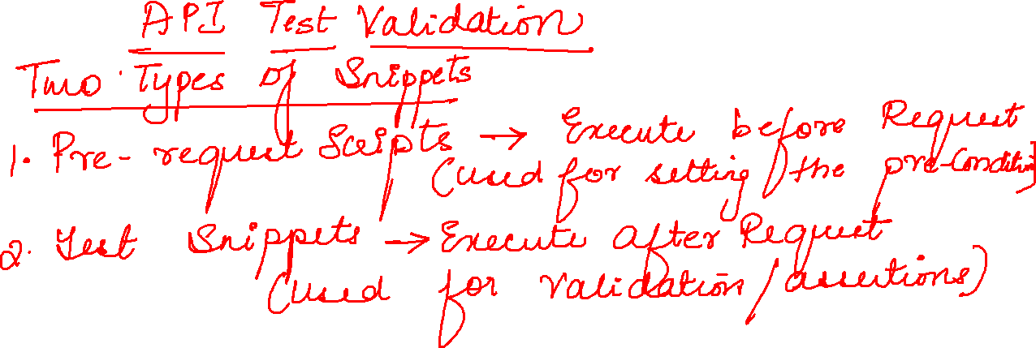

Slide 2
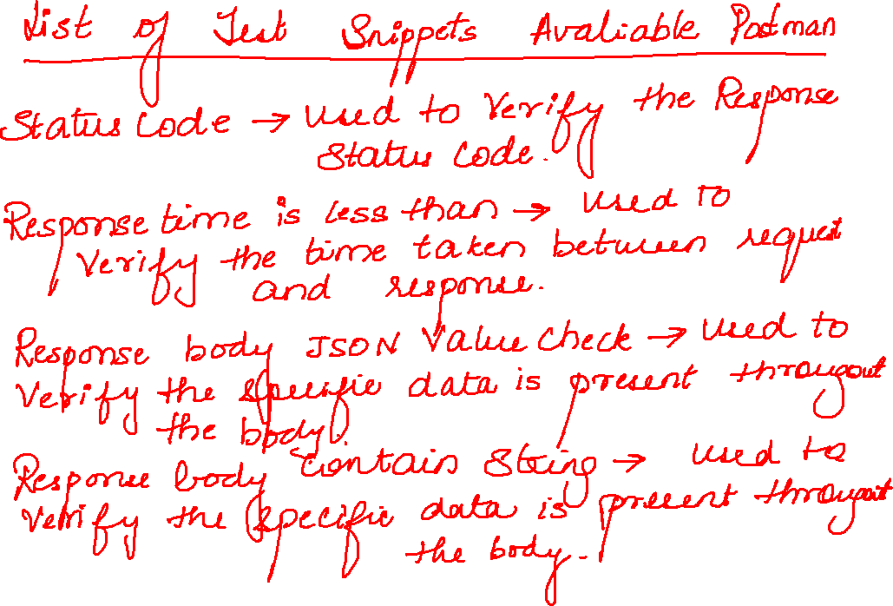

Slide 3
{
"id": 424167047,
"node_id": "R_kgDOGUhGhw",
"name": "wasa2",
"full_name": "javaandselenium/wasa2",
"private": false,
"owner": {
"login": "javaandselenium",
"id": 72552582,
"node_id": "MDQ6VXNlcjcyNTUyNTgy",
"avatar_url": "https://avatars.githubusercontent.com/u/72552582?v=4",
"gravatar_id": "",
"url": "https://api.github.com/users/javaandselenium",
"html_url": "https://github.com/javaandselenium",
"followers_url": "https://api.github.com/users/javaandselenium/followers",
"following_url": "https://api.github.com/users/javaandselenium/following{/other_user}",
"gists_url": "https://api.github.com/users/javaandselenium/gists{/gist_id}",
"starred_url": "https://api.github.com/users/javaandselenium/starred{/owner}{/repo}",
"subscriptions_url": "https://api.github.com/users/javaandselenium/subscriptions",
"organizations_url": "https://api.github.com/users/javaandselenium/orgs",
"repos_url": "https://api.github.com/users/javaandselenium/repos",
"events_url": "https://api.github.com/users/javaandselenium/events{/privacy}",
"received_events_url": "https://api.github.com/users/javaandselenium/received_events",
"type": "User",
"site_admin": false
},
"html_url": "https://github.com/javaandselenium/wasa2",
"description": null,
"fork": false,
"url": "https://api.github.com/repos/javaandselenium/wasa2",
"forks_url": "https://api.github.com/repos/javaandselenium/wasa2/forks",
"keys_url": "https://api.github.com/repos/javaandselenium/wasa2/keys{/key_id}",
"collaborators_url": "https://api.github.com/repos/javaandselenium/wasa2/collaborators{/collaborator}",
"teams_url": "https://api.github.com/repos/javaandselenium/wasa2/teams",
"hooks_url": "https://api.github.com/repos/javaandselenium/wasa2/hooks",
"issue_events_url": "https://api.github.com/repos/javaandselenium/wasa2/issues/events{/number}",
"events_url": "https://api.github.com/repos/javaandselenium/wasa2/events",
"assignees_url": "https://api.github.com/repos/javaandselenium/wasa2/assignees{/user}",
"branches_url": "https://api.github.com/repos/javaandselenium/wasa2/branches{/branch}",
"tags_url": "https://api.github.com/repos/javaandselenium/wasa2/tags",
"blobs_url": "https://api.github.com/repos/javaandselenium/wasa2/git/blobs{/sha}",
"git_tags_url": "https://api.github.com/repos/javaandselenium/wasa2/git/tags{/sha}",
"git_refs_url": "https://api.github.com/repos/javaandselenium/wasa2/git/refs{/sha}",
"trees_url": "https://api.github.com/repos/javaandselenium/wasa2/git/trees{/sha}",
"statuses_url": "https://api.github.com/repos/javaandselenium/wasa2/statuses/{sha}",
"languages_url": "https://api.github.com/repos/javaandselenium/wasa2/languages",
"stargazers_url": "https://api.github.com/repos/javaandselenium/wasa2/stargazers",
"contributors_url": "https://api.github.com/repos/javaandselenium/wasa2/contributors",
"subscribers_url": "https://api.github.com/repos/javaandselenium/wasa2/subscribers",
"subscription_url": "https://api.github.com/repos/javaandselenium/wasa2/subscription",
"commits_url": "https://api.github.com/repos/javaandselenium/wasa2/commits{/sha}",
"git_commits_url": "https://api.github.com/repos/javaandselenium/wasa2/git/commits{/sha}",
"comments_url": "https://api.github.com/repos/javaandselenium/wasa2/comments{/number}",
"issue_comment_url": "https://api.github.com/repos/javaandselenium/wasa2/issues/comments{/number}",
"contents_url": "https://api.github.com/repos/javaandselenium/wasa2/contents/{+path}",
"compare_url": "https://api.github.com/repos/javaandselenium/wasa2/compare/{base}...{head}",
"merges_url": "https://api.github.com/repos/javaandselenium/wasa2/merges",
"archive_url": "https://api.github.com/repos/javaandselenium/wasa2/{archive_format}{/ref}",
"downloads_url": "https://api.github.com/repos/javaandselenium/wasa2/downloads",
"issues_url": "https://api.github.com/repos/javaandselenium/wasa2/issues{/number}",
"pulls_url": "https://api.github.com/repos/javaandselenium/wasa2/pulls{/number}",
"milestones_url": "https://api.github.com/repos/javaandselenium/wasa2/milestones{/number}",
"notifications_url": "https://api.github.com/repos/javaandselenium/wasa2/notifications{?since,all,participating}",
"labels_url": "https://api.github.com/repos/javaandselenium/wasa2/labels{/name}",
"releases_url": "https://api.github.com/repos/javaandselenium/wasa2/releases{/id}",
"deployments_url": "https://api.github.com/repos/javaandselenium/wasa2/deployments",
"created_at": "2021-11-03T09:44:40Z",
"updated_at": "2021-11-08T10:05:30Z",
"pushed_at": "2021-11-08T10:05:27Z",
"git_url": "git://github.com/javaandselenium/wasa2.git",
"ssh_url": "git@github.com:javaandselenium/wasa2.git",
"clone_url": "https://github.com/javaandselenium/wasa2.git",
"svn_url": "https://github.com/javaandselenium/wasa2",
"homepage": null,
"size": 51,
"stargazers_count": 0,
"watchers_count": 0,
"language": "HTML",
"has_issues": true,
"has_projects": true,
"has_downloads": true,
"has_wiki": true,
"has_pages": false,
"forks_count": 0,
"mirror_url": null,
"archived": false,
"disabled": false,
"open_issues_count": 0,
"license": null,
"allow_forking": true,
"is_template": false,
"topics": [],
"visibility": "public",
"forks": 0,
"open_issues": 0,
"watchers": 0,
"default_branch": "master",
"temp_clone_token": null,
"network_count": 0,
"subscribers_count": 1
}

Slide 4
{
"id": 424167047,
"node_id": "R_kgDOGUhGhw",
"name": "wasa2",
"full_name": "javaandselenium/wasa2",
"private": false,
"owner": {
"login": "javaandselenium",
"id": 72552582,
"node_id": "MDQ6VXNlcjcyNTUyNTgy",
"avatar_url": "https://avatars.githubusercontent.com/u/72552582?v=4",
"gravatar_id": "",
"url": "https://api.github.com/users/javaandselenium",
"html_url": "https://github.com/javaandselenium",
"followers_url": "https://api.github.com/users/javaandselenium/followers",
"following_url": "https://api.github.com/users/javaandselenium/following{/other_user}",
"gists_url": "https://api.github.com/users/javaandselenium/gists{/gist_id}",
"starred_url": "https://api.github.com/users/javaandselenium/starred{/owner}{/repo}",
"subscriptions_url": "https://api.github.com/users/javaandselenium/subscriptions",
"organizations_url": "https://api.github.com/users/javaandselenium/orgs",
"repos_url": "https://api.github.com/users/javaandselenium/repos",
"events_url": "https://api.github.com/users/javaandselenium/events{/privacy}",
"received_events_url": "https://api.github.com/users/javaandselenium/received_events",
"type": "User",
"site_admin": false
},

