Slide 1
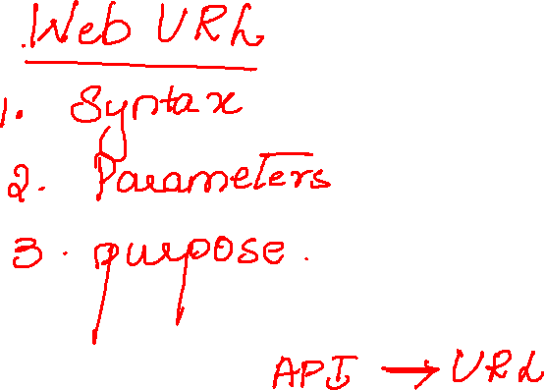

Slide 2
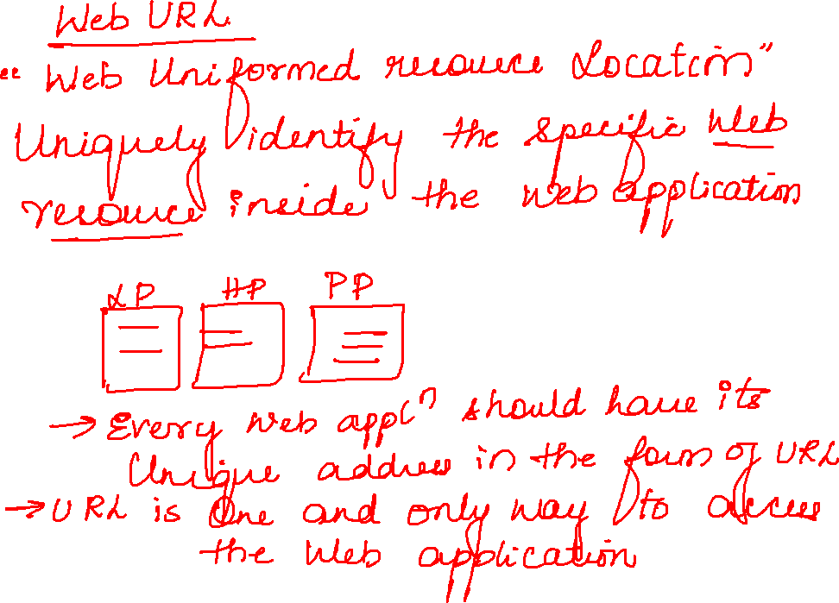

Slide 3
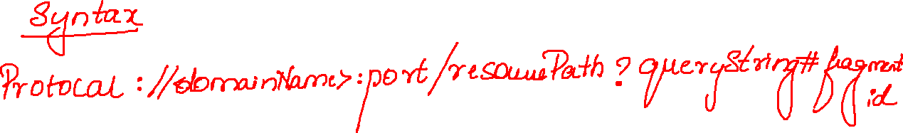





Slide 4
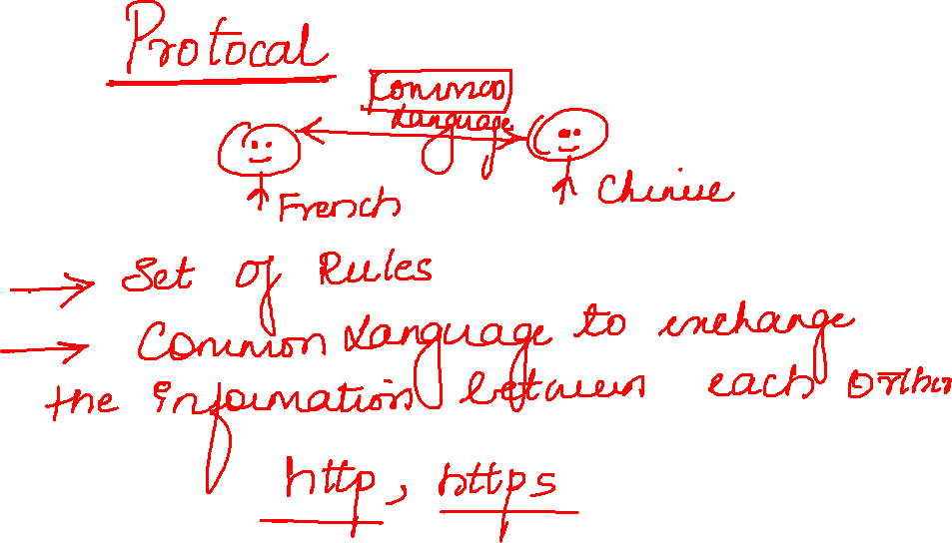

Slide 5
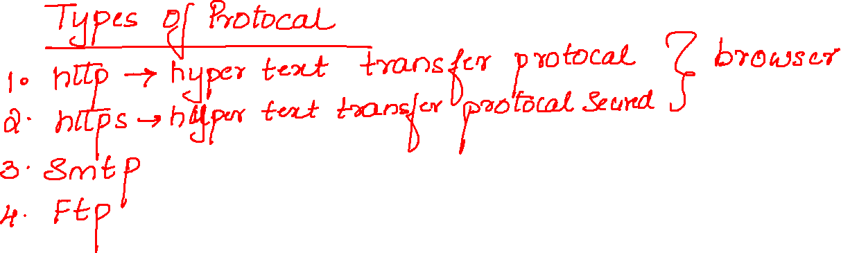

Slide 6
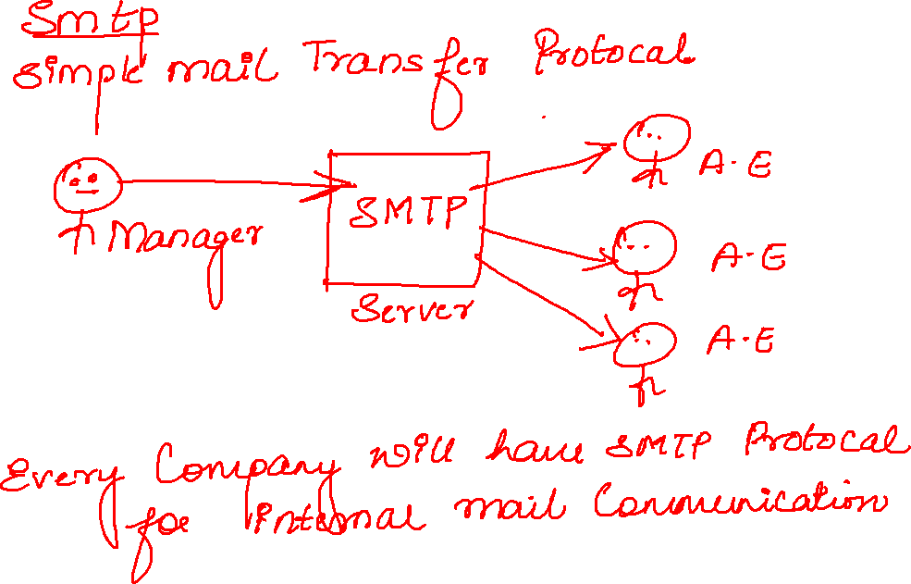

Slide 7
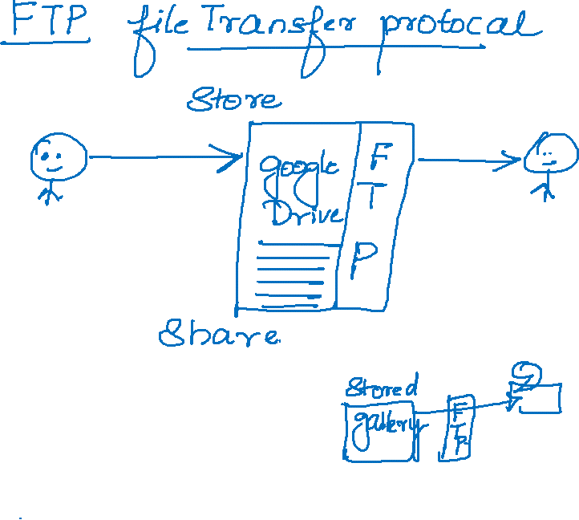

Slide 8
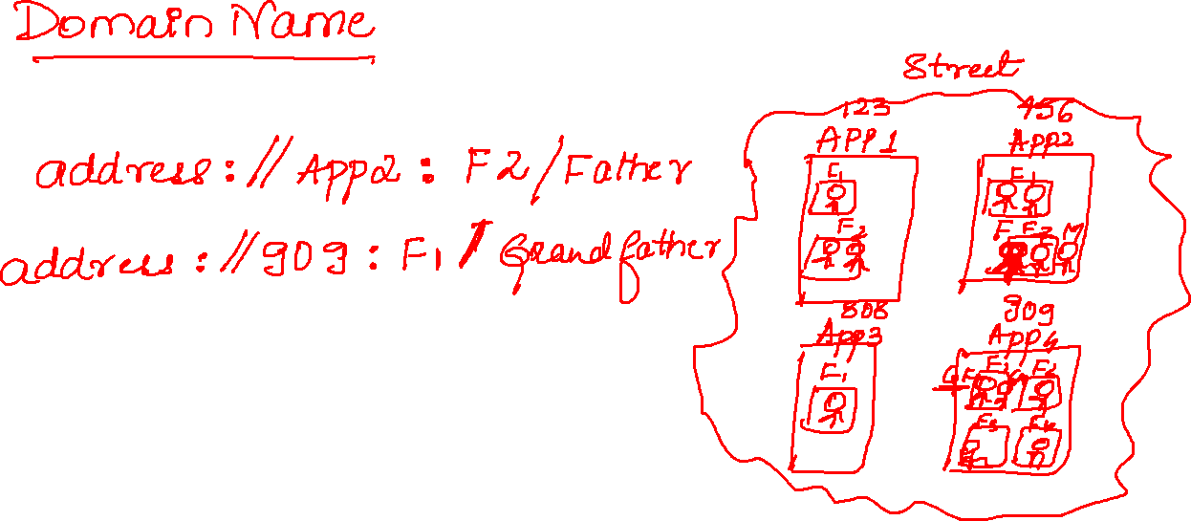


Slide 9
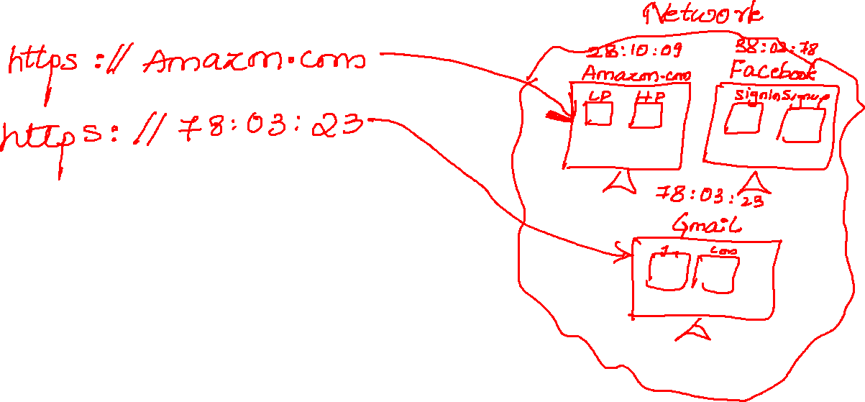

Slide 10
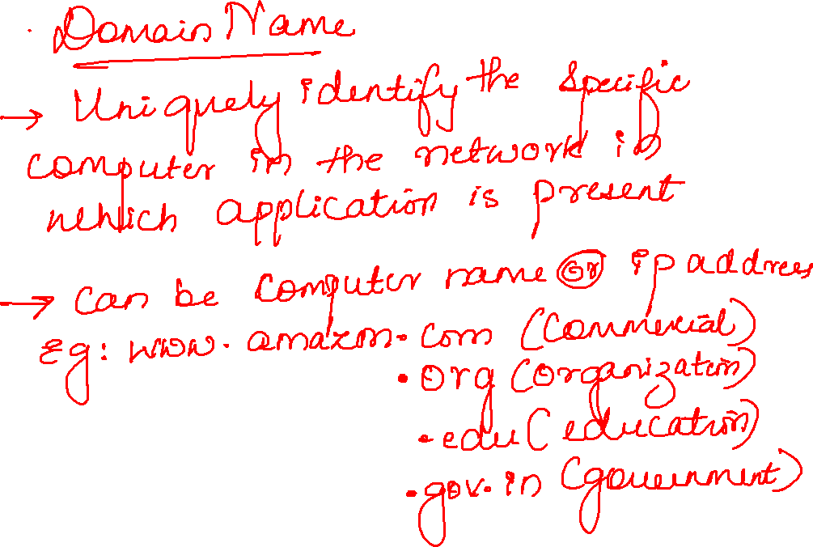

Slide 11
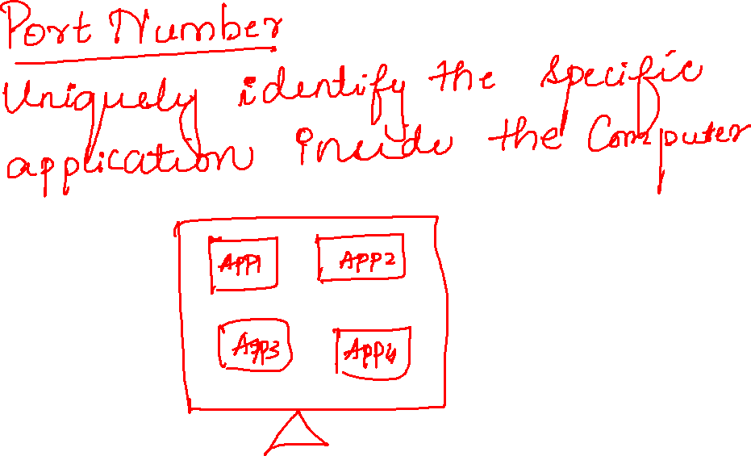


Slide 12
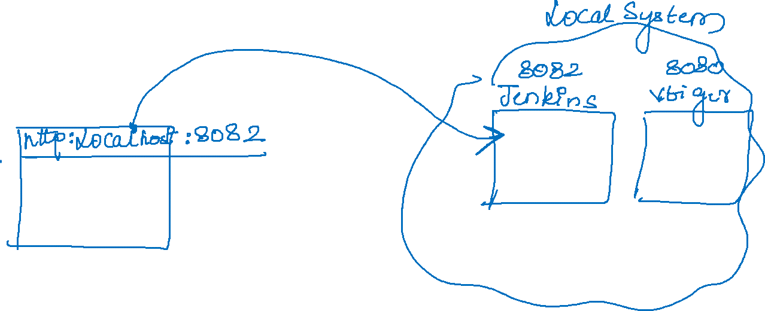

Slide 13
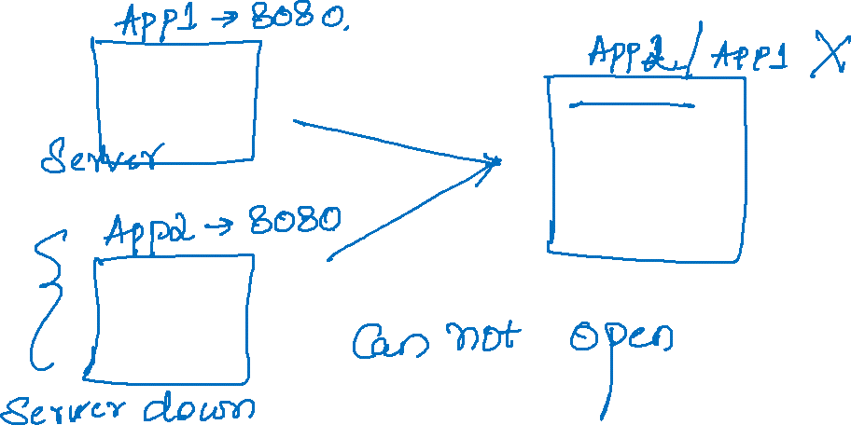

Slide 14
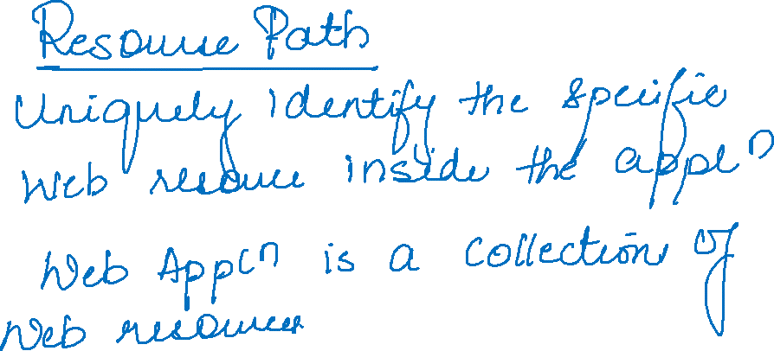

https://www.amazon.com/events/epicdeals

Slide 15
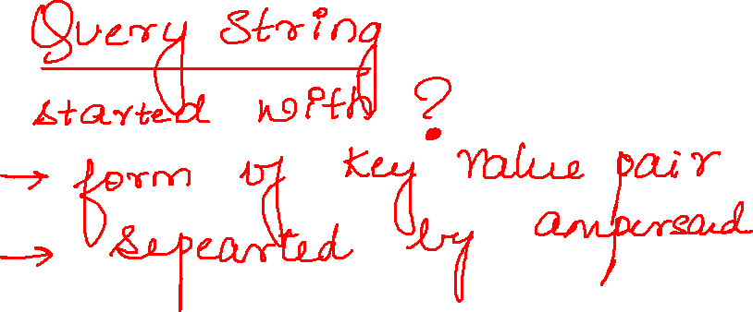

Slide 16
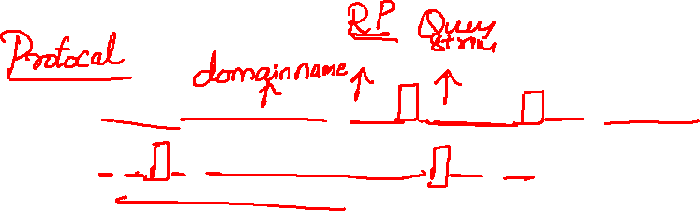
https://www.google.com/search?q=computer&sxsrf=AOaemvKnJNlswtpJVG6Hg3LMWwxhOn8lCw%3A1639450788965&source=hp&ei=pAi4YfO7ONzi2roPs_65-As&iflsig=ALs-wAMAAAAAYbgWtHyvygE

Slide 18
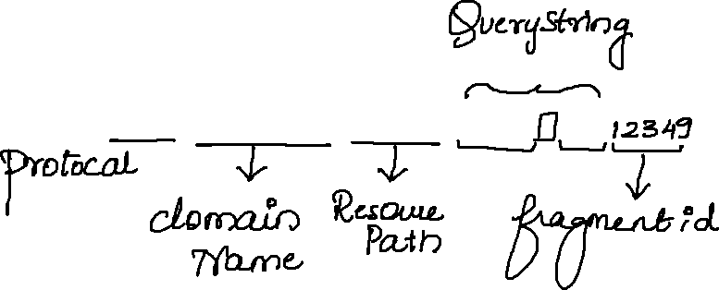
https://play.google.com/store/apps?hl=en_IN&gl=US

