Slide 1
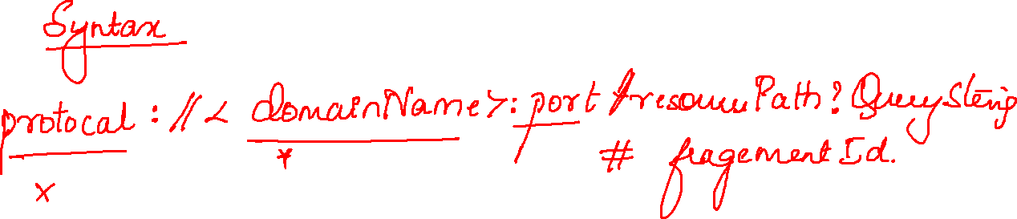

Slide 2
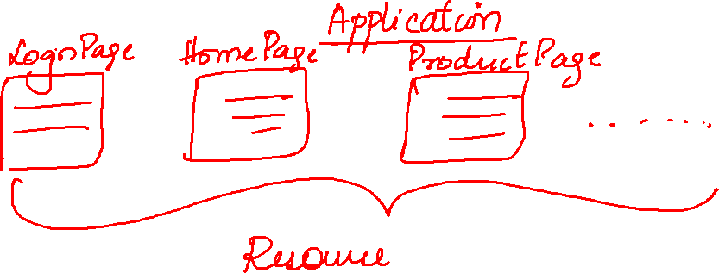
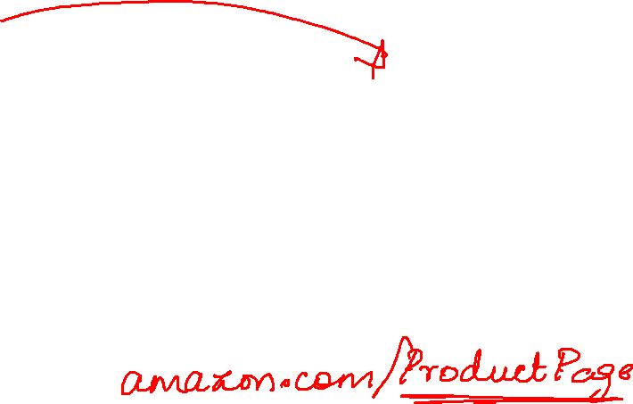

Slide 3
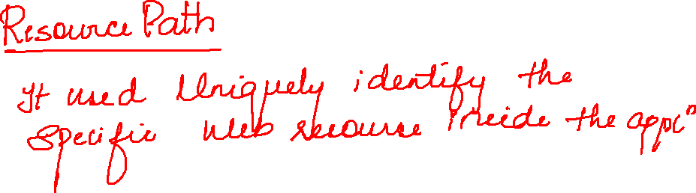

Slide 4
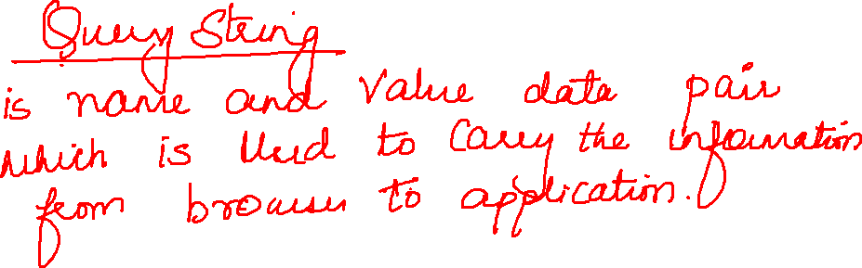
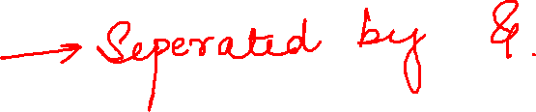

Slide 5
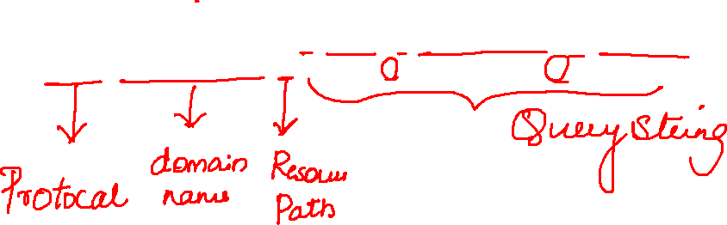
https://www.amazon.com/s?k=phoone&i=kitchen-intl-ship&ref=nb_sb_noss

Slide 6
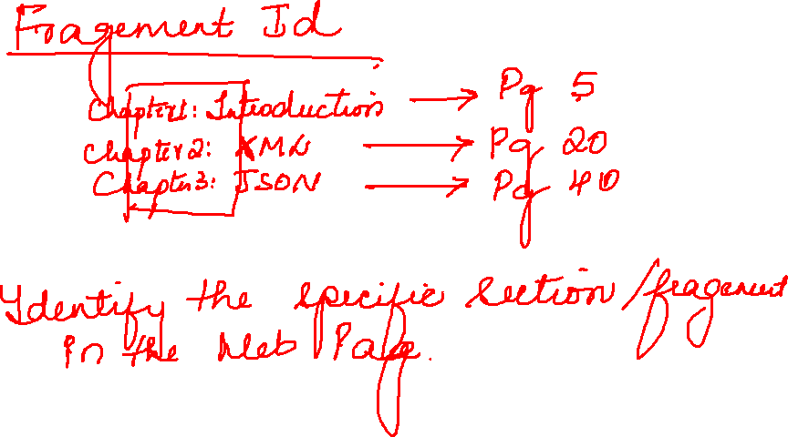

Slide 7
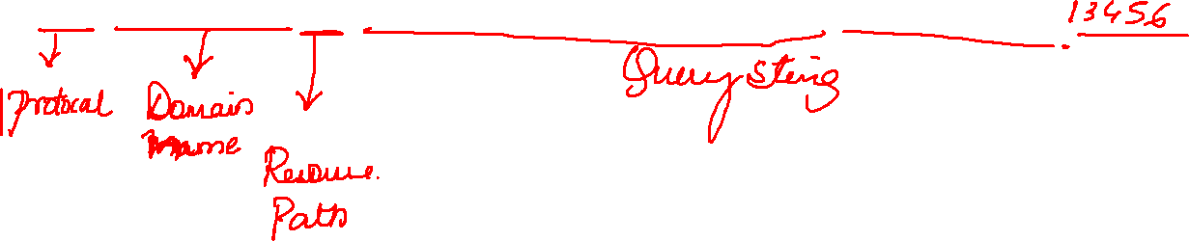
https://www.myntra.com/login?referer=https://www.myntra.com/hair-conditioner?f=Brand%3ASt.Botanica

Slide 8
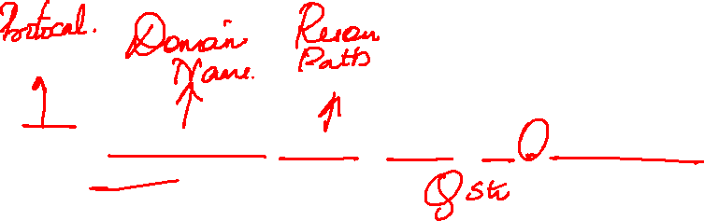
https://www.amazon.com/registries?_encoding=UTF8&redirect=true&ref_=nav_cs_registry_1c421982e26d4ec48ca364be68f201b5

Slide 9
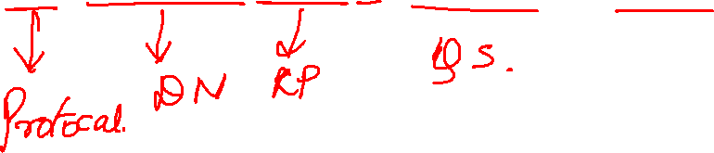
https://www.myntra.com/floor-lamps?rf=Price%3A2099.0_2441.0_2099.0%20TO%202441.0

Slide 10


Slide 11
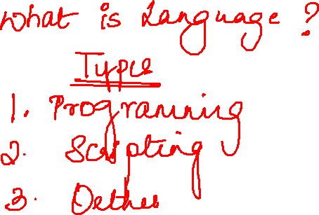

Slide 12
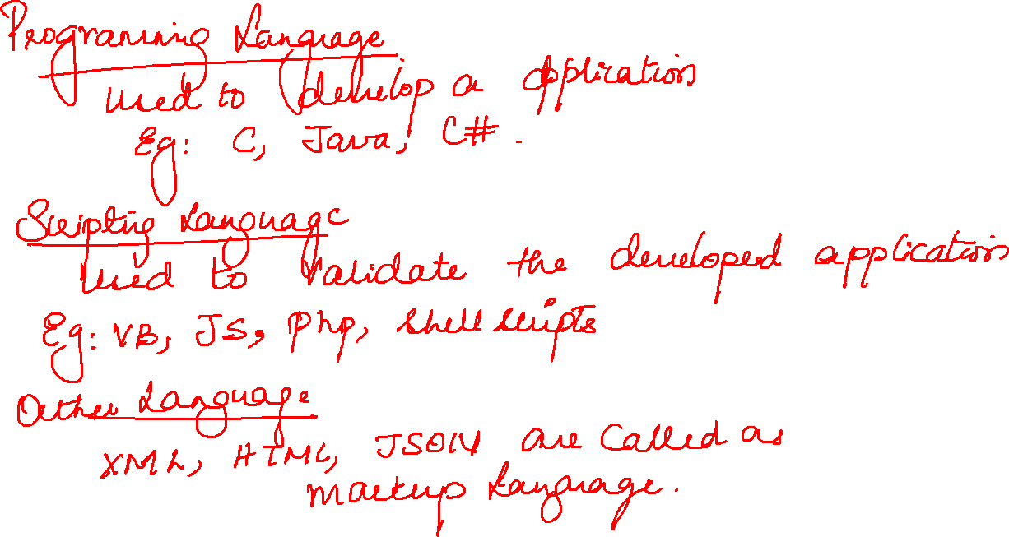

Slide 13
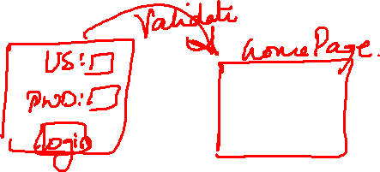

Slide 14
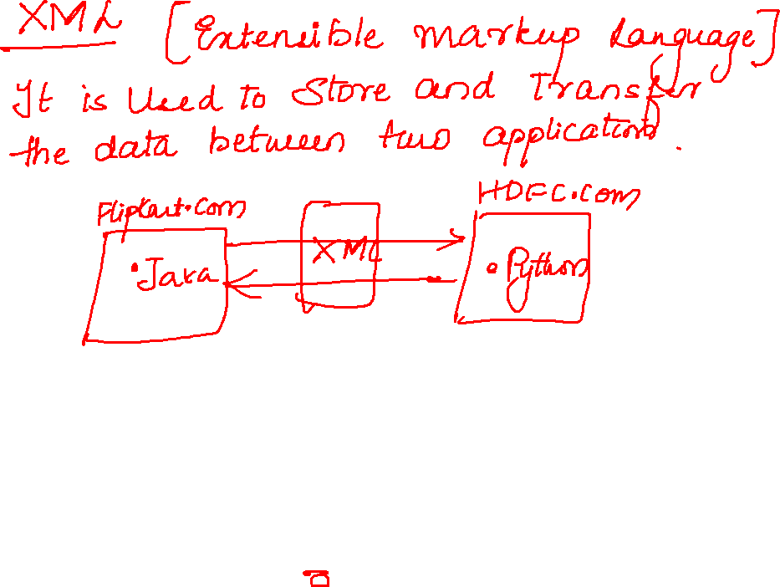

Slide 15
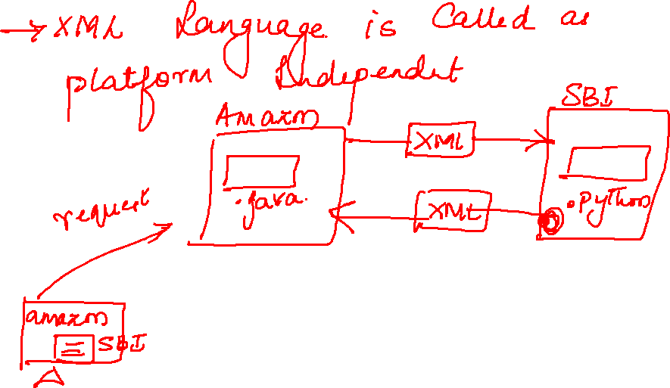

Slide 16
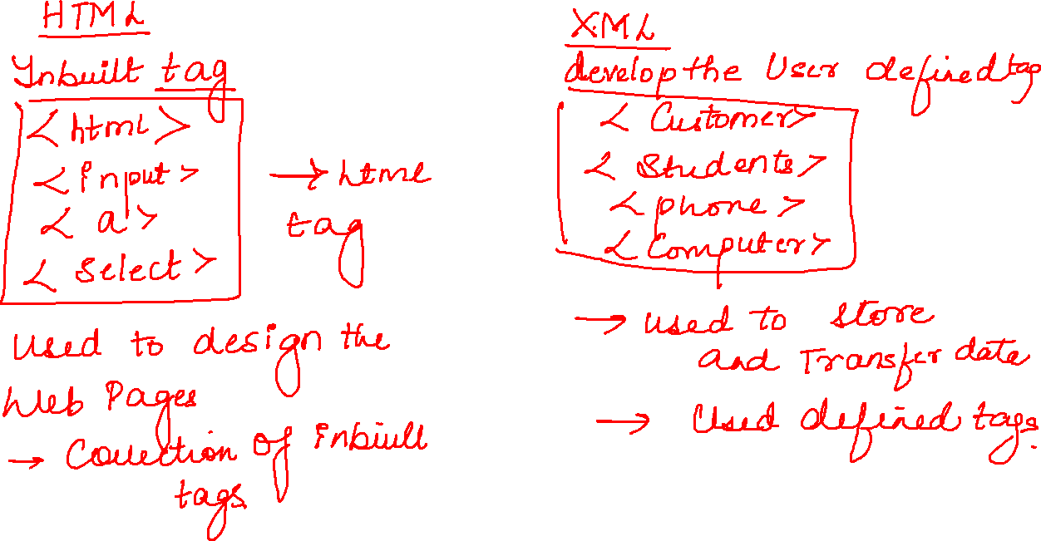

Slide 17
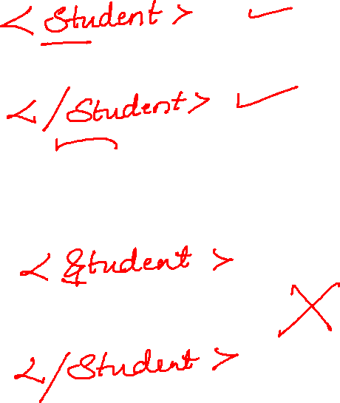

Slide 18
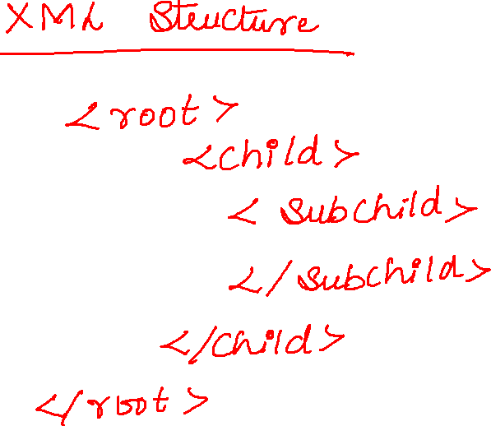

Slide 19
