Slide 1


Slide 2
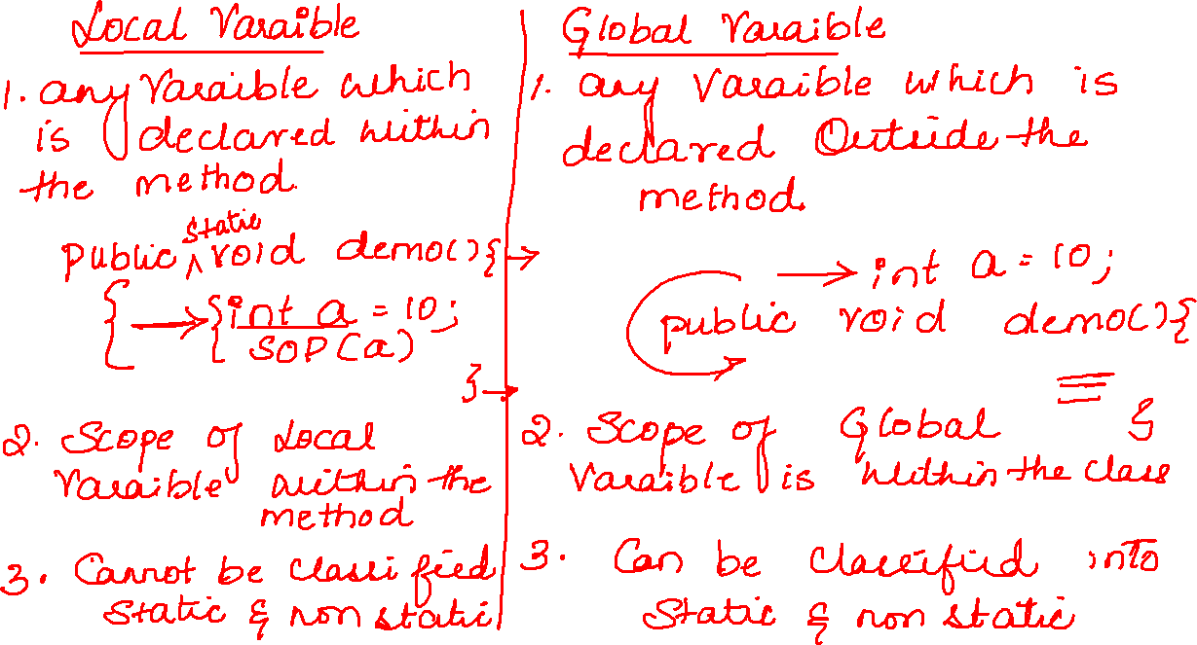

Slide 3
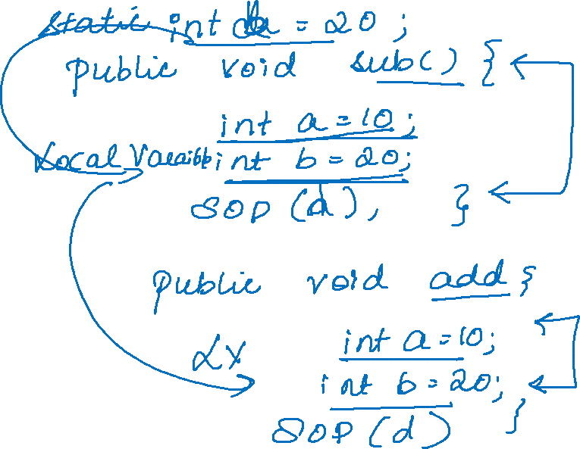

Slide 4
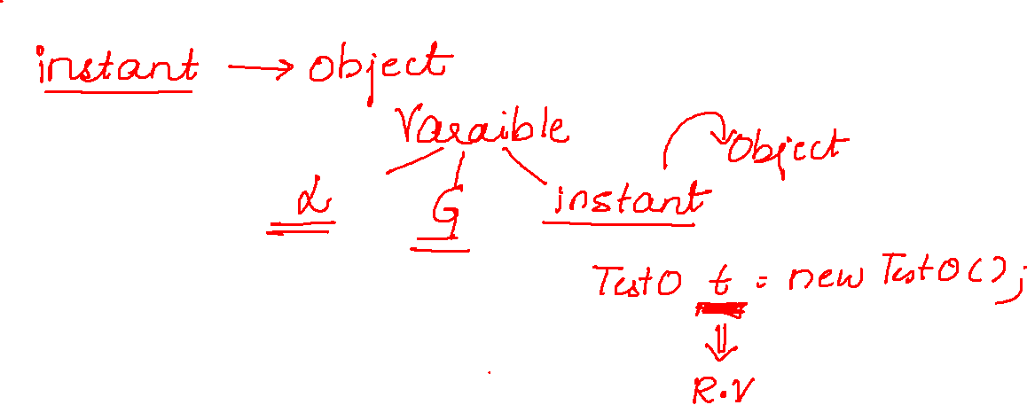

Slide 5
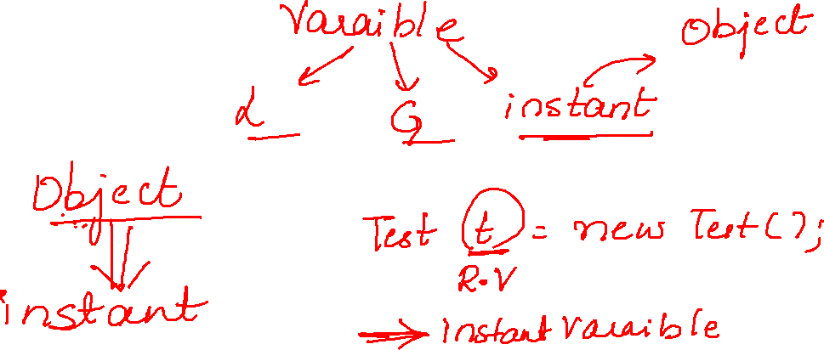

Slide 6
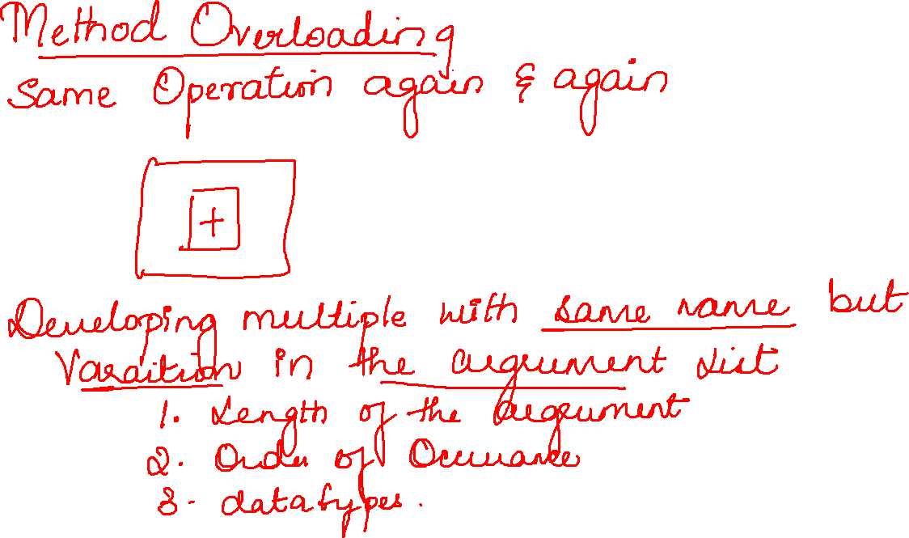

Slide 7
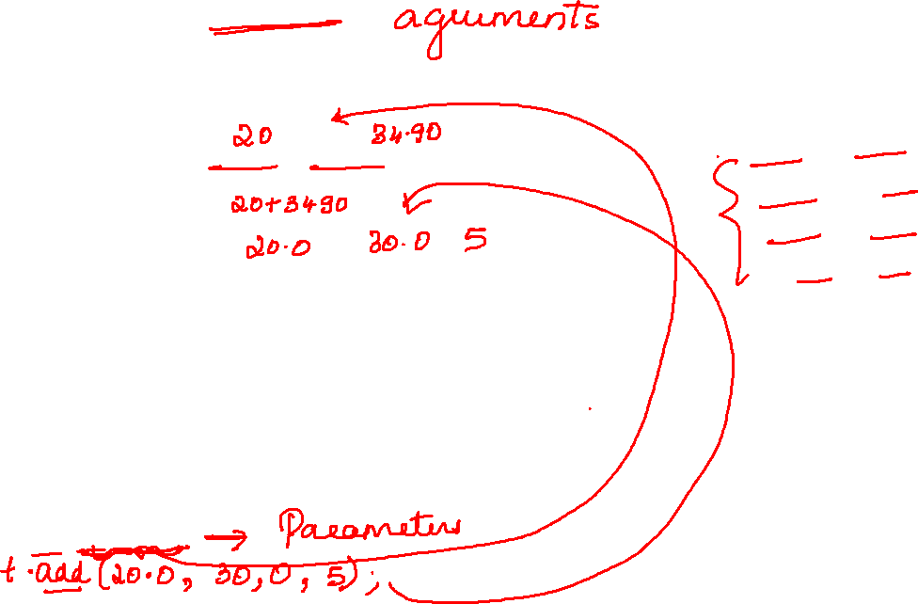
public void add(int a, int b) {
System.out.println(a + b);
}
public void add(int a, double b) {
System.out.println(a + b);
}
public void add(double a, double b,int c) {
System.out.println(a + b+c);
}
public void add(double b, int a) {
System.out.println(a + b);
}
public static void main(String[] args) {
Test8 t=new Test8();
t.add(20,34.90);

Slide 8
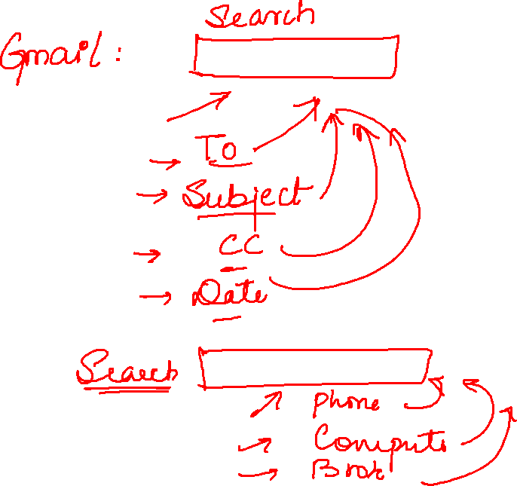

Slide 9


