Slide 1
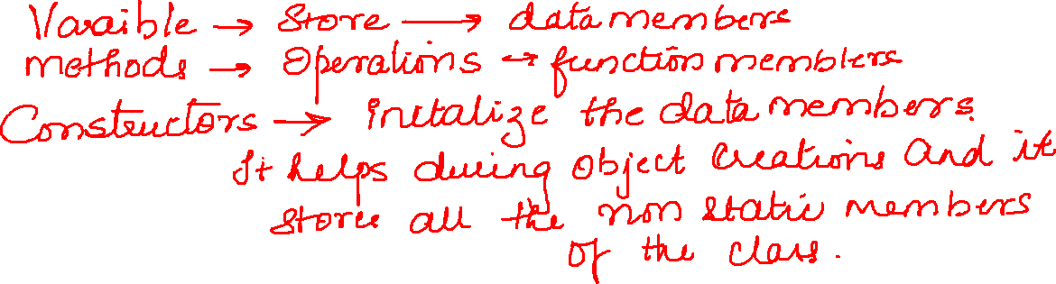

Slide 2
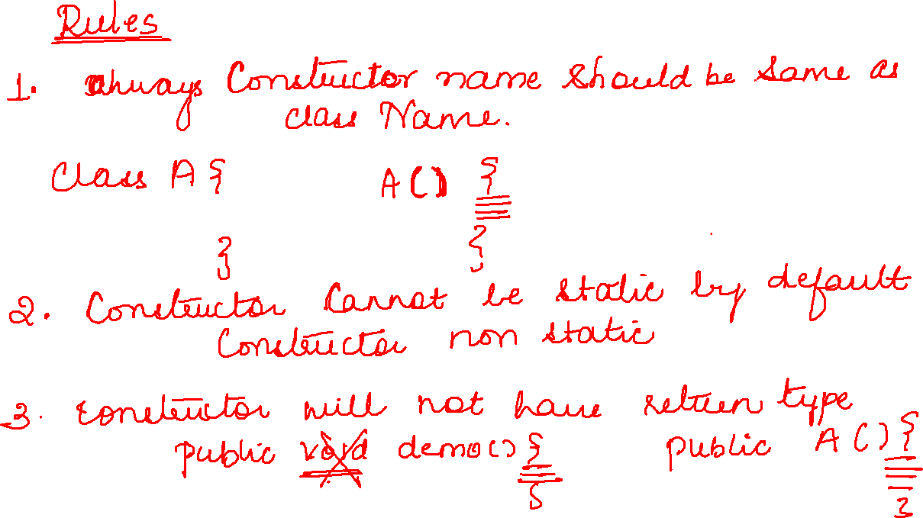

Slide 3
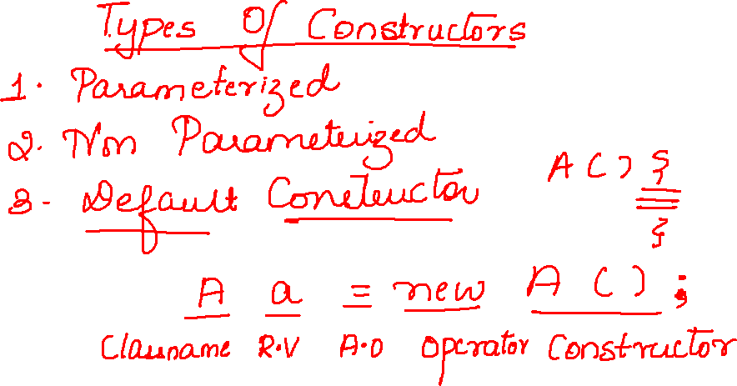

Slide 4
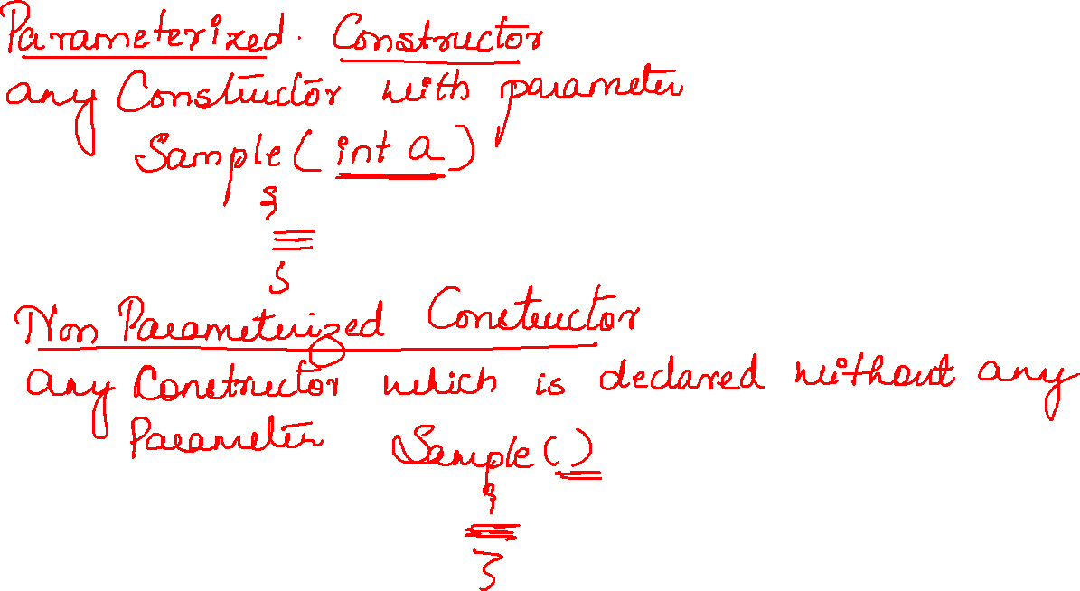

Slide 5
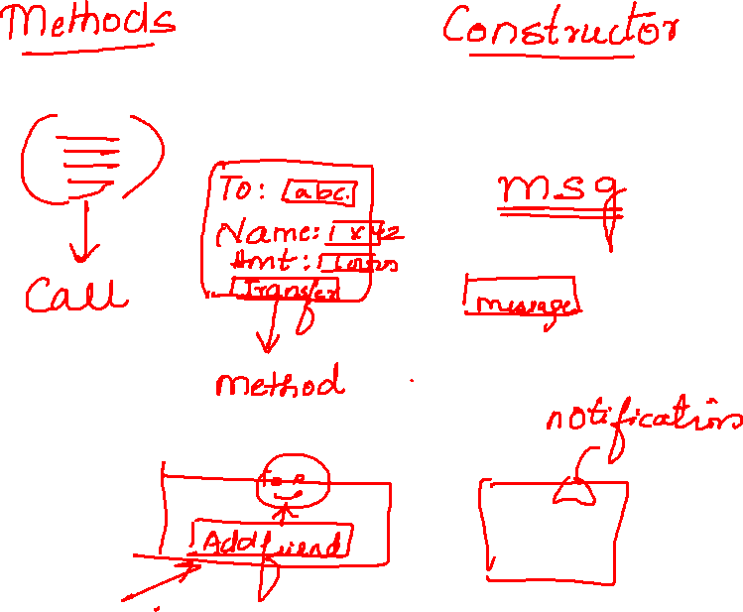

Slide 6

public class Test0 {
public void add(int a,int b) {
System.out.println(a+b);
}
public static void main(String[] args) {
Test0 t=new Test0();
t.add(10,20);
}

Slide 7
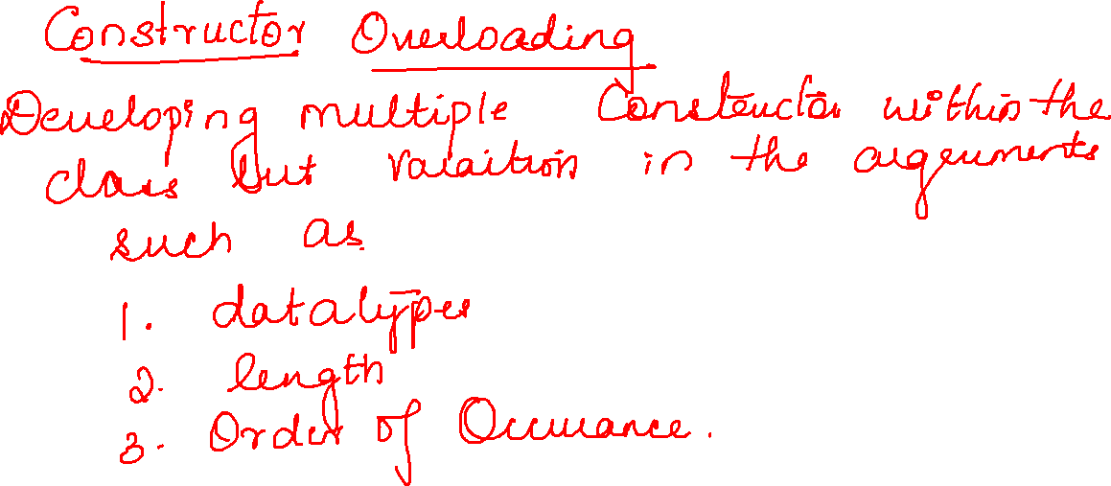

Slide 8
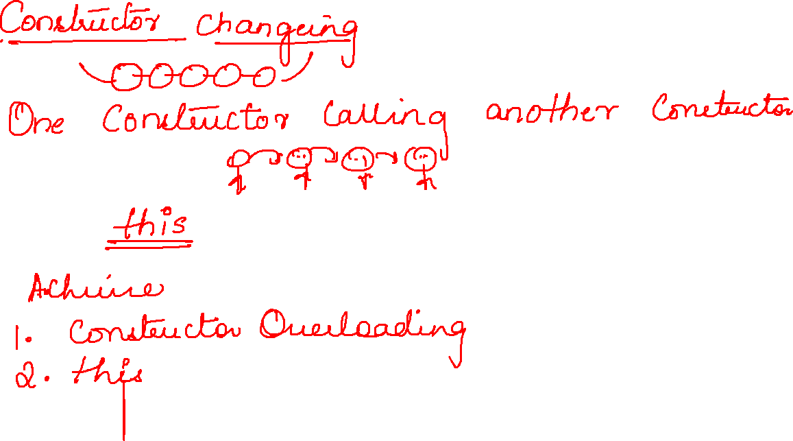

Slide 9
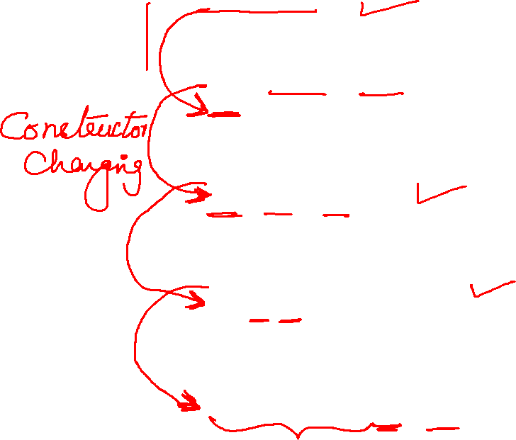
Test4(int a) {
System.out.println(a);
}
Test4(String a, int b) {
this(100);
System.out.println(a + " " + b);
}
Test4(int a, int b) {
this("Hello",60);
System.out.println(a + b);
}
Test4(String a, double b) {
this(10,30);
System.out.println(a + " " + b);
}
public static void main(String[] args) {
Test4 t=new Test4("Hi",90.00);
}

