Slide 1
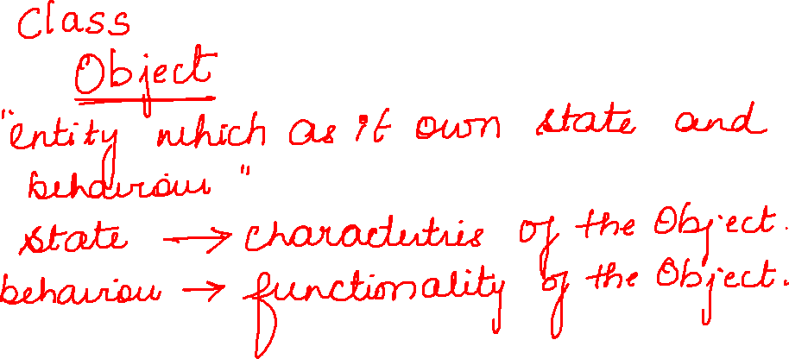

Slide 2
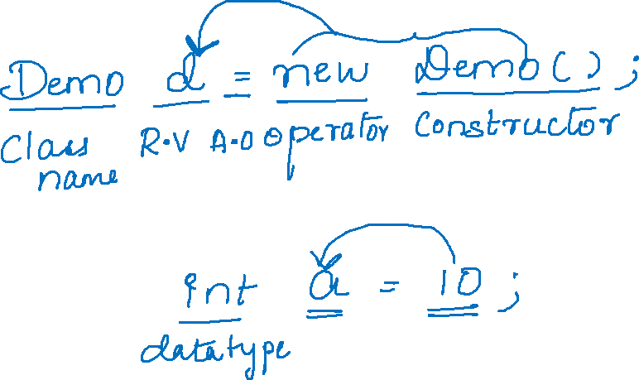

Slide 3
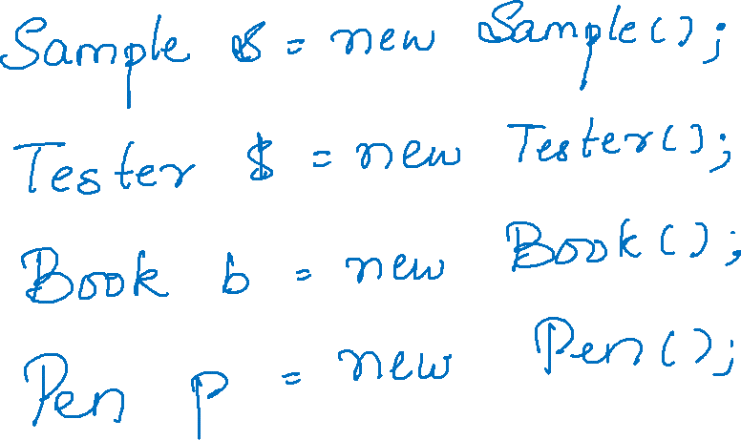

Slide 4
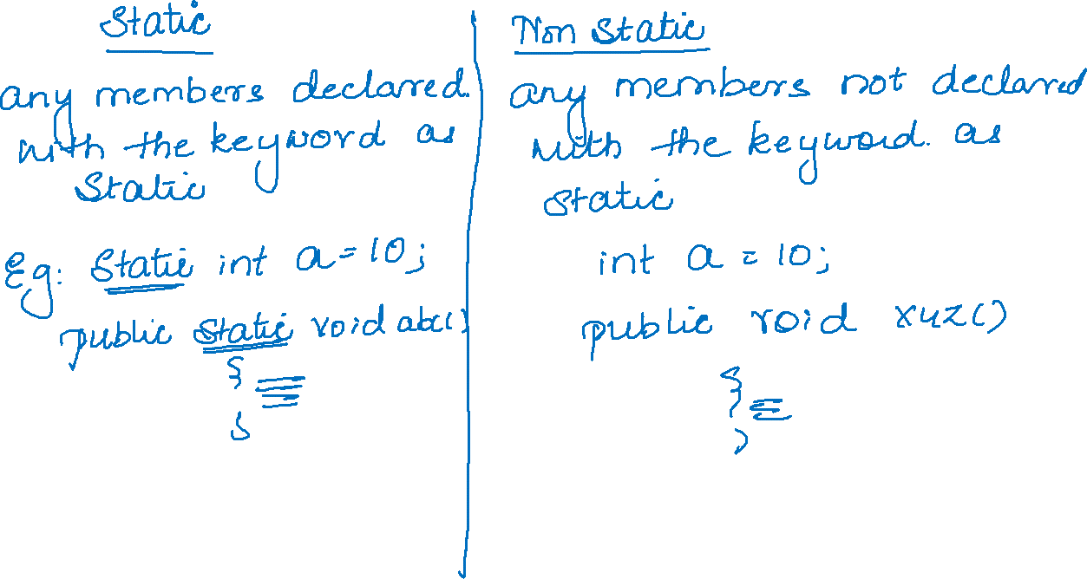

Slide 5
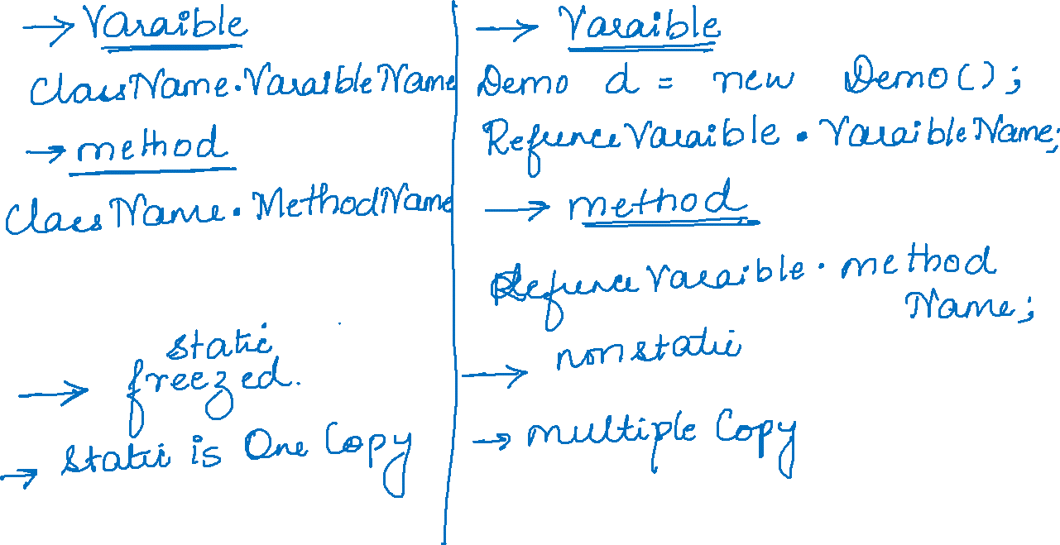

Slide 6
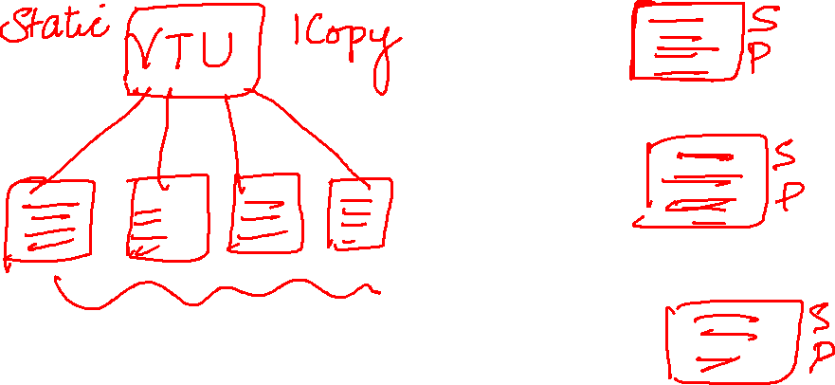

Slide 7
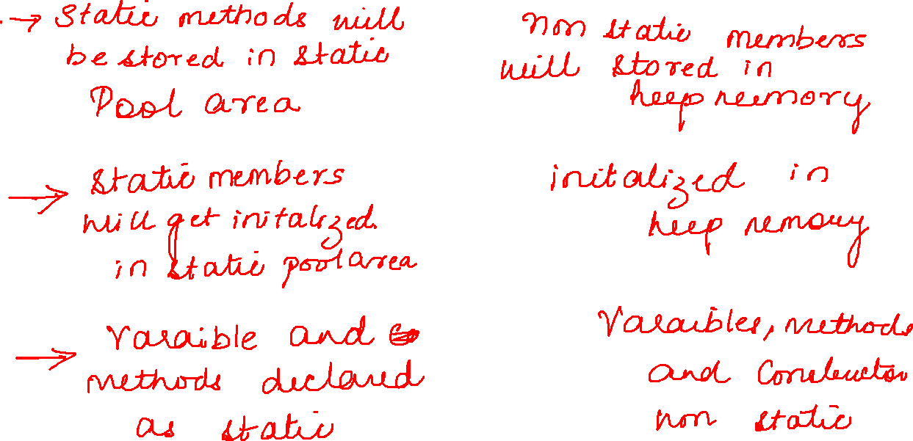


Slide 8
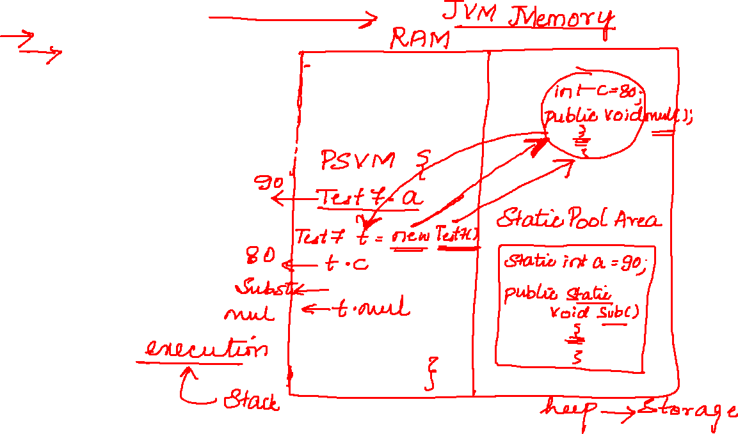
public class Test7 { static int a=90; int c=80; public static void sub() { System.out.println("subtraction"); } public void mul() { System.out.println("multiplication"); } public static void main(String[] args) { System.out.println(Test7.a); Test7 t=new Test7(); System.out.println(t.c); Test7.sub(); t.mul(); } }

