Slide 1
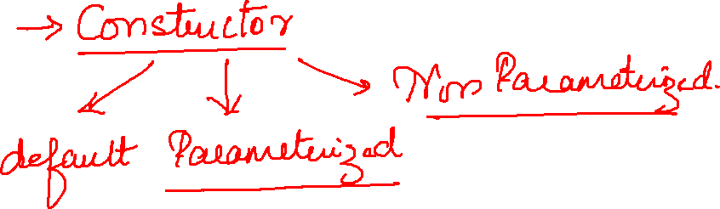

Slide 2
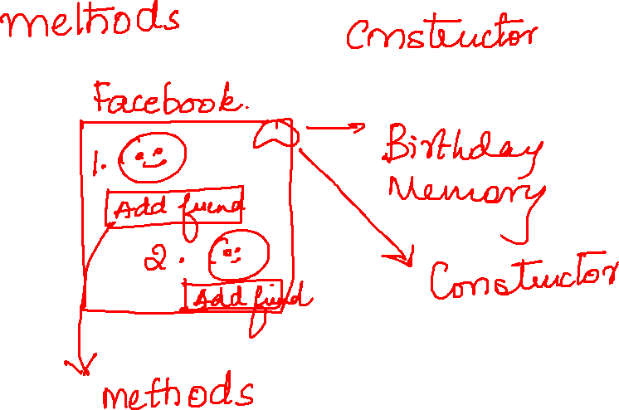

Slide 3
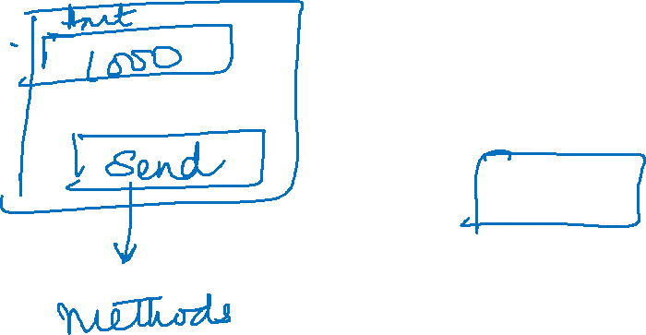

Slide 4
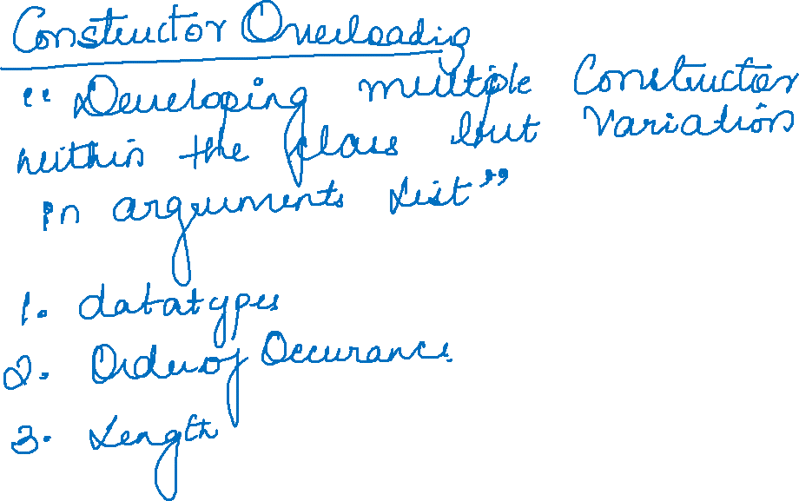

Slide 5
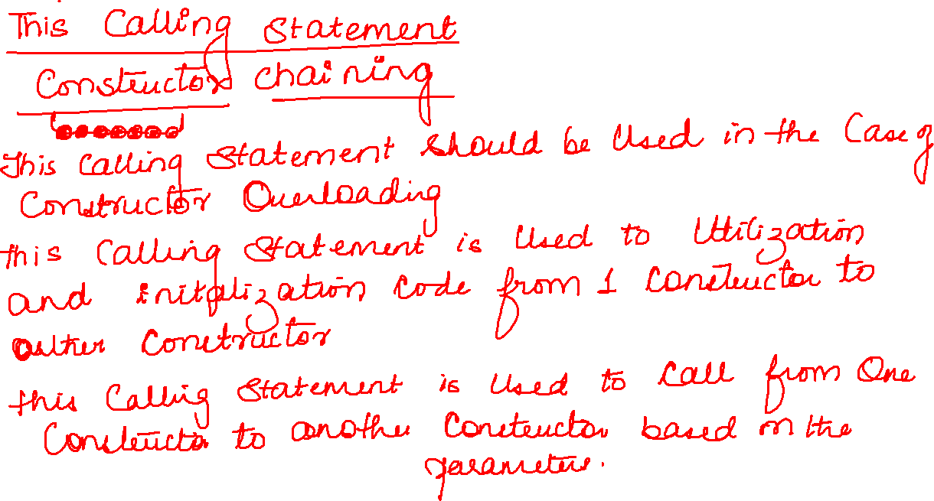

Slide 6
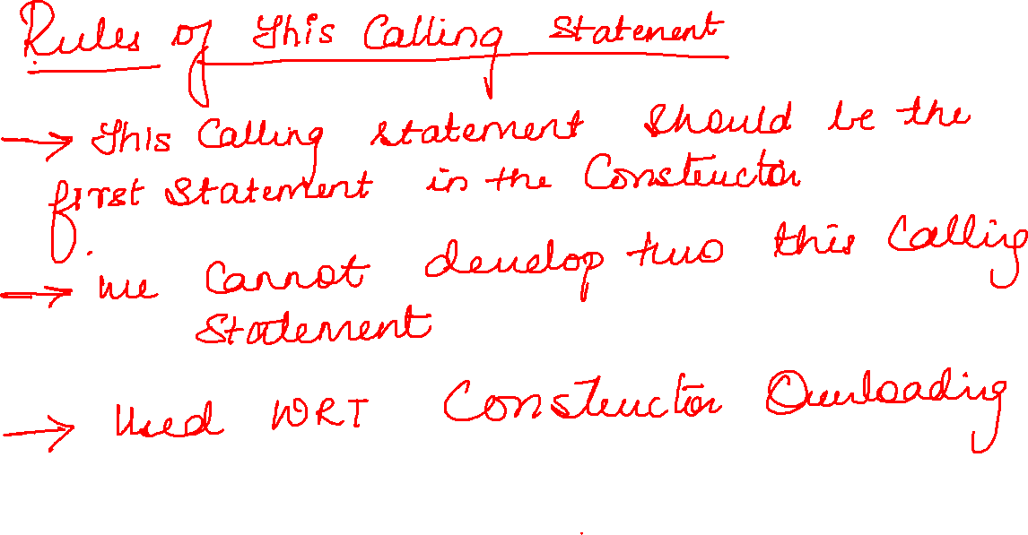

Slide 7
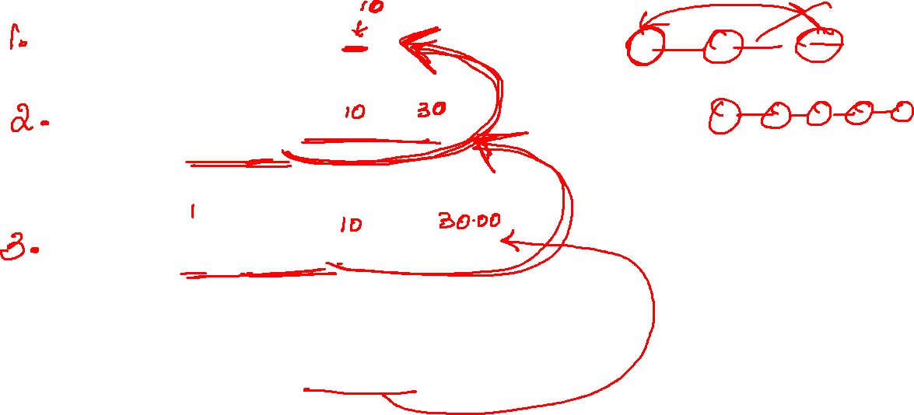
public Sub(int a) {
System.out.println(a);
}
public Sub(int a, int b) {
this(10);
System.out.println(a + b);
}
public Sub(int a, double b) {
this(10,30);
System.out.println(a + b);
}
public static void main(String[] args) {
Sub s=new Sub(10,30.00);
}
}

Slide 8


Slide 9
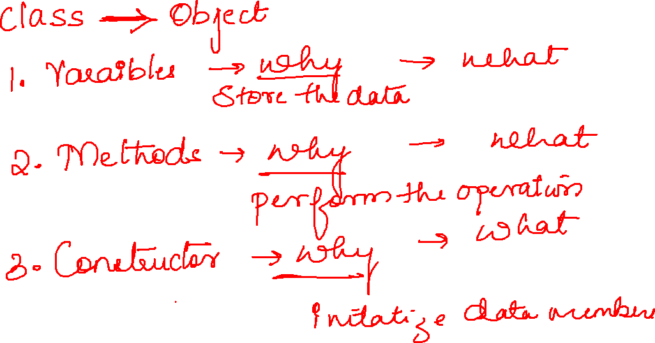

Slide 10

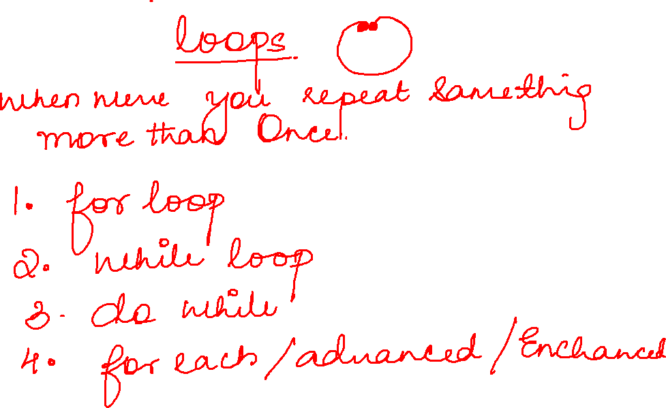

Slide 11
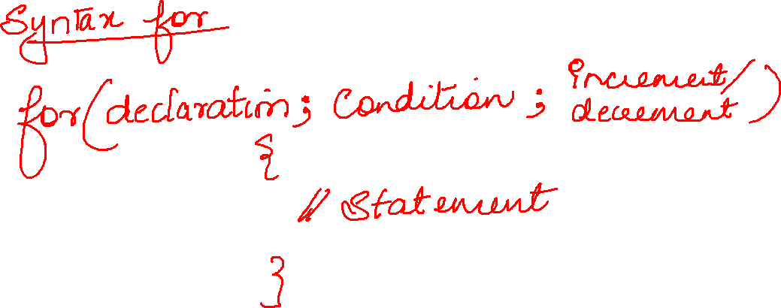

Slide 12
for(int i=1;i<=5;i++) { System.out.println("Hello java"); }

