Slide 1
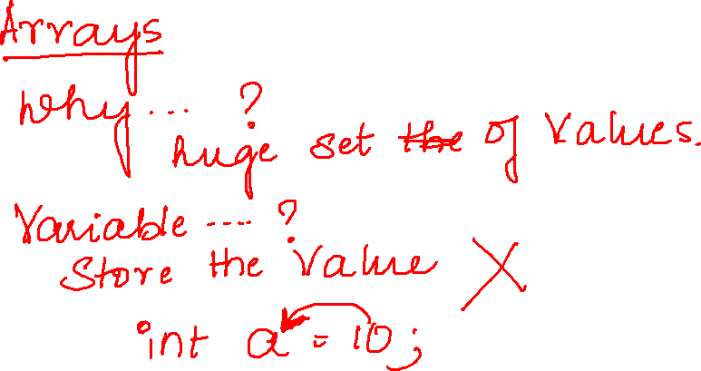

Slide 2
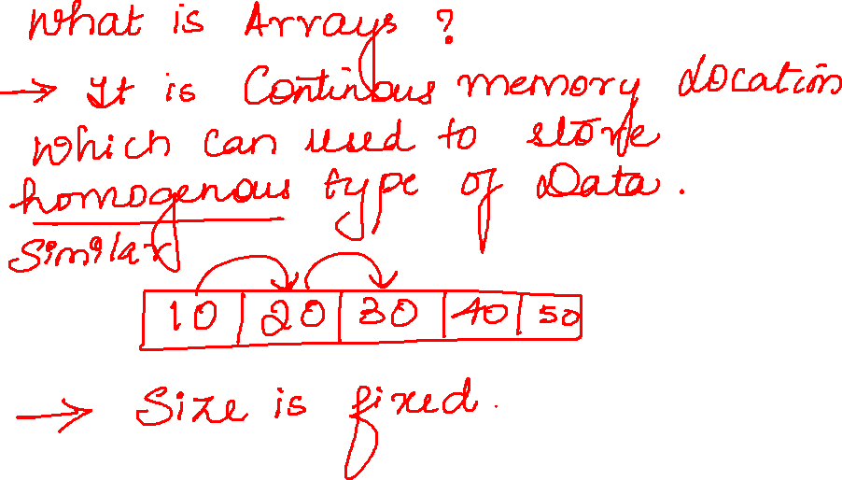

Slide 3
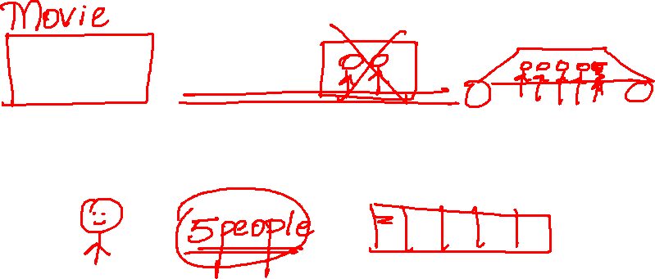

Slide 4
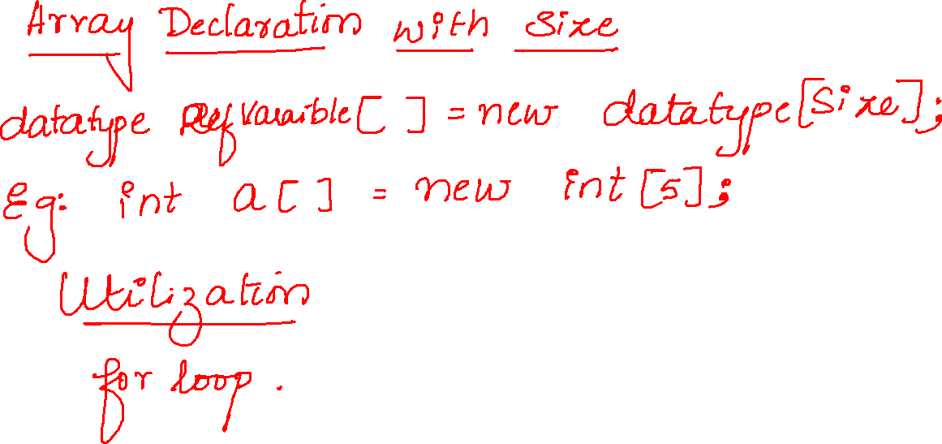

Slide 5
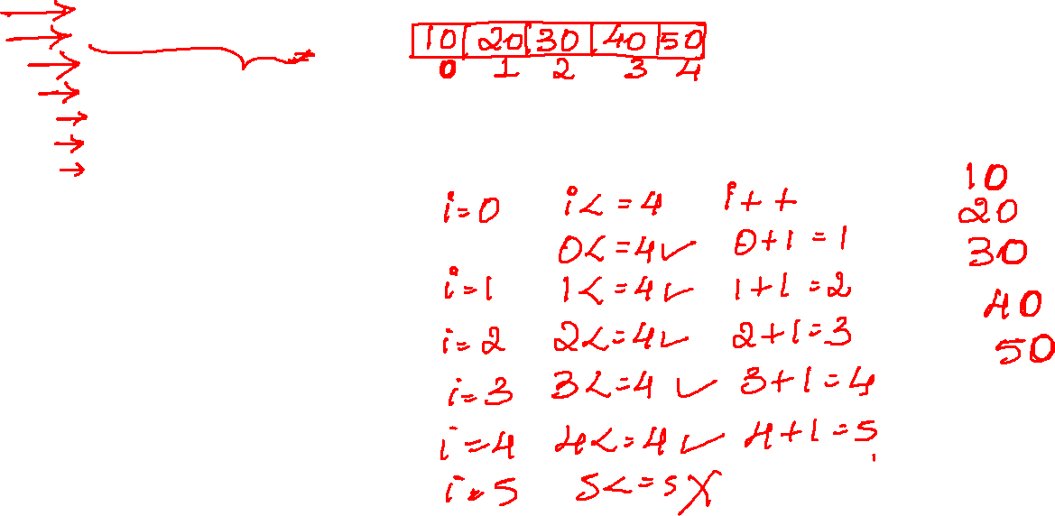
public static void main(String[] args) {
int arr[]=new int[5];
arr[0]=10;
arr[1]=20;
arr[2]=30;
arr[3]=40;
arr[4]=50;
for(int i=0;i<=4;i++) {
System.out.println(arr[i]);
}

Slide 6
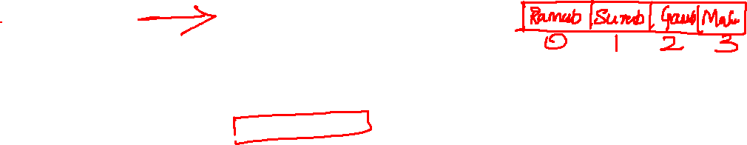
String s[]=new String[4];
s[0]="Ramesh";
s[1]="Suresh";
s[2]="Ganesh";
s[3]="Mahesh";
s[4]="Dinesh";

Slide 7
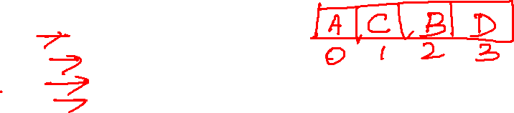
char c[]=new char[4];
c[0]='A';
c[2]='B';
c[1]='C';
c[3]='D';

Slide 8
