Slide 1
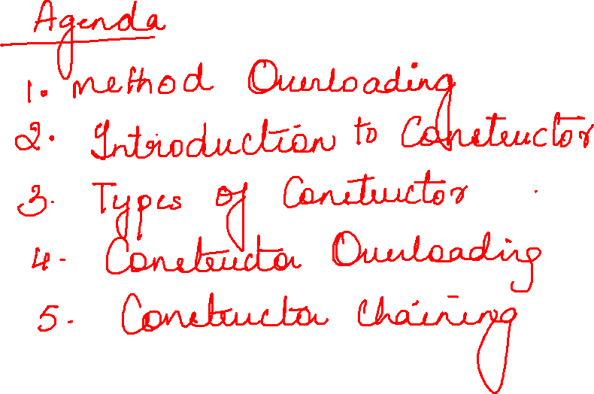

Slide 2
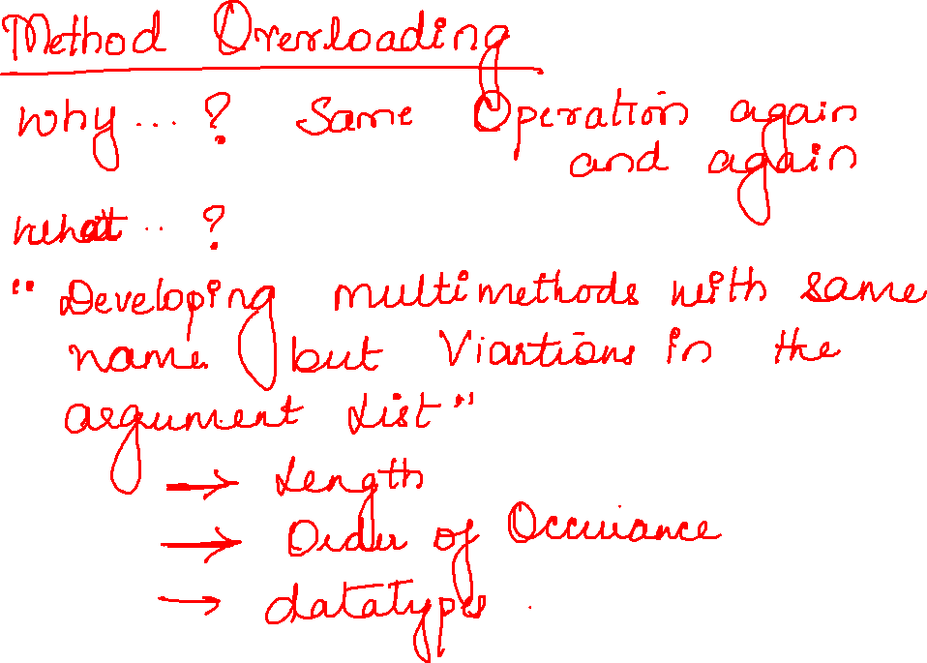

Slide 3


Slide 4
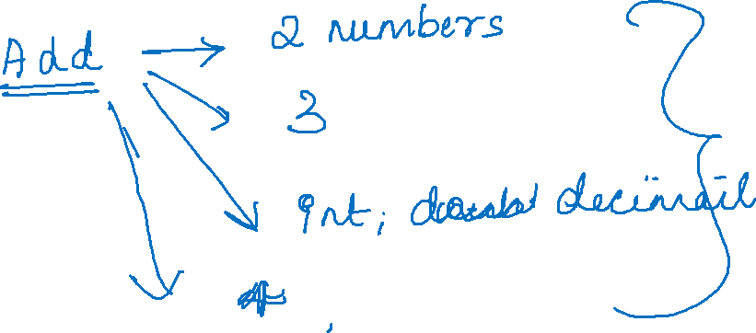

Slide 5


Slide 6
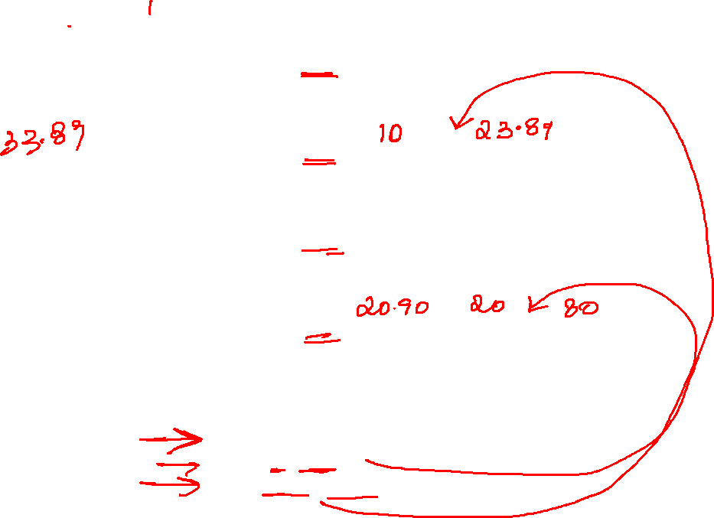
public class Test8 {
public void add(int a, int b) {
System.out.println(a + b);
}
public void add(int a, double b) {
System.out.println(a + b);
}
public void add(int a, int b, double c) {
System.out.println(a + b + c);
}
public void add(double a, int b, int c) {
System.out.println(a + b + c);
}
public static void main(String[] args) {
Test8 t=new Test8();
t.add(10,23.89);
t.add(20.90,20,80);

Slide 7


Slide 8
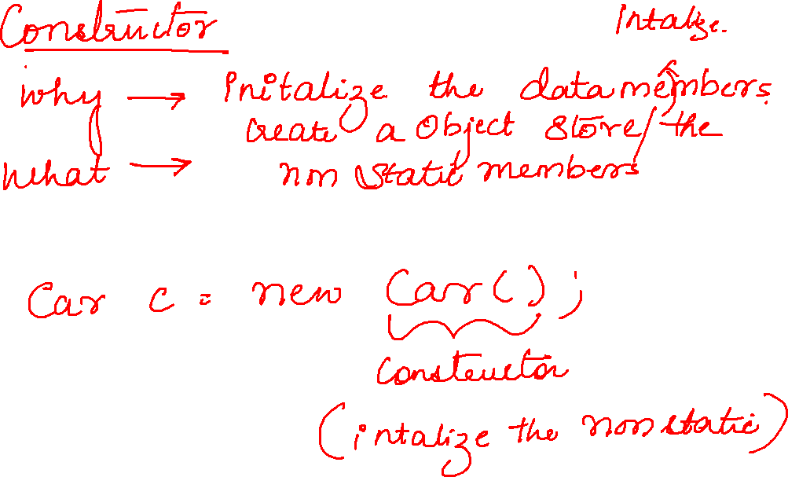

Slide 9
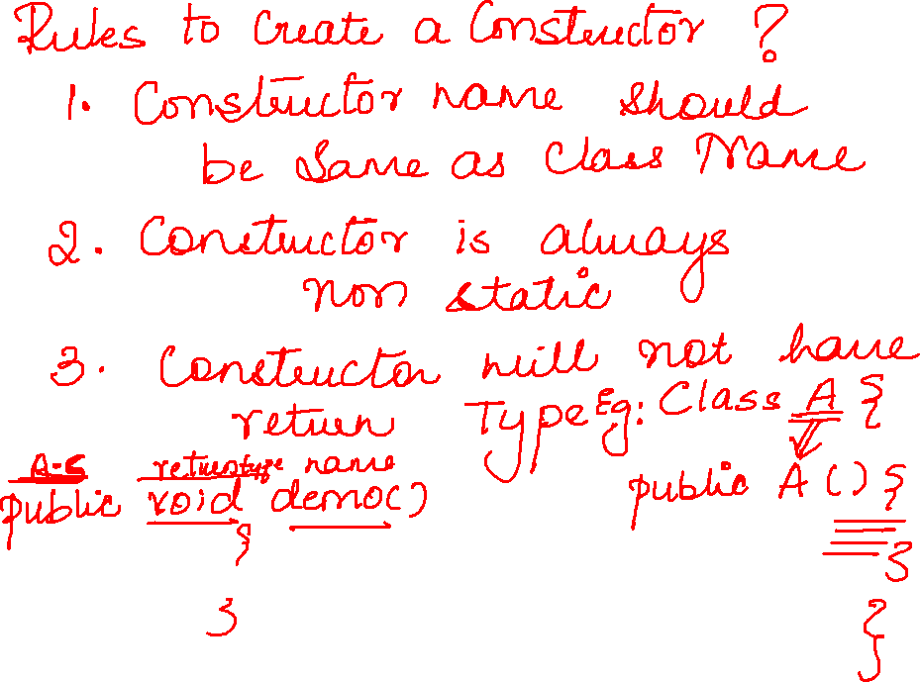

Slide 10
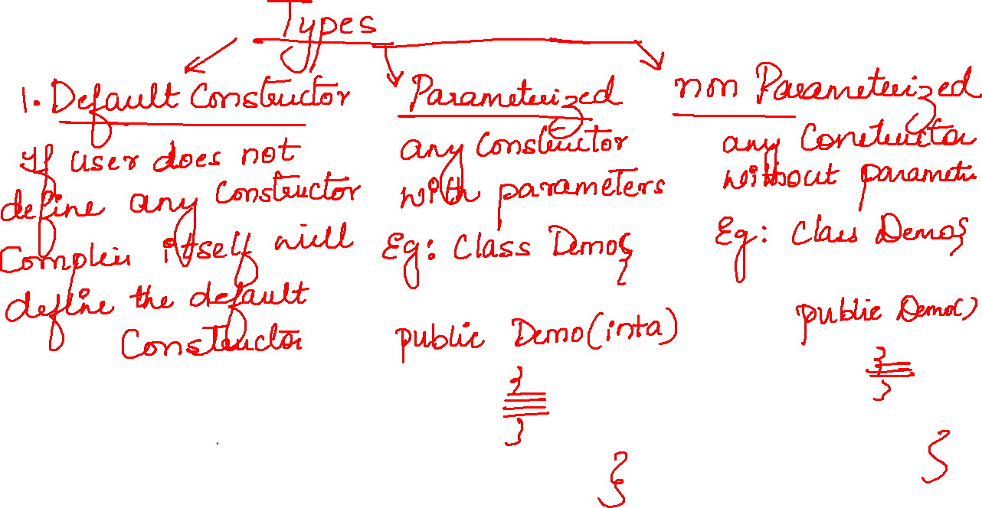

Slide 11
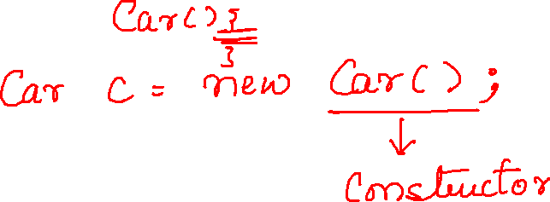

Slide 12
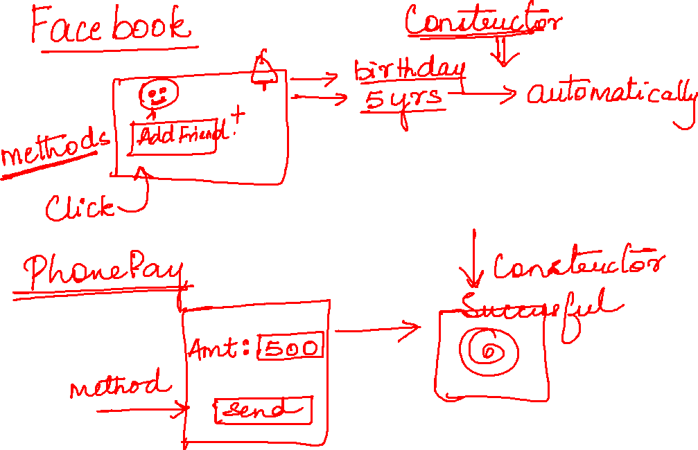

Slide 13
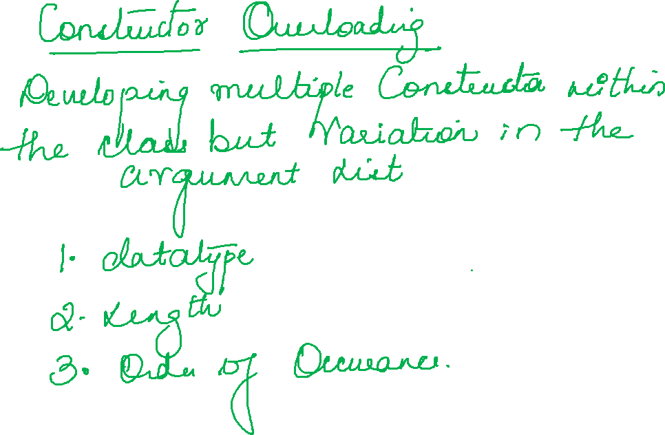

Slide 14


