Slide 1
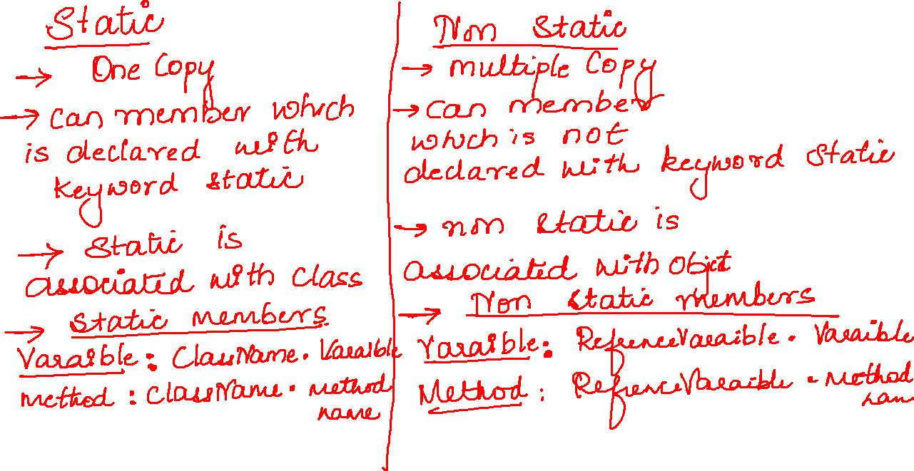

Slide 2
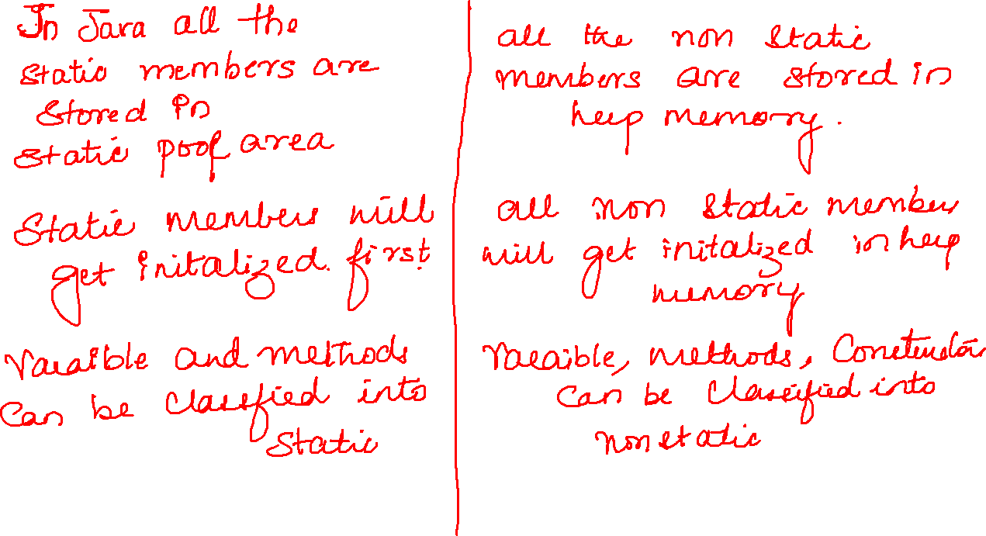

Slide 3

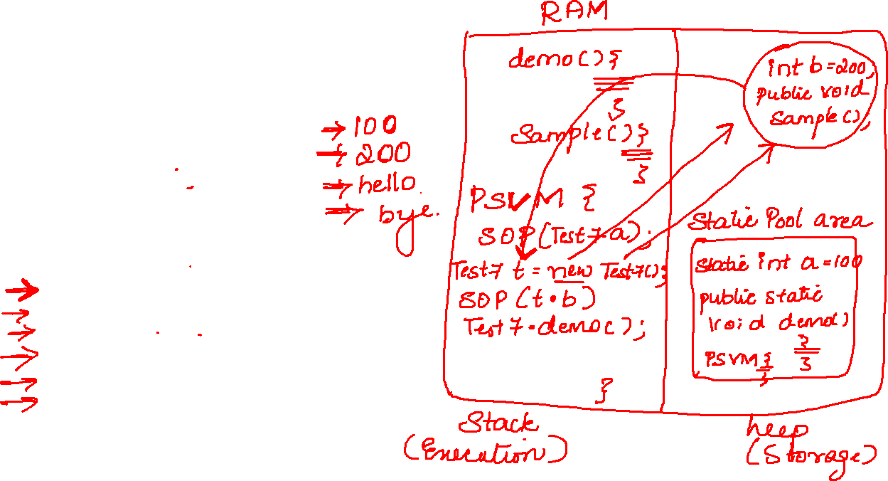
public class Test7 {
static int a = 100;
int b = 200;
public static void demo() {
System.out.println("hello");
}
public void sample() {
System.out.println("bye");
}
public static void main(String[] args) {
System.out.println(Test7.a);
Test7 t = new Test7();
System.out.println(t.b);
Test7.demo();
t.sample();
}

Slide 4
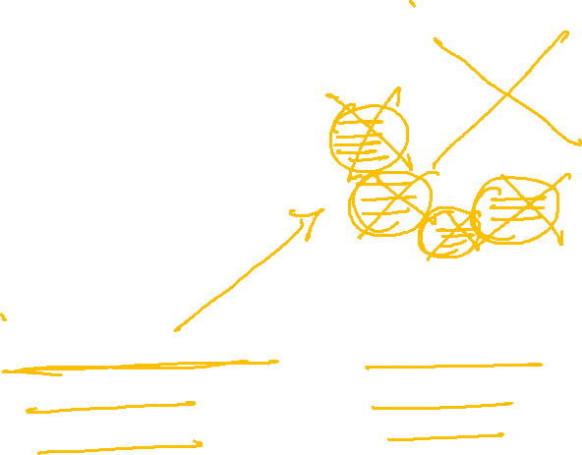
public class Test7 {
static int a = 100;
int b = 200;
public static void demo() {
System.out.println("hello");
}
public void sample() {
System.out.println("bye");
}
public static void main(String[] args) {
System.out.println(Test7.a);
Test7 t = new Test7();
System.out.println(t.b);
Test7.demo();
t.sample();
}

Slide 5


Slide 6
