Slide 1
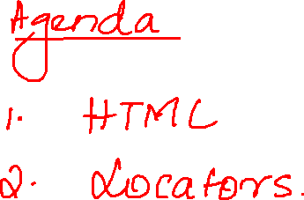

Slide 2
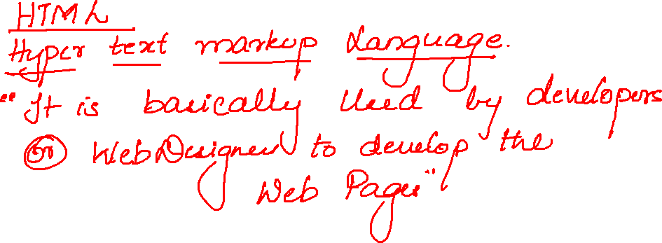

Slide 3
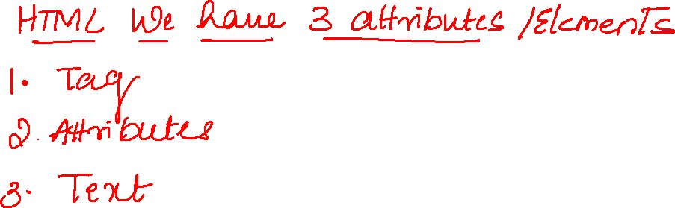

Slide 4
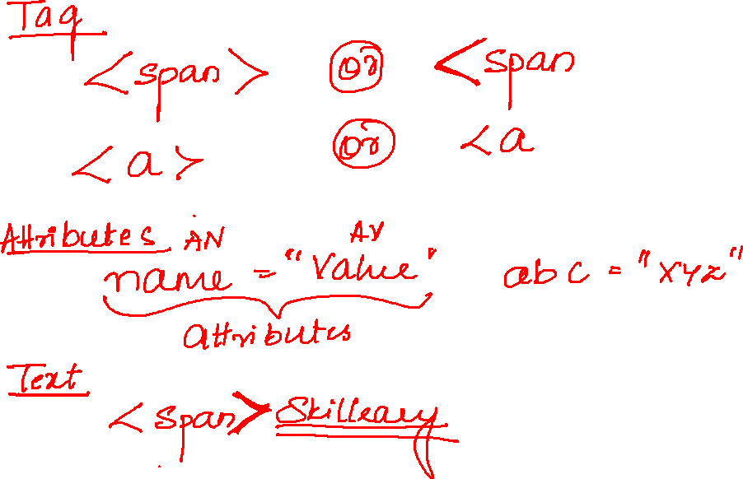

Slide 5
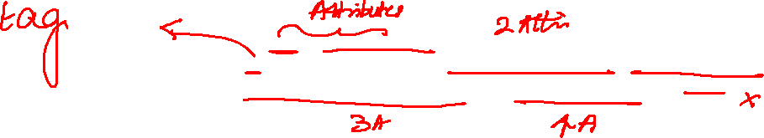
<a href="/ref=nav_logo" id="nav-logo-sprites" class="nav-logo-link nav-progressive-attribute" aria-label="Amazon">

Slide 6
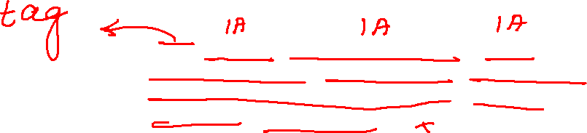
<input type="text" id="twotabsearchtextbox" value="" name="field-keywords" autocomplete="off" placeholder="" class="nav-input nav-progressive-attribute" dir="auto" tabindex="0" aria-label="Search">

Slide 7
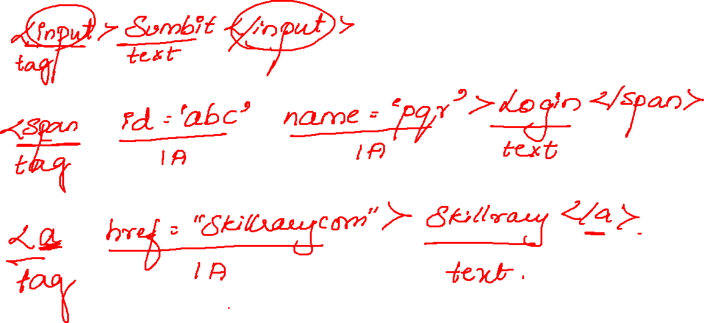

Slide 8
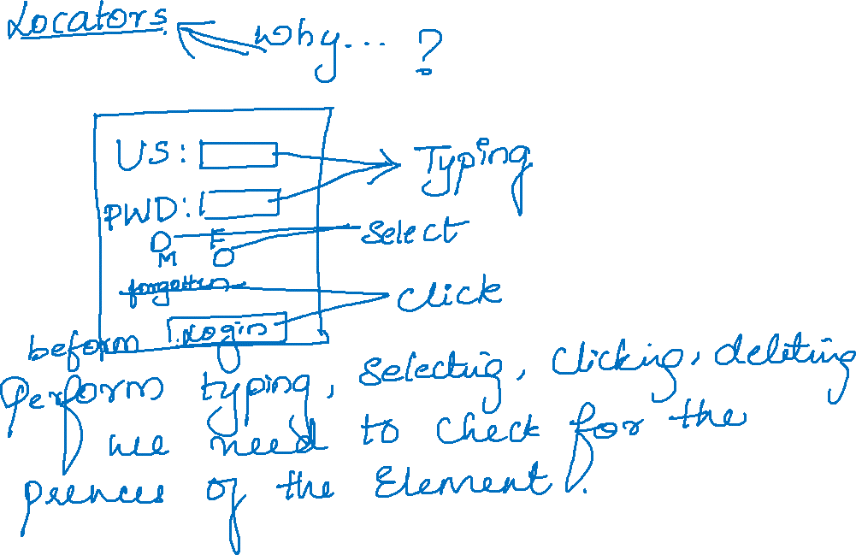

Slide 9
