Slide 1
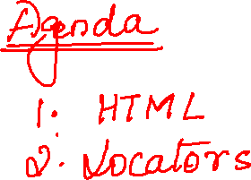

Slide 2
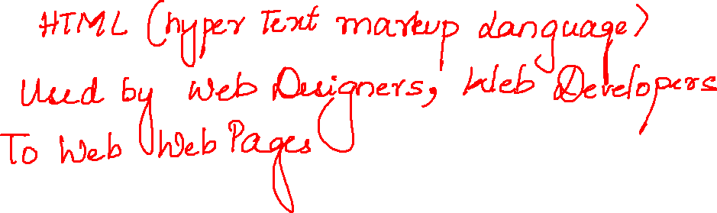

Slide 3
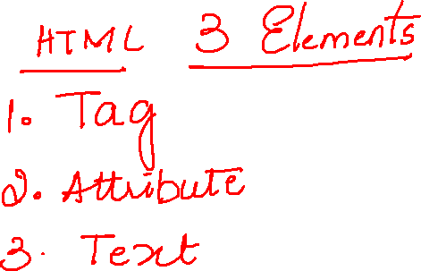

Slide 4
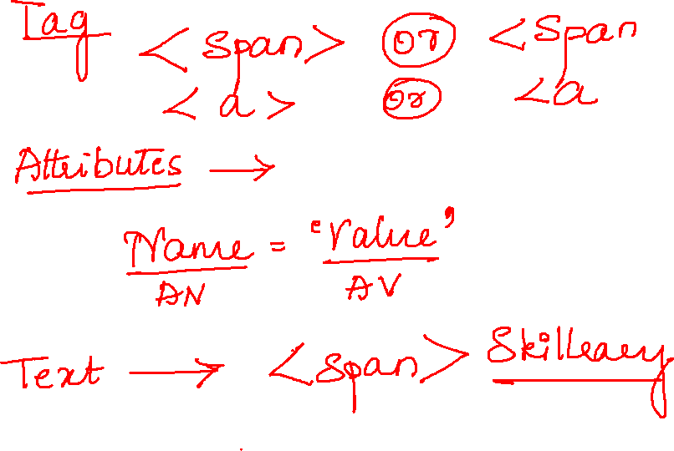

Slide 5
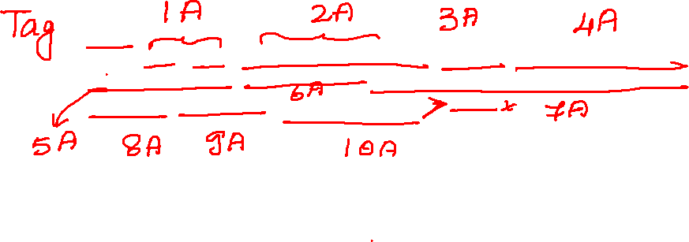
<input type="text" id="twotabsearchtextbox" value="" name="field-keywords" autocomplete="off" placeholder="" class="nav-input nav-progressive-attribute" dir="auto" tabindex="0" aria-label="Search">

Slide 6
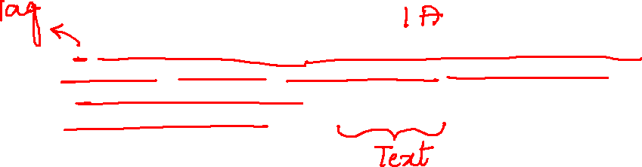
<a href="/gp/goldbox?ref_=nav_cs_gb_5d8ef71f209b44c2acab6343d6a5a05e" class="nav-a " tabindex="0" data-csa-c-type="link" data-csa-c-slot-id="nav_cs_0" data-csa-c-content-id="nav_cs_gb_5d8ef71f209b44c2acab6343d6a5a05e" data-csa-c-id="fihvh7-p147z2-xqf0ve-mfd3ae">Today's Deals</a>

Slide 7
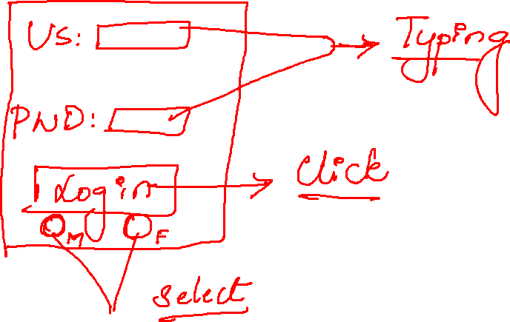

Slide 8
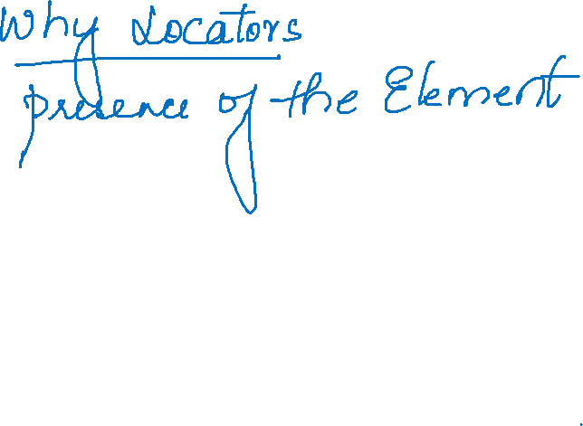

Slide 9
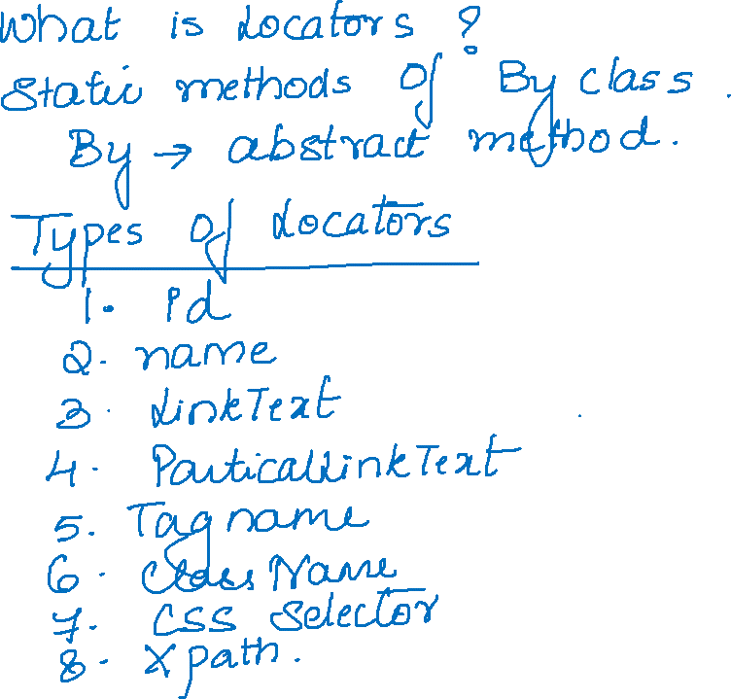
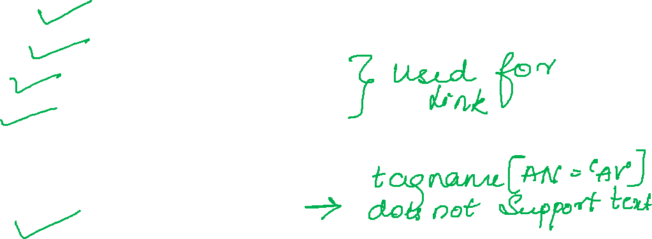

Slide 10
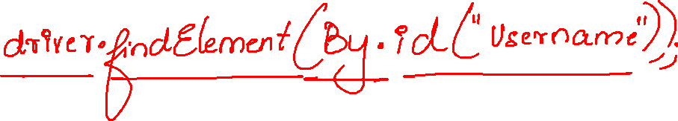
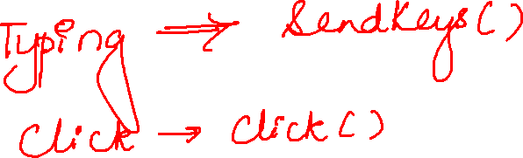

Slide 11

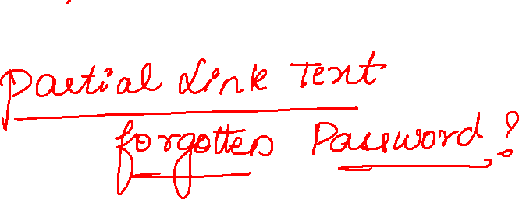
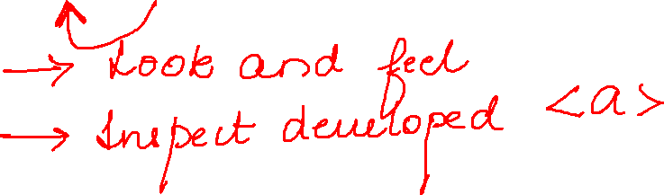

Slide 12
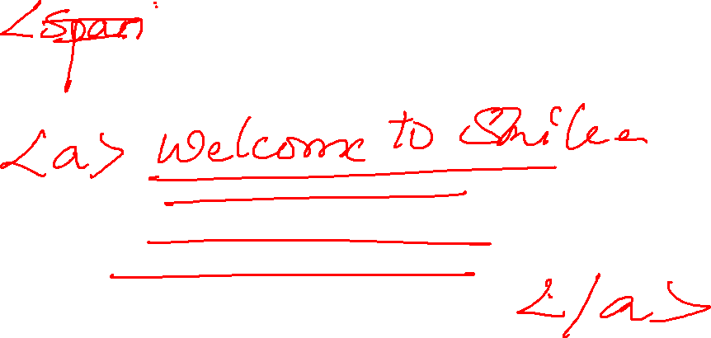

Slide 13
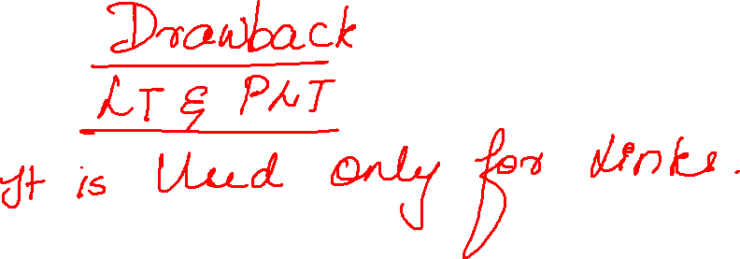

Slide 14
