Slide 1
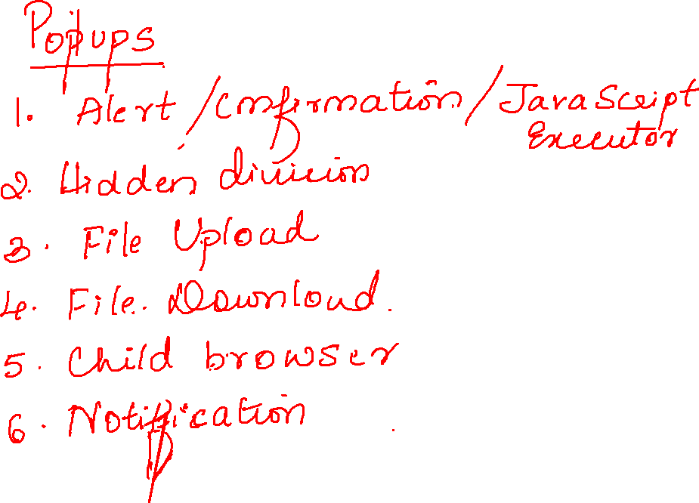

Slide 3

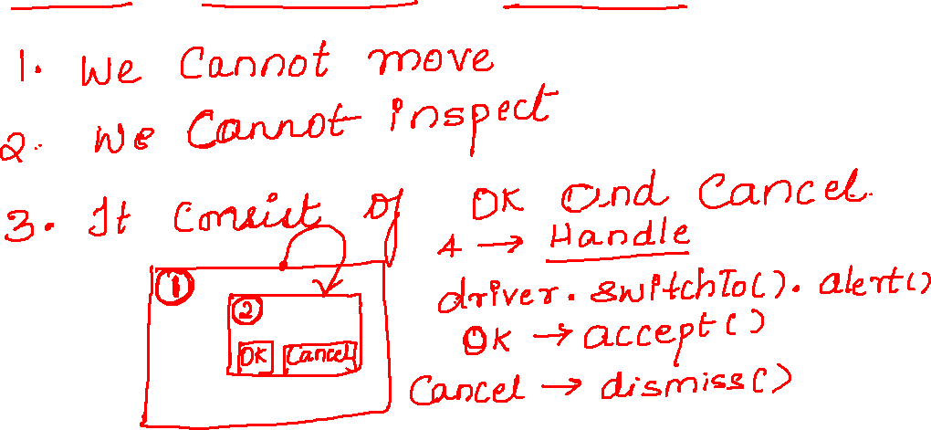

Slide 4
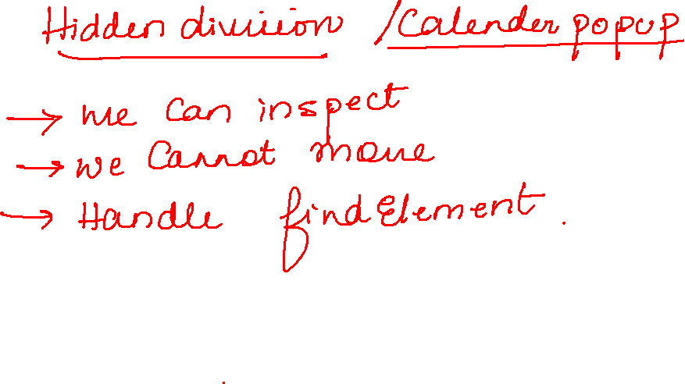

Slide 5
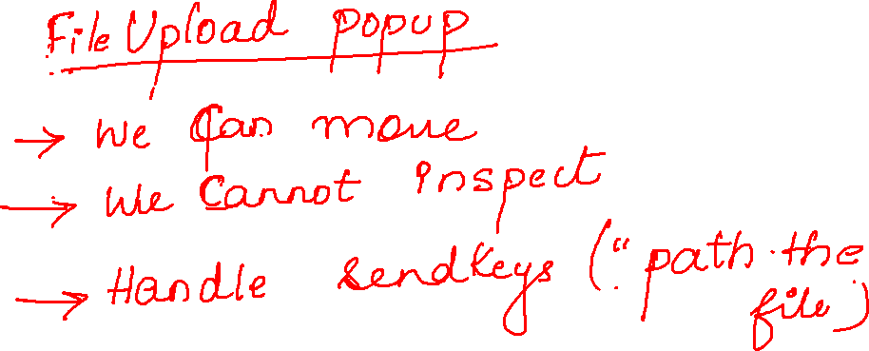

Slide 6

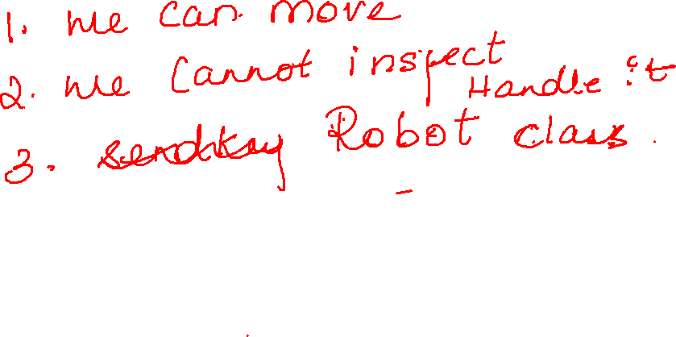

Slide 7
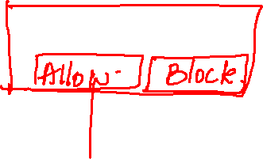
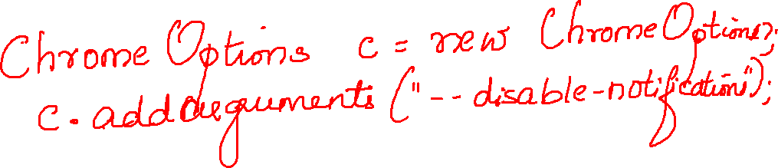

Slide 8

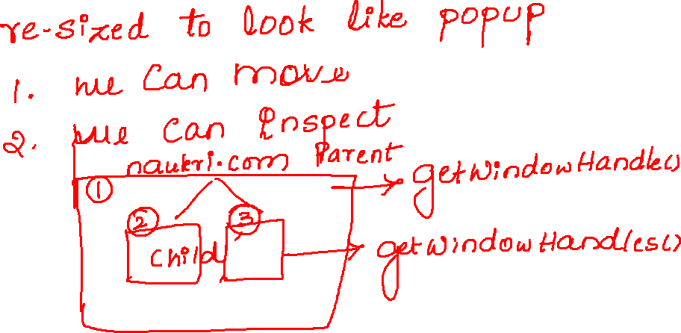

Slide 9
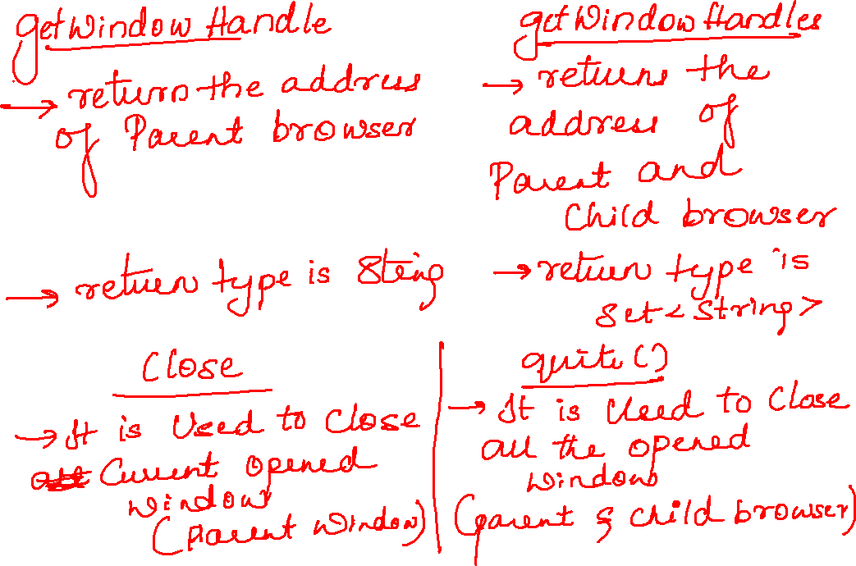

Slide 10

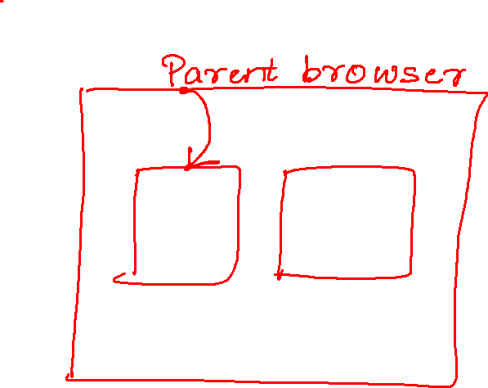

Slide 11

String parent = driver.getWindowHandle();
System.out.println(parent);
Set<String> child = driver.getWindowHandles();
System.out.println(child);
System.out.println(child.size()); for(String b:child)
{ driver.switchTo().window(b);
System.out.println(driver.getTitle());
}

Slide 12
