Slide 1
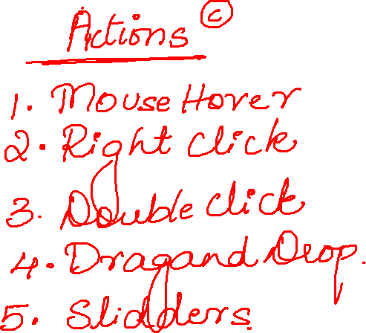

Slide 2
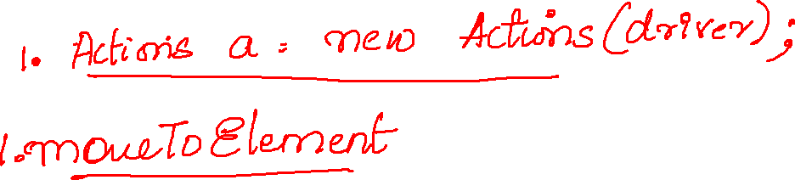
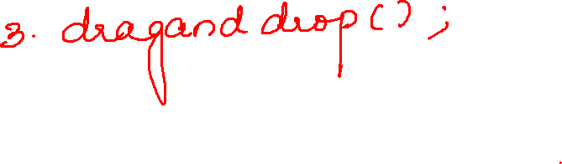
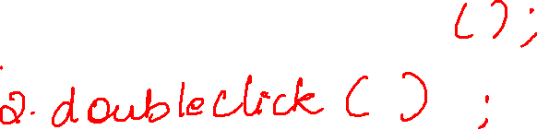
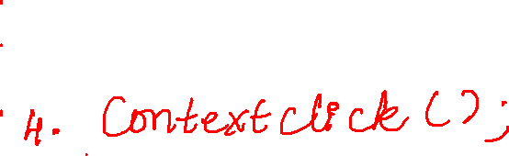

Slide 3
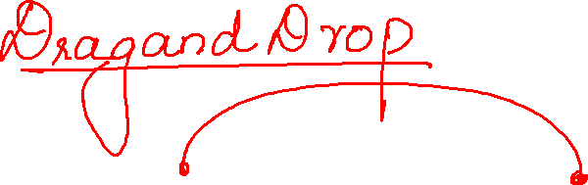

Slide 4
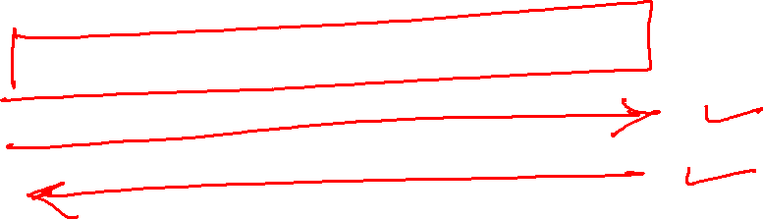

Slide 5
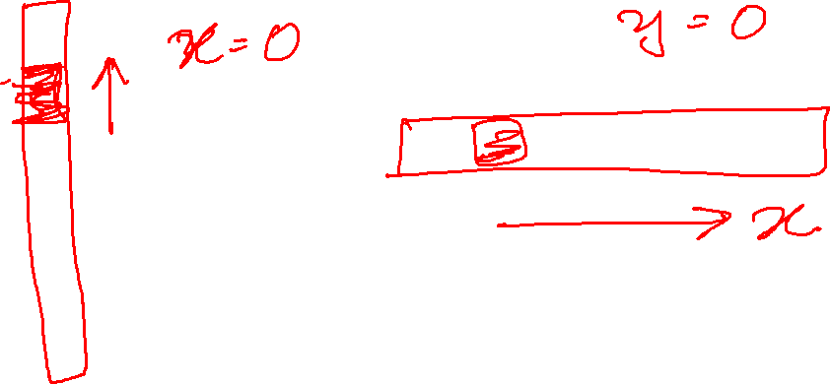
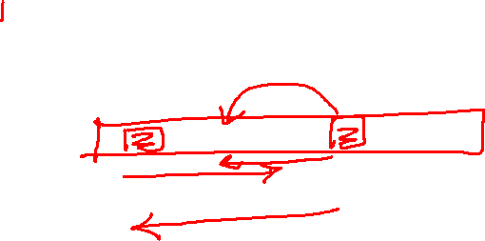

Slide 6
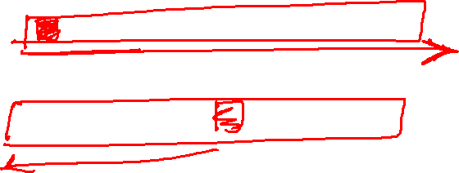

Slide 7
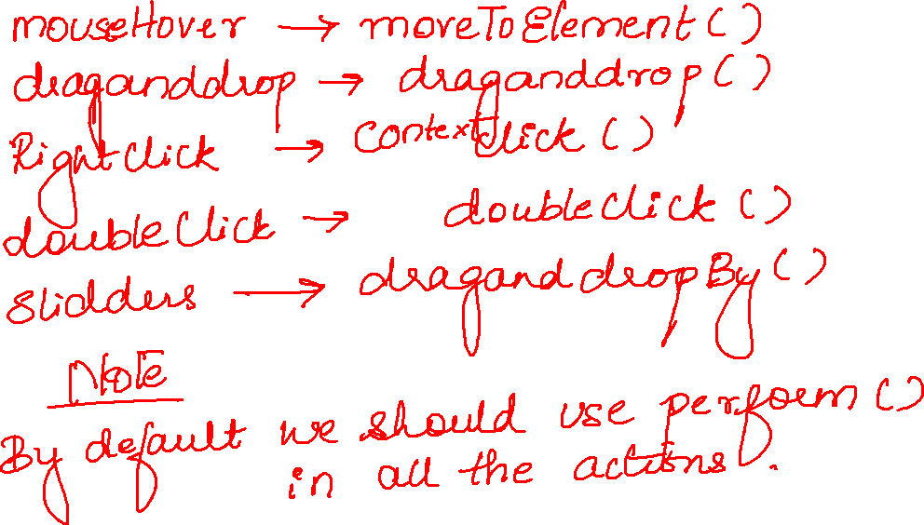

Slide 8
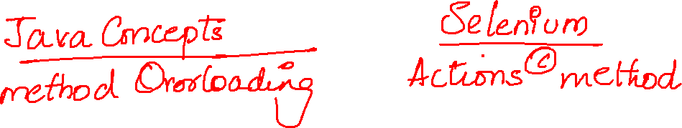

Slide 9
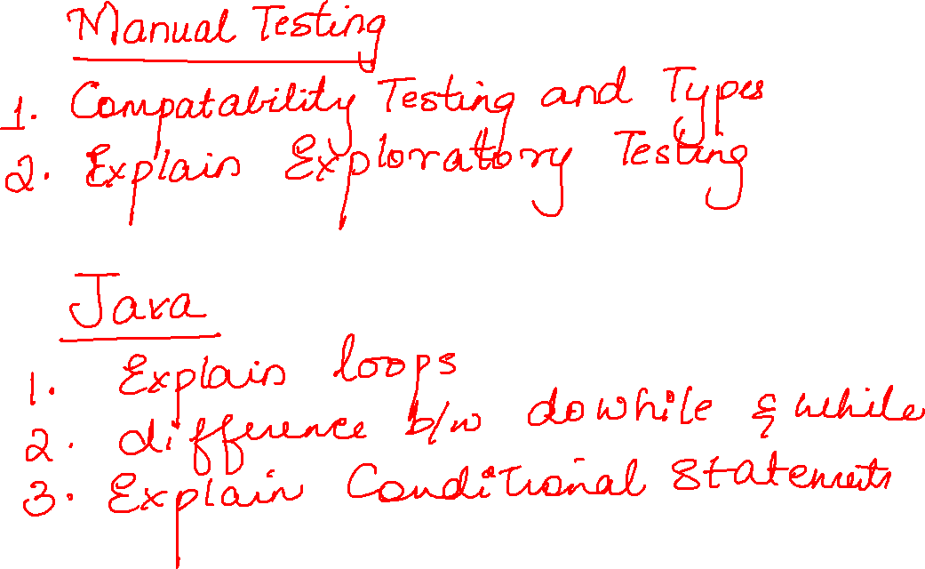

Slide 10
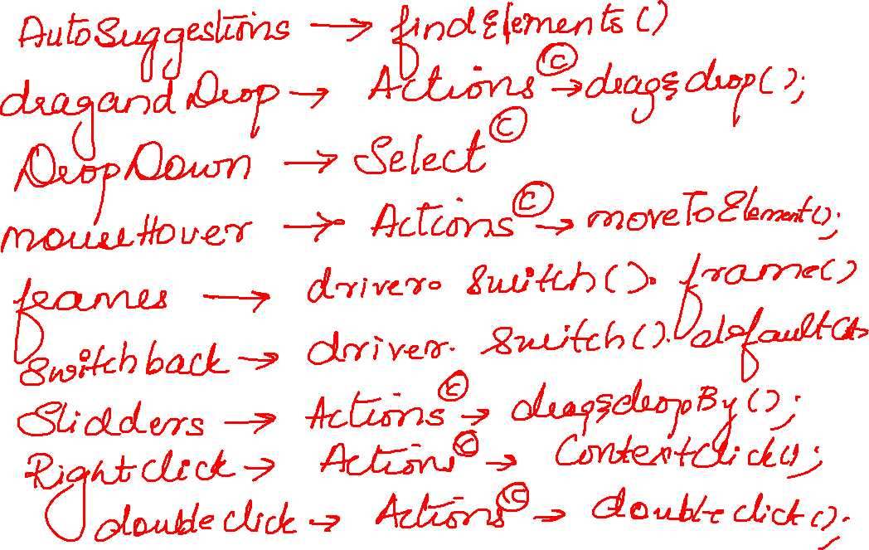

Slide 11
package actions;
import java.util.concurrent.TimeUnit;
import org.openqa.selenium.By;
import org.openqa.selenium.WebDriver;
import org.openqa.selenium.WebElement;
import org.openqa.selenium.chrome.ChromeDriver;
import org.openqa.selenium.interactions.Actions;
public class Test0 {
public static void main(String[] args) throws InterruptedException {
WebDriver driver=new ChromeDriver();
driver.manage().window().maximize();
driver.get("https://www.ebay.com/");
driver.manage().timeouts().implicitlyWait(10,TimeUnit.SECONDS);
WebElement ele = driver.findElement(By.xpath("//a[text()='Sports']"));
Actions a=new Actions(driver);
a.moveToElement(ele).perform();
Thread.sleep(2000);
driver.findElement(By.xpath("//a[text()='Fishing']")).click();
}
}

Slide 12
package actions; import java.util.concurrent.TimeUnit; import org.openqa.selenium.By; import org.openqa.selenium.WebDriver; import org.openqa.selenium.WebElement; import org.openqa.selenium.chrome.ChromeDriver; import org.openqa.selenium.interactions.Actions; public class Test1 { public static void main(String[] args) { WebDriver driver=new ChromeDriver(); driver.manage().window().maximize(); driver.get("https://demoapp.skillrary.com/product.php?product=selenium-training"); driver.manage().timeouts().implicitlyWait(10,TimeUnit.SECONDS); WebElement ele = driver.findElement(By.id("add")); Actions a=new Actions(driver); a.doubleClick(ele).perform(); }}

Slide 13
package actions;
import java.util.concurrent.TimeUnit;
import org.openqa.selenium.By;
import org.openqa.selenium.WebDriver;
import org.openqa.selenium.WebElement;
import org.openqa.selenium.chrome.ChromeDriver;
import org.openqa.selenium.interactions.Actions;
public class Test1 {
public static void main(String[] args) {
WebDriver driver=new ChromeDriver();
driver.manage().window().maximize();
driver.get("https://demoapp.skillrary.com/product.php?product=selenium-training");
driver.manage().timeouts().implicitlyWait(10,TimeUnit.SECONDS);
WebElement ele = driver.findElement(By.id("add"));
Actions a=new Actions(driver);
a.doubleClick(ele).perform();
}}

Slide 14
package actions;
import java.util.concurrent.TimeUnit;
import org.openqa.selenium.By;
import org.openqa.selenium.WebDriver;
import org.openqa.selenium.WebElement;
import org.openqa.selenium.chrome.ChromeDriver;
import org.openqa.selenium.interactions.Actions;
public class Test3 {
public static void main(String[] args) {
WebDriver driver=new ChromeDriver();
driver.manage().window().maximize();
driver.get("https://www.google.com/");
driver.manage().timeouts().implicitlyWait(10,TimeUnit.SECONDS);
WebElement ele = driver.findElement(By.name("q"));
Actions a=new Actions(driver);
a.contextClick(ele).perform();
}}

Slide 15
package actions;
public class Test4 {
public static void main(String[] args) throws InterruptedException {
WebDriver driver=new ChromeDriver();
driver.manage().window().maximize();
driver.get("https://jqueryui.com/slider/");
driver.manage().timeouts().implicitlyWait(10,TimeUnit.SECONDS);
driver.switchTo().frame(0);
WebElement ele = driver.findElement(By.id("slider"));
Actions a=new Actions(driver);
a.dragAndDropBy(ele,100,0).perform();
Thread.sleep(3000);
a.dragAndDropBy(ele,-100,0).perform();
}}

