Slide 1

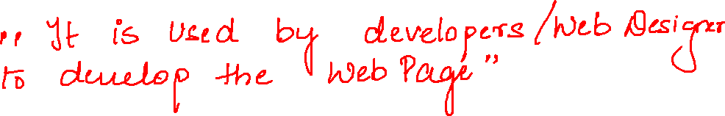

Slide 2
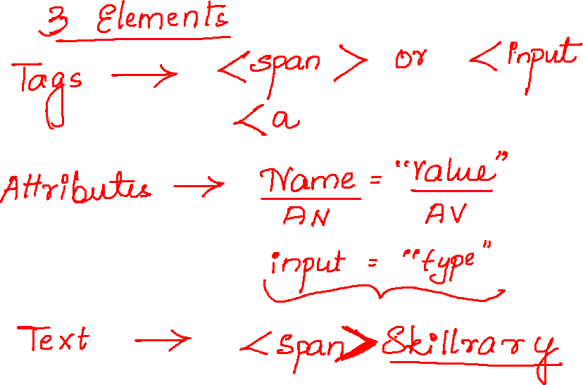
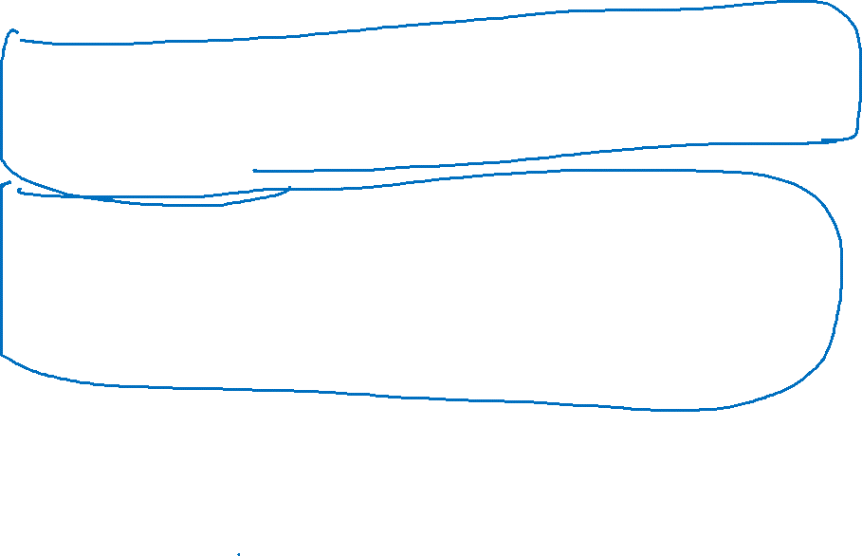

Slide 3
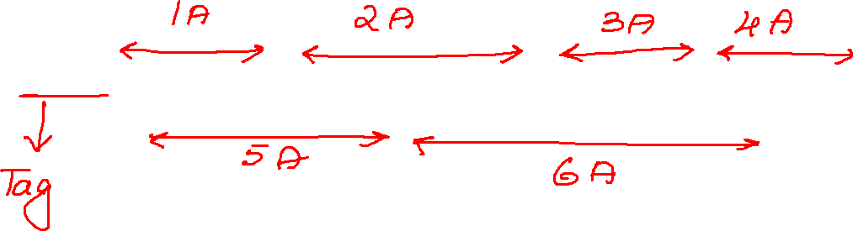

<input type="text" name="username" value="" id="username" class="textField" placeholder="Username">

Slide 4

<input type="password" name="pwd" value="" class="textField pwdfield" placeholder="Password">

Slide 5
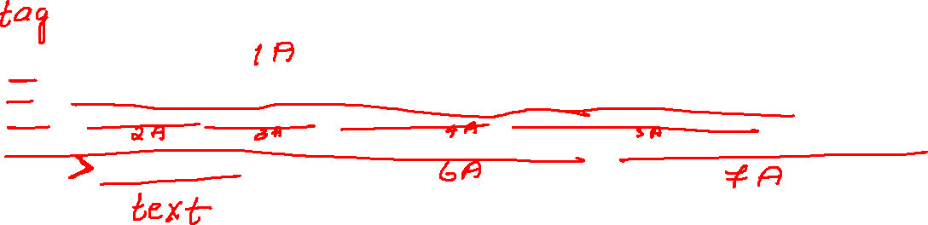
<a href="/gp/help/customer/display.html?nodeId=508510&amp;ref_=nav_cs_customerservice_2bf4fe8c5ec54e6bae2d1c24043f012b" class="nav-a " tabindex="0" data-csa-c-type="link" data-csa-c-slot-id="nav_cs_1" data-csa-c-content-id="nav_cs_customerservice_2bf4fe8c5ec54e6bae2d1c24043f012b" data-csa-c-id="5t30er-p3ex5j-9p81y2-n8c78r">Customer Service</a>

Slide 6
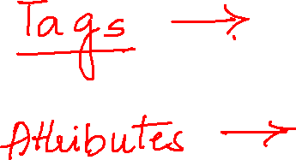

Slide 7
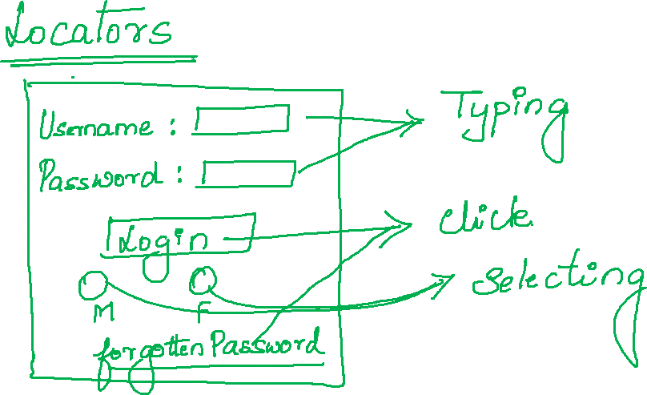

Slide 8
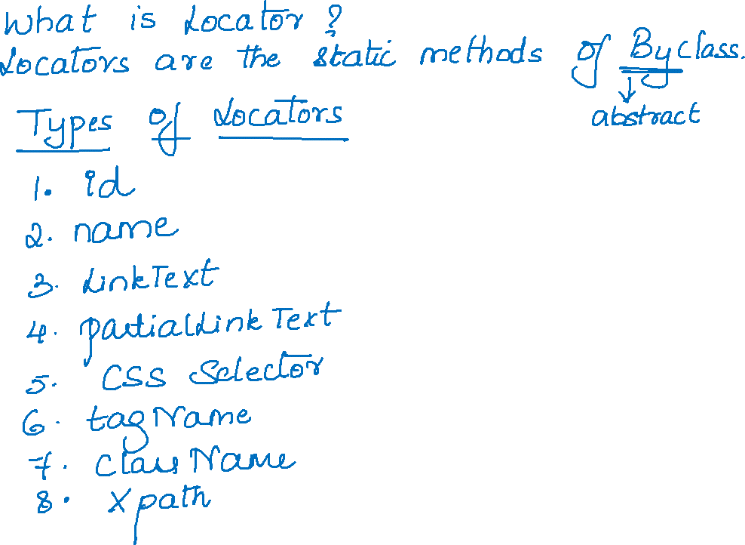
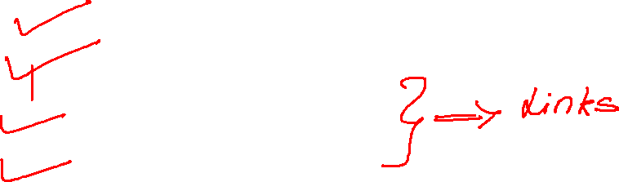

Slide 9
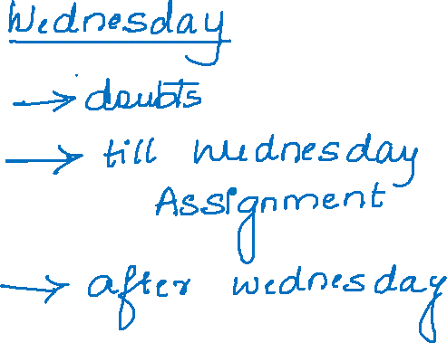

Slide 10
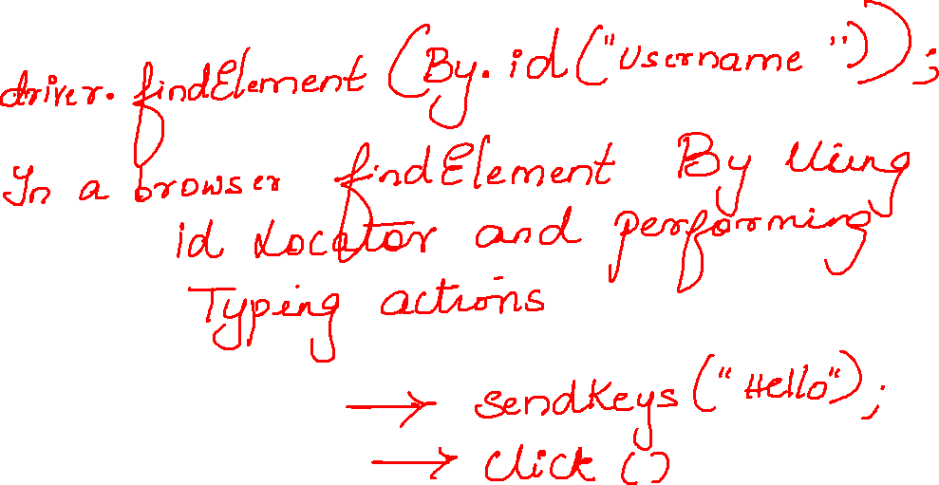

Slide 11
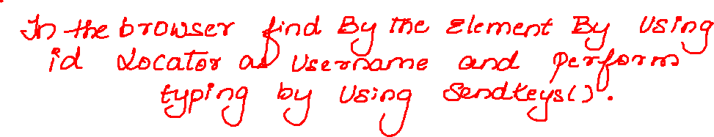
driver.findElement(By.id("username")).sendKeys("hghghhghgjhgj

Slide 12
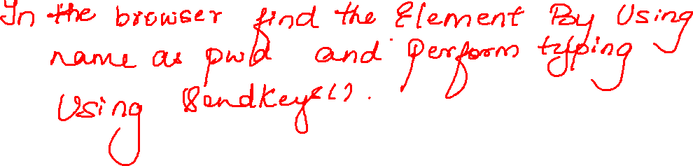
driver.findElement(By.name("pwd")).sendKeys("fghgfhghaghggh");

Slide 13
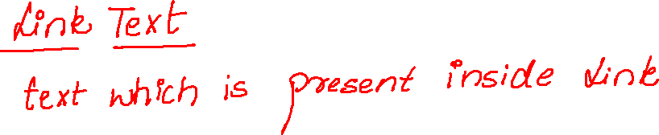
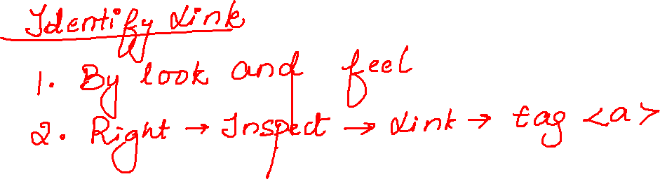

Slide 14
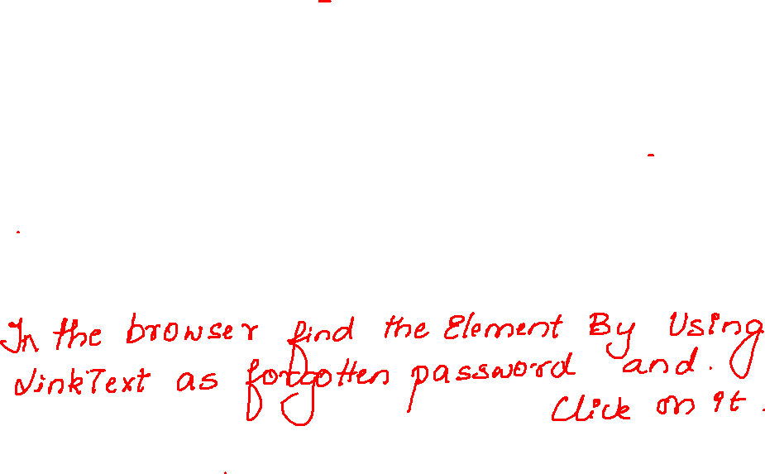
driver.findElement(By.linkText("Forgotten password?")).click();

Slide 15
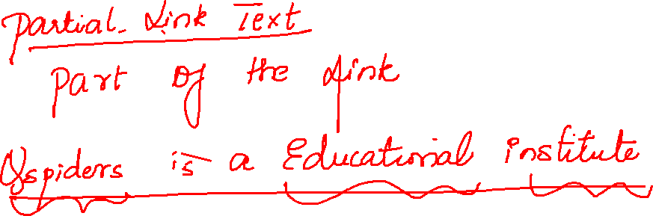

Slide 16
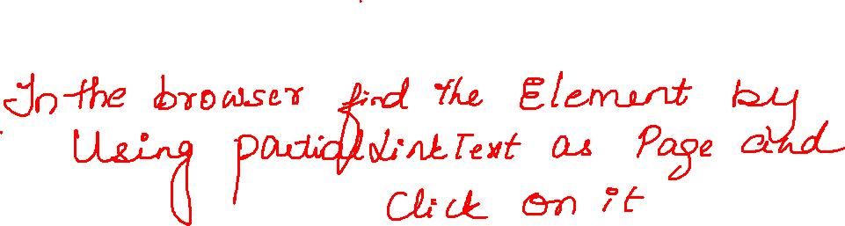
driver.findElement(By.partialLinkText("Page")).click();

Slide 17
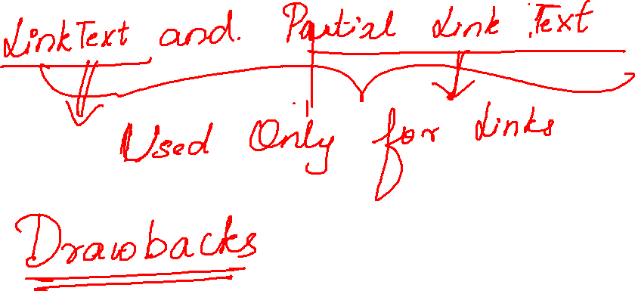

Slide 18
Using id and Name locators
public class Test0 { public static void main(String[] args) { WebDriver driver=new ChromeDriver(); driver.manage().window().maximize(); driver.get("https://demo.actitime.com/login.do"); driver.findElement(By.linkText("username")).sendKeys("hghghhghgjhgjhjh"); driver.findElement(By.name("pwd")).sendKeys("fghgfhghaghggh"); } }

Slide 19
package locators;
import org.openqa.selenium.By;
import org.openqa.selenium.WebDriver;
import org.openqa.selenium.chrome.ChromeDriver;
public class Test2 {
public static void main(String[] args) {
WebDriver driver=new ChromeDriver();
driver.manage().window().maximize();
driver.get("https://en-gb.facebook.com/");
driver.findElement(By.id("email")).sendKeys("gjhgfjhgfgj");
driver.findElement(By.name("pass")).sendKeys("fghfghfgfsg");
driver.findElement(By.linkText("Forgotten password?")).click();
}
}
}

Slide 20
package locators;
import org.openqa.selenium.By;
import org.openqa.selenium.WebDriver;
import org.openqa.selenium.chrome.ChromeDriver;
public class Test3 {
public static void main(String[] args) {
WebDriver driver=new ChromeDriver();
driver.manage().window().maximize();
driver.get("https://en-gb.facebook.com/");
driver.findElement(By.partialLinkText("Page")).click();
}
}

