Slide 1

MAGPAI ( mag practical AI , pronounced (/ˈmæɡ.paɪ/) )
AI Under the Hood
Following a Business Question Through Tokens, Embeddings, Neural Networks, and Inference
What Really Happens When You Ask AI a Question?
Vasilis Katsoulis

Slide 2
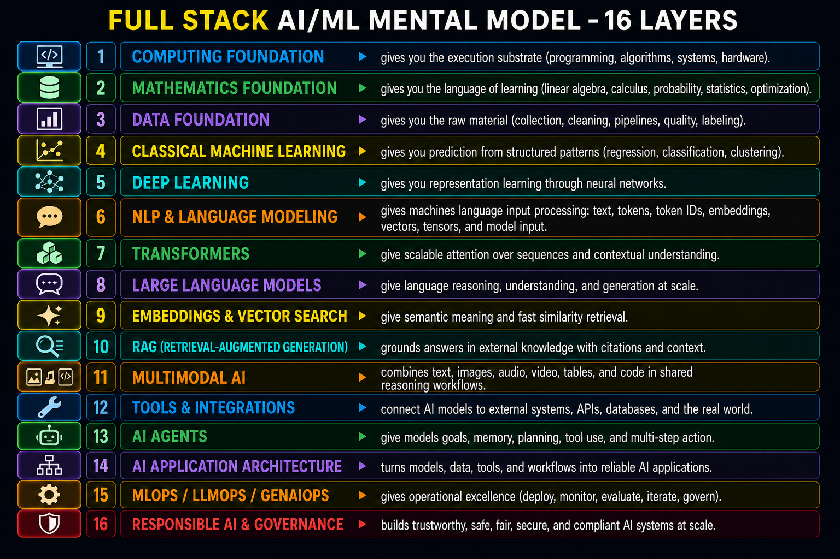
MAGPAI
STARTS HERE
AI Under the hood | Slide 2

Slide 3
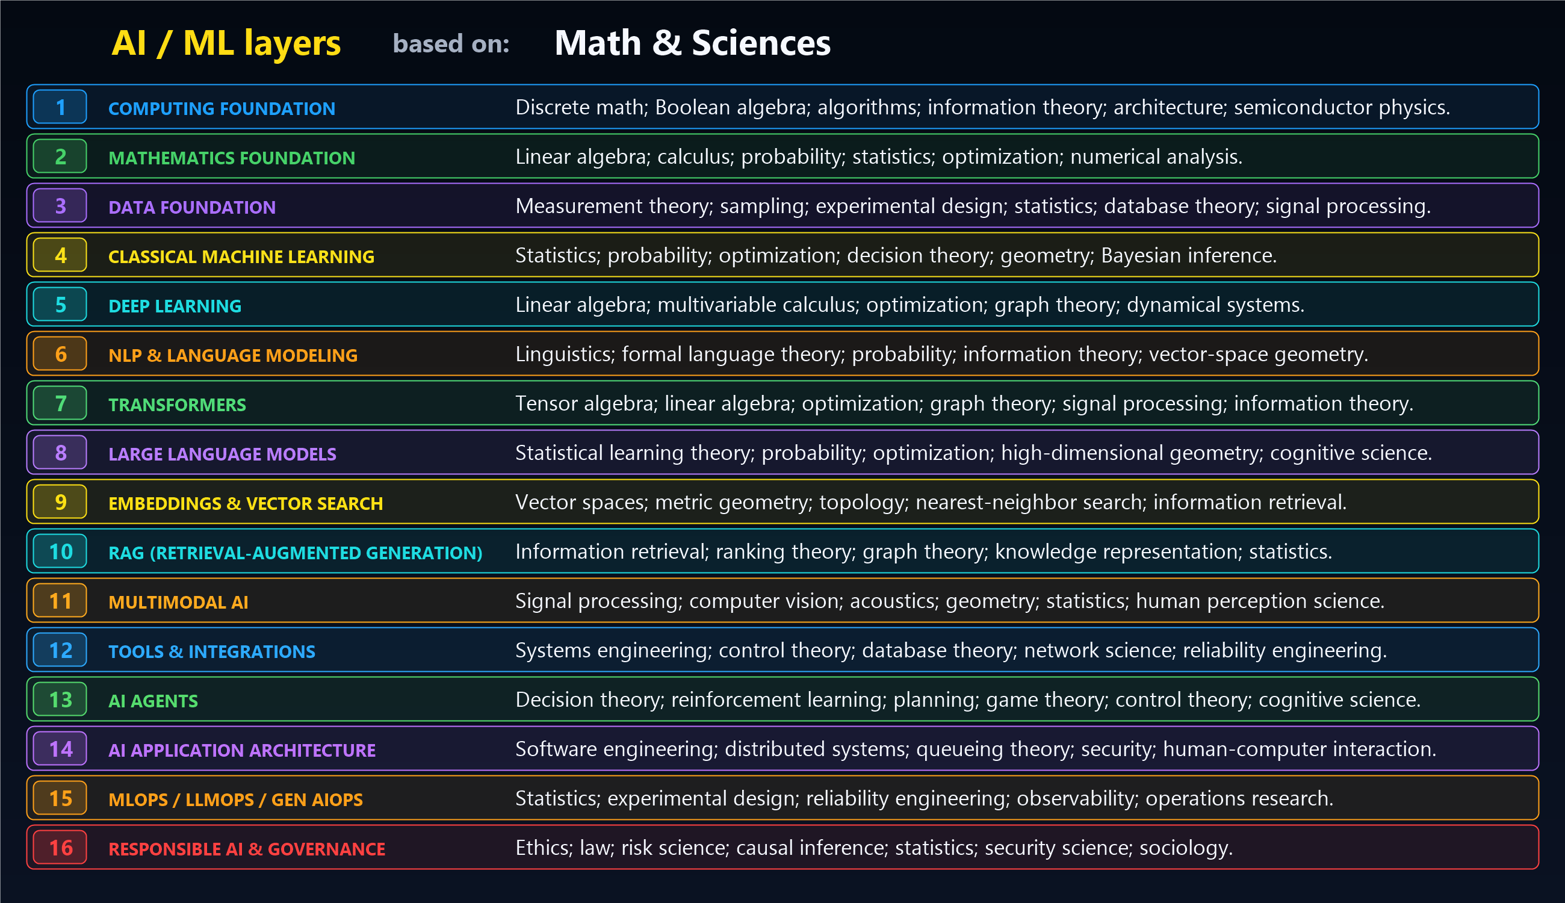
MAGPAI
STARTS HERE
AI Under the hood | Slide 3

Slide 4
MAGPAI
From Sentence to Tokens to Vectors - v1.0
How Text Becomes Numbers
Core idea
AI models do not read words directly. They process numeric patterns.
AI Under the hood | Slide 4

Slide 5
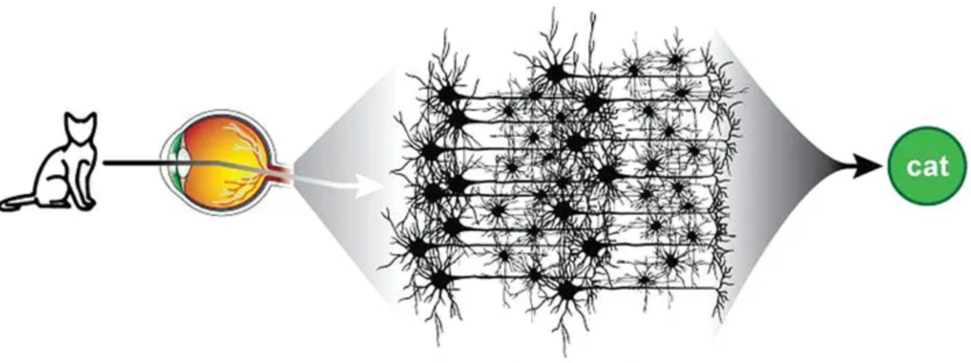
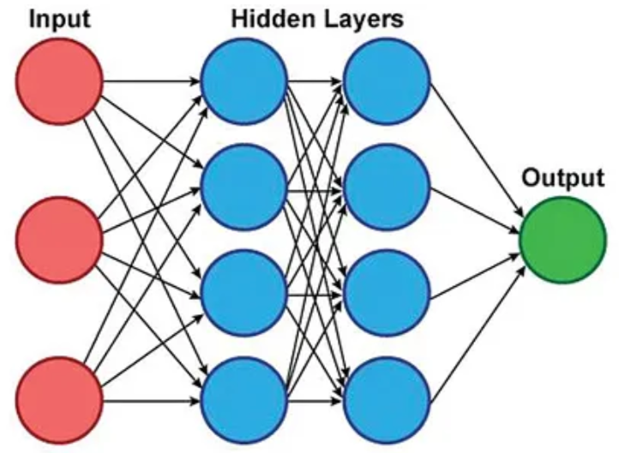
The Big Idea
People read words. Neural-network models process numbers.
Text -> Tokens -> Token IDs -> Vectors -> Neural Network
Human view
We see words, grammar, context, and meaning.
Model view
Here, model means a machine-learning model: a learned function that takes numbers as input and computes an output.
AI Under the hood | Slide 5

Slide 6
Starting Sentence
A simple business question
"are MAG sales up in chicago?"
Key takeaway
This looks simple to us, but the model cannot process this raw English sentence directly. It first has to be converted into a numeric representation.
AI Under the hood | Slide 6

Slide 7
Tokenizer Step 1 - Tokens
Break the sentence into known pieces
["are", "MAG", "sales", "up", "in", "chicago", "?"]
Demo simplification
For this session, we use word-level tokens to make the concept visible.
Real LLM tokenizers
Real tokenizers may use word pieces, subwords, punctuation, spaces, and special tokens.
AI Under the hood | Slide 7

Slide 8
What Are Tokens and Tokenizers?
The tokenizer is the first translation step
Token
A token is a known text piece the model can look up: a word, word piece, punctuation mark, or special marker.
Tokenizer
A tokenizer is the rule or system that breaks raw text into tokens and prepares them for lookup.
Demo rule
Input: are MAG sales up in chicago?
Tokens: ["are", "MAG", "sales", "up", "in", "chicago", "?"]
An example of how GPT-4 tokenizes a phrase.
The set of all tokens a model can work with is called the model’s vocabulary.
The process of breaking an original text into tokens is called tokenization.
An example phrase is:
“The unbelievable replay was replayed unbelievably.”
The | un | believ | able | re | play | was | re | play | ed | un | believ | able | ly
The model can store reusable token fragments
Key takeaway
Tokenization does not understand meaning yet. It creates stable pieces that can be mapped to IDs.
AI Under the hood | Slide 8

Slide 9
Tokenizer Step 2 - Token IDs
Use the vocabulary lookup table
Vocabulary "<PAD>" -> 0 "are" -> 1 "MAG" -> 2 "sales" -> 3 "up" -> 4 "in" -> 5 "chicago" -> 6 "?" -> 7
["are", "MAG", "sales", "up", "in", "chicago", "?"] ↓ [1, 2, 3, 4, 5, 6, 7]
Key takeaway
The tokenizer does not define meaning. It maps known text pieces to integer IDs.
Key takeaway
The vocabulary is the dictionary that allows text to become numbers.
Once text becomes token IDs, the neural network can finally start learning.
AI Under the hood | Slide 9

Slide 10
What Is a Vector?
A compact list of numbers the neural network can compute with
Demo algorithm for sales
1. Token: "sales"
2. Vocabulary lookup: "sales" -> 3
3. Embedding lookup: E[3]
4. Output Vector: [-0.62, 0.18, 0.45, -0.09]
Vector
sales vector:
[-0.62, 0.18, 0.45, -0.09]
Key takeaway
A vector is the numeric representation that moves forward.
The values are learned, then selected by ID.
The word “Sales” now is a point in multidimensional space.
AI Under the hood | Slide 13

Slide 11
How Token ID 3 Becomes a Vector
The algorithm is a row lookup
Token ID 3
E[3]
[-0.62, 0.18, 0.45, -0.09]
Important distinction
The integer 3 does not contain the meaning of “sales.” It points to a learned row in the embedding matrix.
AI Under the hood | Slide 14

Slide 12
What Is an Embedding?
A learned table that turns token IDs into numeric rows
Tiny example
ID token vector row
1 are [ 0.21, -0.44, 0.78, 0.12]
2 MAG [ 0.03, 0.91, -0.14, 0.36]
3 sales [-0.62, 0.18, 0.45, -0.09]
Embedding table
An embedding table is a matrix learned during training. Each token ID selects one row from that matrix.
A neural network contains a gigantic Embedding table matrix
Example dimensions: Vocabulary size * Embedding dimension
GPT4 100,256 * 1,536
Meaning: each token is represented by 1,536 floating point numbers
Key takeaway
During inference, we do not calculate these numbers from spelling. We look up the learned row.
AI Under the hood | Slide 10

Slide 13
Embeddings: Learned Geometric Coordinates of Meaning
Training turns random vectors into a map where distance carries semantics.
Initially
MAG = [random garbage] sales = [random garbage] Chicago = [random garbage]
During training
sales up sales increased revenue growth Chicago region
Backprop moves vectors
similar words move closer unrelated words move apart geometry stores meaning
Visual intuition: distances encode relationships
king (2, 9, 4) queen (2, 9, 5) man (1, 4, 3) woman (1, 4, 4)
king - man + woman ~= queen
Sentence embeddings combine token vectors
averaging | attention | transformers | pooling
"MAG sales are up in Chicago" -> [0.192, -0.551, 0.882, ... 1536 dims ...]
captures business context, trend, location, and organization semantics
Why it works: language has statistical structure. Context patterns -> geometric relationships.
Foundation for Word2Vec, GloVe, BERT, GPT, and LLMs.
AI Under the hood | Slide 11

Slide 14
Embedding Lookup
Token IDs become vectors
1 -> [ 0.21, -0.44, 0.78, 0.12] 2 -> [ 0.03, 0.91, -0.14, 0.36] 3 -> [-0.62, 0.18, 0.45, -0.09]
Conceptually: EmbeddingMatrix[ token_id ] returns a vector
Key takeaway
The token ID is an index. It selects a row from the embedding matrix. The selected row is the token vector.
AI Under the hood | Slide 12

Slide 15
Embeddings Become Neural Network Activations
The vectors are the live numeric input flowing into the neural network
Text
Token IDs
Embeddings
vectors
Transformer Artificial Neural Network
LLM core
Output
probabilities
->
->
->
->
MAGPAI Mental Model
User Question
↓
Tokenizer
↓
Token IDs
↓
Embeddings
( Language -> Geometry)
↓
Transformer Neural Network
(MAGPAI Brain)
↓
Output Probabilities
↓
Decoder
↓
Answer
The embedding vectors become input activations.
They are the live numeric values flowing into the neural network.
There is not usually a separate ANN handing data to the LLM.
The neural network is the computational core of the LLM.
The embedding layer, Transformer layers, output layers, and decoder all work together as one integrated system.
AI Under the hood | Slide 15

Slide 16
The Transformer Artificial Neural Network Is the LLM Core
A modern LLM is one enormous neural network, not a separate system after embeddings
Input activations
embedding vectors
Transformer ANN
attention + feed-forward layers + weights
Output
next-token probabilities
->
->
The ANN learns
sales -> revenue
Chicago -> location
up -> growth
“sales up in Chicago” -> may imply positive business performance
Learned knowledge
stored in weights
billions of parameters
Current state
context window
RAG documents
agent memory
The Weights Are Learned Knowledge
The neural network contains billions of numerical parameters called weights.
Examples:
GPT-4: Hundreds of billions of parameters (estimated)
Llama 3: Tens to hundreds of billions of parameters
Mistral 7B: Approximately 7 billion parameters
MAGPAI: 32 parameters. ☺
These weights store the model's learned long-term knowledge.
They capture statistical patterns learned during training.
Biological Analogy
Human Brain | LLM Equivalent
Sensory cortex | Embeddings
Neurons | Artificial neurons
Synapses | Weights
Memory patterns | Parameter distributions
Attention | Transformer attention
Speech generation | Decoder/output layer
Embeddings convert language into geometry.
The Transformer manipulates that geometry to infer meaning and predict the next token.
AI Under the hood | Slide 16

Slide 17
What Is a Tensor?
The NN input is a stored grid of token vectors
Vector
1-D list
[0.12, -0.08, 0.44]
Matrix
2-D table
rows x columns
Tensor
General numeric container
with shape metadata
For this prompt
7 tokens x 4 numbers per vector
shape = [7, 4]
How the NN sees it
The framework stores the token-vector sequence as an activation tensor before the first neural-network layer.
Key takeaway
A tensor is the in-memory numeric object that carries vectors into neural-network computation.
AI Under the hood | Slide 18

Slide 18
Prompt Stored as an Input Tensor
The original prompt becomes a 7 x 4 numeric grid before NN layers run
are MAG sales up in chicago?
---->
token
v1
v2
v3
v4
Neural Network layers start here
are
0.21
-0.44
0.78
0.12
MAG
0.03
0.91
-0.14
0.36
sales
-0.62
0.18
0.45
-0.09
----->
up
-0.31
0.67
0.11
0.28
in
0.08
-0.15
0.22
0.64
chicago
0.41
0.12
-0.33
0.57
?
-0.07
0.04
0.19
-0.22
activation tensor shape = [7 token positions, 4 vector dimensions]
AI Under the hood | Slide 19

Slide 19
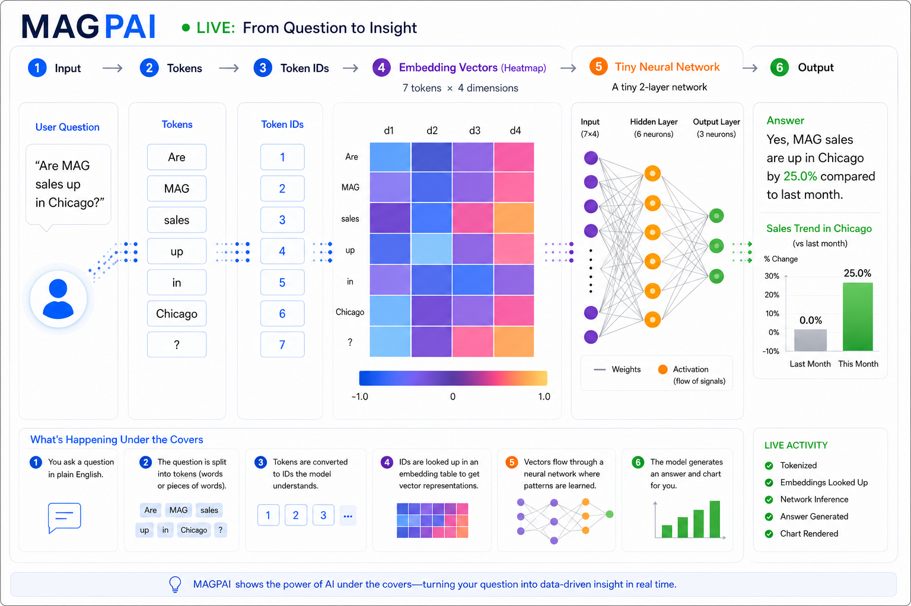

Slide 20
MAGPAI
You now know what is under the hood.
Words become tokens. Tokens become vectors. Vectors activate neural networks. Systems turn answers into action.
AI is not magic; it is a pipeline you can inspect.
Tokenization is where language first becomes structure.
Embeddings are learned coordinates of meaning.
Neural networks learn by changing weights and bias.
Enterprise value comes when the model is connected to data, tools, and governance.
The advantage goes to teams who can see the machinery, not just use the interface.
AI Under the hood

