Slide 1
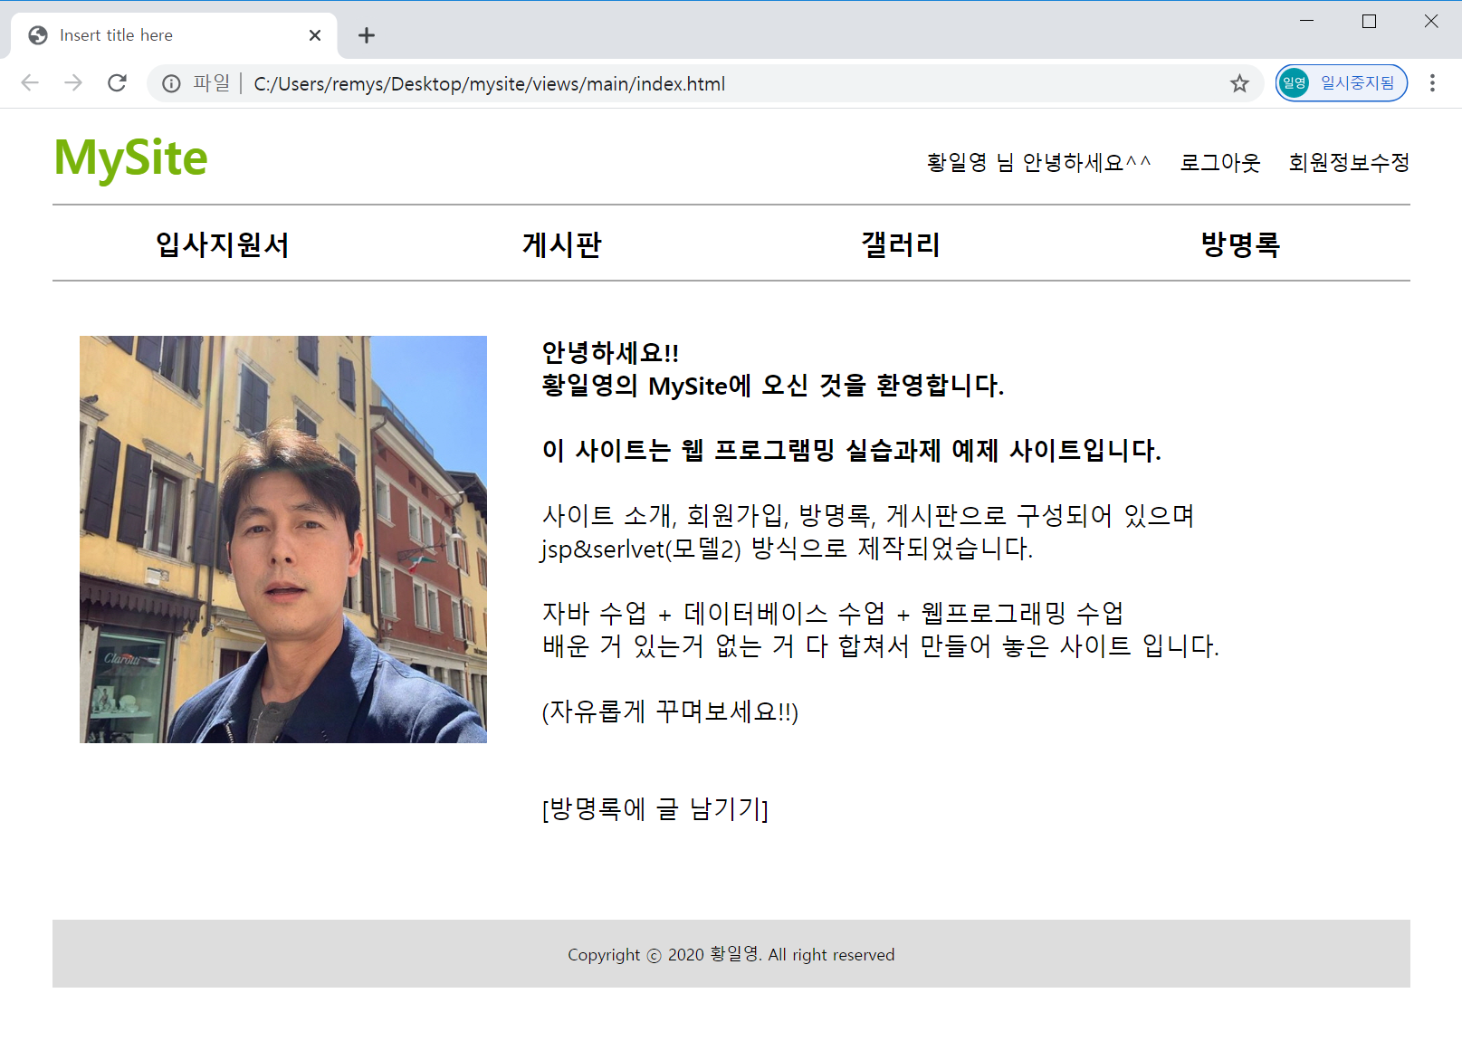
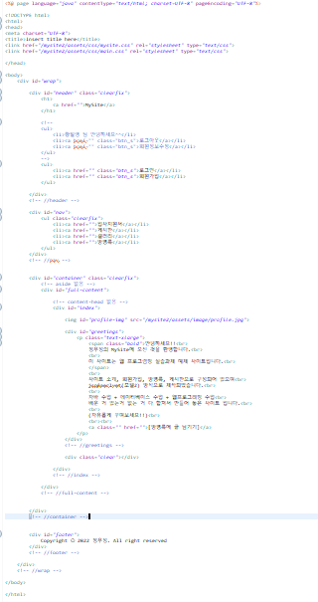
mysite2 메인
Rqeust(요청)
웹서버
http://localhost:8088/mysite2/main
Request header
(파라미터)
Request body
Tomcat
mysite2
MainController (Servlet)객체
Response(응답)
rquest
*파라미터
*어트리뷰트
*포워드
Response header
Response body (html)
index.jsp
요청/응답
/mysite2/assets/css/mysite.css
response
요청/응답
/mysite2/assets/css/main.css
요청/응답
/mysite2/assets/image/profile.jpg
http://localhost:8088/mysite2/main
MainContoller (servlet)
브라우저
요청
/main
포워드
응답
Index.jsp
html

Slide 2
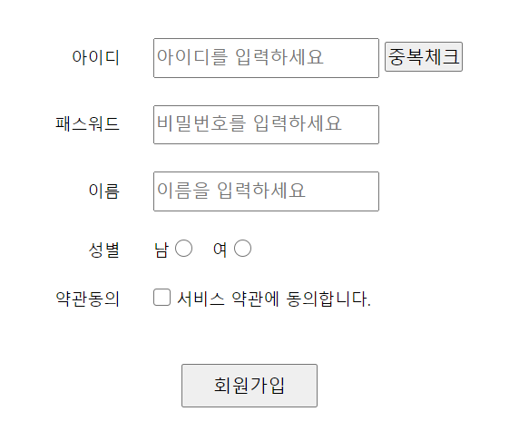
mysite2 users > joinForm
Rqeust(요청)
웹서버
http://localhost:8088/mysite2/user?action=joinForm
Request header
(파라미터) action=joinForm
Request body
Tomcat
mysite2
rquest
*파라미터
action=joinForm
*어트리뷰트
UserController
(Servlet)객체 /user
joinForm 일때 join 일때
Response(응답)
response
*포워드
Response header
Response body (html)
joinForm.jsp
http://localhost:8088/mysite2/user
MainContoller (servlet)
브라우저
요청
/user
포워드
응답
joinForm.jsp
html

Slide 3
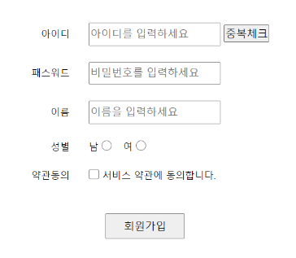
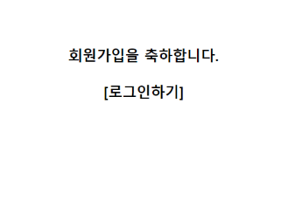
mysite2 users > join
Rqeust(요청)
웹서버
파라미터 꺼내기*4
//0x333= Vo만들기
DB서버
http://localhost:8088/mysite2/user?action=join
Request header
(파라미터)
action=join id=aaa
password=1234
name=황일영
gender=male
Request body
Tomcat
&id=aaa
&password=1234
&name=황일영
&gender=male
mysite2
Oracle
rquest
*파라미터
action=join
id=aaa
password=1234
name=황일영
gender=male
*어트리뷰트
UserController
(Servlet)객체 /user
userDao 객체
UserVo userVo
insert(userVo)
no seq
id
password
name
gender
join 일때
0x333
jdbc *2
0x333
Response(응답)
1
Response header
Response body (html)
response
*포워드
joinOk.jsp
0x333
UserVo
UserVo{
id
password
name
gender
}
action=join
id=aaa
password=1234
name=황일영
gender=male
http://localhost:8088/mysite2/user?action=join
UserContoller (servlet)
UserDao
브라우저
action=join
/user
userVo
insert(vo)
요청
count
응답
포워드
DB
joinOk.jsp

Slide 4
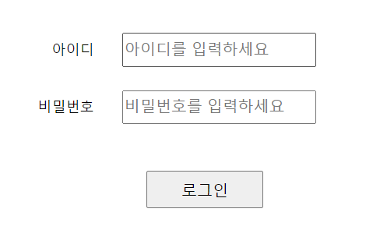
mysite2 users > loginForm
Rqeust(요청)
웹서버
http://localhost:8088/mysite2/user?action=loginForm
Request header
(파라미터)
action=loginForm
Request body
Tomcat
mysite2
rquest
*파라미터
action=loginForm
*어트리뷰트
UserController
(Servlet)객체 /user
UserVo userVo
loginForm 일때
0x333
Response(응답)
response
*포워드
Response header
Response body (html)
loginForm.jsp
0x333
UserVo
UserVo{
id
password
name
gender
}
http://localhost:8088/mysite2/user?action=loginForm
UserContoller (servlet)
브라우저
action=loginForm
/user
요청
포워드
응답
loginForm.jsp

Slide 5
mysite2 users > login
Rqeust(요청)
웹서버
DB서버
http://localhost:8088/mysite2/user?action=login
Request header
(파라미터)
action=login id=aaa
password=1234
Request body
Tomcat
ssid = 123A
&id=aaa
&password=1234
mysite2
Oracle
"authUser" = 0x999
rquest
*파라미터
action=login id=aaa
password=1234
getParameter()
getSession()
*어트리뷰트
UserController
(Servlet)객체 /user
userDao 객체
0x333
userVo
id,passwrd
select no,
name
from users
where id = 'eee'
and password = '1234';
login 일때
리다이렉트
getUser(userVo)
jdbc *2
authUser
no,name
Response(응답)
response
0x999
Response header
Response body 리다이렉트
UserVo userVo
UserVo authUser
UserVo authUser
0x333
0x999
null
0x333
UserVo
0x999
UserVo
id = aaa
password = 1234
no = 7
name = 이효리
UserVo{
id
password
name
gender
}
UserVo{
id
password
name
gender
}

Slide 6
session 설명
"yn", "y"
"yn", "y"

Slide 7
mysite2 users > logout
Rqeust(요청)
웹서버
http://localhost:8088/mysite2/user?action=logout
Request header
(파라미터)
action=logout
Request body
Tomcat
ssid = 123A
"authUser" = 0x999
mysite2
rquest
*파라미터
action=login
*어트리뷰트
UserController
(Servlet)객체 /user
logout 일때
Response(응답)
response
Response header
Response body 리다이렉트
UserVo userVo
UserVo authUser
UserVo authUser
0x333
0x999
null
0x333
UserVo
0x999
UserVo
id = aaa
password = 1234
no = 7
name = 이효리
UserVo{
id
password
name
gender
}
UserVo{
id
password
name
gender
}

