Slide 1
Percentage of customres in Top 7 countries
<visualization>
We queried number of customers in each country and limited results to 7 countries with highest number of customers.
As we see, the USA has the most number of customers. In addition, USA and Canada contain more than 50% percent of all customres among top 7 countries.

Slide 2
Top 10 Rock Artist
<visualization>
As we see Led Zeppelin and U2 are two artiststs with more than 100 Rock songs. All other Rock artists have less than 100 songs.
All of the top 10 Rock Artists have released 35 Rock songs at least.

Slide 3
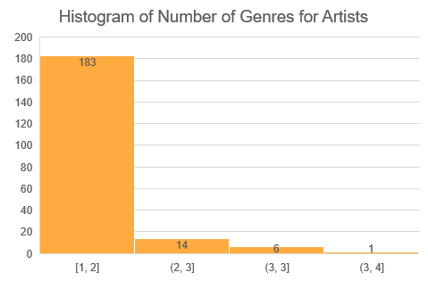
Histogram of Number of Genres for Artists
An artist may have released songs in more than one genre. We find the number of genres artists have created songs. We see the histogram here.
Only 1 artist has released songs in 4 Genres. Most of the artists has created songs in just one genre.

Slide 4
Number of Love Songs in Each Genres
We define a Love Song as track which has one of the words (“Love”, “love”, “LOVE”) in name of the track.
Using this definition, the number of Love Songs in each genres is queried. As we see most of the love songs are in Rock genre. By far the number of Love Songs in Rock genres is more than other genres.

