Slide 1
RFQ
October 12 2017

Slide 2
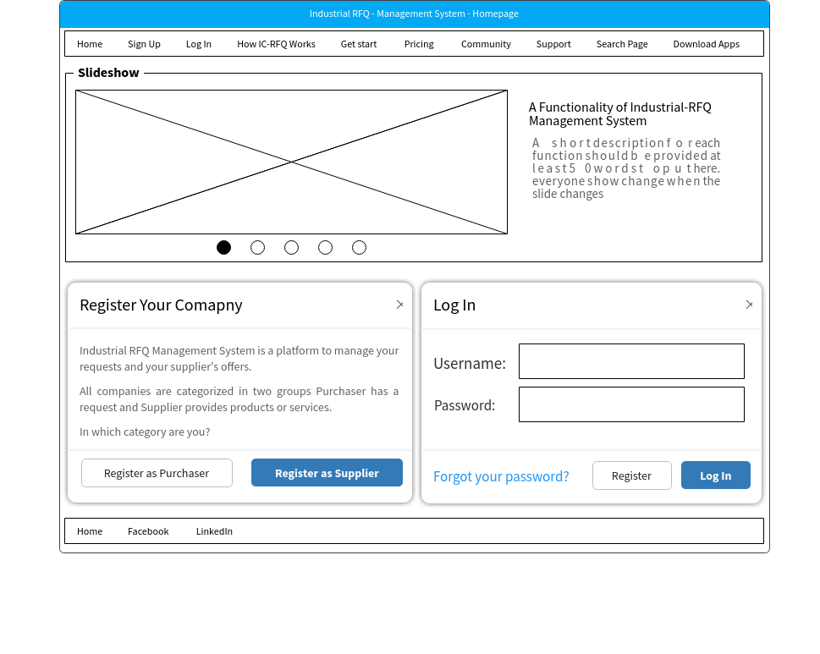

Slide 3
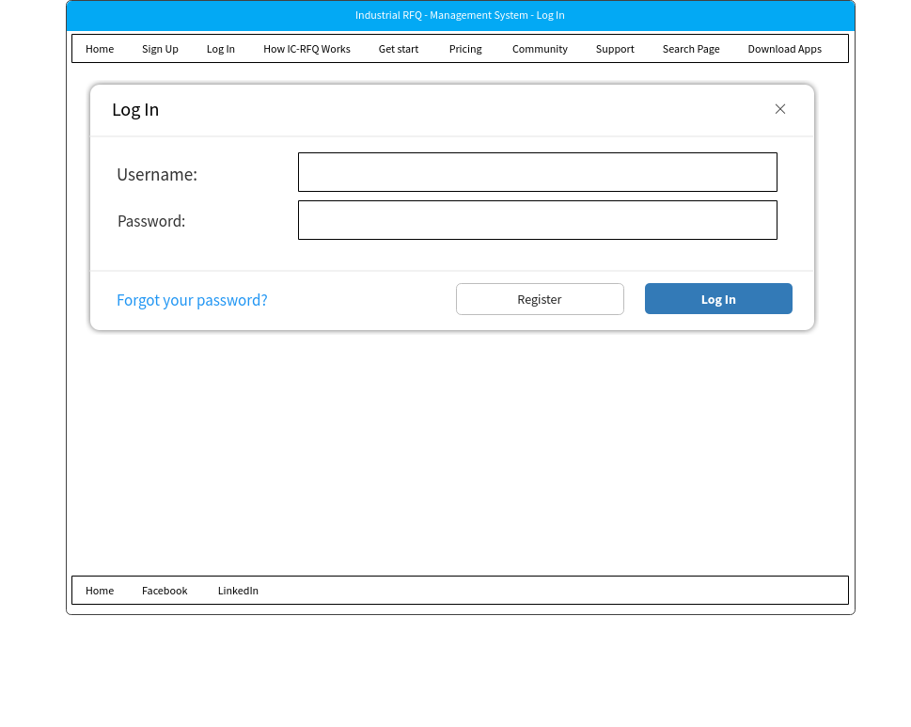

Slide 4
