Slide 1
DSLs and Code Generation
Scott Stanchfield
http://javadude.com

Slide 2
Data Entry
Programmers
Code
Binary
CSV
XML – “human-readable”
yeah… right…
JSON
Non-Programmers / Subject-Matter Experts
Say “ewwwwwww”
Spreadsheets -> CSV
“Bad” characters (<-- like those quotes)
XML, JSON
Easy to make syntax mistakes

Slide 3
Domain-Specific Languages (DSLs)
A “little language”
Simpler data entry
Less code (depends)
More terse
Specific to task
Terms possibly more familiar to SME (than code)
Better validation

Slide 4
Internal DSLs (Uses programming language directly)
Fluent API
// Java example
new Robot()
.turnLeft(90)
.move(100)
.shoot();
More Complex
// Groovy example
Email.make {
to “Luke"
from “Han"
subject “Don’t Get Cocky, Kid"
body “…”
send
}

Slide 5
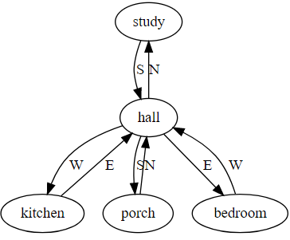
External DSLs (Input parsed by language)
// GraphViz dot example
digraph map {
study -> hall [label = "S"]
kitchen -> hall [label = "E"]
hall -> porch [label = "S"]
hall -> bedroom [label = "E"]
hall -> study [label = "N"]
hall -> kitchen [label = "W"]
bedroom -> hall [label = "W"]
porch -> hall [label = "N"]
}
// Custom DSL example
carryable item key "It is a shiny brass key"
carryable item letter "It reads You win!"
fixed item safe "It is a very heavy locked box. There is a keyhole on it"
opens with key locked closed
contains letter
room bedroom "This is where you sleep"
contains key
exit west hall
start in porch

Slide 6
Today’s Examples
Text Adventure Game
Two DSLs
Commands (ANTLR)
Data (xText)
ANother Tool for Language Recognition
Run actions when input matched
xText
Model classes (Build)
Generated IDE (Build)
Read Model Instance (Runtime)
Object Model Generation
One DSL
Object Model (xText)
xText
Model classes (Build)
Generated IDE (Build)

