Slide 1

Nuts & Bolts of Java EE 6
Arun Gupta, Java EE & GlassFish Guy
blogs.oracle.com/arungupta, @arungupta

Slide 2
The following/preceding is intended to outline our general product direction. It is intended for information purposes only, and may not be incorporated into any contract. It is not a commitment to deliver any material, code, or functionality, and should not be relied upon in making purchasing decisions.
The development, release, and timing of any features or functionality described for Oracle’s products remains at the sole discretion of Oracle.

Slide 3
Who is Arun ?
Java EE & GlassFish Evangelist
With Sun/Oracle and Java EE for over 12 years
  Team that released J2EE 1.2
Conferences, Social media, Forums, Partners, Customers, Articles, Training, Workshops, Demos, …
  Web services, CORBA, Standard bodies, Testing, ...

Slide 4
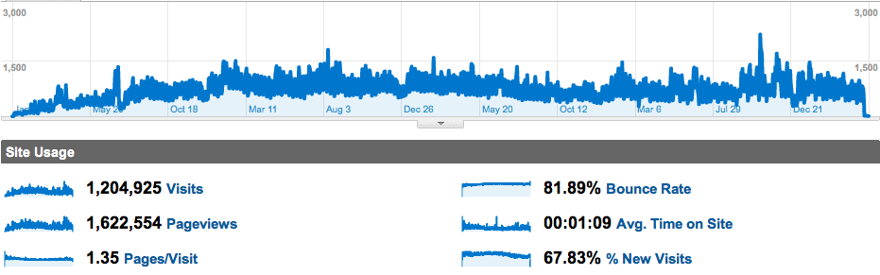
blogs.oracle.com/arungupta
1200+ entries, 4470+ comments

Slide 5
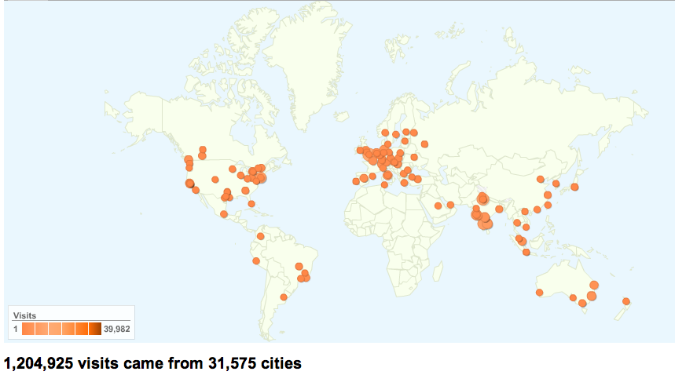
blogs.oracle.com/arungupta

Slide 6
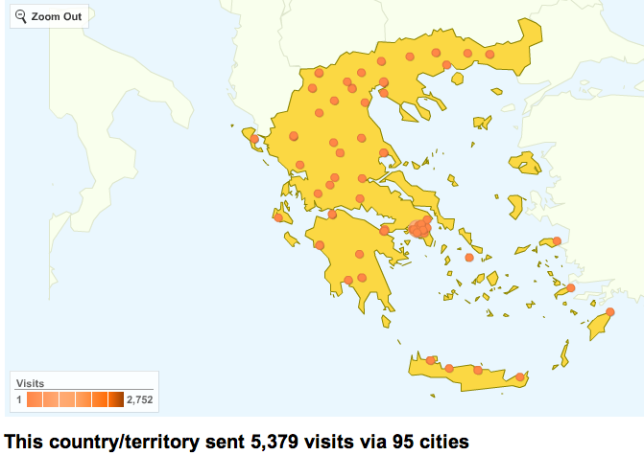
blogs.oracle.com/arungupta

Slide 7
Agenda – Time Slots for Day 1/2
Part 1
9am – 10:30am
15 min break
10:45am – 12:30pm
1 hr lunch
1:30 – 3pm
15 min break
3:15 - 5pm
Part 2
Part 3
Part 4

Slide 8
Agenda - Topics
Day 1
Day 2
Java EE 6 Overview
Servlets 3.0
Recap + Docs
JSF 2
JPA 2.0
Servlets + JPA2 Lab
CDI 1.0
JSF2 + CDI Lab
EJB 3.1
JAX-RS 1.1
Eclipse Demo
GlassFish
EJB + JAX-RS Lab
OSGi/Java EE Apps
Summary / Open

Slide 9
Nuts & Bolts of Java EE 6
Arun Gupta, Java EE & GlassFish Guy
blogs.oracle.com/arungupta, @arungupta

