Slide 1

What's new in Java EE 6 & Upcoming ?
Arun Gupta, Java EE & GlassFish Guy
blogs.oracle.com/arungupta, @arungupta

Slide 2
The following/preceding is intended to outline our general product direction. It is intended for information purposes only, and may not be incorporated into any contract. It is not a commitment to deliver any material, code, or functionality, and should not be relied upon in making purchasing decisions.
The development, release, and timing of any features or functionality described for Oracle’s products remains at the sole discretion of Oracle.

Slide 3

Past, Present, Future
Cloud
Flexible
Java EE 7
Multi-tenancy
Elasticity
JSON
HTML 5
Web Sockets
. . .
Ease of
Development
Java EE 6
Pruning
Extensibility
Profiles
Ease-of-dev
EJB Lite
RESTful WS
CDI
Java EE 5
Ease of
Development
Annotations
EJB 3.0
Persistence API
New and
Updated
Web Services
Web Services
J2EE 1.4
Web Services,
Management,
Deployment,
Async.
Connector
Robustness
Enterprise Java Platform
J2EE 1.3
CMP,
Connector
Architecture
J2EE 1.2
Servlet, JSP,
EJB, JMS
RMI/IIOP
Java EE 6
Web Profile
JPE
Project
Managed
Bean 1.0
May 98 Dec 99 Sep 01 Nov 03 May 06 Dec 09 Q3 12
10 specs 13 specs 20 specs 23 specs 28 specs ?? specs

Slide 4











Compatible Java EE 5 Impl
http://www.oracle.com/technetwork/java/javaee/overview/compatibility-jsp-136984.html
Notes:
P2A: Can you talk about the ecosystem of compatible implementations? What has been the feedback of various vendors as they have gone through the EE 6 spec lifecycle?
J2EE 1.4 Implementations (17)
Apache
BEA
CAS Once
Hitachi
IBM
JBoss
Kingdee
NEC
ObjectWeb
Oracle
Pramati
SAP
Sun
Sybase
TmaxSoft
TongTech
Trifork

Slide 5




Compatible Java EE 6 Impls
Today:
Web Profile Only
Announced:
Notes:
P2A: Can you talk about the ecosystem of compatible implementations? What has been the feedback of various vendors as they have gone through the EE 6 spec lifecycle?
J2EE 1.4 Implementations (17)
Apache
BEA
CAS Once
Hitachi
IBM
JBoss
Kingdee
NEC
ObjectWeb
Oracle
Pramati
SAP
Sun
Sybase
TmaxSoft
TongTech
Trifork

Slide 6
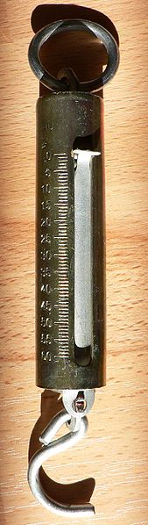
Light-weight
Java EE 6 Web Profile
Pruning
  Pruned today, means
    Optional in the next release
    Deleted in the subsequent releases
  Technologies marked in Javadocs
    EJB 2.x Entity Beans, JAX-RPC, JAXR, JSR 88

Slide 7
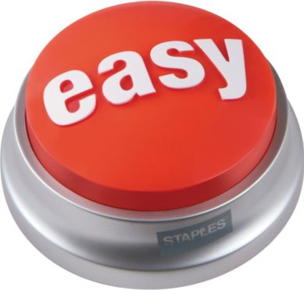
EJB-in-WAR
No-interface EJB
Optional “web.xml”/”faces-config.xml”
Annotation-driven
  @Schedule
  @Path
  @Inject
  . . .

Slide 8
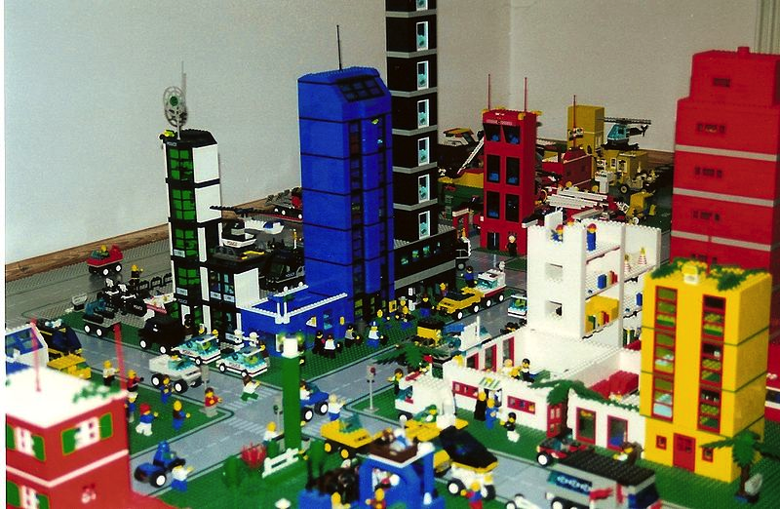
<web-fragment>
<filter>
<filter-name>wicket.helloworld</filter-name>
<filter-class>org.apache.wicket.protocol.http.WicketFilter</filter-class>
<init-param>
<param-name>applicationClassName</param-name>
<param-value>...</param-value>
</init-param>
</filter>
<filter-mapping>
<filter-name>wicket.helloworld</filter-name>
<url-pattern>/*</url-pattern>
</filter-mapping>
</web-fragment>

Slide 9
Java EE 6 - Done
Specifications approved by the JCP
Reference Implementation derived from GlassFish 3 Open Source Edition
TCK
Dec 10th 2009

Slide 10
Java EE 6 Specifications
The Platform
Java EE 6 Web Profile 1.0
Managed Beans 1.0

Slide 11
Java EE 6 Specifications
New
Contexts and Dependency Injection for
Java EE (JSR 299)
Bean Validation 1.0 (JSR 303)
Java API for RESTful Web Services (JSR 311)
Dependency Injection for Java (JSR 330)

Slide 12
Java EE 6 Specifications
Extreme Makeover
Java Server Faces 2.0 (JSR 314)
Java Servlets 3.0 (JSR 315)
Java Persistence 2.0 (JSR 317)
Enterprise Java Beans 3.1 & Interceptors 1.1 (JSR 318)
Java EE Connector Architecture 1.6 (JSR 322)

Slide 13
Java EE 6 Specifications
Updates
Java API for XML-based Web Services 2.2 (JSR 224)
Java API for XML Binding 2.2 (JSR 222)
Web Services Metadata MR3 (JSR 181)
JSP 2.2/EL 2.2 (JSR 245)
Web Services for Java EE 1.3 (JSR 109)
Common Annotations 1.1 (JSR 250)
Java Authorization Contract for Containers 1.3 (JSR 115)
Java Authentication Service Provider Interface for Containers 1.0 (JSR 196)

Slide 14
Java EE 6 Specifications
As is
JDBC 4.0 API
Java Naming and Directory Interface 1.2
Java Message Service 1.1
Java Transaction API 1.1
Java Transaction Service 1.0
JavaMail API Specification 1.4
JavaBeans Activation Framework 1.1
Java API for XML Processing 1.3
Java API for XML-based RPC 1.1
SOAP with Attachments API for Java 1.3
Java API for XML Registries 1.0
Java EE Management Specification 1.1 (JSR 77)
Java EE Deployment Specification 1.2 (JSR 88)
Java Management Extensions 1.2
Java Authentication and Authorization Service 1.0
Debugging Support for Other Languages (JSR 45)
Standard Tag Library for JSP 1.2 (JSR 52)
Streaming API for XML 1.0 (JSR 173)

Slide 15
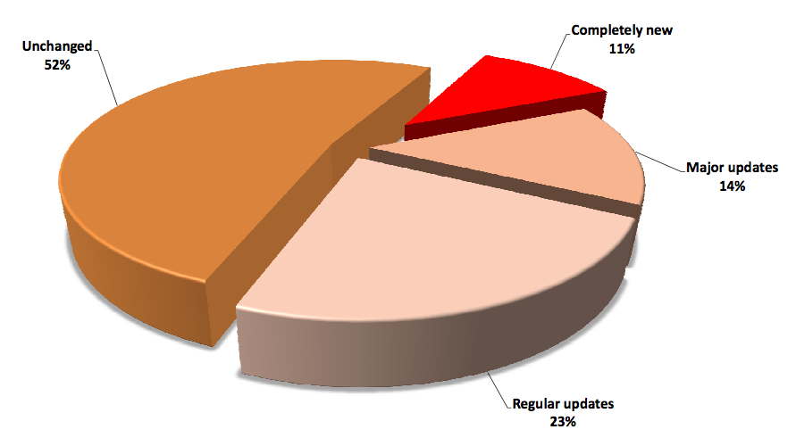
http://blog.eisele.net/2010/12/who-is-afraid-of-java-ee-6-get-rid-of.html

Slide 16
Java EE 6 Web Profile 1.0
Servlets 3.0
JPA 2.0
EJB 3.1
JDBC
StAX
JSF 2.0
Interceptors
1.1
JAX-RS
JNDI
JavaMail
EJB 3.1 Lite
Bean
Validation1.0
JAXB
JMS
JACC
JSP 2.2
CDI 1.0
JAX-WS
JAXP
SAAJ
JTA 1.1
Managed
Beans 1.0
JASPIC
JAX-RPC
. . .
Contributed
by RedHat
New
Updated

Slide 17
Java EE 6 & Ease-of-development
Continue advancements of Java EE 5
Primary focus: Web Tier
General principles
  Annotation-based programming model
  Reduce or eliminate need for DD
  Traditional API for advanced users

Slide 18
Managed Beans 1.0
JavaBeans component model for Java EE
  Simple and Universally useful
  Advanced concepts in companion specs
Basic Services
  Resource Injection, Lifecycle Callbacks, Interceptors
Available as
  @Resource / @Inject
  java:app/<module-name>/<bean-name>
  java:module/<bean-name>

Slide 19
Managed Beans 1.0 - Sample
public class MyManagedBean {
public void setupResources() {
// setup your resources
}
public void cleanupResources() {
// collect them back here
}
public String sayHello(String name) {
return "Hello " + name;
}
}
@Resource
MyManagedBean bean;
@javax.annotation.ManagedBean
@PostConstruct
@PreDestroy
@Inject
MyManagedBean bean;
http://blogs.oracle.com/arungupta/entry/totd_129_managed_beans_1

Slide 20
Servlets in Java EE 5
At least 2 files
<!--Deployment descriptor web.xml -->
<web-app>
<servlet>
<servlet-name>MyServlet
</servlet-name>
<servlet-class>
com.sun.MyServlet
</servlet-class>
</servlet>
<servlet-mapping>
<servlet-name>MyServlet
</servlet-name>
<url-pattern>/myApp/*
</url-pattern>
</servlet-mapping>
...
</web-app>
/* Code in Java Class */
package com.sun;
public class MyServlet extends HttpServlet {
public void doGet(HttpServletRequest req,HttpServletResponse res)
{
...
}
...
}

Slide 21
Servlets 3.0 (JSR 315)
Annotations-based @WebServlet
package com.sun;
@WebServlet(name=”MyServlet”, urlPatterns={”/myApp/*”})
public class MyServlet extends HttpServlet {
public void doGet(HttpServletRequest req, HttpServletResponse res)
{
...
}
<!--Deployment descriptor web.xml -->
<web-app>
<servlet>
<servlet-name>MyServlet</servlet-name>
<servlet-class>
com.sun.MyServlet
</servlet-class>
</servlet>
<servlet-mapping>
<servlet-name>MyServlet</servlet-name>
<url-pattern>/myApp/*</url-pattern>
</servlet-mapping>
...
</web-app>
http://blogs.oracle.com/arungupta/entry/totd_81_getting_started_with

Slide 22
Servlets 3.0
@WebServlet, @WebListener, @WebFilter, …
Asynchronous Servlets
  @WebServlet(asyncSupported=true)
Plugin libraries using web fragments
Dynamic registration of Servlets
WEB-INF/lib/[*.jar]/META-INF/resources accessible in the root
Programmatic authentication login/logout
Default Error Page
. . .

Slide 23
EJB 3.1 (JSR 318)
Package & Deploy in a WAR
Java EE 5
Java EE 6
myApp.ear
myApp.war
WEB-INF/classes
com.sun.FooServlet
com.sun.TickTock
com.sun.FooBean
com.sun.FooHelper
web.war
WEB-INF/web.xml
WEB-INF/classes
com.sun.FooServlet
com.sun.TickTock
beans.jar
com.sun.FooBean
com.sun.FooHelper
web.xml ?
http://blogs.oracle.com/arungupta/entry/totd_95_ejb_3_1

Slide 24
EJB 3.1 - Sample
public class MySessionBean {
public void setupResources() {
// setup your resources
}
public void cleanupResources() {
// collect them back here
}
public String sayHello(String name) {
return "Hello " + name;
}
}
@EJB / @Inject
MySessionBean bean;
@Stateless
@PostConstruct
@PreDestroy

Slide 25
EJB 3.1
No interface view – one source file per bean
Embeddable API
@Singleton
  Initialization in @PostContruct
Simplified Cron-like syntax for Timer
Asynchronous Session Bean
Portable Global JNDI Name

Slide 26
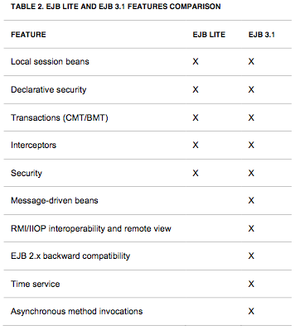
EJB 3.1
EJB 3.1 Lite – Feature Comparison

Slide 27
Contexts & Dependency Injection
JSR 299
Standards-based Dependency Injection
Type-safe – Buids on @Inject API
Context/Scope management
Strong Typing, Loose Coupling
Includes ELResolver
@Inject @LoggedIn User user
@Inject @LoggedIn User
Request
Injection
What ?
(Type)
Which one ?
(Qualifier)

Slide 28
CDI
Qualifiers
Events
Stereotypes
Interceptors
Decorators
Alternatives
. . .

Slide 29
Java Server Faces 2.0 (JSR 314)
Facelets as “templating language” for the page
  Custom components much easier to develop
Integrated Ajax
“faces-config.xml” optional in common cases
Default navigation rules
Much more …
  Runs on Servlet 2.5+
  Bookmarkable URLs
  Conditional navigation
  ...

Slide 30
Java Persistence API 2 (JSR 317)
Improved O/R mapping
Type-safe Criteria API
Expanded and Richer JPQL
2nd-level Cache
New locking modes
  PESSIMISTIC_READ – grab shared lock
  PESSIMISTIC_WRITE – grab exclusive lock
  PESSIMISTIC_FORCE_INCREMENT – update version
Standard configuration options
  javax.persistence.jdbc.[driver | url | user | password]

Slide 31
Bean Validation (JSR 303)
Tier-independent mechanism to define constraints for data validation
  Represented by annotations
  javax.validation.* package
Integrated with JSF and JPA
  JSF: f:validateRequired, f:validateRegexp
  JPA: pre-persist, pre-update, and pre-remove
@NotNull(message=”...”), @Max, @Min, @Size
Fully Extensible
  @Email String recipient;

Slide 32
JAX-RS 1.1 (JSR 311)
Java API for building RESTful Web Services
POJO based
Annotation-driven
Server-side API
HTTP-centric

Slide 33
JAX-RS 1.1
Code Sample - Simple
public class PersonResource {
public List<Person> getPersons() {
return personList;
}
public Person getPerson( int id) {
return getPersons().get(id);
}
}
@Path("helloworld")
@Produces("text/plain")
@Context UriInfo ui;
@GET
@GET
@Path("{id}")
@PathParam("id")

Slide 34



IDE Support for Java EE 6

Slide 35
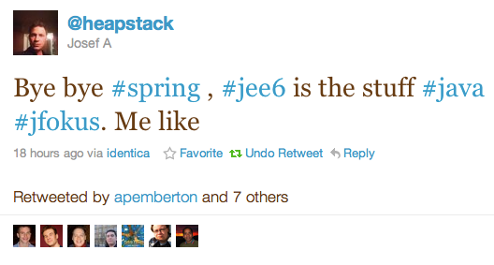
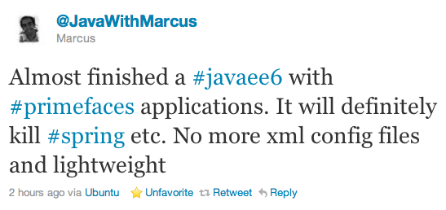

Slide 36
9 Reasons why Java EE 6 will save $$
Prototyping (multiple IDEs)
Development (~30MB, incremental deployment, ...)
Production (Variety, Start small/then scale)
Support (Pick the best one)
Training (“Only” Java EE 6 APIs)
Portability (Backwards compatibility)
Adoption (Growing)
Freedom of choice (Multiple vendors)
Plan B (Similar component models)
http://www.adam-bien.com/roller/abien/entry/8_reasons_why_java_ee

Slide 37
From the real users ...
Jigsaw puzzle, Modular, standard, less xml, easy, easy, have I said easy?
Developers can concentrate
on business logic, Java EE 6 is
providing a standard for
the infrastructure.
Standards compliance, vendor
independence, milliseconds
and kilobyte deployment
Faster development, less frameworks, less complexity, more great code shipped
Higher integrated specs,
simple and annotation driven,
single-classloader WARs,
next level of industry
standard
Definite excuse to avoid Spring forever
Simplified Java Development, Focus on building great products
Not your fat grandfather's enterprise Java anymore, enterprise Java renaissance
http://blogs.oracle.com/arungupta/tags/community+feedback

Slide 38
Avoid “framework explosion”
In selecting an application server our main goal was to avoid the framework explosion that happens when you use a "custom" Enterprise stack like Tomcat + Spring + Hibernate + Myfaces +... Java EE 6 had 80% of what we needed out of the box: strong persistence support ( JPA ), inversion of control ( CDI ), and a lightweight component model ( EJB 3.1 )
http://blogs.oracle.com/stories/entry/egesa_engineering_avoids_framework_explosion

Slide 39
What does Java EE offer to Cloud ?
  Containers
  Injectable services
  Scale to large clusters
  Security model
  . . .

Slide 40
Java EE 7 JSR Soup
Java Persistence API 2.1 – JSR 338
JAX-RS 2.0 – JSR 339
Servlets 3.1 – JSR 340
Expression Language 3.0 – JSR 341
Java EE 7 – JSR 342
Java Message Service 2.0 – JSR 343
Java Server Faces 2.2 – JSR 344
EJB 3.2 – JSR 345
CDI 1.1 – JSR 346
JCache – JSR 107
Bean Validation 1.1 – JSR 349
...

Slide 41
Servlets 3.1 (JSR 340) http://jcp.org/en/jsr/detail?id=340 http://servlet-spec.java.net
Cloud support
Multi-tenancy
  Security / Session state / Resources isolation
Asynchronous IO based on NIO2
Simplified Asynchronous Servlets
Utilize Java EE concurrency utilities
Enable support for Web Sockets

Slide 42
JPA 2.1 (JSR 338) http://jcp.org/en/jsr/detail?id=338 http://jpa-spec.java.net
  Multi-tenancy
  Support for stored procedures, vendor function
  Update and Delete Criteria queries, JPQL ↔ Criteria
  Query by Example
  Support for schema generation
  Persistence Context synchronization control
  Dynamic definition of PU
  Additional event listeners

Slide 43
EJB 3.2 (JSR 345) http://jcp.org/en/jsr/detail?id=345
Enablement for use in cloud
Factorization of the EJB technology
  Interceptors was the first example
  Container-managed transactions as target
Alignment with other specifications
Mark “pruned” technologies as optional
  EJB 1.x and 2.x entity beans
  Web service invocation using JAX-RPC

Slide 44
JAX-RS 2.0 (JSR 339) http://jcp.org/en/jsr/detail?id=339 http://jax-rs-spec.java.net
  Client API
    Low level using Builder pattern, Higher-level
  Hypermedia
  MVC Pattern
    Resource controllers, Pluggable viewing technology
  Bean Validation
    Form or Query parameter validation
  Closer integration with @Inject, etc.
  Server-side asynchronous request processing
  Server-side content negotiation

Slide 45
CDI 1.1 (JSR 346) http://www.jcp.org/en/jsr/proposalDetails?id=346
Global ordering of interceptors and decorators
API for managing built-in contexts
Embedded mode to startup outside Java EE container
Send Servlet events as CDI events

Slide 46
Expression Language 3.0 (JSR 341) http://jcp.org/en/jsr/detail?id=341 http://el-spec.java.net
A JSR by itself
Make EL easier to use outside EE container
  Simplified to use in Java SE
EL Context is split into Parsing and Evaluation context
Explicit coercion rules using API
Criteria-based selection from Collection
Operators: ==, concat, sizeof
CDI events for expression evaluation

Slide 47
JMS 2.0 (JSR 343) http://jcp.org/en/jsr/detail?id=343 http://jms-spec.java.net
Long overdue – after 9 years
Modest scope, major extensions deferred to a subsequent revision
Ease-of-development
Clarification of relationship with other Java EE specs
New mandatory API for pluggable JMS provider

Slide 48
Bean Validation 1.1 (JSR 349) http://jcp.org/en/jsr/detail?id=349
Integration with other specs
  JAX-RS: Validate parameters on HTTP calls
  JAXB: convert into XML schema descriptor
  JPA: DDL generation
Method level validation
@Valid and group propagation
Apply constraints on element collection
public void processOrder(@Valid Order order,
@Min(0) @Max(30) int retry) {
}

Slide 49
JSF 2.2 (JSR 344) http://jcp.org/en/jsr/detail?id=344 http://jsf-spec.java.net
Ease of development
  cc:interface is optional
  JSF lifecycle is CDI aware
  Runtime configuration options change
Support implementation of Portlet Bridge 2.0
Support for HTML5 features
  Forms, Heading/Section content model, ...
New components like FileUpload and BackButton

Slide 50
Java EE 7 : Technology Refresh
Ease-of-development: JMS 2.0
Latest web standards
  New JSRs: Web Sockets, Java JSON API
  HTTP Client API (JAX-RS 2.0)
Possible JSRs inclusion
  Concurrency Utilities for Java EE (JSR 236)
  JCache (JSR 107)

Slide 51
Transparency Checklist http://jcp.org/en/resources/transparency
NEW
EG members names
EG business reported on publicly readable alias
Schedule is public, current and updated regularly
Public can read/write to a wiki
Discussion board on jcp.org
Public read-only issue tracker

Slide 52
Java EE 7 – When ?
Late 2012
Date-driven release
  Anything not ready will be deferred to Java EE 8
Participate
  Expert Groups forming
  Public discussion lists
  JCP membership free for individuals

Slide 53

What is GlassFish ?
A community
  Users, Partners, Testers, Developers, ...
  Started in 2005 on java.net
Application Server
  Open Source (CDDL & GPL v2)
  Java EE Reference Implementation

Slide 54
GlassFish Server Distributions
Distribution | License | Features
GlassFish Server Open Source Edition 3.1 Web Profile | CDDL & GPLv2 | Java EE 6 compatibility Web Profile support In-memory replication / clustering Centralized Administration
GlassFish Open Source Edition 3.1 | CDDL & GPLv2 | Java EE 6 compatibility Full Java EE distribution In-memory replication / clustering Centralized Administration
Oracle GlassFish Server 3.1 Web Profile | Commercial | Adds Oracle GlassFish Server Control Patches, support, knowledge base
Oracle GlassFish Server 3.1 | Commercial | Adds Oracle GlassFish Server Control Patches, support, knowledge base

Slide 55
References
oracle.com/javaee
glassfish.org
oracle.com/goto/glassfish
blogs.oracle.com/theaquarium
youtube.com/GlassFishVideos
Follow @glassfish

Slide 56
What's new in Java EE 6 & Upcoming ?
Arun Gupta, Java EE & GlassFish Guy
blogs.oracle.com/arungupta, @arungupta

