Slide 1

Using the Latest Java Persistence API 2.0 Features
Arun Gupta, Java EE & GlassFish Guy
blogs.oracle.com/arungupta, @arungupta

Slide 2
The following/preceding is intended to outline our general product direction. It is intended for information purposes only, and may not be incorporated into any contract. It is not a commitment to deliver any material, code, or functionality, and should not be relied upon in making purchasing decisions.
The development, release, and timing of any features or functionality described for Oracle’s products remains at the sole discretion of Oracle.

Slide 3
Java Persistence API
Object/Relational Mapping for Java Developers
The standard API for object/relational persistence for Java SE and Java EE applications
Automatic mapping from Java object domain model to relational database
Mapping is explicit, not “magic”
  Uses annotations and/or XML
  Many useful defaults
  Lots of hooks and options for customization
SQL-like query language (JPQL)
  Applied to domain model
  Supports both static and dynamic queries

Slide 4

Background
JPA 1.0
  Introduced as part of Java EE 5; also available standalone
    Part of the EJB 3.0 simplification effort
  Based on experience with existing technology:
    TopLink, Hibernate, JDO
  Covered all the essentials++

Slide 5

JPA 2.0 (JSR 317)
JPA 2.0
  Part of Java EE 6 and/or available standalone
  Adds more sophisticated mapping and modeling options
  Expanded query language
  Adds Criteria API, together with Metamodel API
  Support for Validation
  EclipseLink is reference implementation
  Integrated in GlassFish

Slide 6
Object/Relational Mapping
Essentials
Entities
Basic types
  Strings, integers, floats, decimals, …
Embeddable classes
  E.g., Address
Relationships
  One-to-one, one-to-many/many-to-one, many-to-many
  Collections modeled with java.util Collection, Set, List, or Map
  Customized via metadata: @JoinColumn, @JoinTable, etc.
Inheritance
  Single table, joined subclass, table per class (optional)

Slide 7
Object/Relational Mapping
New in JPA 2.0
Element collections
  Collections of strings, integers, floats, decimals, …
  Collections of embeddable classes
Embeddable classes
  Nested embeddables; embeddables with relationships
Persistently ordered lists
Improved Map support
More relationship mapping options
  Unidirectional one-many foreign key mappings
  Join table mappings for one-one, one-many/many-one

Slide 8
Collections of Basic Types
@Entity
public class Person {
@Id protected String ssn;
protected String name;
protected Date birthDate;
. . .
@ElementCollection
protected Set<String> nickNames;
}

Slide 9
Collections of Basic Types
@Entity
public class Person {
@Id protected String ssn;
protected String name;
protected Date birthDate;
. . .
@ElementCollection
@CollectionTable(name=”ALIAS”)
protected Set<String> nickNames;
}

Slide 10
Collection of Embeddable Types
@Embeddable public class Address {
String street;
String city;
String state;
. . .
}
@Entity public class RichPerson extends Person {
. . .
@ElementCollection
protected Set<Address> vacationHomes;
. . .
}

Slide 11
Multiple Levels of Embedding
@Entity public class Employee {
@Id int empId;
String name;
@Embedded ContactInfo contactInfo;
. . .
}
@Embeddable public class ContactInfo {
@Embedded Address address;
. . .
}

Slide 12
Embeddables with Relationships
@Entity public class Employee {
@Id int empId;
String name;
@Embedded ContactInfo contactInfo;
. . .
}
@Embeddable public class ContactInfo {
@Embedded Address address;
@OneToMany Set<Phone> phones;
. . .
}

Slide 13
Ordered Lists
@Entity public class CreditCard {
@Id long cardNumber;
@OneToOne Person cardHolder;
. . .
@OneToMany
@OrderColumn
List<CardTransaction> transactions;
}

Slide 14
Maps
@Entity public class VideoStore {
@Id Integer storeId;
Address location;
. . .
@ElementCollection
Map<Movie, Integer> inventory;
}
@Entity public class Movie {
@Id String title;
@String director;
. . .
}

Slide 15
Automatic Orphan Deletion
For entities logically “owned” by “parent”
@Entity public class Order {
@Id int orderId;
. . .
@OneToMany(cascade=PERSIST, orphanRemoval=true)
Set<Item> lineItems;
. . .
}

Slide 16
Key Interfaces
EntityManagerFactory
  Used to create entity managers
  One entity manager factory per persistence unit
EntityManager
  Used to manage persistence context
    Entities read/written from database
  Operations: persist, remove, find, refresh, createQuery,…
Query, TypedQuery
  Used for query configuration, parameter binding, query execution

Slide 17
Java Persistence Query Language
String-based SQL-like query language
  SELECT, FROM, WHERE, GROUP BY, ORDER BY,…
Queries written over Java domain model
  Entities, state, relationships
  Supports navigation using dot-notation
  Mapped into SQL by the provider
Supports static and dynamic use
SELECT AVG (p.price)
FROM Order o JOIN o.products p
WHERE o.customer.address.zip = ‘94301’

Slide 18
Java Persistence Query Language
New in JPA 2.0
Support for all new modeling and mapping features
Operators and functions in select list
Case, coalesce, nullif expressions
Restricted polymorphism
Collection-valued parameters for IN-expressions

Slide 19
JPQL New Operators
INDEX
For ordered Lists
KEY, VALUE, ENTRY
For maps
CASE, COALESCE, NULLIF
For case expressions, etc.
TYPE
For restricted polymorphism

Slide 20
Ordered Lists
SELECT t
FROM CreditCard c JOIN c.transactions t
WHERE c.cardHolder.name = 'John Doe'
AND INDEX(t) < 10

Slide 21
Maps
// Inventory is Map<Movie, Integer>
SELECT v.location.street, KEY(i).title, VALUE(i),
FROM VideoStore v JOIN v.inventory i
WHERE KEY(i).director LIKE '%Hitchcock%'
AND VALUE(i) > 0

Slide 22
Case Expressions
UPDATE Employee e
SET e.salary =
CASE e.rating
WHEN 1 THEN e.salary * 1.05
WHEN 2 THEN e.salary * 1.02
ELSE e.salary * 0.95
END

Slide 23
Restricted Polymorphism
All queries are polymorphic by default
  “from” clause include entity class/sub-class instances
Restrict queries to specific types
SELECT e
FROM Employee e
SELECT e
FROM Employee e
WHERE TYPE(e) IN :empTypes

Slide 24
Metamodel
Abstract “schema-level” view of managed classes
  Entities, mapped superclasses, embeddables
Accessed dynamically
  EntityManagerFactory.getMetamodel()
  EntityManager.getMetamodel()
And/or materialized as static metamodel classes
  Used to create strongly-typed criteria queries
  Spec defines canonical format

Slide 25
Java Persistence API 2
Metamodel Example
@Entity
public class Customer {
@Id Integer custId;
String name;
...
@Embedded Address address;
@ManyToOne SalesRep rep;
@OneToMany Set<Order> orders;
}
import javax.persistence.metamodel.*;
@StaticMetamodel(Customer.class)
public class Customer_ {
public static SingularAttribute<Customer, Integer> custId;
public static SingularAttribute<Customer, String> name;
public static SingularAttribute<Customer, Address> address;
public static SingularAttribute<Customer, SalesRep> rep;
public static SetAttribute<Customer, Order> orders;
}

Slide 26
Metamodel using CLI
javac -processor org.eclipse.persistence.internal.jpa.modelgen.CanonicalModelProcessor -sourcepath src -d src -classpath /ace2_apps/eclipselink/jlib/eclipselink.jar:.:/ace2_apps/eclipselink/jlib/JPA/javax.persistence_2.0.0.v200911271158.jar -proc:only -Aeclipselink.persistencexml=src/META-INF/persistence.xml src/demo/*.java
Note: Creating the metadata factory …
Note: Building metadata class for round element: demo.Item
. . .
http://weblogs.java.net/blog/lancea/archive/2009/12/15/generating-jpa-20-static-metamodel-classes-using-eclipselink-20-and-n

Slide 27
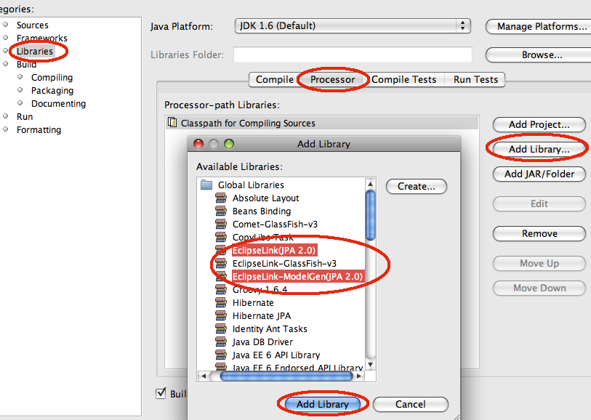
Canonical Metamodel using NetBeans
http://blogs.oracle.com/arungupta/entry/totd_148_jpa2_metamodel_classes

Slide 28
Criteria API
New in JPA 2.0
Object-based API for building queries
Designed to mirror JPQL semantics
Strongly typed
  Based on type-safe metamodel of persistent classes and relationships
  Heavy use of Java generics
  Supports object-based or string-based navigation
Query construction at development time or runtime

Slide 29
Criteria API: Core Interfaces
CriteriaBuilder
  Construct criteria queries, selections, predicates, orderings
CriteriaQuery
  Used to add / replace/ browse query elements
  from, select, where, orderBy, groupBy, having,… methods
Root
  Query roots
Join, ListJoin, MapJoin, …
  Joins from a root or existing join
Path
  Navigation from a root, join, or path
Subquery

Slide 30
How to Build a Criteria Query
EntityManager em = emf.createEntityManager();
CriteriaBuilder builder = em.getCriteriaBuilder();
CriteriaQuery criteria = builder.createQuery(Manufacturer.class);
Root root = criteria.from(Manufacturer.class); // FROM clause
criteria.select(root); // SELECT clause
Predicate condition = builder.like(root.get(Manufacturer_.name),
"%" + name + "%");
criteria.where(condition); // WHERE clause
TypedQuery query = em.createQuery(criteria); // FIRE query
List manufacturers = query.getResultList();

Slide 31
Validation
New in JPA 2.0
Leverages work of Bean Validation (JSR 303)
Automatic validation upon lifecycle events
  PrePersist, PreUpdate, PreRemove
Configured using
  <validation-mode> element in “persistence.xml”
    AUTO (default)
    CALLBACK
    NONE
  “javax.persistence.validation.mode” property for Persistence.createEntityManagerFactory
NetBeans 7.0 generates the constraints

Slide 32
Concurrency
Java Persistence assumes optimistic concurrency
  Short-term read locks
  Long-term write locks
  Provider can defer writing to database to transaction commit
  Application can flush to database on demand
Optimistic “locking” done via version attributes
  Integral or timestamp attributes, managed by provider
  Provider validates version when writing to database
  Explicit lock() calls available to validate read data

Slide 33
Pessimistic Locking
New in JPA 2.0
Java Persistence assumes optimistic concurrency
  Normal pessimistic locking
  Persistent state of entity
    Relationships, Element collections
Grab database locks upfront
  JPA spec defines semantics, not mechanism
  Provider can lock more (not less)
Lock modes
  PESSIMISTIC_READ – grab shared lock
  PESSIMISTIC_WRITE – grab exclusive lock
  PESSIMISTIC_FORCE_INCREMENT – update version

Slide 34
Locking APIs
EntityManager methods: lock, find, refresh
Query / TypedQuery methods: setLockMode, setHint
NamedQuery annotation: lockMode element
javax.persistence.lock.scope property
javax.persistence.lock.timeout hint
PessimisticLockException (if transaction rolls back)
LockTimeoutException (if only statement rolls back)

Slide 35
Caching Configuration
New in JPA 2.0
EntityManager persistence context corresponds to “first level” cache
  Entities managed by persistence provider
    Entities read from database
    Entities to be written to database
Most implementations also use second-level caches
  Not always transparent to application
JPA 2.0 standardizes basic second-level cache options

Slide 36
Standard Configuration Properties
javax.persistence.jdbc.driver
javax.persistence.jdbc.url
javax.persistence.jdbc.user
javax.persistence.jdbc.password
. . .

Slide 37
Summary of JPA 2.0 New Features
More flexible modeling capabilities
Expanded O/R mapping functionality
Additions to Java Persistence query language
Criteria API
Metamodel API
Pessimistic locking
Support for validation
Standardization of many configuration options

Slide 38
JPA 2.1 (JSR 338) http://jcp.org/en/jsr/detail?id=338 http://jpa-spec.java.net
NEW
  Multi-tenancy
  Support for stored procedures, vendor function
  Update and Delete Criteria queries, JPQL ↔ Criteria
  Query by Example
  Support for schema generation
  Persistence Context synchronization control
  Dynamic definition of PU
  Additional event listeners

Slide 39
References
oracle.com/javaee
glassfish.org
oracle.com/goto/glassfish
blogs.oracle.com/theaquarium
youtube.com/GlassFishVideos
Follow @glassfish

Slide 40
Using the Latest Java Persistence API 2.0 Features
Arun Gupta, Java EE & GlassFish Guy
blogs.oracle.com/arungupta, @arungupta

