Slide 1

Java Server Faces 2.0
Arun Gupta, Java EE & GlassFish Guy
blogs.oracle.com/arungupta, @arungupta

Slide 2
The following/preceding is intended to outline our general product direction. It is intended for information purposes only, and may not be incorporated into any contract. It is not a commitment to deliver any material, code, or functionality, and should not be relied upon in making purchasing decisions.
The development, release, and timing of any features or functionality described for Oracle’s products remains at the sole discretion of Oracle.

Slide 3
Java Server Faces 2.0
JSR 314
Focus
  Ease-of-development
  New features
  Runtime Performance & Scalability
  Adoption

Slide 4
JSF2 – Ease of development
Real-world view description technology
  Facelets
Custom component with little/no Java coding
“faces-config.xml” / “web.xml” optional
  Annotations
No JSP tag handler for components
Improved developer experience by reporting project stage
Make it easy to create CRUD-based apps

Slide 5
Facelets
Designed for JSF from beginning
XHTML + CSS
  Document validation
Better error handling, including line numbers
Library prefixes as namespaces
EL directly in page:
  #{bean.propertyname}
Templating made easy
  ui:composition, ui:define, ui:insert
  ui:include, ui:repeat

Slide 6
Facelets – Sample Code
<html xmlns="http://www.w3.org/1999/xhtml"
xmlns:ui="http://java.sun.com/jsf/facelets"
xmlns:h="http://java.sun.com/jsf/html">
<h:head>
<title>Enter Name &amp; Password</title>
</h:head>
<h:body>
<h1>Enter Name &amp; Password</h1>
<h:form>
<h:panelGrid columns="2">
<h:outputText value="Name:"/>
<h:inputText value="#{simplebean.name}" title="name"
id="name" required="true"/>
<h:outputText value="Password:"/>
<h:inputText value="#{simplebean.password}" title="password"
id="password" required="true"/>
</h:panelGrid>
<h:commandButton action="show" value="submit"/>
</h:form>
</h:body>
</html>

Slide 7
Composite Components
Enable True Abstraction
  Create a true, reusable, component from an arbitrary region of a page
  Built by composing other components
“Using” and “Defining” page
Full support for using attached objects in the using page
  Action methods
  Validators, etc

Slide 8
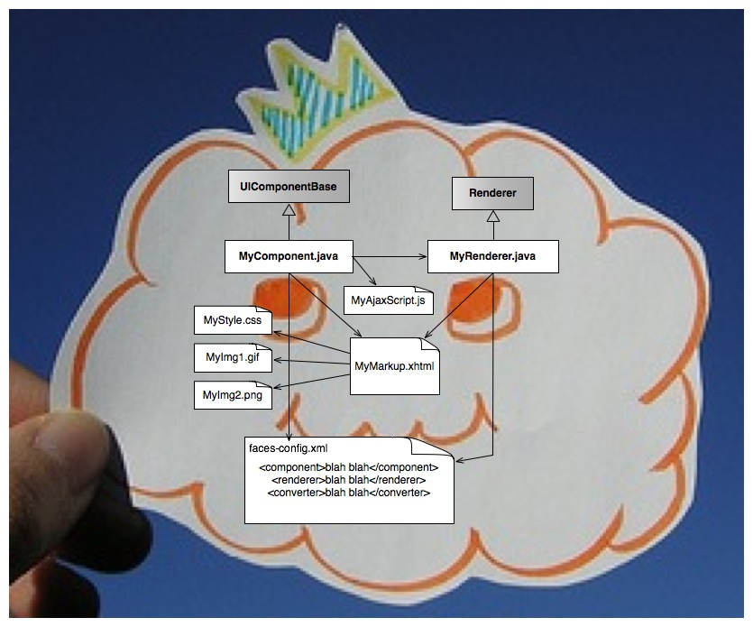
Composite Components in JSF 1.x ...

Slide 9
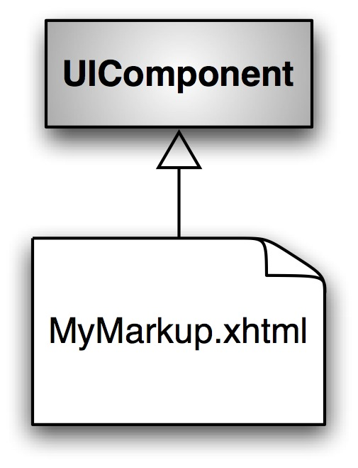
Becomes this...

Slide 10
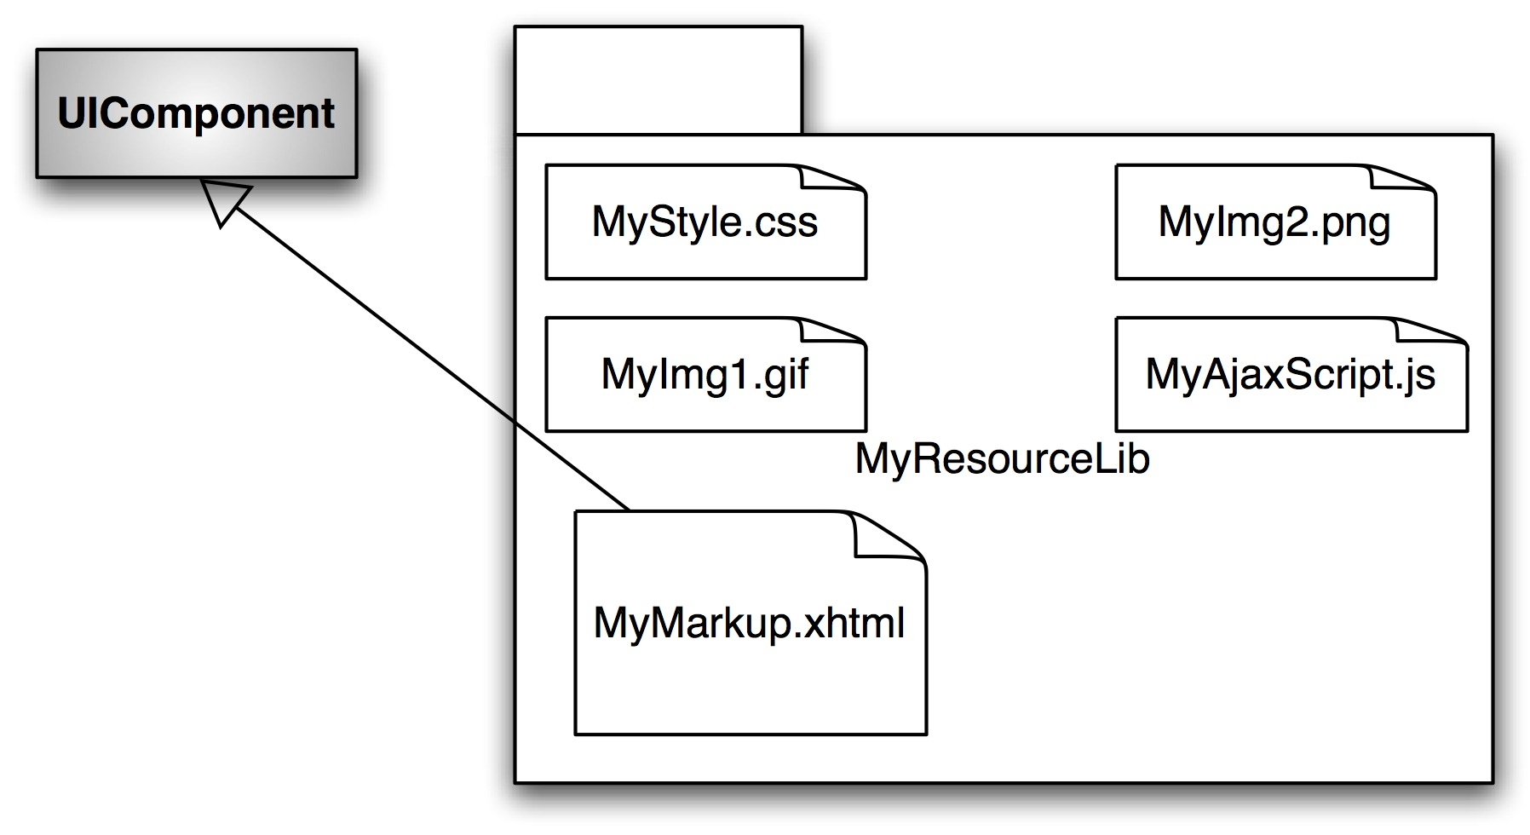
Or maybe this:

Slide 11
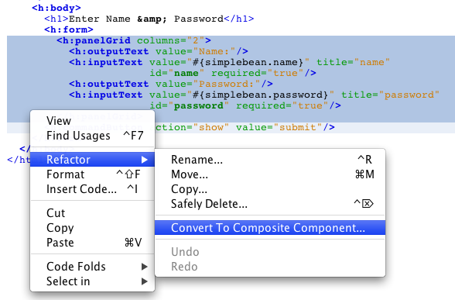
Composite Components – Sample Code

Slide 12
Composite Component – Sample Code
<html xmlns="http://www.w3.org/1999/xhtml"
xmlns:ui="http://java.sun.com/jsf/facelets"
xmlns:h="http://java.sun.com/jsf/html">
<h:head>
<title>Enter Name &amp; Password</title>
</h:head>
<h:body>
<h1>Enter Name &amp; Password</h1>
<h:form>
<h:panelGrid columns="2">
<h:outputText value="Name:"/>
<h:inputText value="#{simplebean.name}" title="name"
id="name" required="true"/>
<h:outputText value="Password:"/>
<h:inputText value="#{simplebean.password}" title="password"
id="password" required="true"/>
</h:panelGrid>
<h:commandButton action="show" value="submit"/>
</h:form>
</h:body>
</html>

Slide 13
Composite Components – Mapping
<html xmlns="http://www.w3.org/1999/xhtml"
xmlns:ui="http://java.sun.com/jsf/facelets"
xmlns:h="http://java.sun.com/jsf/html"
xmlns:ez="http://java.sun.com/jsf/composite/ezcomp">
<h:head>
<title>Enter Name &amp; Password</title>
</h:head>
<h:body>
<h1>Enter Name &amp; Password</h1>
<h:form>
<ez:username-password/>
<h:commandButton action="show" value="submit"/>
</h:form>
</h:body>
</html>
. . .
WEB-INF
index.xhtml
resources/
ezcomp/
username-password.xhtml
http://blogs.oracle.com/arungupta/entry/totd_147_java_server_faces

Slide 14
Optional “faces-config.xml”
<managed-bean> → @ManagedBean or @Named
  Validator, Renderer, Listener, ...
<managed-bean>
<managed-bean-name>simpleBean</managed-bean-name>
<managed-bean-class>samples.SimpleBean</managed-bean-class>
<managed-bean-scope>request</managed-bean-scope>
<managed-property>
. . .
</managed-property>
</managed-bean>
@ManagedBean(“simplebean”)
@SessionScoped
public class SimpleBean {
. . .
}

Slide 15
Optional “faces-config.xml”
Implicit navigation rules – match a view on the disk
  Conditional navigation
<h:commandButton action="next" value="submit"/>
<navigation-rule>
<navigation-case>
<from-outcome>next</from-outcome>
<to-view-id>/show.jsp</to-view-id>
</navigation-case>
</navigation-rule>
<h:commandButton action="show" value="submit"/>

Slide 16
Optional “web.xml”
@SuppressWarnings({"UnusedDeclaration"})
@HandlesTypes({
ManagedBean.class,
FacesComponent.class,
FacesValidator.class,
FacesConverter.class,
FacesBehaviorRenderer.class,
ResourceDependency.class,
ResourceDependencies.class,
ListenerFor.class,
ListenersFor.class,
UIComponent.class,
Validator.class,
Converter.class,
Renderer.class
})
public class FacesInitializer implements ServletContainerInitializer {
// NOTE: Loggins should not be used with this class.
private static final String FACES_SERVLET_CLASS = FacesServlet.class.getName();

Slide 17
Optional “web.xml”
public void onStartup(Set<Class<?>> classes, ServletContext servletContext)
throws ServletException {
if (shouldCheckMappings(classes, servletContext)) {
Map<String,? extends ServletRegistration> existing = servletContext.getServletRegistrations();
for (ServletRegistration registration : existing.values()) {
if (FACES_SERVLET_CLASS.equals(registration.getClassName())) {
// FacesServlet has already been defined, so we're
// not going to add additional mappings;
return;
}
}
ServletRegistration reg =
servletContext.addServlet("FacesServlet",
"javax.faces.webapp.FacesServlet");
reg.addMapping("/faces/*", "*.jsf", "*.faces");
servletContext.setAttribute(RIConstants.FACES_INITIALIZER_MAPPINGS_ADDED, Boolean.TRUE);

Slide 18
Project Stage
Inspired by Rails
Development
  Better error reporting, debugging
Production
  Better performance

Slide 19
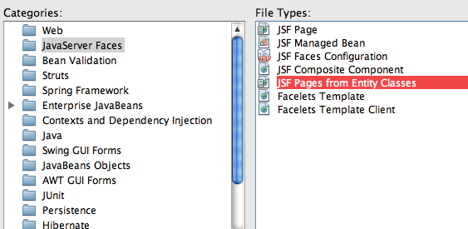
CRUD-based Applications

Slide 20
JSF2 – New features
Integrated Ajax
  Partial tree traversal
HTTP GET support
Form-level validation
Bundling/delivering static resources with a component
System Events

Slide 21

Integrated Ajax
Inspiration – ADF, RichFaces, IceFaces, DynamicFaces
Two entry points:
  Declarative: <f:ajax> tag, uses AjaxBehavior
  Programmatic ajax
    resource library javax.faces
    resource name jsf.js
    JavaScript namespace jsf.ajax.
      jsf.ajax.request function

Slide 22
Integrated Ajax – Sample Code
<h:commandButton
actionListener="#{sakilabean.findActors}"
value="submit">
<f:ajax execute="length"
render="actorTable totalActors"/>
</h:commandButton>
http://blogs.oracle.com/arungupta/entry/totd_123_f_ajax_bean

Slide 23
HTTP GET Support
GET Request handling required low-level primitives
  PhasesListener
Now first-class support in JSF2
  View Parameters
  Bookmarkable URLs
    <h:link>/<h:button>

Slide 24
JSF2 GET – View Parameters
Declarative way to map request parameters to EL-reachable location/model property
  <f:metadata>/<f:viewParam>
Only for Facelets
Faces lifecycle for GET
  Converted to proper target type
  Validated before assignment
  Pushed into the model
Converters/validators can be attached to <f:viewParam>

Slide 25
View Parameters – Sample Code
@Named
public class Blog {
int entryId;
. . .
}
page1.xhtml
<f:metadata>
<f:viewParam name="id" value="#{blog.entryId}"/>
</f:metadata>
page1.xhtml?id=10
blog.entryId will equal “10”

Slide 26
JSF2 GET – Bookmarkable URLs
<h:link outcome="viewEntry" value="Link">
<f:param name="entry" value="#{aBean.entry}"/>
</h:link>
<a href="http://localhost:8080/myapp/viewEntry.xhtml?entry=entry1">Link</a>

Slide 27
Validation
Integration with JSR 303: Bean Validation
  @NotEmpty String name;
  Default validator: javax.faces.Bean – automatically applied to all input fields
Use cases
  Ordering constraints using Validation Groups
    Basic/Cheap constraints before complex/costly ones
  Partial data validation: wizard-style form
Error messages are translated to FacesMessages

Slide 28
Validation – Sample Code
<h:inputText value="#{address.zip}">
<f:validateBean validationGroups="myGroup"/>
</h:inputText>
<h:input id="zip" value="#{address.zip}">
<f:validateRequired />
</h:input>
<h:input id="zip" value="#{address.zip}" required=”true”/>
<h:input id="zip" value="#{address.zip}">
<f:validateRegex pattern="/^\d{5}([\-]\d{4})?$/" />
</h:input>

Slide 29
Resources
Standard way to serve image, JavaScripts, CSS, …
  /resources or /META-INF/resources
  No need for separate Servlet or Filter
  Logically related to components, treat them that way
@ResourceDependency or @ResourceDependencies on custom components
  @ResourceDependency(library=”corporate”, name=”colorAndMedia.css”)

Slide 30
Resource EL – Sample Code
Syntax
  #{resource['<resource>']}
  #{resource['<library>:<resource>']}
Examples of use
  <a href="#{resource['header.jpg']}"/>
  <h:graphicImage value="#{resource['corp:header.jpg']}"/>

Slide 31
System Events
Inspired by Solaris Dtrace, Linux strace, etc.
Publish/Subscribe event bus for things that happen during the JSF Lifecycle
Adds to event listening abilities
  FacesEvent → FacesListener (existing)
  PhaseEvent → PhaseListener (existing)
  SystemEvent → SystemEventListener (new)
Mainly targeted at page/component/framework authors

Slide 32
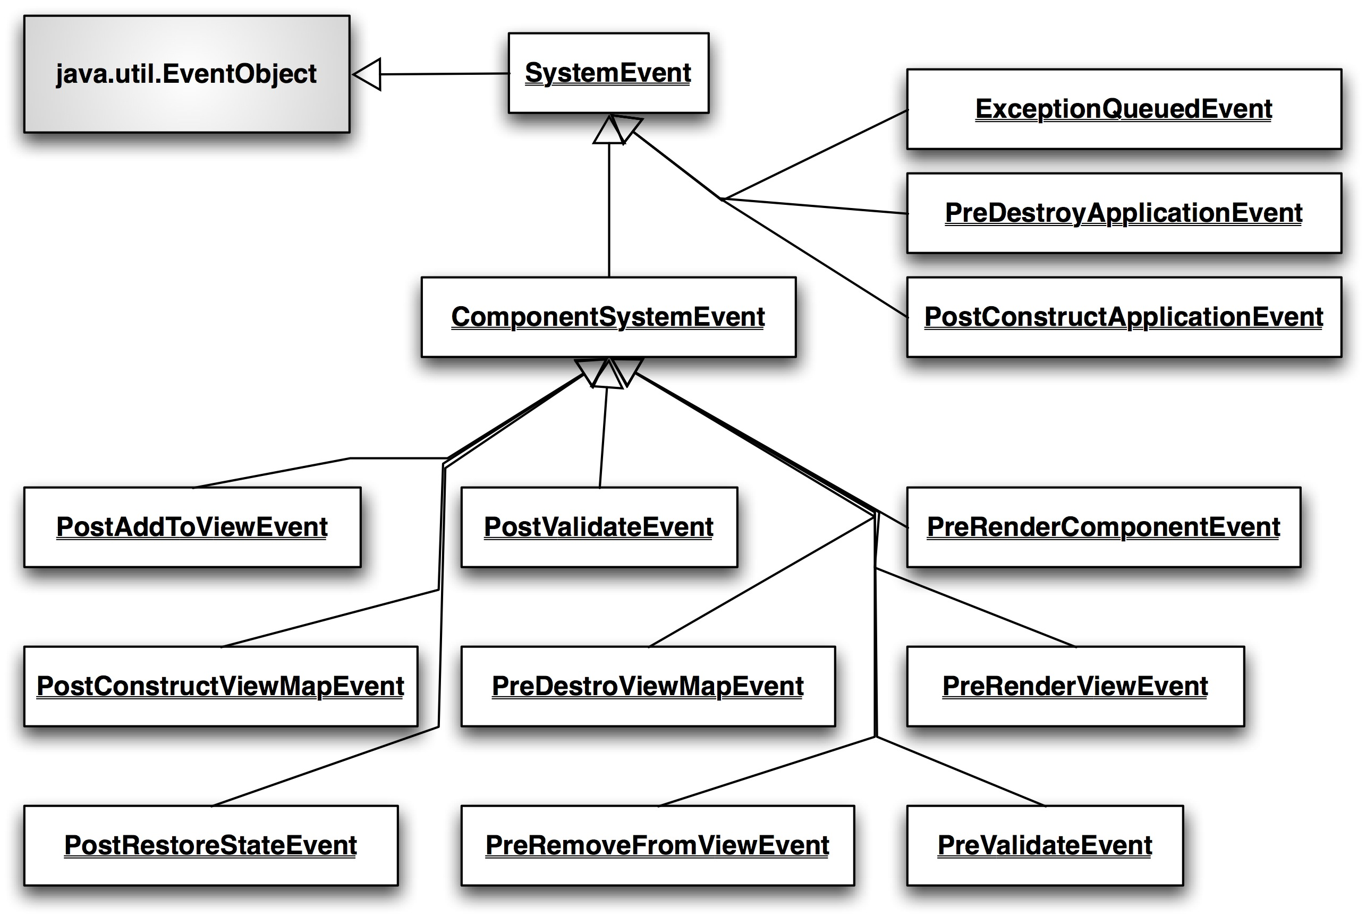
System Event Types

Slide 33
System Events – Sample Code
<h:inputText>
<f:event type="preValidate"
listener="#{bean.doSomePreValidation}"/>
</h:inputText>
<h:inputText value="#{myBean.text}">
<f:event type="beforeRender"
listener="#{myBean.beforeTextRender}"/>
</h:inputText>

Slide 34
JSF2 – Runtime Performance & Scalability
Partial State Saving
Behavior

Slide 35
Partial State Saving
Inspired by Trinidad state saving
Save only the state that's changed since creation of the component tree
  Initial state can be restored by re-executing the view
Per-view state size up to 4X smaller
Default for pages written with Facelets
Implemented in standard components
  Default for composite components

Slide 36
Behaviors
New type of “attached object” that enhance the component's client-side functionality
  Unlike server-side Validator/Renderer
  Use cases: Client-side validation, Animations and visual effects, Alerts and confirmation dialogs, Tooltips
3 new behaviors – ClientBehavior, ClientBehaviorHolder, AjaxBehavior
  f:ajax is AjaxBehavior

Slide 37
Behaviors
UI Component
ClientBehaviorHolder
addClientBehavior(eventName, behavior)
ClientBehavior
getScript()
Loose Coupling
  Client behaviors product scripts in a component-agnostic manner
  Components retrieve scripts/insert into markup in a behavior-agnostic manner

Slide 38
Behaviors – Sample Code
public class MyBehavior implements ClientBehavior {
public String getScript(ClientBehaviorContext context) {
return "return confirm('Really???')";
}
}
<h:commandLink
onclick="return confirm('Really???')"/>
<h:commandLink>
<foo:confirm event="click"/>
</h:commandLink>
http://java.dzone.com/articles/jsf-2-client-behaviors

Slide 39
JSF 2.2 (JSR 344) http://jcp.org/en/jsr/detail?id=344 http://jsf-spec.java.net
NEW
Ease of development
  cc:interface is optional
  JSF lifecycle is CDI aware
  Runtime configuration options change
Support implementation of Portlet Bridge 2.0
Support for HTML5 features
  Forms, Heading/Section content model, ...
New components like FileUpload and BackButton

Slide 40
References
oracle.com/javaee
glassfish.org
oracle.com/goto/glassfish
blogs.oracle.com/theaquarium
youtube.com/GlassFishVideos
Follow @glassfish

Slide 41
Java Server Faces 2.0
Arun Gupta, Java EE & GlassFish Guy
blogs.oracle.com/arungupta, @arungupta

