Slide 1

OSGi-enabled Java EE Applications in GlassFish
Arun Gupta, Java EE & GlassFish Guy
blogs.oracle.com/arungupta, @arungupta

Slide 2
The following/preceding is intended to outline our general product direction. It is intended for information purposes only, and may not be incorporated into any contract. It is not a commitment to deliver any material, code, or functionality, and should not be relied upon in making purchasing decisions.
The development, release, and timing of any features or functionality described for Oracle’s products remains at the sole discretion of Oracle.

Slide 3
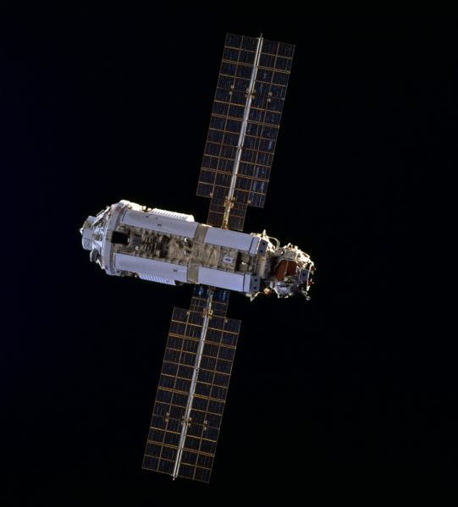

Slide 4


Slide 5
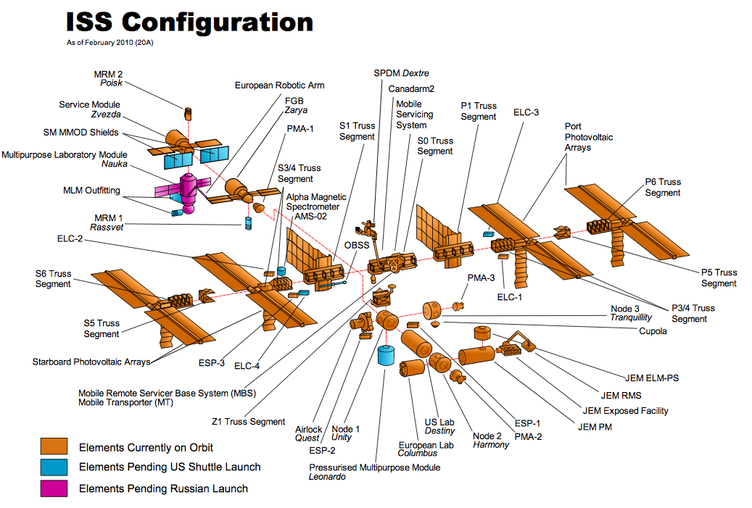

Slide 6






Slide 7
Generally complex ...
13 assembly missions
16 pressurized modules
35k cubic feet
400 metric tons ~ 400K kg ~ 882K lbs
173 – 286 miles above Earth
Average speed: 17,227 mph
15.7 orbits/day
Estimated cost: $157 billion

Slide 8

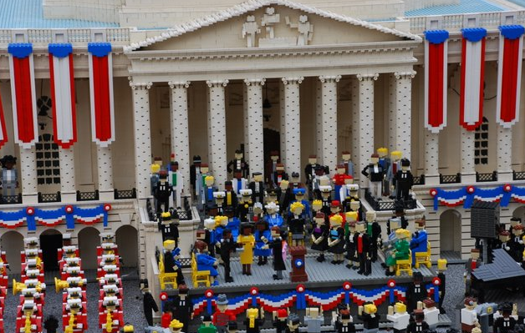


Slide 9

The OSGi Alliance is a worldwide
consortium of technology innovators that advances a proven and mature process to assure interoperability of applications and services based on its component integration platform.

Slide 10
OSGi Alliance provides ...
Specifications
Reference Implementation
Test Suites
Certifications

Slide 11
What is OSGi Specification ?
Delivered by OSGi Alliance
  Originally for embedded devices, set top boxes, network
Architecture for modular application development in Java
  Breaks applications into “modules” or “bundles”
Can install, uninstall, start, and stop each bundle dynamically without restarting container
  Multiple versions are supported
Dependencies explicitly defined with clear boundaries

Slide 12
“JAR Hell”
JAR is a build-time and deploy-time concept, not run-time
  Based on the ZIP file format
No metadata to indicate dependencies
Multiple versions of JARs cannot be loaded
All “public” classes are public
  Access modifiers are for packages, not JAR

Slide 13
OSGi Layers
Service
Life Cycle
Module
Execution Environment

Slide 14
OSGi Bundle – Just a JAR File!
Export-Package
Import-Package
Java Classes, Static Files, …
(bundle private)
Bundle-ClassPath
. . .
META-INF/MANIFEST.MF
Persistent
OSGI-OPT
(docs, source code, ...)
Atomic

Slide 15
Bundle is identified by ...
Bundle Identifier
  Unique for the lifetime
  getBundleId()
Bundle Location
  Unique location of the bundle
  getLocation()
Bundle Symbolic Name and Version
  Globally unique identifier
  getSymbolicName(), getVersion()

Slide 16
Java Classes, Static Files, ...
Service
META-INF/MANIFEST.MF
. . .
Export-Package
. . .
Client
Java Classes, Static Files, ...
META-INF/MANIFEST.MF
. . .
Import-Package
. . .

Slide 17
Interaction between layers
Service
register / unregister
get / unget
Life Cycle
start / stop
Bundle
Module
classload
EE
execute

Slide 18
Bundle State Diagram
update
refresh
INSTALLED
STARTING
start
update
refresh
resolve
RESOLVED
ACTIVE
uninstall
stop
STOPPING
Each bundle installation is new

Slide 19



OSGi Containers
http://stackoverflow.com/questions/560794/what-osgi-container-do-you-recommend

Slide 20
OSGi in GlassFish
GlassFish runs on top of OSGi
Felix is default, also runs on Equinox & Knopflerfish
  Runs in an existing shell
  260+ bundles in 3.1
All GlassFish modules are OSGi bundles
No OSGi APIs are used in GlassFish
  HK2 provides abstraction layer
http://blogs.oracle.com/arungupta/entry/totd_103_glassfish_v3_with
http://blogs.oracle.com/arungupta/entry/totd_127_embedding_glassfish_in

Slide 21
GlassFish: Modular Platform
Application Container
REST
Web Services
SOAP
Web Services
Clustering
High
Availability
JMS
Web
Container
JSF
Connection
Pooling (JCA)
Java
Persistence
EJB Container
Management Console
Update Center
Management CLI
Naming
Service
Config
Deploy
Security
Monitor
Cluster
Injection
Manager
Grizzly Framework
Configuration
Monitoring/
Serviceability/
Logging
GlassFish V3 Core
(Module Subsystem)
Transaction
Service
Security
Service
Deployment
Clustering
OSGi
Java SE

Slide 22
GlassFish v3 Runtime with OSGi
GlassFish V3 modules
(OSGi + extra metadata)
Random OSGi Bundle
HK2 Service layer
OSGi
Service Layer
Service
Mapper
OSGi Bundle Management

Slide 23
Benefits of OSGi for GlassFish
Demands and enforces stronger modularity
Enables custom tailored App server
Lazy loading based on usage patterns
Successfully maintained quick startup
Available to GlassFish developers and users

Slide 24
Create an OSGi Bundle – Maven
Create a Maven project
Implement “BundleActivator”
Update “pom.xml”
  Change packaging to “bundle”
  Add dependencies on OSGI APIs
  Use “maven-bundle-plugin” to package
Build the bundle
http://blogs.oracle.com/arungupta/entry/totd_36_deploy_osgi_bundles

Slide 25
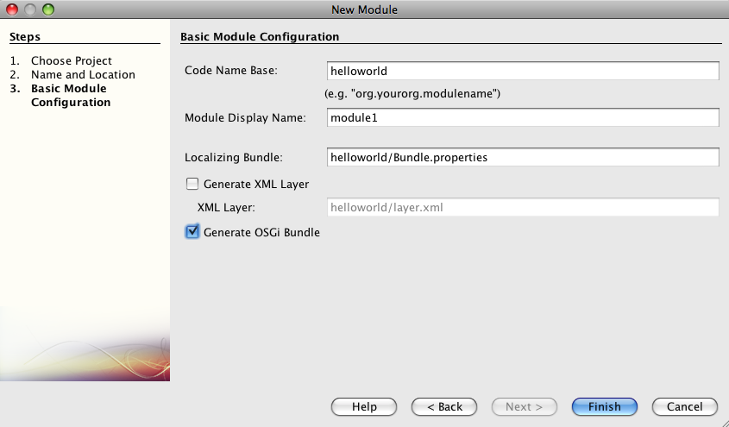
Create an OSGi bundle – NetBeans
http://blogs.oracle.com/arungupta/entry/totd_125_creating_an_osgi

Slide 26
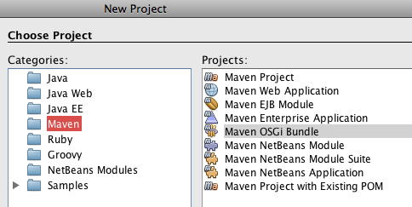
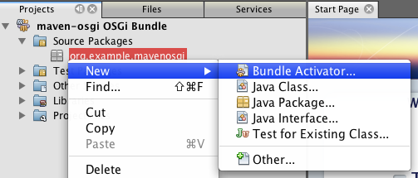
Create an OSGi bundle – NetBeans
http://blogs.oracle.com/arungupta/entry/totd_125_creating_an_osgi

Slide 27
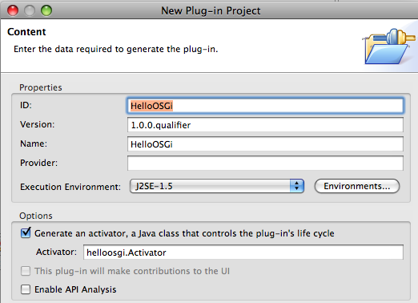
Create an OSGi bundle – Eclipse
http://blogs.oracle.com/arungupta/entry/totd_126_creating_an_osgi

Slide 28
OSGi Bundles in GlassFish
asadmin deploy –type osgi
“cp”/“rm” glassfish/domains/domain1/autodeploy/bundles
telnet localhost 6666
Apache Felix Web Console
REST Console bundle
Perl-based shell (Osgish)
VisualVM OSGi Plugin
Supports OBR
  Discover and deploy dependencies together
http://blogs.oracle.com/arungupta/entry/totd_118_managing_osgi_bundles

Slide 29
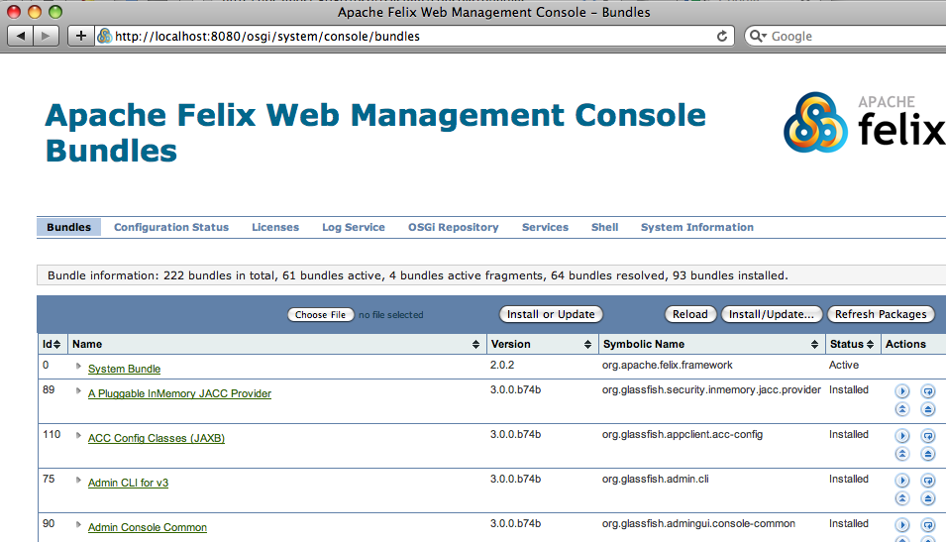

Slide 30
Dynamic Discovery of OSGi service
API
OSGi
Service
Registry
Export-Package
Impl
Import-Package
Bundle-Activator
Import-Package
Client
Service Tracker
Bundle-Activator
Filters
http://blogs.oracle.com/arungupta/entry/totd_131_dynamic_osgi_services

Slide 31
Why OSGi in Enterprise Apps ?
Improved modularity
  Reusable bundles
  Dependencies are more visible
  Better isolation / Cleaner class loading model
  Better version control
  Faster deployment cycle
Better tools for deployment
Observable bundle life cycle
Service Tracking
Criteria-based service selection

Slide 32
Why Java EE in Enterprise Apps ?
Better API (JPA, JTA, JAXB, JNDI)
Better component model (Servlet, EJB, JAX-RS)
Better frameworks (JSF, CDI)
Ease-of-use (Annotations, Convention-over-configuration)
Platform provided integrated infrastructure services
  Transaction, Security, Persistence, Remoting, ...
Many more reasons ...

Slide 33
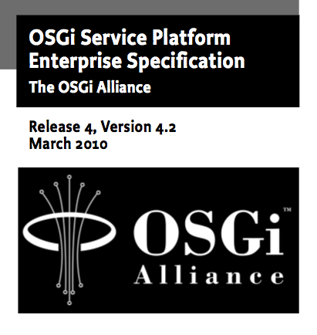

Slide 34
OSGi Enterprise Expert Group
The OSGi Enterprise Expert Group (EEG) is chartered to define the technical requirements and specifications to tailor and extend the OSGi Service Platform to address information technology software infrastructure use cases found in enterprise business scenarios.
http://www.osgi.org/EEG/HomePage

Slide 35
OSGi EEG Focus
Scaling, including multi-container and multi-process environments
Distributed and/or federated service model for
  Multiple Service Platforms
  External, heterogeneous systems
Requirements for extensions to the OSGi publish/find/bind service model
Enterprise-class life cycle and configuration management
Integration of established Java EE technology into OSGi

Slide 36
Hybrid Applications
“A hybrid application is an OSGi bundle as well as a Java EE
archive and hence has both an OSGi bundle context and Java EE context at runtime and can leverage capabilities of both the platforms.”

Slide 37
Why Hybrid Apps ?
Best of both worlds!!!
Why do you want to learn new APIs ?

Slide 38
Role of GlassFish
Provides a runtime for Hybrid Applications
Implements Java EE related OSGi services and standards
Don't have to assemble the bits
OSGi is no longer under the cover
  Raises visibility from GlassFish developers to users

Slide 39
OSGi Compendium Specs in GlassFish
OSGi/HTTP Service
OSGi/Web Application (rfc #66)
OSGi/JTA (rfc #98)
OSGi/JDBC (rfc #122)
OSGi/JPA (rfc #143)
OSGi/JNDI (rfc #142, coming post 3.1)
http://wikis.sun.com/display/GlassFish/3.1OSGi

Slide 40
OSGi/Web Application (rfc #66)
Web Application Bundle (WAB)
  WAR + OSGi + Web-ContextPath Header
  Can use all enterprise APIs include JPA with lazy loading
  Sample manifest:
  Manifest­Version: 1.0
Import­Package: javax.servlet.http; javax.persistence
Bundle­ClassPath: WEB­INF/classes/,WEB­INF/lib/entities.jar
Bundle­Version: 1.0
Bundle­ManifestVersion: 2
Web­ContextPath: /hello
Bundle­SymbolicName: test.hellowab
Wrapped WAR Support
  webbundle: URL scheme

Slide 41
OSGi Declarative Services
Complications of Publish/Find/Bind
  Long startup time
  Memory footprint
  Complex service programming model
OSGi services in Java EE
@Resource(mappedName=”osgiName”)
SomeOSGiService osgiService;
  JNDI Lookup
  Portable, no OSGi dependencies in application
Exported APIs visible to Java EE apps

Slide 42
OSGi Declarative Service
<scr:component enabled="true" name="hello-service">
<implementation class="org.glassfish.samples.osgi.helloservice.impl.HelloImpl"/>
<service servicefactory="false">
<provide interface="org.glassfish.samples.osgi.helloservice.api.HelloService"/>
</service>
<property name="service.pid" value="hello-service"/>
</scr:component>
OSGI-INF/
serviceComponents.xml
API
Export-Package
Servlet Client
. . .
import org.glassfish.samples.osgi.helloservice.api.HelloService;
@WebServlet(urlPatterns={"/HelloClient"})
public class HelloClient extends HttpServlet {
@Resource(mappedName="hello-service")
HelloService helloService;
@Resource(mappedName="howdy-service")
HelloService howdyService;
. . .
HelloImpl
HowdyImpl
http://blogs.oracle.com/arungupta/entry/totd_124_osgi_declarative_services

Slide 43
OSGi Declarative Services
import org.apache.felix.scr.annotations.Component;
import org.apache.felix.scr.annotations.Service;
import org.glassfish.samples.osgi.helloservice.api.HelloService;
@Component(name="hello-service")
@Service
public class HelloImpl implements HelloService {
public String sayHello(String name) {
return "Hello " + name;
}
}
maven-
bundle-
plugin
maven-
scr-
plugin
http://blogs.oracle.com/arungupta/entry/totd_124_osgi_declarative_services

Slide 44
JAX-WS & OSGi
JAX-WS
Endpoint
Artifacts
WSDL
JAX-WS
Client
Business
Method

Slide 45
JAX-WS & OSGi
JAX-WS
Endpoint
Artifacts
WSDL
JAX-WS
Client
Delegate
Business
Method
Query
Registry
OSGi
Bundle
OSGi
Service
Registry
Business
Method
http://blogs.oracle.com/arungupta/entry/totd_130_invoking_a_osgi

Slide 46
OSGi & EJB
Client
OSGi Service Registry
API
login
Export-Package
register
Impl
Export-EJB
Container-managed
JPA
LoadData
http://weblogs.java.net/blog/ss141213/archive/2010/03/30/ejb-osgi-service-demo-eclipsecon

Slide 47
OSGi + EJB
  Export EJB as OSGi services
  Export-EJB: ALL/None/<names>
  Pure OSGi components can discover/invoke
  Advantages
    Declarative security, transaction, CDI, … are available to non-EE components
  Tx context from pure OSGi bundle propagates to invoked EJB
    Ditto for security and persistence context

Slide 48
OSGi & JMS
Consumer
Export-EJB: None
Destination
ConnectionFactory
Messages#
Producer
BundleActivator
OSGi Config Admin
http://www.java.net/blog/ss141213/archive/2010/04/21/osgijmsmdb-example

Slide 49
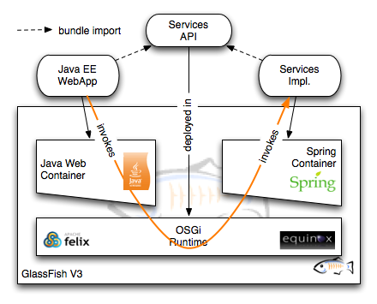
Extending GlassFish v3
Using Spring dm Container
Simple Spring bean implementing the service
Invoke the service from a servlet using standard @Resource injection
Single runtime for both Spring and full Java EE
http://blogs.oracle.com/dochez/entry/glassfish_v3_extensions_part_4

Slide 50
OSGi + CDI
API
OSGi
Service
Registry
Export-Package
Impl
Import-Package
Bundle-Activator
Import-Package
Client
ServiceTracker
@OSGiService
Bundle-Activator
Filters
http://blogs.oracle.com/arungupta/entry/totd_154_dynamic_osgi_services

Slide 51
OSGi + CDI
ServiceTracker tracker = new ServiceTracker(context, Hello.class.getName(), null);
tracker.open();
Hello hello = (Hello) tracker.getService();
System.out.println(hello.sayHello("Duke"));
@Inject @OSGiService(dynamic=true) Hello hello;
System.out.println(hello.sayHello("Duke"));
Injected reference is never null because of CDI proxies

Slide 52
OSGi + JPA
Enhancement of JPA entities at runtime
Entities + persistence.xml bundled as OSGi bundle
EntityManagerFactory available as
@Inject @OSGiService
Shared persistence unit and there by shared second level cache

Slide 53
OSGi + EE Resources
Define a DataSource, JavaMail, or JMS resource available in Admin Console
Corresponding OSGi service is already available
Resource/Services are dynamic

Slide 54
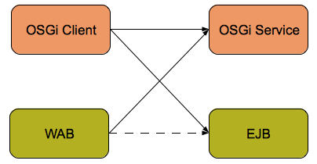
JavaOne 2010 / EclipseCon 2011
Hands-on Lab
NetBeans - http://blogs.oracle.com/arungupta/entry/s313522_instructions_for_osgi_enabled
Eclipse - http://blogs.oracle.com/arungupta/entry/screencast_38_developing_osgi_enabled

Slide 55
References
oracle.com/javaee
glassfish.org
oracle.com/goto/glassfish
blogs.oracle.com/theaquarium
youtube.com/GlassFishVideos
Follow @glassfish
http://wikis.sun.com/display/GlassFish/OSGi
http://wikis.sun.com/download/attachments/209655166/GF-OSGi-Features-1.0.pdf

Slide 56
OSGi-enabled Java EE Applications in GlassFish
Arun Gupta, Java EE & GlassFish Guy
blogs.oracle.com/arungupta, @arungupta

