Slide 1


GlassFish Server 3.1
Simple, Fast, Innovative Java EE 6 Clustering
Arun Gupta, Java EE & GlassFish Guy
blogs.oracle.com/arungupta, @arungupta
Notes:
Welcome to this session about GlassFish, the open source application server from Oracle. In this session we'll provide you with a status on where GlassFish stands, how it fully implements Java EE 6, describe its modular architecture based on OSGi, cover its developer-friendly features and close with a look at the upcoming GlassFish 3.1 release featuring clustering and much more.

Slide 2
The following is intended to outline our general product direction. It is intended for information purposes only, and may not be incorporated into any contract. It is not a commitment to deliver any material, code, or functionality, and should not be relied upon in making purchasing decisions.
The development, release, and timing of any features or functionality described for Oracle's products remains at the sole discretion of Oracle.
Notes:
Don't make purchasing decisions based on this presentation (standard safe-harbor verbiage)

Slide 3



Java EE 6 and GlassFish Server 3 shipped final releases on
December 10th 2009
Notes:
You can experience for yourself everything you're about to hear on GlassFish 3. Java EE 6 was released as a specification on December 2009, more than 9 months ago. It has many exciting new features and enhancement to most existing APIs as you've probably heard in the Java EE 6 session.
The good news is that GlassFish implements all of Java EE 6 today as in was released together with the specification. So, you're a download away from testing anything you'd like for this new platform.
As we will see throughout this presentation, GlassFish is much more than a reference implementation with enterprise quality, performance, and management as well as offering a number of developer productivity features.

Slide 4

World's First Java EE 6 Compatible App Server with
Clustering & High Availability
Shipped Feb 28th 2011
Notes:
You can experience for yourself everything you're about to hear on GlassFish 3. Java EE 6 was released as a specification on December 2009, more than 9 months ago. It has many exciting new features and enhancement to most existing APIs as you've probably heard in the Java EE 6 session.
The good news is that GlassFish implements all of Java EE 6 today as in was released together with the specification. So, you're a download away from testing anything you'd like for this new platform.
As we will see throughout this presentation, GlassFish is much more than a reference implementation with enterprise quality, performance, and management as well as offering a number of developer productivity features.

Slide 5
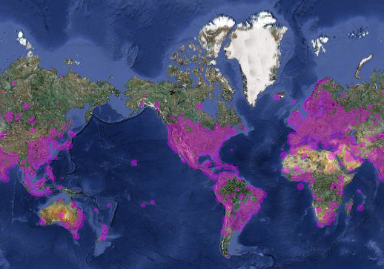
GlassFish Around You
http://maps.glassfish.org
Notes:
GlassFish is an open source project and just like any other successful project it has many users across the globe.
GlassFish enjoys a very large number of users, not just downloads, but also *users*. The map you're looking at was built based on the *usage* of the web administration console. Europe is he region that has seen great adoption of GlassFish in many different geographies and industry sectors.
Get your own close-up screenshot using : http://maps.glassfish.org

Slide 6
GlassFish Server Chronology*
2006
2007
2008
2009
2010
2011
…
GlassFish v1
Java EE 5, Single Instance
GlassFish v2
Java EE 5, High Availability
GlassFish Server 3
Java EE 6, Single Instance
GlassFish Server 3.1
Java EE 6, High Availability
GlassFish.next
Java EE 7
* GlassFish Server Open Source Edition
Notes:
GlassFish v1 was the first release of the project in 2006 with a fully certified Java EE 5 server (that's more than 4 years ago). With every new feature that came into Java EE 5, this version of GlassFish was very much focused on developers and offered single instance deployments.
GlassFish v2 was the second generation Java EE 5 server from Sun Microsystems adding clustering, high availability, and centralized administration as well as great performance enhancements.
GlassFish 3 had two main release drivers: full support for Java EE 6 and modularization (with OSGi as discussed later). Similarly to v1, it is a single instance release.
The team is now busy releasing 3.1, a version offering the great developer features of GlassFish 3 and the enterprise management feature of the 2.x family.

Slide 7

GlassFish Community
Proven by developers
  Over 24 million downloads
  Over 22 million active users (cumulative in past 4 yrs)
  50K active users in 30 days w/GlassFish Server 3
  900K+ upgrades from GlassFish Server 3 to 3.1 in just 2 months
  Active user forums
  Sub-projects
    Jersey (JAX-RS), Metro (JAX-WS), Grizzly (nio), Atmosphere, OpenMQ (JMS), and more
Notes:
From the very beginning 5 years ago, GlassFish enjoyed a very large user base to reach 100 million downloads annually (this includes GlassFish and the Java EE SDK) across various versions of the product.
The launch of GlassFish 3 was also very successful with 50,000 active users (measured by “pings” on server startup) in less than a month.
The forums is the place where developers and users gather to discuss issues and future directions in a very transparent fashion (hence the name “GlassFish”, a tropical transparent fish, btw)
A while back we decided to also give names to subprojects because they have their own community and can be used outside of GlassFish. People contributing to those sub-projects in fact still enhance GlassFish.
The end result, the GlassFish Application Server product is not only a “reference implementation” (sometimes seen as a negative term) which is always the first to market on new technologies, but more importantly, it is a fully-featured enterprise-ready server supported by Oracle.

Slide 8
Deliverables
Application Server
  Open Source and high-quality runtime
  Java EE 5 / 6 Reference Implementation, early access to latest standards
  Clustering and High Availability
  Full Commercial Support from Oracle
Continued Investment in Open Source
  Open Source license, governance, participation, transparency, ...
Notes:
With the recent acquisition of Sun by Oracle, some people had doubts about the future of GlassFish as a first-class open source application server. Oracle was quite fast to announce back in March 2010 in a roadmap that there would be no change in the operation of the open source project, not in the open source license, not in the participation, and not in the transparency. In fact we've experienced more external contributions in the past 9 months than we did in the past.
The roadmap also laid out product releases, starting with 3.0.1, the Oracle-branded release with 100+ bug fixes, support for additional OS's and for jrockit. This release shipped in June 2010. Two more releases (3.1 and 3.2) are planned for 2011 with clustering, centralized admin and Coherence*Web integration. As we've seen previously this is consistent with the approach of shipping first a single-instance product and delivering the clustering features in a subsequent release. GlassFish 3.1 is the “clustering” release (see later part of the preso).
Looking further out, better virtualization, support for cloud constraints and Java EE 7 are all closely being looked at and your feedback is most welcome.

Slide 9
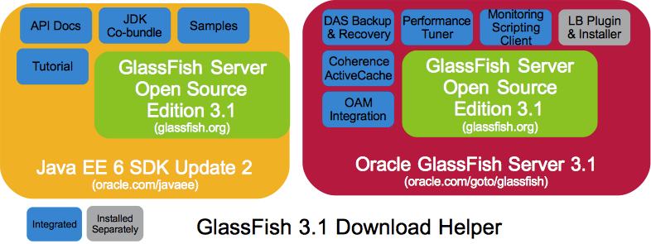
General Picture of Distributions
Notes:
Just like Sun had an open source distribution and a supported/branded product, Oracle now has:
GlassFish Application Server, Open Source Edition
Oracle GlassFish Server
Both are available for download. The Open Source version is available under the open source CDDL/GPLV2wCPE license while the commercial version is available under an OTN license which allows for a free evaluation (production deployment requires a license).
“Oracle GlassFish Server” is the only supported offering and builds on top of the open source edition, adding production value adds referenced under the “GlassFish Server Control” name (formerly “Sun GlassFish Enterprise Manager”). There add-ons are part of the Oracle GlassFish Server distribution for easy evaluation.
Finally, note that moving to the supported version does NOT require a re-install, it is possible and easy to upgrade from the open source to the supported product.

Slide 10
GlassFish Server Distributions
Distribution | License | Features
GlassFish Server Open Source Edition 3.1 Web Profile | CDDL & GPLv2 | Java EE 6 compatibility Web Profile support In-memory replication / clustering Centralized Administration
GlassFish Open Source Edition 3.1 | CDDL & GPLv2 | Java EE 6 compatibility Full Java EE distribution In-memory replication / clustering Centralized Administration
Oracle GlassFish Server 3.1 Web Profile | Commercial | Adds Oracle GlassFish Server Control Patches, support, knowledge base
Oracle GlassFish Server 3.1 | Commercial | Adds Oracle GlassFish Server Control Patches, support, knowledge base

Slide 11
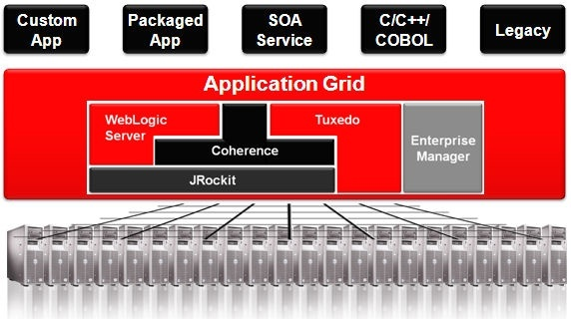
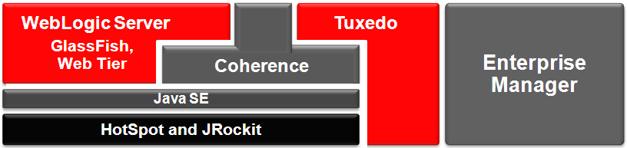
Oracle Application Grid
Efficiency
Lowest operational costs
Simplification
Best foundation for entire software stack
Competitiveness
Outperform with speed and flexibility
Notes:
GlassFish is now part of the larger “Application Grid” family of products developed at Oracle. This includes the WebLogic Server, the Web Tier products (HTTP server, HTTP Caching), the Coherence distributed datastore as well as the Tuxedo product line.
This means that product teams share common processes, common resources and best practices in developing the software.
Yet WebLogic server and GlassFish serve different purposes as we'll see in the next slide.

Slide 12
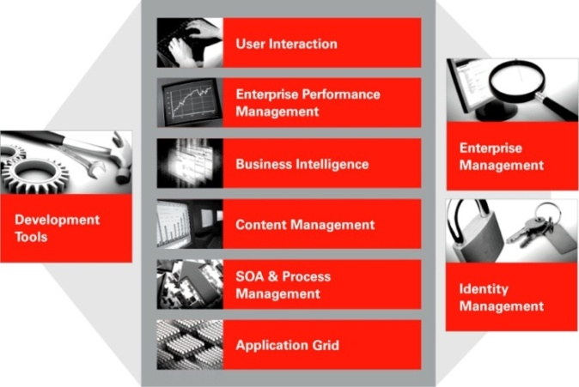


GlassFish and WebLogic together
Best open source application server with
support from Oracle
Open source platform of choice for light-
weight Web applications
Focus on latest Java EE standards and
community driven innovation
Certified interoperability with Fusion
Middleware
Differentiated innovation, scout thread
Best commercial application server for transactional Java EE applications
Platform of choice for standardization
Focus on lowest operational cost and mission critical applications
integration with Oracle Database, Fusion Middleware & Fusion Applications
Production Java
Application Deployment
Production Java
Application Deployment
GlassFish Server
WebLogic Server
Notes:
GlassFish Server offers an open source implementation of Java EE 6 with a modular (OSGi-based) architecture today. It scales from lightweight embedded usage to enterprise Java EE deployments and offers interoperability with Fusion Middleware, including Coherence.
WebLogic Server is the rock-solid and battle-tested runtime for Java EE 5 applications, for ESB and SOA Suite as well as for the Fusion Applications coming out in a few months now. It offers un-matched operational features (such as rolling upgrades) and best in class Oracle database integration.
Both share multiple components: EclipseLink is the common JPA implementation (initially developed by Oracle), Metro is the common WS-* stack, WebLogic uses Mojarra, the JSF implementation from GlassFish, etc... More recently Oracle announced that WebLogic will integrate HK2, the lightweight micro-kernel from GlassFish (see later slide).

Slide 13
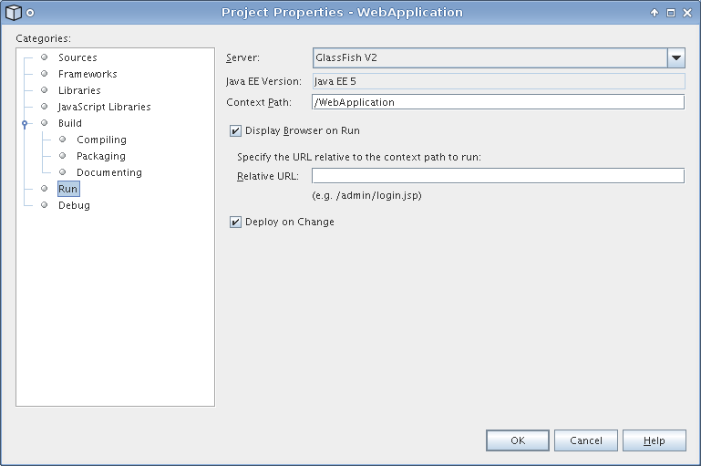
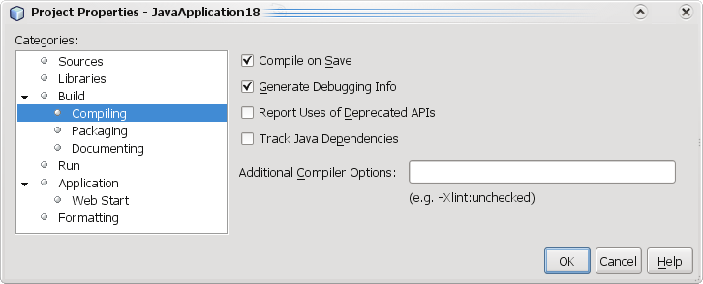
Painless Java EE development !
The save/reload paradigm
Auto-deploy of all Java EE and static artifacts
Notes:
The typical scenario for Java EE developers is to :
- modify source code
- compile
- package
- deploy
- sometimes restart the appserver
- reload the web page
- recreate the session (shopping cart)
... and do that over and over. This can range from 30s to loooong minutes of waiting which causes the developer to loose his train of thought (huge productivity impact).
The combination of compile on save (and IDE feature) and deploy on change (a plugin feature), the above steps can be collapsed to a simple save and reload in the browser with very fast under the covers redeployment.
A demo can be viewed (and shown) from : http://www.youtube.com/watch?v=ct-qujC2918

Slide 14
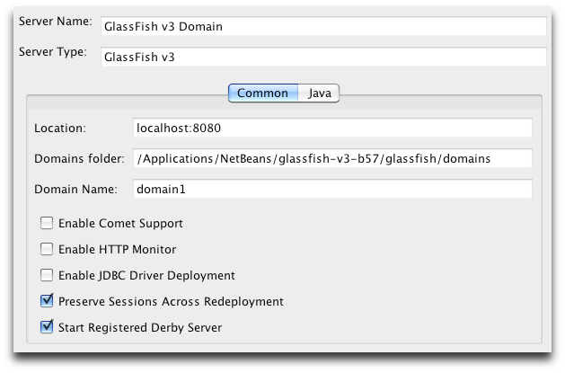

Session Retention
Deployment option to maintain stateful sessions across re-deployments
$ asadmin redeploy --properties keepSessions=true myapp.war
Greatly simplifies the
development paradigm
Integrated in IDEs
Notes:
Beyond compile-on-save and deploy-on-change, the missing link to provide a seamless development experience is the ability to preserve the session content across redeployments.
This is featured offered by GlassFish 3 and above. While this is integrated in various development tools, it is also usable from the “asadmin” command line.
From a technical perspective, this feature serializes the user sessions, removes the old application, instanciates the new one and re-injects the sessions. If session data cannot be restored, a warning is logged.
The combination of all three features (compile on save, deploy-on-change and preserve sessions on redeploy) is what makes the developer much more productive than in the previous development paradigm.

Slide 15

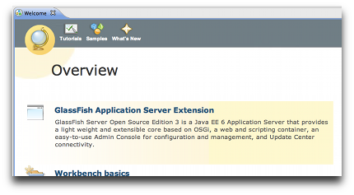
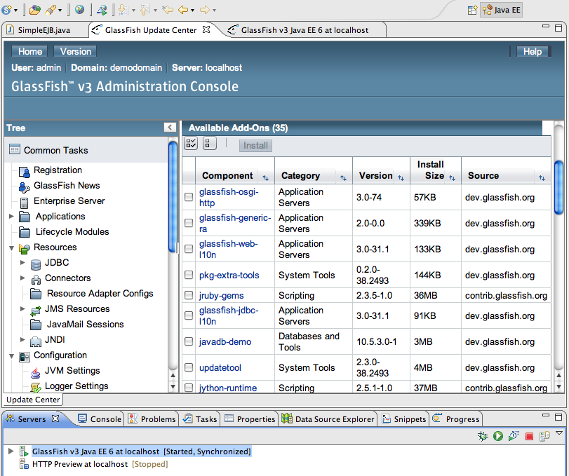
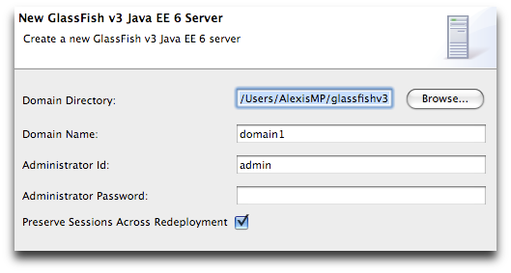
Yes, Eclipse too !
OEPE : http://www.oracle.com/technetwork/developer-tools/eclipse
Notes:
The very same features previously discussed (deploy on save and session preservation across redeployments) are also available to Eclipse users via a OEPE (Oracle Enterprise Pack for Eclipse) or a standalone plugin available directly from the Eclipse IDE.
A series of screencasts is available here : http://www.youtube.com/watch?v=9Kf5m7bMu74

Slide 16
Introducing GlassFish Server 3
Notes:
Up until now, we discussed GlassFish 3 from a developer perspective and didn't require the applications to use recent versions of Java EE to benefit from the productivity features.
We'll now look into what makes GlassFish different from a standards (Java EE 6) and architectural (Modularity, extensibility) perspective.

Slide 17
Java EE 6 Themes
Flexible
&
Lightweight
Embrace open source frameworks
Enables Drag & Drop framework installation
Web Profile
Pruning
Extensible
Java EE
Developer
Productivity
More annotations
POJO development
Less XML configuration
Notes:
Java EE 6, as any specification work, focused on a number of important themes. These have been covered in the Java EE presentation but it is important that we restate them here to understand how GlassFish builds and extends on them.
The Web Profile and the pruning process help build a right-sized platform. The extensibility (in CDI 1.0 and Servlet 3.0) encourage additional features rather than competing frameworks. The programming paradigm takes the POJO-based development one step further with more default behaviors, strongly-typed annotations and less XML.

Slide 18
GlassFish Server Goals
Java EE 6 Themes | Oracle GlassFish Server
Flexibility | Flexibility
Extensibility | Extensibility
Developer Productivity | Developer Productivity
 | Modularity / OSGi / Hybrid Apps
 | Manageability
 | High availability clustering
 | 24 x 7 x 365 support
Notes:
GlassFish of course implements all of Java EE 6 (the full platform, not just the Web Profile) but it also takes the platform themes one step further :
Modularity : GlassFish is modular, implemented using OSGi which enables a number of uses-cases for exposing this technology to application developers (see. Enterprise OSGi specification).
Manageability : clearly a runtime feature that enables GlassFish to be controlled from a fully-featured web interface, a scriptable command-line, and now a RESTful interface (see later slides)
High availability is not a specification requirement but clearly a frequent deployment need. GlassFish offers clustering, centralized admin, and failover.
24x7 support from Oracle.

Slide 19
3.1 Overview
Built on GlassFish 3
Modular and Extensible HK2 Kernel
  ~260+ modules
Clustering and High Availability
  HTTP, EJB, IIOP, SSO, Metro
Dynamic Invocation of Services
End-to-end extensibility
Notes:
Looking a little bit out to the future, and specifically GlassFish 3.1 Open Source Edition, the high-level goal was to bring to GlassFish 3 enterprise features for centralized administration, clustering and failover.
The team is well into the development process and has reached “feature completeness” after a number of signification milestones. You are encouraged to try out these pre-final versions and provide feedback on how they work for you and your applications.
Full details can be found at : http://wikis.sun.com/display/GlassFish/PlanForGlassFish3.1

Slide 20
Fast and Furious ...
29% better startup/deploy/re-deploy cycle over 3.0.1
33% better HA performance over 2.1.1
  Scalable Grizzly Adapter based on Java NIO
  Full-session and Modified-attribute* scope
Multiple Standalone instances and Clusters per domain
http://weblogs.java.net/blog/sdo/archive/2011/03/01/whats-new-glassfish-v31-performance
Notes:
Looking a little bit out to the future, and specifically GlassFish 3.1 Open Source Edition, the high-level goal was to bring to GlassFish 3 enterprise features for centralized administration, clustering and failover.
The team is well into the development process and has reached “feature completeness” after a number of signification milestones. You are encouraged to try out these pre-final versions and provide feedback on how they work for you and your applications.
Full details can be found at : http://wikis.sun.com/display/GlassFish/PlanForGlassFish3.1

Slide 21
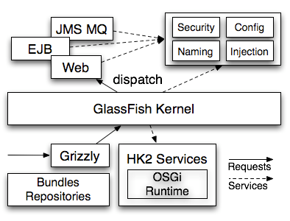
Modular and Dynamic
Modular : Apache Felix (OSGi)
Extensible : HK2
Yet very Fast !
Notes:
OSGi is a key technology for GlassFish v3's modularity. By default we use Apache's Felix (project lead Rich Hall is on the GlassFish team). More on OSGi in later slides.
But modularity only does so much for an application server, it's also key to be extensible and that's what HK2 abstraction layer does (note that HK2 is also now being integrated into WebLogic server, albeit without the OSGi bindings).
Also, being modular brings flexibility but doesn't necessarily mean a better user experience. In the case of GlassFish we've spend many cycles on the user experience making sure the product does NOT feel like a bunch of loosely-coupled modules.
In particular, startup time and the on-demand start of services have been a killer feature for both developers and operations.
Another important feature provided is the extensible HK2 architecture : adding a new container does NOT add a new configuration file and a new management tool. Instead each part of the runtime contributes to the unique config file (domain.xml), to the web console (adding nodes and screens) as well as to the command-line admin (adding commands).

Slide 22
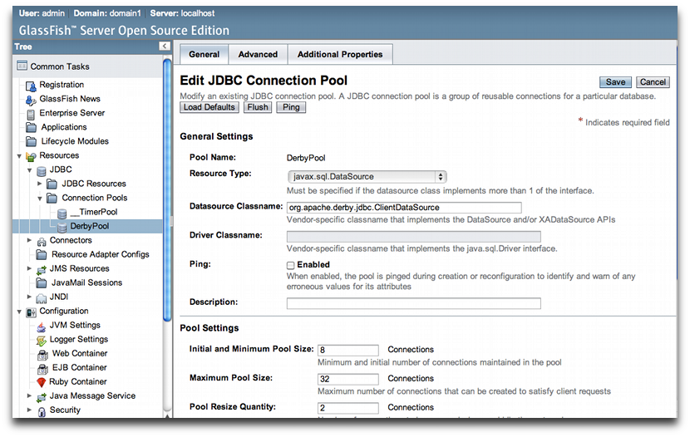
Notes:
Building on the tradition of the previous versions, GlassFish provides a built-in graphical admin tool. As we'll see later, it is now extensible and integrates the management of the application server modules and the update center.
The web admin tool is repeatedly mentioned by GlassFish users as THE killer feature (especially compared to open source competition like Tomcat or JBoss).

Slide 23
More Painless Development
Fast auto-deploy of all Java EE and static artifacts
Application runner
  java -jar glassfish.jar toto.war
Maven integration
  mvn gf:run, gf:start, gf:deploy, ...
Containers added dynamically and transparently
Excellent Tools support
Notes:
Wether you use a development IDE or not, GlassFish offers ultra-fast (re)deployment of any artifact, static (html, images, css) and dynamic (jsp, servlet, ejb, etc...)
The “Application Runner” feature illustrates how GlassFish can be started by simply pointing to the bootstrap JAR (glassfish.jar) but also how an application can be deployed on startup. This makes for easier testing.
Maven is increasingly used in development teams to drive the build process but also testing. The GlassFish Maven integration offers several goals to drive the appserver runtime (start, stop, deploy, ...) in Maven testing phases.
From a developer and user perspective the experience of using some or all of the containers and services from GlassFish is seamless: no need to configure them before starting the server.
IDE support is excellent in NetBeans, Eclipse as well as in IntelliJ

Slide 24
Embedded uses
Testing
  EJBContainer API (EJB 3.1)
  Simple testing using Java SE (JUnit, Maven, ...) using EJB container
Packaging / Bundling
  Beyond the specification: control all of GlassFish Server with an API = GlassFish Embedded
  Integration testing & ship the server inside the app
Notes:
GlassFish offers “embedded” capabilities which enable new use-cases.
The EJB 3.1 specification standardized the EJBContainer API which allows a Java SE application to start the container (mainly for testing purposes but also usable for integrating an EJB container in a rich client, Swing for instance). Using this API with GlassFish is just a different way of starting the same application server runtime.
Taking the concept of an embedded API further, GlassFish offers a full-blown API to drive all of its features (not just the EJB container). This allows developers to do more functional testing but also to package a runtime with their application, thus removing the need for Java EE Application Server install and administration. This can be useful for ISV's willing to ship an all-in-one solution with a minimum set of technical requirements.

Slide 25
What's the deal with OSGi?
GlassFish Server runs on top of OSGi (Felix)
  Also runs unmodified on Equinox (and Knopflerfish)
  GlassFish ships as 260+ bundles
  Can run without OSGi (Static mode)
  Can use OSGi management tools (CLI or Web)
  Can be installed on top of existing OSGi runtime
Any OSGi bundle will run in GlassFish Server
  Drop it in glassfish/modules{/autostart}
  Can also asadmin deploy it using --type osgi
  GlassFish OSGi admin console
Notes:
Coming back to the modularity and OSGi topics, let's take a closer look at what it means for GlassFish to be built using OSGi : First, there is no dependency on a specific OSGi runtime (Felix is the default GlassFish ships with).
GlassFish is an OSGi application. Starting GlassFish starts the OSGi runtime and loads the minimum set of GlassFish OSGi bundles from the 200+ available.
GlassFish developers (implementers) never use OSGi directly, instead they use the HK2 abstraction layer (micro-kernel). This makes it possible to even run without OSGi, in static mode.
When you do use OSGi, you can benefit from the number of tools the runtime provides: web console, command line shell, ... GlassFish can also be installed as a set of bundles on top of an existing OSGi runtime.
Since there is an OSGi runtime, any bundle can be simply dropped into GlassFish and run alongside. You can also explicitly deploy OSGi bundles using “asadmin”

Slide 26
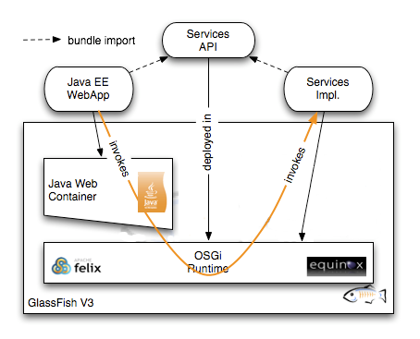
Extending GlassFish
OSGi-style – an example, a demo and a picture
OSGi declarative service
Service-Component entry in the JAR Manifest
Invoke the service from a servlet using standard @Resource injection
Never use a GlassFish API !
No need to chose between OSGi and
Java EE
Step by step: http://blogs.sun.com/dochez/entry/glassfish_v3_extensions_part_4
Notes:
To illustrate the possibilities of having GlassFish be built on an OSGi runtime, let's consider the following extensibility scenario :
GlassFish hosts a traditional Java Web Application (deployed as a WAR file) alongside with an OSGi “Declarative Service” deployed using 'asadmin'.
The portable Java Servlet code uses the @Resource annotation to inject a reference to the OSGi bundle, thus extending the runtime features without ever using an OSGi API nor a GlassFish API. Everything here is portable and loosely coupled.
This scenario could be instanciated to have the Spring DM container deployed as a set of OSGi bundles which would in turn be made available to the rest of the applications hosted in GlassFish.

Slide 27
OSGi + Java EE = Hybrid Apps
GlassFish Server as the modular runtime
  Assembled spontaneously
  Admin tools (Web & CLI)
Implementation of Java EE related OSGi services & standards
  OSGi RFC's
Support for Java EE 6 platform
  e.g. JPA, EJB, JDBC, JTA, ... as OSGi services
Web Application Bundle (WAB)
  WAR + OSGi metadata + Web-ContextPath header
Notes:
So far, we've discussed OSGi from the perspective of an implementation choice made by the GlassFish team. Let's look at the benefits for a developer willing to leverage OSGi in its applications.
The OSGi Alliance has produced a number of “enterprise” specification in March 2010 which are in part implemented in GlassFish 3.0 with more coming in 3.1. This enables services such as JPA, JDBC, JTA but also EJB's and WAR's to be packaged as OSGi bundles. This provides the ability to express dependencies between modules (at the application or services levels), to deal with versioning, and more generally to break out a potentially complex system into smaller manageable parts.
A web application packaged as an OSGi bundle is called a WAB (Web Application Bundle).

Slide 28
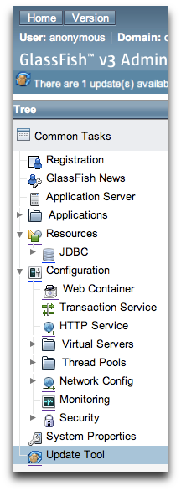
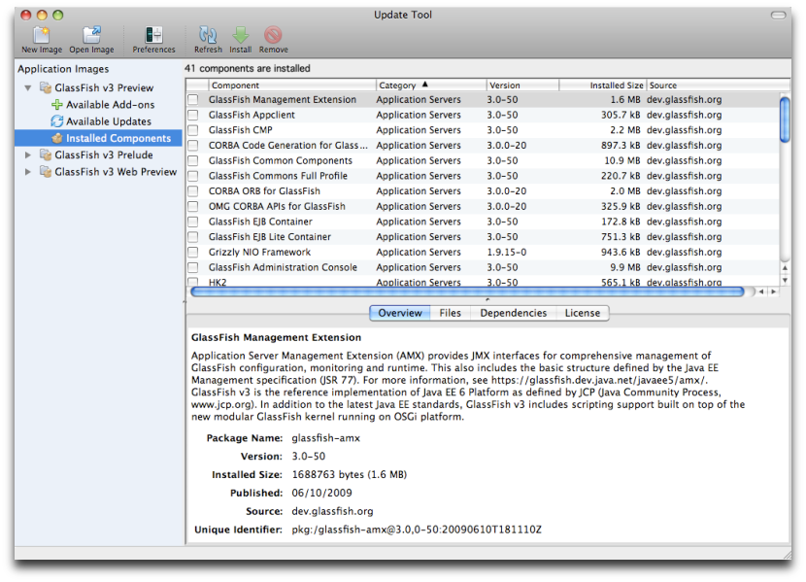
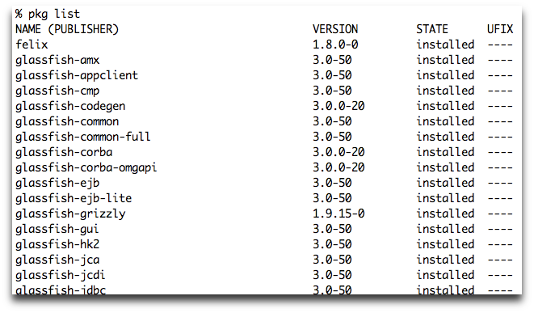
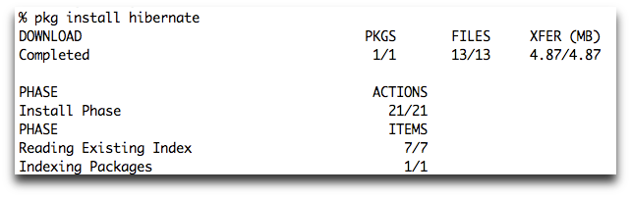

Update Center
Notes:
The update center and update tool are already present in GlassFish v2, but with the modular architecture or GlassFish v3, it was clear that it needed to be improved and better integrated with the admin tools.
The update center is built using IPS (the Solaris package format), is available on command line (“pkg” command), supports multiple repositories, provides dependency management and is available right from the traditional web admin GUI (with notifications of new version of already installed packages).
You can build your own distribution of GlassFish by assembling IPS package. See this series of screencasts: http://www.youtube.com/watch?v=EG_O9DXcaWY
The various repositories are used to make updates available to users as well as new features from Oracle and from the community (“contrib” repository). An organization is also free to run it own internal GlassFish repository.

Slide 29

Monitoring and Management
Beyond web console and asadmin
Dynamic and non-intrusive monitoring
  BTrace integration
    Portable, dynamic and safe tracing tool for Java
    Btrace annotations and API to write scripts
  Java-defined Probe Providers
  RESTful interface
  DTrace for end-to-end
JavaScript Monitoring tool (add-on)
Still exposed via JMX
  jconsole and visualvm as natural clients
Notes:
While “asadmin” and the web console provide state-of-the-art management tools, troubleshooting can also be achieved with the new btrace (http://kenai.com/projects/btrace) technology integrated into GlassFish.
You can think of btrace as specialized AOP for monitoring and troubleshooting. The developer write btrace probes in Java which will cause the code to be instrumented in a very safe manner to produce statistics.
Another new feature that builds on this technology is the “JavaScript Monitoring Tool” (an add-on available only in Oracle GlassFish Server). This tools lets users manipulate one of the many default probes (session creation, request handling, ...) using JavaScript.
Of course, everything here is still exposed as JMX and accessible from default tools such as jconsole and visualvm (both of which ship with Oracle's JDK distribution).

Slide 30
RESTful admin
Jersey + Grizzly to provide REST interfaces to :
  Configure runtime (via GET, POST, DELETE)
  Invoke commands (restart, stop, deploy, etc..)
  Monitoring (GET only)
Available from :
  http://localhost:4848/management/domain
  http://localhost:4848/monitoring/domain
Use REST clients as Admin GUI substitute
  Use your favorite glue/scripting language or tool
Data offered as either XML, HTML or JSON
Extensible
Notes:
As stated in the previous slide, a new exciting feature in GlassFish is the ability to manage and monitor the server using a RESTful interface. This is implemented using Jersey and Grizzly and exposes everything via GET (read), POST (modify) and DELETE (suppress) operations on server resources.
For instance, since GET methods are idempotent, a POST request is required to stop the server. Such a RESTful interface means that a simple HTTP client is enough to manage GlassFish clusters and instances.
The data can be served in HTML (browser client), XML or json which makes for easy integration with JavaScript web libraries.
With a running GlassFish instance, simply point your browser to http://localhost:4848/management/domain
Extensible means that new containers can expose monitoring and management via probes

Slide 31

More GlassFish Server 3.x
Developer performance
Embedded API
RESTful API
Update Center
Metro 2.0
OpenMQ 4.x
Admin console
Btrace monitoring
...
Notes:
While we've covered a lot of ground, there's yet much more to GlassFish.
Quickly some of the additional features that need to be mentioned :
The overall developer experience and productivity: see for yourself and for your application
Metro 2.0 offers a fully-features WS-* stack implementing a broad range of standards such as WS-Addressing, WS-Security, MTOM/XOP, WS-ReliableMessaging and more. The end result is full compatibility with Microsoft's .Net 3.5 web services stack
OpenMQ is a high performing JMS implementation which can be used in standalone mode or integrated with GlassFish (in-memory or shared life-cycle). It offers HA for message stores.

Slide 32

















GlassFish Server Users
Notes:
This merely a small subset of GlassFish users in production today. This sample has most industries well represented with a good mix of tactical and strategic applications, some with very demanding loads.
Most of these are documented on http://blogs.sun.com/stories
BioWare is one of the recent new customers that was featured at JavaOne 2010 during Thomas Kurian keynote.

Slide 33
GlassFish Server 3.1
Developer Highlights
Developer Productivity
  Improved embedded API support
  Updated NetBeans and Eclipse plugin
Updated Technologies
  Grizzly WebSocket support
  Improved CDI, JSON, hypermedia support in Jersey
  Technology refresh – JSF, CDI, Grizzly, OSGi, JPA,
  Jersey, Bean Validation, Metro, UC, etc.
  Implementation of various Enterprise OSGi Specs
Notes:
The embedded API discussed previously has been tightened up and now offers greater fidelity with the default GlassFish HK2 mode.
Plugins for Eclipse and NetBeans have been both enhanced to work with GlassFish 3.1
With GlassFish 3.1, we're seeing the first grizzly-powered implementation of WebSocket (defined as part of HTML 5 and a potential Comet replacement)
A large number of technologies built into GlassFish have been upgraded to newer versions with many bugs being fixed.
More Enterprise OSGi specifications have been implemented. Check http://wikis.sun.com/display/GlassFish/OSGi for details

Slide 34
GlassFish Server 3.1
Clustering Highlights
HTTP, EJB, IIOP, SSO, Metro
  New - RM Sequence, Secure Conversations
Session-based replication using Shoal
  Distributes session state uniformly & consistently among instances
Shoal OSGi module, loaded when HA-enabled apps are deployed
Support for conventional clustering of MQs brokers in embedded mode
Notes:
Shoal is the dynamic clustering framework used by GlassFish (heartbeats, members joining/leaving, ...), it use to run on top of JXTA.
The state replication and load-balancing features have been enhanced for a more flexible and more fine-grained behavior.
High-availability is not only provided for HTTP Sessions and stateful EJBs but also for WS-ReliableMessaging sequences.
OpenMQ can now support HA in embedded mode (remote mode was previously required).
Delegated transaction recovery now used the filesystem for more reliable results.

Slide 35
GlassFish Server 3.1
Manageability Highlights
SSH based remote management and provisioning
Application versioning support
Application scoped resources
Statement leak detection and reclaim
Improved monitoring
Console based on RESTful API
Notes:
SSH-based management and provisioning is inspired by Hudson and Hadoop cluster deployments and enables an overall lighter-weight deployment.
Application versioning is a new feature allowing users to tag an application with a version at deploy time. This let's them disable all previously running versions of the application in a single command. It also enabled later rollback to any version still deployed but disabled. Only one version can be active at a given time.
Application-scoped resources as bundled with application artifacts (WAR, EAR, RAR, JAR) and are created on deploy and destroyed on undeploy. They are also only accessible by the application they came with.
The JDBC connection pools can now be probed for statement leaks, monitored for cache hits/misses, and log all SQL statements. With monitoring now grouped by app
The RESTful API was covered previously. It now generated the JAX-RS resources on the fly.

Slide 36
Application-Scoped Resources
“glassfish-resources.xml”
Created/deleted with app deploy/undeploy
Supported in NetBeans
glassfish-resources.xml
java:app/...
glassfish-resources.xml
glassfish-resources.xml
Servlet
EJB
java:module/...
java:module/...
X
X
http://blogs.sun.com/JagadishPrasath/entry/application_scoped_resources_in_glassfish
Notes:
SSH-based management and provisioning is inspired by Hudson and Hadoop cluster deployments and enables an overall lighter-weight deployment.
Application versioning is a new feature allowing users to tag an application with a version at deploy time. This let's them disable all previously running versions of the application in a single command. It also enabled later rollback to any version still deployed but disabled. Only one version can be active at a given time.
Application-scoped resources as bundled with application artifacts (WAR, EAR, RAR, JAR) and are created on deploy and destroyed on undeploy. They are also only accessible by the application they came with.
The JDBC connection pools can now be probed for statement leaks, monitored for cache hits/misses, and log all SQL statements. With monitoring now grouped by app
The RESTful API was covered previously. It now generated the JAX-RS resources on the fly.

Slide 37

Application Versioning
Deploy multiple versions of an application, only one enabled
Commands
asadmin deploy foo.war
  asadmin deploy –name=foo:BETA-1 foo.war
  asadmin deploy –name=foo:BETA-1.1
  –enable=false foo.war
  asadmin enable foo:BETA-1.1
  asadmin deploy –name=foo:RC1 foo.war
  asadmin undeploy foo:BETA*
  asadmin undeploy foo:*
Notes:
SSH-based management and provisioning is inspired by Hudson and Hadoop cluster deployments and enables an overall lighter-weight deployment.
Application versioning is a new feature allowing users to tag an application with a version at deploy time. This let's them disable all previously running versions of the application in a single command. It also enabled later rollback to any version still deployed but disabled. Only one version can be active at a given time.
Application-scoped resources as bundled with application artifacts (WAR, EAR, RAR, JAR) and are created on deploy and destroyed on undeploy. They are also only accessible by the application they came with.
The JDBC connection pools can now be probed for statement leaks, monitored for cache hits/misses, and log all SQL statements. With monitoring now grouped by app
The RESTful API was covered previously. It now generated the JAX-RS resources on the fly.

Slide 38

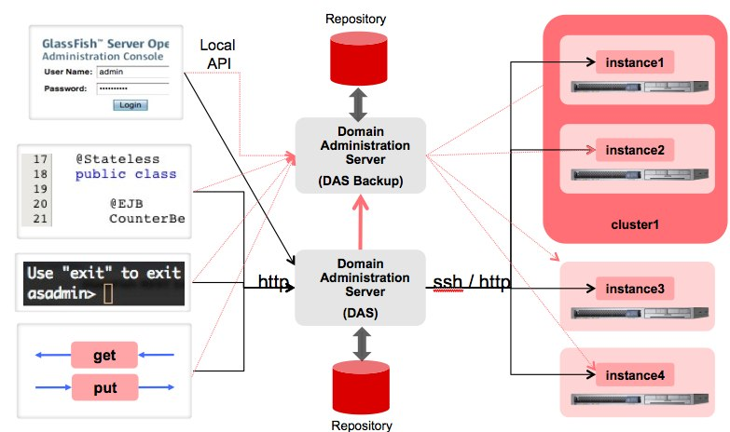
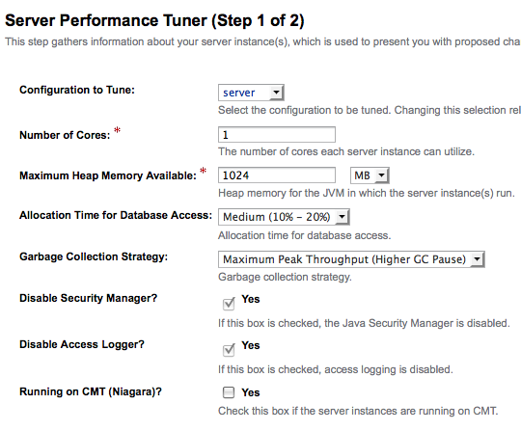
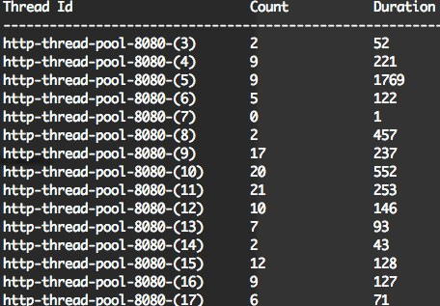
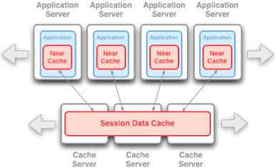

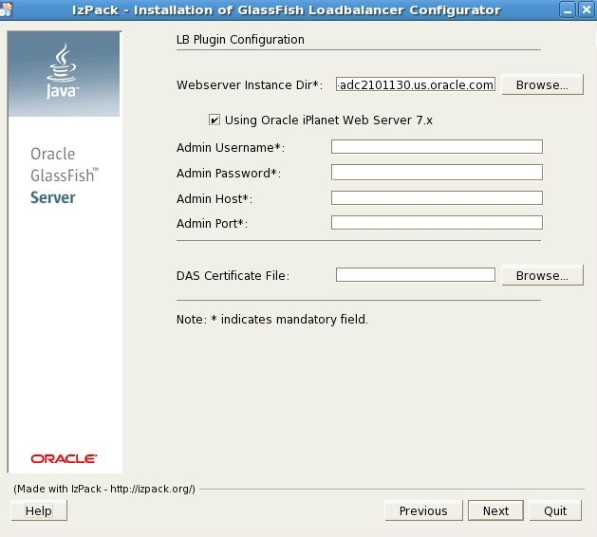


GlassFish Server Control
Monitoring
Scripting Client
DAS Backup & Recovery
Performance Tuner
Coherence Active Cache
Oracle Access
Manager Integration
Load Balancer
Plugin & Installer

Slide 39
Strategy for continued success
Continue to deliver outstanding performance
Continue to improve developer productivity
Continue product execution
  Deliver Java EE 7 first
  Deliver on product roadmap
Continue to innovate
  Improve manageability
  Hybrid OSGi / Java EE applications
Notes:
Of course we don't plan on stopping there. As presented early in those slides, GlassFish has many other things to work on including better virtualization and management to accommodate cloud-based deployments.
Other focus areas include yet even more developer productivity and overall performance enhancements.
Looking further out to Java EE 7, GlassFish intends to be the first to offer support for upcoming new standards by virtue of being the reference implementation.

Slide 40
References
oracle.com/javaee
glassfish.org
oracle.com/goto/glassfish
blogs.oracle.com/theaquarium
youtube.com/GlassFishVideos
Follow @glassfish

