Slide 1

Contexts And Dependency Injection In The Java EE 6 Ecosystem
Arun Gupta, Java EE & GlassFish Guy
blogs.oracle.com/arungupta, @arungupta

Slide 2
The following is intended to outline our general product direction. It is intended for information purposes only,
and may not be incorporated into any contract. It is not a commitment to deliver any material, code, or functionality, and should not be relied upon in making purchasing decisions.
The development, release, and timing of any features or functionality described for Oracle’s products remains at the sole discretion of Oracle.

Slide 3
How we got here ?
Java EE 5 had resource injection
  @EJB, @PersistenceUnit, @Resource
Motivated by Seam, Guice, and Spring
  More typesafe than Seam
  More stateful and less XML-centric than Spring
  More web and enterprise-capable than Guice
Adapts JSR 330 for Java EE environments
  @Inject, @Qualifier, @ScopeType
Notes:
With Guic
CDI is Java EE oriented, integrates well with EL
Portable extensions that run very well with other Java EE 6 compliant containers.
Spring, Guice, and Seam evolved to support corner cases, CDI has been designe to support these cases.

Slide 4
CDI Key Concepts
Type-safe approach to Dependency Injection
Strong typing, Loose coupling
  Events, Interceptors, Decorators
Context & Scope management
Works with Java EE modular and component architecture
  Integration with Unified Expression Language (UEL)
Portable extensions
Bridge EJB (transactional tier) and JSF (presentation tier) in the platform
Notes:
Strong typing, loose coupling - A bean specifies only the type and semantics of other beans it depends upon, and that too using typing information available in the the Java object model, and no String-based identifiers. It need not be aware of the actual lifecycle, concrete implementation, threading model or other clients of any bean it interacts with. Even better, the concrete implementation, lifecycle and threading model of a bean may vary according to the deployment scenario, without affecting any client. This loose-coupling makes your code easier to maintain.
Events, interceptors and decorators enhance the loose-coupling inherent in this model:
• event notifications decouple event producers from event consumers,
• interceptors decouple technical concerns from business logic, and
• decorators allow business concerns to be compartmentalized.

Slide 5
What is a CDI managed bean ?
“Beans”
  All managed beans by other Java EE specifications
    Except JPA
  Meets the following conditions
    Not a non-static inner class
    Concrete class or decorated with @Decorator
    Constructor with no parameters or a constructor annotated with @Inject
“Contextual instances” - Instances of “beans” that belong to contexts

Slide 6
How to configure ?
There is none!
Discovers bean in all modules in which CDI is enabled
“beans.xml”
  WEB-INF of WAR
  META-INF of JAR
  META-INF of directory in the classpath
Can enable groups of bean selectively via a descriptor

Slide 7
Injection Points
Field, Method, Constructor
0 or more qualifiers
Type
Which one ?
(Qualifier)
@Inject @LoggedIn User user
@Inject @LoggedIn User user
Request
Injection
What ?
(Type)

Slide 8
Basic – Sample Code
public interface Greeting {
public String greet(String name);
}
@Dependent scope
public class SimpleGreeting implements Greeting {
public String greet(String name) {
return “Hello “ + name;
}
}
@Stateless
public class GreetingService {
@Inject Greeting greeting;
public String greet(String name) {
return greeting.greet(name);
}
}
No String identifiers,
All Java

Slide 9
Qualifier
Annotation to uniquely identify a bean to be injected
No direct dependency to any particular implementation (of many)
Built-in qualifiers
  @Named required for usage in EL
  @Default qualifier on all beans without an explicit qualifier
    Except @Named
  @Any matches any qualifier for a bean (including @Default)
  @New

Slide 10
Qualifier – Sample Code
@Qualifier
@Retention(RUNTIME)
@Target({METHOD, FIELD, PARAMETER, TYPE})
public @interface Fancy {
}
@Fancy
public class FancyGreeting implements Greeting {
public String greet(String name) {
return “Nice to meet you, hello “ + name;
}
}
@Stateless
public class GreetingService {
@Inject @Fancy Greeting greeting;
public String sayHello(String name) {
return greeting.greet(name);
}
}

Slide 11
Qualifier – Sample Code
public interface Greeting {
public String greet(String name);
}
@Inject Greeting greeting;
@Inject @Default Greeting greeting;
public class SimpleGreeting implements Greeting {
public String greet(String name) {
return “Hello “ + name;
}
}
X
@Inject @Any Greeting greeting;
@Inject @Any @Fancy Greeting greeting;
@Inject @Any @Default Greeting greeting;
@Fancy
public class FancyGreeting implements Greeting {
public String greet(String name) {
return “Nice to meet you, hello “ + name;
}
}
@Inject @Fancy Greeting greeting;

Slide 12
Field and Method Injection
public class CheckoutHandler {
@Inject @LoggedIn User user;
@Inject PaymentProcessor processor;
@Inject
void setShoppingCart(@Default Cart cart) {
…
}
}

Slide 13
Constructor Injection
public class CheckoutHandler {
@Inject
CheckoutHandler(@LoggedIn User user,
PaymentProcessor processor,
Cart cart) {
...
}
}
Only one constructor can have @Inject
All parameters are injection points
Non-public constructor makes the bean immutable

Slide 14
Multiple Qualifiers and Qualifiers with Arguments
public class CheckoutHandler {
@Inject
CheckoutHandler(@LoggedIn User user,
@Reliable
@PayBy(CREDIT_CARD)
PaymentProcessor processor,
@Default Cart cart) {
...
}
}

Slide 15
Bean Initialization Sequence
Public constructor or injected constructor
@Inject for all fields
@Inject private void setXXX(Greeting greeting)
  Initializer methods
  Defined within bean hierarchy
  Call order not portable within a single bean
@PostConstruct method

Slide 16
Typesafe Resolution
Resolution is performed at system initialization time
@Qualifier, @Alternative
  Unsatisfied dependency
    Create a bean which implements the bean type with all qualifiers
    Explicitly enable an @Alternative bean using beans.xml
    Make sure it is in the classpath
  Ambiguous dependency
    Introduce a qualifier
    Disable one of the beans using @Alternative
    Move one implementation out of classpath

Slide 17
Client Proxies
Container indirects all injected references through a proxy object unless it is @Dependent
@ApplicationScoped
public class UserService {
@Inject User user;
public void doSomething() {
user.setMessage("...");
// some other stuff
user.getMessage();
}
}
@RequestScoped
public class User {
private String message;
// getter & setter
}
“User” proxy is injected
CDI will supply a different “User” for each request

Slide 18
Scopes
Determines the lifecycle of instances of the bean
  When a new instance of a bean in that scope is created/destroyed
    Created only once per scope and then reused
  Which injected references refer to any instance of a bean with that scope
Runtime makes sure the right bean is created at the right time
Client do NOT have to be scope-aware

Slide 19
Types of Scopes
Pre-defined Scopes
  Pseudo-scope (default): @Dependent
  Everywhere: @ApplicationScoped, @RequestScoped
  Web app: @SessionScoped (serializable)
  JSF app: @ConversationScoped (serializable)
Custom scopes defined using @Scope
  Context implements scope
  Typically defined by framework authors

Slide 20
@Dependent Scope
Never shared between different multiple injection points
Bound to the lifecycle of the newly created object
  Instantiated/Destroyed with the object
No proxy, client holds a direct reference to the bean
Instance of the bean is instantiated every time for an EL expression evaluation
  Value set by JSF input is lost immediately
  Required to use @Named, @RequestScoped

Slide 21
@New Qualifier
Allows to obtain a dependent object of a specified class, independent of the declared scope
  Useful with @Produces
@ConversationScoped
public class Calculator { . . . }
public class PaymentCalc {
@Inject Calculator calculator;
@Inject @New Calculator newCalculator;
}

Slide 22
@ConversationScope
Like session-scope – spans multiple requests to the server
Unlike – demarcated explicitly by the application, holds state with a particular browser tab in a JSF application
  Browser hold domain cookies,
  and hence the session cookies,
  between tabs
public class ShoppingService {
@Inject Conversation conv;
public void startShopping() {
conv.begin();
}
. . .
public void checkOut() {
conv.end();
}
}

Slide 23
Custom Scopes – Sample Code
@ScopeType
@Retention(RUNTIME)
@Target({TYPE, METHOD})
public @interface ClusterScoped {}
public @interface TransactionScoped {}
public @interface ThreadScoped {}

Slide 24
Producer & Disposer
@Inject and @Qualifier gives static object creation
Producer & Disposer follow “object factory” pattern
  Complex object creation/destruction
  Dynamic object construction at runtime
  Bridge the gap with Java EE DI
  Perform custom initialization not possible in a constructor
  Runtime polymorphism
Disposer – cleans up the “produced” object
  e.g. explicitly closing JDBC connection
  Defined in the same class as the “producer” method
Notes:
For example, producer methods let us:
expose a JPA entity as a bean,
expose any JDK class as a bean,
define multiple beans, with different scopes or initialization, for the same implementation class, or
vary the implementation of a bean type at runtime.

Slide 25
Producer – Sample Code
public class Greetings {
@Produces
public List<Greeting> getGreetings() {
...
}
}
@Inject
List<Greeting> greetings;

Slide 26
Producer – Sample Code
@SessionScoped
public class Preferences implements Serializable {
private PaymentStrategyType paymentStrategy;
. . .
@Produces @Preferred
public PaymentStrategy getPaymentStrategy() {
switch (paymentStrategy) {
case CREDIT_CARD: return new CreditCardPaymentStrategy();
case CHECK: return new CheckPaymentStrategy();
case PAYPAL: return new PayPalPaymentStrategy();
default: return null;
}
}
}
Default scope is @Dependent
@SessionScoped
@Inject @Preferred PaymentStrategy paymentStrategy;

Slide 27
Disposer – Sample Code
@Produces @RequestScoped
Connection connect(User user) {
return createConnection(user.getId(), user.getPassword());
}
void close(@Disposes Connection connection) {
connection.close();
}

Slide 28
Interceptors
Two interception points on a target class
  Business method
  Lifecycle callback
Cross-cutting concerns: logging, auditing, profiling
Different from EJB 3.0 Interceptors
  Type-safe, Enablement/ordering via beans.xml, ...
Defined using annotations and DD
Class & Method Interceptors
  In the same transaction & security context

Slide 29
Interceptors – Business Method (Logging)
@InterceptorBinding
@Retention(RUNTIME)
@Target({METHOD,TYPE})
public @interface LoggingInterceptorBinding {
}
@LoggingInterceptorBinding
public class MyManagedBean {
. . .
}
@Interceptor
@LoggingInterceptorBinding
public class LogInterceptor {
@AroundInvoke
public Object log(InvocationContext context) {
System.out.println(context.getMethod().getName());
System.out.println(context.getParameters());
return context.proceed();
}
}

Slide 30
Why Interceptor Bindings ?
Remove dependency from the interceptor implementation class
Can vary depending upon deployment environment
Allows central ordering of interceptors

Slide 31
Interceptors – Business Method (Transaction)
@Transactional
public class ShoppingCart { . . . }
@InterceptorBinding
@Retention(RUNTIME)
@Target({METHOD,TYPE})
public @interface Transactional {
}
public class ShoppingCart {
@Transactional public void checkOut() { . . . }
@Interceptor
@Transactional
public class @TransactionInterceptor {
@Resource UserTransaction tx;
@AroundInvoke
public Object manageTransaction(InvocationContext context) {
tx.begin()
Object response = context.proceed();
tx.commit();
return response;
}
}
http://blogs.oracle.com/arungupta/entry/totd_151_transactional_interceptors_using

Slide 32
Decorators
Complimentary to Interceptors
Apply to beans of a particular bean type
  Semantic aware of the business method
  Implement “business concerns”
Disabled by default, enabled in “beans.xml”
  May be enabled/disabled at deployment time
@Delegate – injection point for the same type as the beans they decorate
Interceptors are called before decorators

Slide 33
Decorator – Sample Code
public interface Account {
public BigDecimal getBalance();
public User getOwner();
public void withdraw(BigDecimal amount);
public void deposit(BigDecimal amount);
}
@Decorator
public abstract class LargeTransactionDecorator
implements Account {
@Inject @Delegate @Any Account account;
@PersistenceContext EntityManager em;
public void withdraw(BigDecimal amount) {
…
}
public void deposit(BigDecimal amount);
…
}
}
<beans ...
<decorators>
<class>
org.example.LargeTransactionDecorator
</class>
</decorators>
</beans>

Slide 34
Alternatives
Deployment time polymorphism
@Alternative beans are unavailable for injection, lookup or EL resolution
  Bean specific to a client module or deployment scenario
Need to be explicitly enabled in “beans.xml” using <alternatives>/<class>

Slide 35
Events – More decoupling
Annotation-based event model
  Based upon “Observer” pattern
A “producer” bean fires an event
An “observer” bean watches an event
Events can have qualifiers
Transactional event observers
  IN_PROGRESS, AFTER_SUCCESS, AFTER_FAILURE, AFTER_COMPLETION, BEFORE_COMPLETION
Notes:
Observers and Producers are completely decoupled from each other and thus providing an additional level of loose coupling.
Observers can specify a combination of “selectors” to narrow the set of event notifications they will receive.

Slide 36
Events – Sample Code
@Inject @Any Event<PrintEvent> myEvent;
void print() {
. . .
myEvent.fire(new PrintEvent(5));
}
void onPrint(@Observes PrintEvent event){…}
public class PrintEvent {
public PrintEvent(int pages) {
this.pages = pages;
}
. . .
}
void addProduct(@Observes(during = AFTER_SUCCESS) @Created Product product)
Notes:
Observers and Producers are completely decoupled from each other and thus providing an additional level of loose coupling.
Observers can specify a combination of “selectors” to narrow the set of event notifications they will receive.

Slide 37
Stereotypes
Encapsulate architectural patterns or common metadata in a central place
  Encapsulates properties of the role – scope, interceptor bindings, qualifiers, etc.
Pre-defined stereotypes
  @Interceptor
  @Decorator
  @Model
“Stereotype stacking”

Slide 38
Stereotypes – Sample Code (Pre-defined)
@Named
@RequestScoped
@Stereotype
@Target({TYPE, METHOD})
@Retention(RUNTIME)
public @interface Model {}
Use @Model on JSF “backing beans”

Slide 39
Stereotypes – Sample Code (Make Your Own)
@RequestScoped
@Transactional(requiresNew=true)
@Secure
@Named
@Stereotype
@Retention(RUNTIME)
@Target(TYPE)
public @interface Action {}

Slide 40
Loose Coupling
@Alternative – deployment time polymorphism
@Produces – runtime polymorphism
@Interceptor – cross-cutting concerns
@Decorator – decouple business concerns
@Observes – decouple event producer and consumers
Contextual lifecycle management decouples bean lifecycles
Notes:
These techniques serve to enable loose coupling of client and server. The client is no longer tightly bound to an implementation of an interface, nor is it required to manage the lifecycle of the implementation. This approach lets stateful objects interact as if they were services.
Loose coupling makes a system more dynamic. The system can respond to change in a well-defined manner. In the past, frameworks that attempted to provide the facilities listed above invariably did it by sacrificing type safety (most notably by using XML descriptors). CDI is the first technology, and certainly the first specification in the Java EE platform, that achieves this level of loose coupling in a typesafe way.

Slide 41
Strong Typing
No String-based identifiers, only type-safe Java constructs
  Dependencies, interceptors, decorators, event produced/consumed, ...
IDEs can provide autocompletion, validation, and refactoring
Lift the semantic level of code
  Make the code more understandable
  @Asynchronous instead of asyncPaymentProcessor
Stereotypes
Notes:
These techniques serve to enable loose coupling of client and server. The client is no longer tightly bound to an implementation of an interface, nor is it required to manage the lifecycle of the implementation. This approach lets stateful objects interact as if they were services.
Loose coupling makes a system more dynamic. The system can respond to change in a well-defined manner. In the past, frameworks that attempted to provide the facilities listed above invariably did it by sacrificing type safety (most notably by using XML descriptors). CDI is the first technology, and certainly the first specification in the Java EE platform, that achieves this level of loose coupling in a typesafe way.

Slide 42
CDI & EJB - Typesafety
Java EE resources injected using String-based names (non-typesafe)
JDBC/JMS resources, EJB references, Persistence Context/Unit, …
Typesafe dependency injection
Loose coupling, Strong typing
Lesser errors due to typos in String-based names
Easier and better tooling

Slide 43
CDI & EJB – Stateful Components
Stateful components passed by client in a scope
Explicitly destroy components when the scope is complete
Session bean through CDI is “contextual instance”
CDI runtime creates the instance when needed by the client
CDI runtime destroys the instance when the context ends

Slide 44
CDI & EJB – As JSF “backing bean”
JSF managed beans used as “glue” to connect with Java EE enterprise services
EJB may be used as JSF managed beans
  No JSF backing beans “glue”
Brings transactional support to web tier

Slide 45
CDI & EJB – As JSF “backing bean”
@Stateless
public class MyBean {
@EJB MyOtherBean bean;
public String myMethod() { … }
}
@ManagedBean
public class MyGlueBean {
@EJB MyBean bean;
public String myMethod() { … }
}
@Named
@Stateless
public class MyBean {
@Inject MyOtherBean bean;
public String myMethod() { … }
}

Slide 46
CDI & EJB – Enhanced Interceptors
Interceptors only defined for session beans or message listener
methods of MDBs
Enabled statically using “ejb-jar.xml” or @Interceptors
Typesafe Interceptor bindings on any managed bean
Can be enabled or disabled at deployment using “beans.xml”
Order of interceptors can be controlled using “beans.xml”

Slide 47
What does CDI not offer, but EJB do ?
Pooling: Important for throttling and DoS attacks
Monitoring: All EJBs exposed via JMX
Timers
Asynchronous, TX execution with <Future>
Declarative “convention over configuration” TX, Security

Slide 48
CDI & JSF
Brings transactional support to web tier by allowing EJB as JSF “backing beans”
Built-in stereotypes for ease-of-development - @Model
Integration with Unified Expression Language
  <h:dataTable value=#{cart.lineItems}” var=”item”>
Context management complements JSF's component-oriented model

Slide 49
CDI & JSF
@ConversationScope holds state with a browser tab in JSF application
  @Inject Conversation conv;
Transient (default) and long-running conversations
    Shopping Cart example
    Transient converted to long-running: Conversation.begin/end
@Named enables EL-friendly name
Notes:
Instead of typing to a HTTP session and accidentally timing out, shopping cart has a well-defined life cycle and so should be likely implemented using ConversationScope.

Slide 50
CDI & JPA
Typesafe dependency injection of PersistenceContext & PersistenceUnit using @Produces
  Single place to unify all component references
@PersistenceContext(unitName=”...”) EntityManager em;
@Produces @PersistenceContext(unitName=”...”)
@CustomerDatabase EntityManager em;
CDI
Qualifier
@Inject @CustomerDatabase EntityManager em;

Slide 51
CDI & JPA
Create “transactional event observers”
  Kinds
    IN_PROGRESS
    BEFORE_COMPLETION
    AFTER_COMPLETION
    AFTER_FAILURE
    AFTER_SUCCESS
  Keep the cache updated

Slide 52
CDI & JAX-RS
Manage the lifecycle of JAX-RS resource by CDI
  Annotate a JAX-RS resource with @RequestScoped
@Path to convert class of a managed component into a root resource class

Slide 53
CDI & JAX-WS
Typesafe dependency injection of @WebServiceRef using @Produces
@Produces @WebServiceRef(lookup="java:app/service/PaymentService") PaymentService paymentService;
@Inject PaymentService remotePaymentService;
@Inject can be used in Web Service Endpoints & Handlers
Scopes during Web service invocation
  @RequestScoped during request invocation
  @ApplicationScoped during any Web service invocation

Slide 54
Portable Extensions
Key development around Java EE 6 “extensibility” theme
Addition of beans, decorators, interceptors, contexts
  OSGi service into Java EE components
  Running CDI in Java SE environment
  TX and Persistence to non-EJB managed beans
Integration with BPM engines
Integration with 3rd-party frameworks like Spring, Seam, Wicket
New technology based upon the CDI programming model

Slide 55
Portable Extension – How to author ?
Implement javax.enterprise.inject.spi.Extension SPI
  Register service provider
Observe container lifecycle events
  Before/AfterBeanDiscovery, ProcessAnnotatedType
Ways to integrate with container
  Provide beans, interceptors, or decorators
  Satisfy injection points with built-in or wrapped types
  Contribute a scope and context implementation
  Augment or override annotation metadata

Slide 56
Portable Extensions – Weld Bootstrapping in Java SE
public class HelloWorld {
public void printHello(@Observes ContainerInitialized event,
@Parameters List<String> parameters) {
System.out.println("Hello" + parameters.get(0));
}
}

Slide 57
Portable Extensions – Weld Logger
public class Checkout {
@Inject Logger log;
public void invoiceItems() {
ShoppingCart cart;
...
log.debug("Items invoiced for {}", cart);
}
}

Slide 58
Portable Extensions – Typesafe injection of OSGi Service
org.glassfish.osgi-cdi – portable extensionin GlassFish 3.1
Intercepts deployment of hybrid applications
Discover (using criteria), bind, track, inject the service
Metadata – filter, wait timeouts, dynamic binding
http://blogs.oracle.com/arungupta/entry/totd_154_dynamic_osgi_services

Slide 59



CDI Implementations

Slide 60

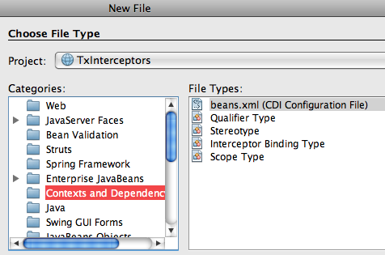
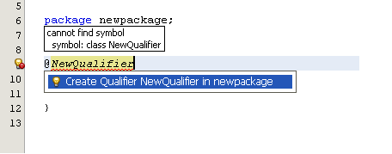
IDE Support

Slide 61
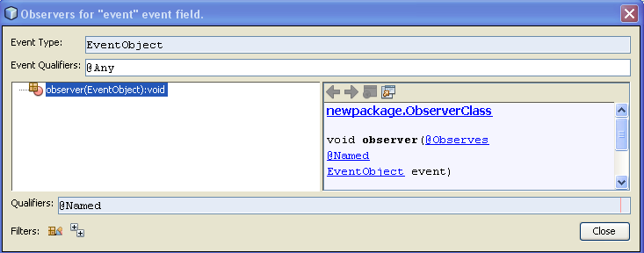
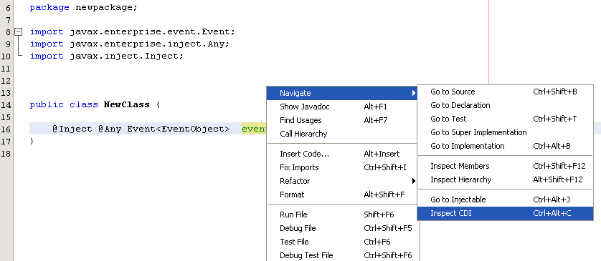
IDE Support
Inspect Observer/Producer for a given event
http://wiki.netbeans.org/NewAndNoteworthyNB70#CDI

Slide 62

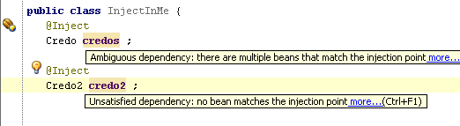
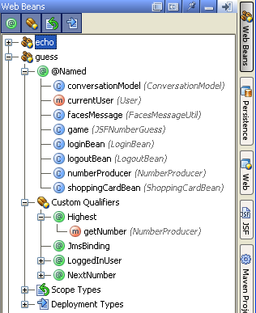
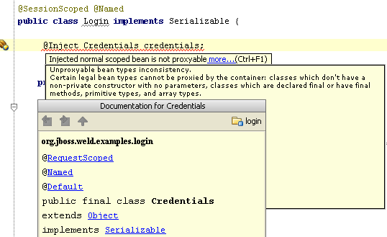
IDE Support
http://blogs.jetbrains.com/idea/2009/11/cdi-jsr-299-run-with-me/

Slide 63
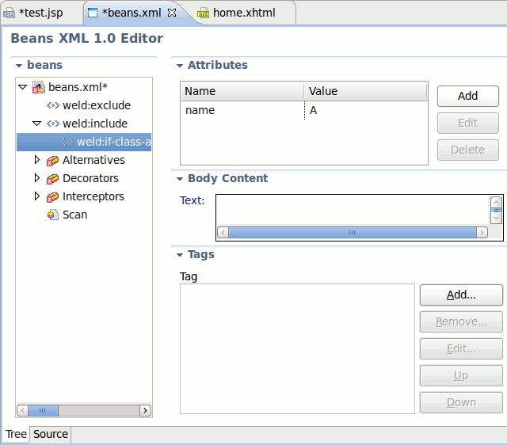

IDE Support
http://docs.jboss.org/tools/whatsnew/

Slide 64
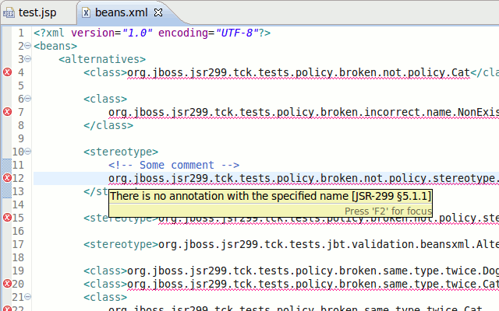
IDE Support
http://docs.jboss.org/tools/whatsnew/

Slide 65
Summary
Provides standards-based and typesafe dependency injection in Java EE 6
Integrates well with other Java EE 6 technologies
Portable Extensions facilitate richer programming model
Weld is the Reference Implementation
  Integrated in GlassFish and JBoss
Improving support in IDEs

Slide 66
CDI 1.1 (JSR 346) http://www.jcp.org/en/jsr/proposalDetails?id=346
NEW
Global ordering of interceptors and decorators
API for managing built-in contexts
Embedded mode to startup outside Java EE container
Send Servlet events as CDI events

Slide 67
References
oracle.com/javaee
glassfish.org
oracle.com/goto/glassfish
blogs.oracle.com/theaquarium
youtube.com/GlassFishVideos
Follow @glassfish
http://docs.jboss.org/weld/reference/latest/en-US/html/

Slide 68
Contexts And Dependency Injection In The Java EE 6 Ecosystem
Arun Gupta, Java EE & GlassFish Guy
blogs.oracle.com/arungupta, @arungupta

