Slide 1

Flexible
Ease of
Development
Java EE 6
Pruning
Extensibility
Profiles
Ease-of-dev
EJB Lite
RESTful WS
CDI
Java EE 5
Ease of
Development
Annotations
EJB 3.0
Persistence API
New and
Updated
Web Services
Web Services
J2EE 1.4
Web Services,
Management,
Deployment,
Async.
Connector
Robustness
Enterprise Java Platform
J2EE 1.3
CMP,
Connector
Architecture
J2EE 1.2
Servlet, JSP,
EJB, JMS
RMI/IIOP
Java EE 6
Web Profile
JPE
Project
Managed
Bean 1.0
May 98 Dec 99 Sep 01 Nov 03 May 06 Dec 09
10 specs 13 specs 20 specs 23 specs 28 specs

Slide 2
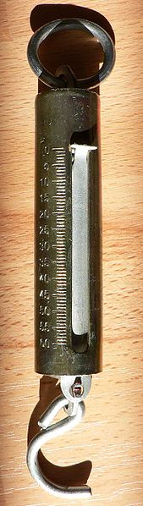
Light-weight
Java EE 6 Web Profile
Pruning
  Pruned today, means
    Optional in the next release
    Deleted in the subsequent releases
  Technologies marked in Javadocs
    EJB 2.x Entity Beans, JAX-RPC, JAXR, JSR 88

Slide 3
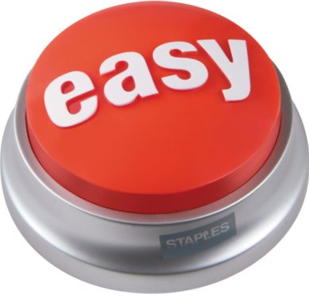
EJB-in-WAR
No-interface EJB
Optional “web.xml”/”faces-config.xml”
Annotation-driven
  @Schedule
  @Path
  @Inject
  . . .

Slide 4
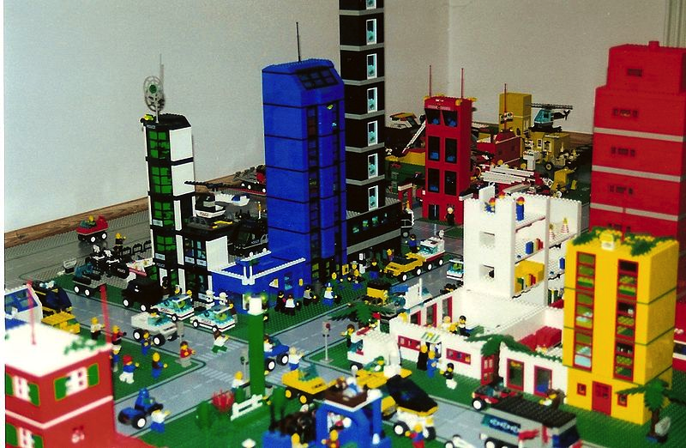
<web-fragment>
<filter>
<filter-name>wicket.helloworld</filter-name>
<filter-class>org.apache.wicket.protocol.http.WicketFilter</filter-class>
<init-param>
<param-name>applicationClassName</param-name>
<param-value>...</param-value>
</init-param>
</filter>
<filter-mapping>
<filter-name>wicket.helloworld</filter-name>
<url-pattern>/*</url-pattern>
</filter-mapping>
</web-fragment>

Slide 5
Java EE 6 Specifications
The Platform
Java EE 6 Web Profile 1.0
Managed Beans 1.0

Slide 6
Java EE 6 Specifications
New
Contexts and Dependency Injection for
Java EE (JSR 299)
Bean Validation 1.0 (JSR 303)
Java API for RESTful Web Services (JSR 311)
Dependency Injection for Java (JSR 330)

Slide 7
Java EE 6 Specifications
Extreme Makeover
Java Server Faces 2.0 (JSR 314)
Java Servlets 3.0 (JSR 315)
Java Persistence 2.0 (JSR 317)
Enterprise Java Beans 3.1 & Interceptors 1.1 (JSR 318)
Java EE Connector Architecture 1.6 (JSR 322)

Slide 8
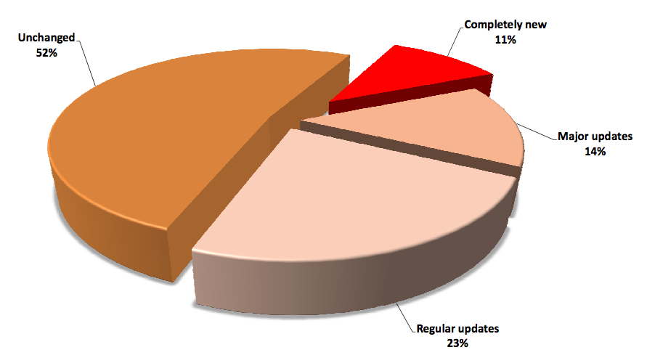
http://blog.eisele.net/2010/12/who-is-afraid-of-java-ee-6-get-rid-of.html

Slide 9
Java EE 6 Web Profile 1.0
Servlets 3.0
JPA 2.0
EJB 3.1
JDBC
StAX
JSF 2.0
Interceptors
1.1
JAX-RS
JNDI
JavaMail
EJB 3.1 Lite
Bean
Validation1.0
JAXB
JMS
JACC
JSP 2.2
CDI 1.0
JAX-WS
JAXP
SAAJ
JTA 1.1
Managed
Beans 1.0
JASPIC
JAX-RPC
. . .
Contributed
by RedHat
New
Updated

Slide 10
Servlets in Java EE 5
At least 2 files
<!--Deployment descriptor web.xml -->
<web-app>
<servlet>
<servlet-name>MyServlet
</servlet-name>
<servlet-class>
com.sun.MyServlet
</servlet-class>
</servlet>
<servlet-mapping>
<servlet-name>MyServlet
</servlet-name>
<url-pattern>/myApp/*
</url-pattern>
</servlet-mapping>
...
</web-app>
/* Code in Java Class */
package com.sun;
public class MyServlet extends HttpServlet {
public void doGet(HttpServletRequest req,HttpServletResponse res)
{
...
}
...
}

Slide 11
Servlets 3.0 (JSR 315)
Annotations-based @WebServlet
package com.sun;
@WebServlet(name=”MyServlet”, urlPatterns={”/myApp/*”})
public class MyServlet extends HttpServlet {
public void doGet(HttpServletRequest req, HttpServletResponse res)
{
...
}
<!--Deployment descriptor web.xml -->
<web-app>
<servlet>
<servlet-name>MyServlet</servlet-name>
<servlet-class>
com.sun.MyServlet
</servlet-class>
</servlet>
<servlet-mapping>
<servlet-name>MyServlet</servlet-name>
<url-pattern>/myApp/*</url-pattern>
</servlet-mapping>
...
</web-app>
http://blogs.oracle.com/arungupta/entry/totd_81_getting_started_with

Slide 12
Servlets 3.0
@WebServlet, @WebListener, @WebFilter, …
Asynchronous Servlets
  @WebServlet(asyncSupported=true)
Plugin libraries using web fragments
Dynamic registration of Servlets
WEB-INF/lib/[*.jar]/META-INF/resources accessible in the root
Programmatic authentication login/logout
Default Error Page
. . .

Slide 13
EJB 3.1 (JSR 318)
Package & Deploy in a WAR
Java EE 5
Java EE 6
myApp.ear
myApp.war
WEB-INF/classes
com.sun.FooServlet
com.sun.TickTock
com.sun.FooBean
com.sun.FooHelper
web.war
WEB-INF/web.xml
WEB-INF/classes
com.sun.FooServlet
com.sun.TickTock
beans.jar
com.sun.FooBean
com.sun.FooHelper
web.xml ?
http://blogs.oracle.com/arungupta/entry/totd_95_ejb_3_1

Slide 14
EJB 3.1 - Sample
public class MySessionBean {
public void setupResources() {
// setup your resources
}
public void cleanupResources() {
// collect them back here
}
public String sayHello(String name) {
return "Hello " + name;
}
}
@EJB / @Inject
MySessionBean bean;
@Stateless
@PostConstruct
@PreDestroy

Slide 15
EJB 3.1
No interface view – one source file per bean
Embeddable API
@Singleton
  Initialization in @PostContruct
Simplified Cron-like syntax for Timer
Asynchronous Session Bean
Portable Global JNDI Name

Slide 16
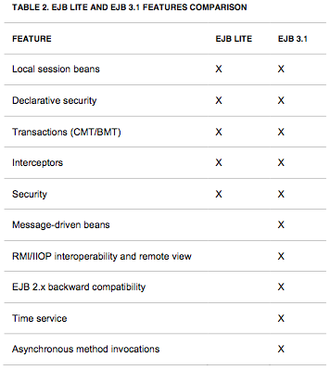
EJB 3.1
EJB 3.1 Lite – Feature Comparison

Slide 17
Contexts & Dependency Injection
JSR 299
Standards-based Dependency Injection
Type-safe – Buids on @Inject API
Context/Scope management
Strong Typing, Loose Coupling
Includes ELResolver
@Inject @LoggedIn User user
@Inject @LoggedIn User
Request
Injection
What ?
(Type)
Which one ?
(Qualifier)

Slide 18
CDI
Qualifiers
Events
Stereotypes
Interceptors
Decorators
Alternatives
. . .

Slide 19
Java Server Faces 2.0 (JSR 314)
Facelets as “templating language” for the page
  Custom components much easier to develop
Integrated Ajax
“faces-config.xml” optional in common cases
Default navigation rules
Much more …
  Runs on Servlet 2.5+
  Bookmarkable URLs
  Conditional navigation
  ...

Slide 20
Java Persistence API 2 (JSR 317)
Improved O/R mapping
Type-safe Criteria API
Expanded and Richer JPQL
2nd-level Cache
New locking modes
  PESSIMISTIC_READ – grab shared lock
  PESSIMISTIC_WRITE – grab exclusive lock
  PESSIMISTIC_FORCE_INCREMENT – update version
Standard configuration options
  javax.persistence.jdbc.[driver | url | user | password]

Slide 21
Bean Validation (JSR 303)
Tier-independent mechanism to define constraints for data validation
  Represented by annotations
  javax.validation.* package
Integrated with JSF and JPA
  JSF: f:validateRequired, f:validateRegexp
  JPA: pre-persist, pre-update, and pre-remove
@NotNull(message=”...”), @Max, @Min, @Size
Fully Extensible
  @Email String recipient;

Slide 22
JAX-RS 1.1 (JSR 311)
Java API for building RESTful Web Services
POJO based
Annotation-driven
Server-side API
HTTP-centric

Slide 23
JAX-RS 1.1
Code Sample - Simple
public class PersonResource {
public List<Person> getPersons() {
return personList;
}
public Person getPerson( int id) {
return getPersons().get(id);
}
}
@Path("helloworld")
@Produces("text/plain")
@Context UriInfo ui;
@GET
@GET
@Path("{id}")
@PathParam("id")

Slide 24



IDE Support for Java EE 6

Slide 25
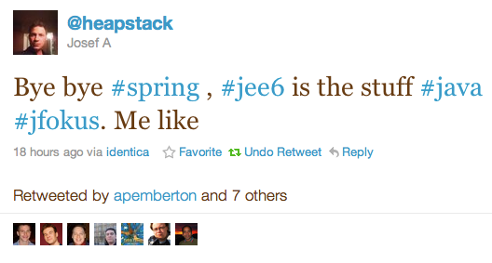
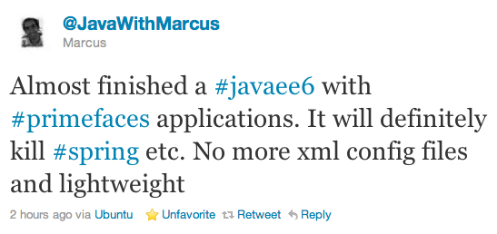

Slide 26
9 Reasons why Java EE 6 will save $$
Prototyping (multiple IDEs)
Development (~30MB, incremental deployment, ...)
Production (Variety, Start small/then scale)
Support (Pick the best one)
Training (“Only” Java EE 6 APIs)
Portability (Backwards compatibility)
Adoption (Growing)
Freedom of choice (Multiple vendors)
Plan B (Similar component models)
http://www.adam-bien.com/roller/abien/entry/8_reasons_why_java_ee

Slide 27
Jigsaw puzzle, Modular, standard, less xml, easy, easy, have I said easy?
Developers can concentrate
on business logic, Java EE 6 is
providing a standard for
the infrastructure.
Standards compliance, vendor
independence, milliseconds
and kilobyte deployment
Faster development, less frameworks, less complexity, more great code shipped
Higher integrated specs,
simple and annotation driven,
single-classloader WARs,
next level of industry
standard
Definite excuse to avoid Spring forever
Simplified Java Development, Focus on building great products
Not your fat grandfather's enterprise Java anymore, enterprise Java renaissance
http://blogs.oracle.com/arungupta/tags/community+feedback

Slide 28
Avoid “framework explosion”
In selecting an application server our main goal was to avoid the framework explosion that happens when you use a "custom" Enterprise stack like Tomcat + Spring + Hibernate + Myfaces +... Java EE 6 had 80% of what we needed out of the box: strong persistence support ( JPA ), inversion of control ( CDI ), and a lightweight component model ( EJB 3.1 )
http://blogs.oracle.com/stories/entry/egesa_engineering_avoids_framework_explosion

