Slide 1


Plug Your JavaServer Faces Application into the GlassFish v3 Admin Console
Ken Paulsen
Anissa Lam
Senthil Chidambaram
Ana Caballero
  GlassFish Admin Console Team
    Sun Microsystems, Inc.

Slide 2


Agenda
Introduction
Plugging into GlassFish
Charting with jMaki
Templating your Plugin
Q & A

Slide 3
GlassFish v3
We are waiting for 2-3 intro slides for GF v3

Slide 4
Agenda
Introduction
Plugging into GlassFish
Charting with jMaki
Templating your Plugin
Q & A

Slide 5
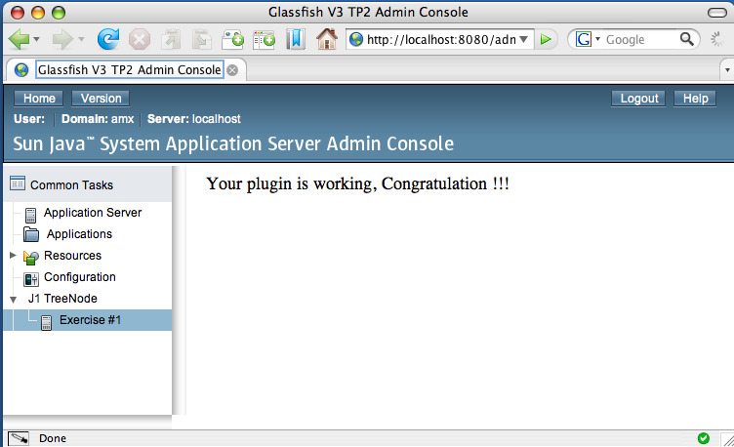
Plugging into GlassFish
Plugin Page
Plugin Tree Node

Slide 6






Integration Design

Slide 7
Console Provider
Marker for HK2
Provides console-config.xml URL
    @Service
    public class JavaOnePlugin implements
        ConsoleProvider {
    public URL getConfiguration() {
    return null;
    }
    }

Slide 8
Integration Points
Defined inside console-config.xml:
    <?xml version="1.0" encoding="UTF-8"?>
    <console-config id="javaone">
    <integration-point
    id="JavaOneNode"
    type="tree"
    priority="210"
    parentId="tree"
    content="treenode-ex1.jsf" />
    </console-config>

Slide 9
Plugging into GlassFish
Integration Point

Slide 10
The Tree Node
IntegrationPoint “content” refers to JSFTemplating page fragment:
    <sun:treeNode
    id="first"
    text="Exercise #1"
    url="javaone/hello.jsf"
    imageURL=
    "resource/images/instance.gif"
    target="main" />

Slide 11
Lab Files
Lab Root
lab/
index.html
plugin/
solution/
glassfish/

Slide 12
Lab Files
Lab Instructions
lab/
index.html
plugin/
solution/
glassfish/

Slide 13
Lab Files
Lab Workspace
lab/
index.html
plugin/
solution/
glassfish/

Slide 14
Lab Files
lab/
Lab Solution
index.html
plugin/
solution/
glassfish/

Slide 15
Lab Files
lab/
index.html
GlassFish Application Server
plugin/
solution/
glassfish/

Slide 16
Plugging into GlassFish
Lab Time!
Estimated Working Time: 45 min

Slide 17

Agenda
Introduction
Plugging into GlassFish
Charting with jMaki
Templating your Plugin
Q & A

Slide 18
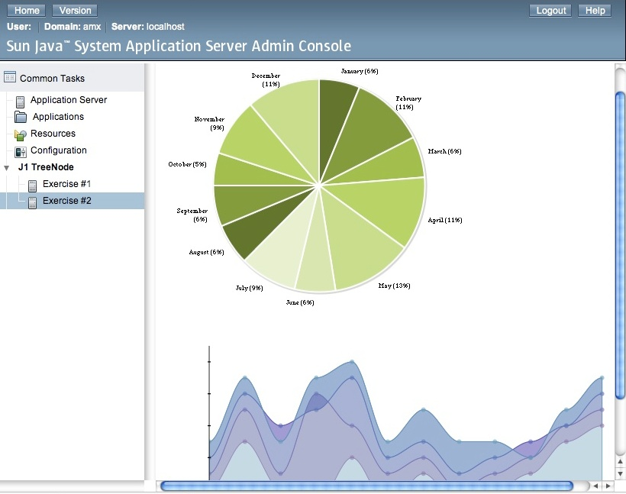
Charting with jMaki

Slide 19
Charting with jMaki
TBD: Get Intro 2 jMaki slides from Greg or Carla -- 2 slides is plenty

Slide 20
Charting with jMaki
Exercise length – 25 minutes
Tip: Try different chart types

Slide 21
Agenda
Introduction
Plugging into GlassFish
Charting with jMaki
Templating your Plugin
Q & A

Slide 22
Templating your Plugin
Screen Shot – TBD
JavaServer Faces Templates
Template Example

Slide 23
JavaServer Faces Templates
Example:

Slide 24
Charting with jMaki
Exercise length – 25 minutes
Tip: Try different chart types

Slide 25
Agenda
Introduction
Plugging into GlassFish
Charting with jMaki
Templating your Plugin
Q & A

Slide 26
Summary
GlassFish v3
jMaki
Admin Console Plugin
JSFTemplating
Get Involved!

Slide 27
References
https://jsftemplating.dev.java.net
https://glassfish.dev.java.net
https://jmaki-charting.dev.java.net
https://ajax.dev.java.net
https://woodstock.dev.java.net
All Open Source
Get Involved!

Slide 28
Q&A

Slide 29

Plug Your JavaServer Faces Application into the GlassFish v3 Admin Console
Ken Paulsen
ken.paulsen@sun.com
Anissa Lam
anissa.lam@sun.com
  Senthil Chidambaram
  cchidamb@sun.com
  Ana Caballero
  ana.caballero@sun.com
1

