Slide 1

Plug Your JavaServer Faces Application into the GlassFish v3 Admin Console
Ken Paulsen – ken.paulsen@sun.com
Anissa Lam – anissa.lam@sun.com
Senthil Chidambaram – cchidamb@sun.com
Ana Caballero – ana.caballero@sun.com

Slide 2
Agenda
Lab Setup
Introduction
Plugging into GlassFish
Charting with jMaki
Templating your Plugin
Q & A

Slide 3
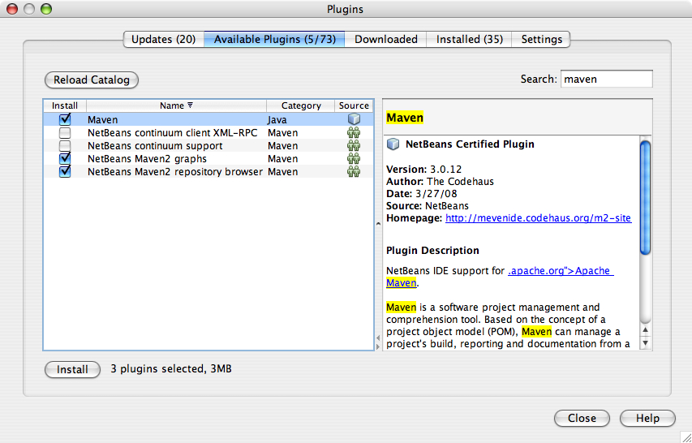
Lab Setup
Unzip 4520_gfplugin.zip
Install Maven 2
Configure NetBeans (optional)

Slide 4
Lab Files
Lab Root
gfplugin/
index.html
myplugin/
solution/
glassfish/

Slide 5
Lab Files
Lab Instructions
gfplugin/
index.html
myplugin/
solution/
glassfish/

Slide 6
Lab Files
Lab Workspace
gfplugin/
index.html
myplugin/
solution/
glassfish/

Slide 7
Lab Files
gfplugin/
Lab Solution
index.html
myplugin/
solution/
glassfish/

Slide 8
Lab Files
gfplugin/
index.html
GlassFish Application Server
myplugin/
solution/
glassfish/

Slide 9
Agenda
Lab Setup
Introduction
Plugging into GlassFish
Charting with jMaki
Templating your Plugin
Q & A

Slide 10

What Is GlassFish?
A Java EE 5 compliant Application Server
  Can run J2EE applications too
Enterprise Quality
  Sun Java System Application Server 9.x
  Use it in production!
Open Source
  CDDL (like OpenSolaris, NetBeans)
  GPLv2 (like Java and NetBeans)
  Use it in production!

Slide 11

What Is GlassFish? (Cont.)
Community Awards Program
  $1M to reward contribution to Open Source projects
  GlassFish one of 6 communities to award $175k
  More at http://glassfish.org/GAP
TBD: Change picture... award ribbon?

Slide 12
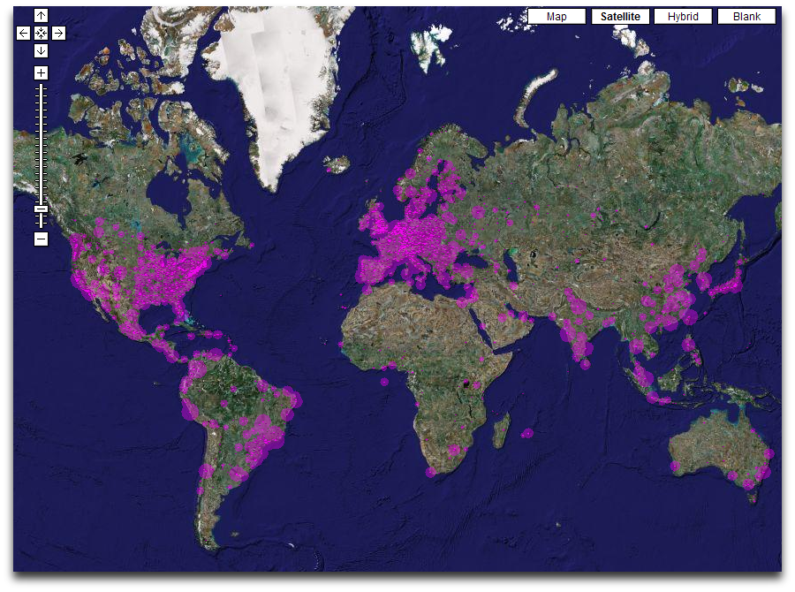
GlassFish around you
Notes:
Live map available from : http://beta.glassfish.java.net:81/maps/

Slide 13




































Frameworks and Applications
Quercus PHP
OSWorkFlow
OSCache
Integration ORB
Project Tango
Apache Httpd
CJUG-Classifieds
BIRT
jBPM
DOJO
Facelets
MyFaces ADF
Shale
SiteMesh
WebDAV
JSPwiki
SEAM
Tapestry
MC4J
StringBeans Portal
AJAX
BlogTrader
Wicket
Java WSDP
Equinox
Dalma
WebSphere MQ
EHCache

Slide 14
Agenda
Lab Setup
Introduction
Plugging into GlassFish
Charting with jMaki
Templating your Plugin
Q & A

Slide 15
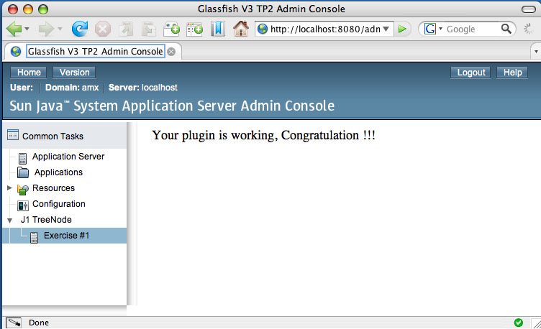
Plugging into GlassFish
Plugin Page
Plugin Tree Node

Slide 16






Plugin Design

Slide 17
Console Provider
Marker for HK2
Provides console-config.xml URL
Default: META-INF/admingui/console-config.xml
        @Service
        public class JavaOnePlugin implements ConsoleProvider {
    public URL getConfiguration() {
    return null;
    }
    }

Slide 18
Integration Points
Defined inside console-config.xml:
    <?xml version="1.0" encoding="UTF-8"?>
    <console-config id="javaone">
    <integration-point
    id="JavaOneNode"
    type="tree"
    priority="210"
    parentId="tree"
    content="treenode-ex1.jsf" />
    </console-config>

Slide 19
The Tree Node
IntegrationPoint “content” refers to JSFTemplating page fragment:
    <sun:treeNode
    id="first"
    text="Exercise #1"
    url="javaone/hello.jsf"
    imageURL=
    "resource/images/instance.gif"
    target="main" />

Slide 20
Plugging into GlassFish
Integration Point

Slide 21
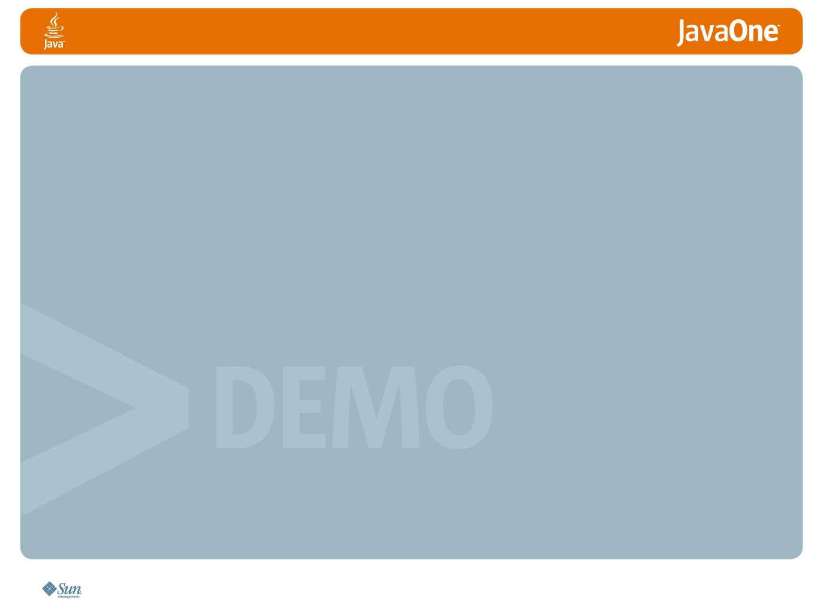
Lab Exercise #1
Create your first GlassFish plugin

Slide 22
Plugging into GlassFish
Lab Time!
Estimated Working Time: 45 min

Slide 23

Agenda
Lab Setup
Introduction
Plugging into GlassFish
Charting with jMaki
Templating your Plugin
Q & A

Slide 24
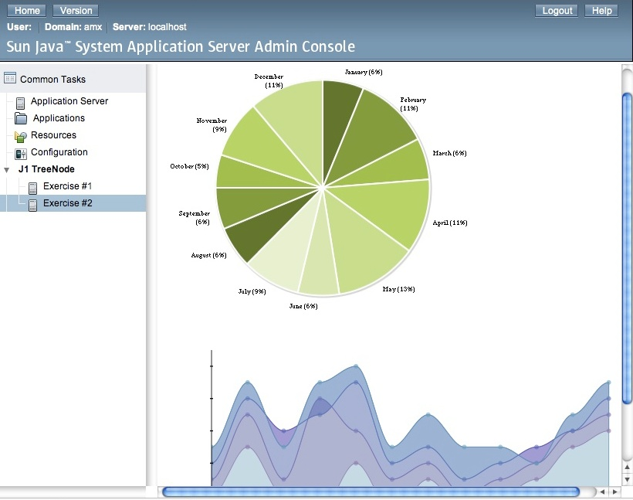
Charting with jMaki

Slide 25
Charting with jMaki
TBD: Get Intro 2 jMaki slides from Greg or Carla -- 2 slides is plenty

Slide 26
Lab Exercise #2
Charting with jMaki

Slide 27
Charting with jMaki
Exercise length – 25 minutes
Tip: Try different chart types

Slide 28
Agenda
Lab Setup
Introduction
Plugging into GlassFish
Charting with jMaki
Templating your Plugin
Q & A

Slide 29
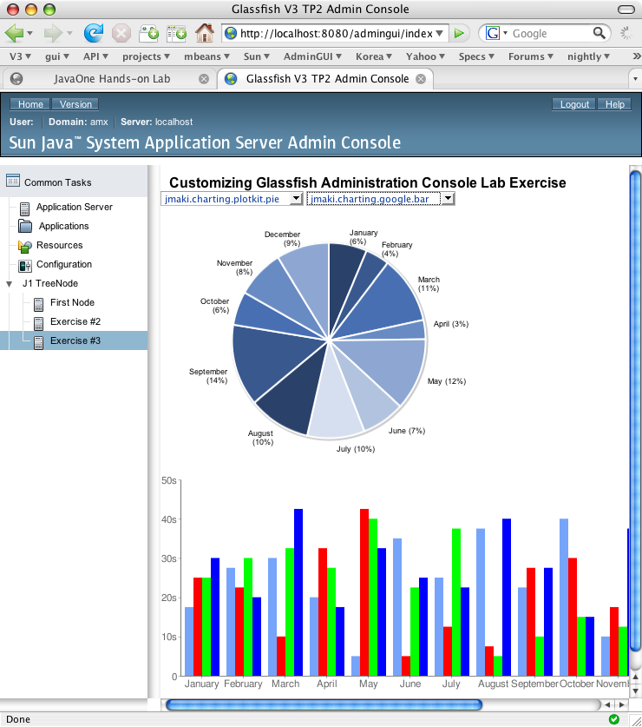
Templating your Plugin
Templating in
JavaServer Faces
Template Example

Slide 30
Templating in JavaServer Faces
<sun:page>
<!beforeCreate
setResourceBundle(key="i18n" bundle="core.Strings")
setResourceBundle(key="help" bundle="core.Helplinks")
/>
#include "/shared/restart.inc"
<sun:html>
<!insert name="head">
<sun:head title="Default Title" />
</insert>
<sun:body onLoad="synchRestartRequired('#{restartRequired}')">
<sun:body>
<sun:form id="form">
#include "/treeBreadcrumbs.inc"
<!insert name="pageTitle">
<sun:title title="Default Page Title" />
</insert>
<!insert name="content">
"Content Goes Here
</insert>
<!insert name="helpkey" />
</sun:form>
</sun:body>
</sun:html>
</sun:page>
~
~
“baseTemplate.xhtml”

Slide 31
Templating in JavaServer Faces
<!composition template="/templates/propertySheet.tpl">
<!define name="pageTitle">
<sun:title id="j1PageTitle"
title="Customizing Glassfish Administration
Console Lab Exercise" />
</define>
<!define name="head">
<sun:head
title="Customizing Glassfish Administration
Console Lab Exercise" />
</define>
</composition>
~
~
~
~
~
~
~
~
~
~
“javaOneTemplate.tpl”

Slide 32
Lab Exercise #3
Templating Your Plugin

Slide 33
Templating in JavaServer Faces
Exercise length – 25 minutes
Tip: Try different chart types

Slide 34
Agenda
Lab Setup
Introduction
Plugging into GlassFish
Charting with jMaki
Templating your Plugin
Q & A

Slide 35
Summary
GlassFish v3
jMaki
Admin Console Plugin
JSFTemplating
Get Involved!

Slide 36
References
https://jsftemplating.dev.java.net
https://glassfish.dev.java.net
https://jmaki-charting.dev.java.net
https://ajax.dev.java.net
https://woodstock.dev.java.net
All Open Source
Get Involved!

Slide 37
Q&A

Slide 38
Plug Your JavaServer Faces Application into the GlassFish v3 Admin Console
Ken Paulsen – ken.paulsen@sun.com
Anissa Lam – anissa.lam@sun.com
Senthil Chidambaram – cchidamb@sun.com
Ana Caballero – ana.caballero@sun.com

