Slide 1


Project Dynamic Faces:
Using DynaFaces
Ed Burns
Senior Staff Engineer
Enterprise Java Platforms

Slide 2

Agenda
Design Details
  Overview
  Views and Partial Views
  JSF lifecycle review
Application Setup
Usage Patterns
  AjaxZone usage
  DynaFaces.fireAjaxTransaction usage
  DynaFaces.
  installDeferredAjaxTransaction usage
  Dispatching JSF Events from Ajax

Slide 3
DynaFaces — Overview
Useful for updating a JSF View in the browser without requiring a full page refresh.
Intended for situations where you want do more on one page, without having the user go to a new page.
Doesn't preclude tradtional “page flow” based applications, can do page transitions via AJAX.
Expose the JSF lifecycle to partial view updates, initiated and handled via AJAX.
Support for firing Faces Events from the browser directly.

Slide 4
The Importance of the Lifecycle
Initial request to JSF Server goes through normal lifecycle.
AJAX requests go through normal lifecycle, but only desired subviews get processed.
Server can dynamically add and remove subviews during the lifecycle, allowing for a true “dirty region”
Client can suggest distinct sets of subviews for “execute” and “render”.
Server sends back XML describing subviews to be refreshed.

Slide 5
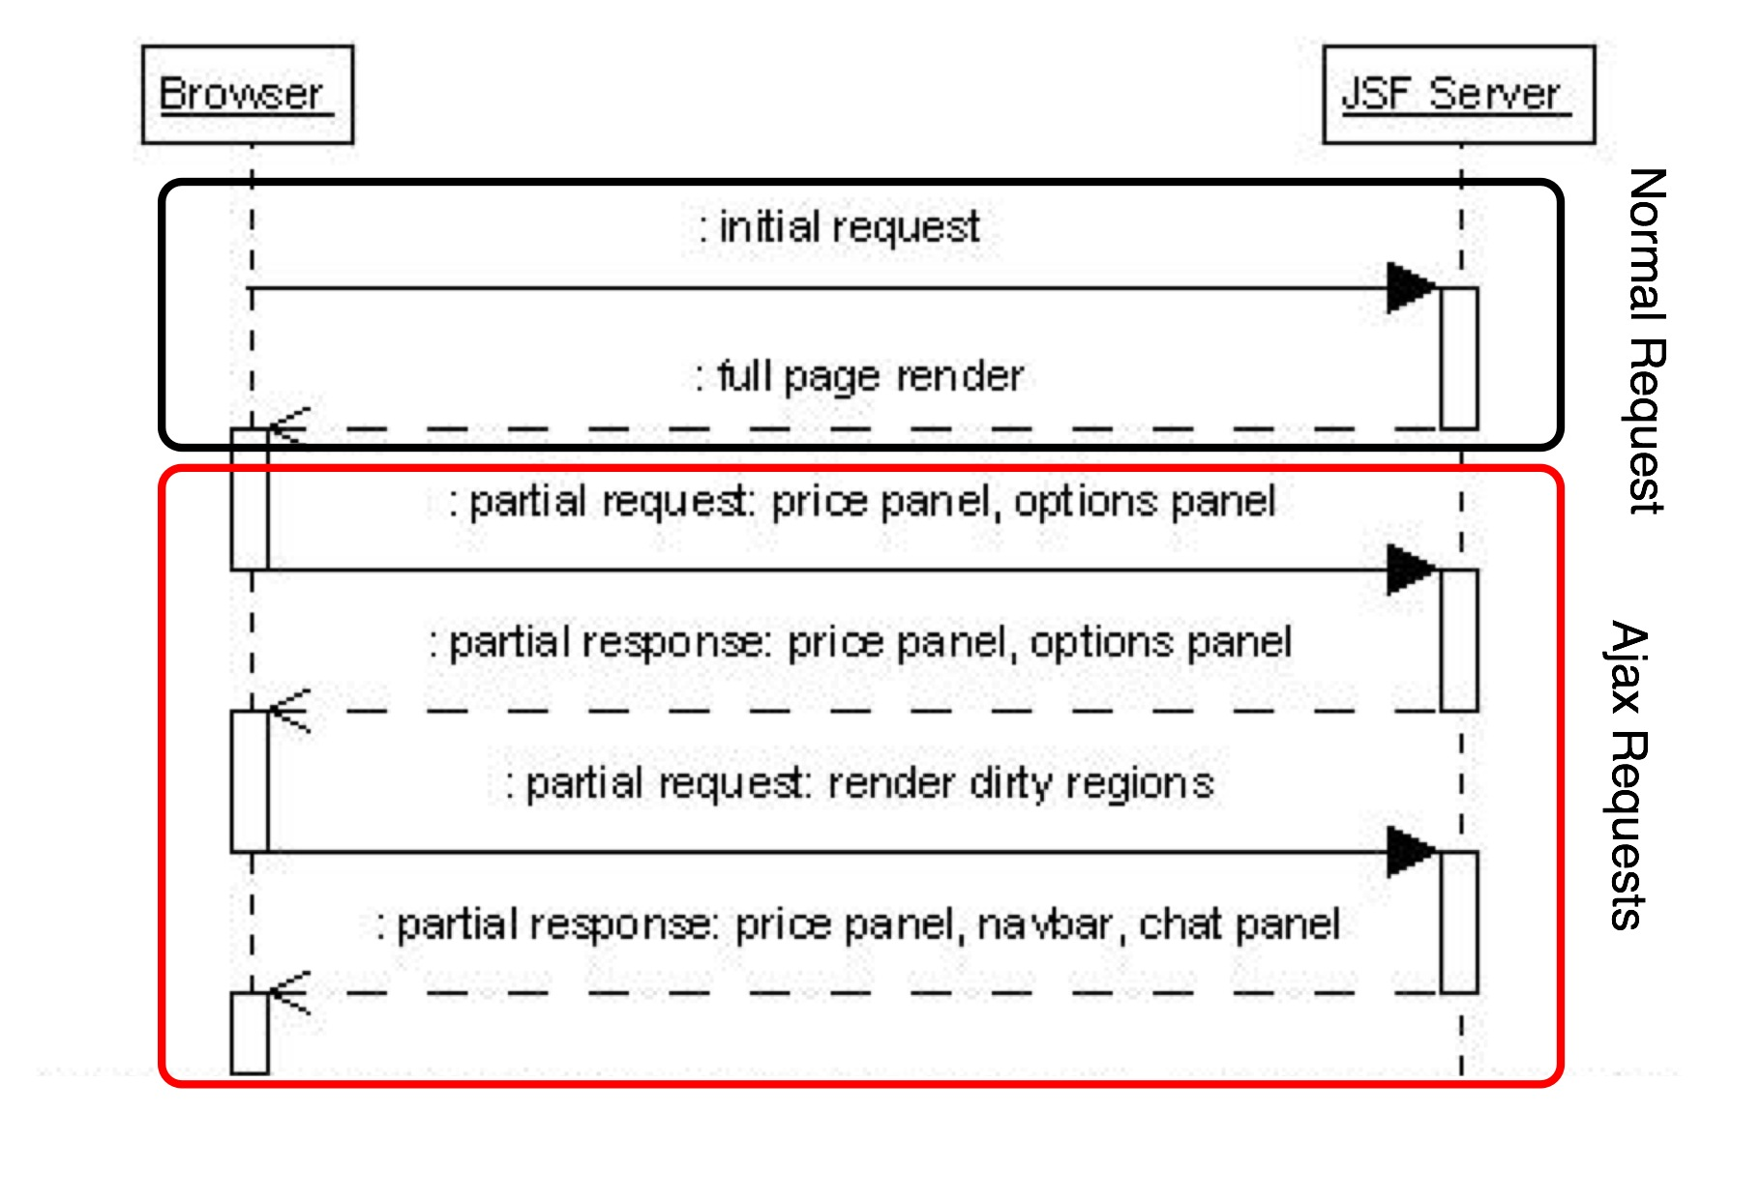
The Importance of the Lifecycle

Slide 6
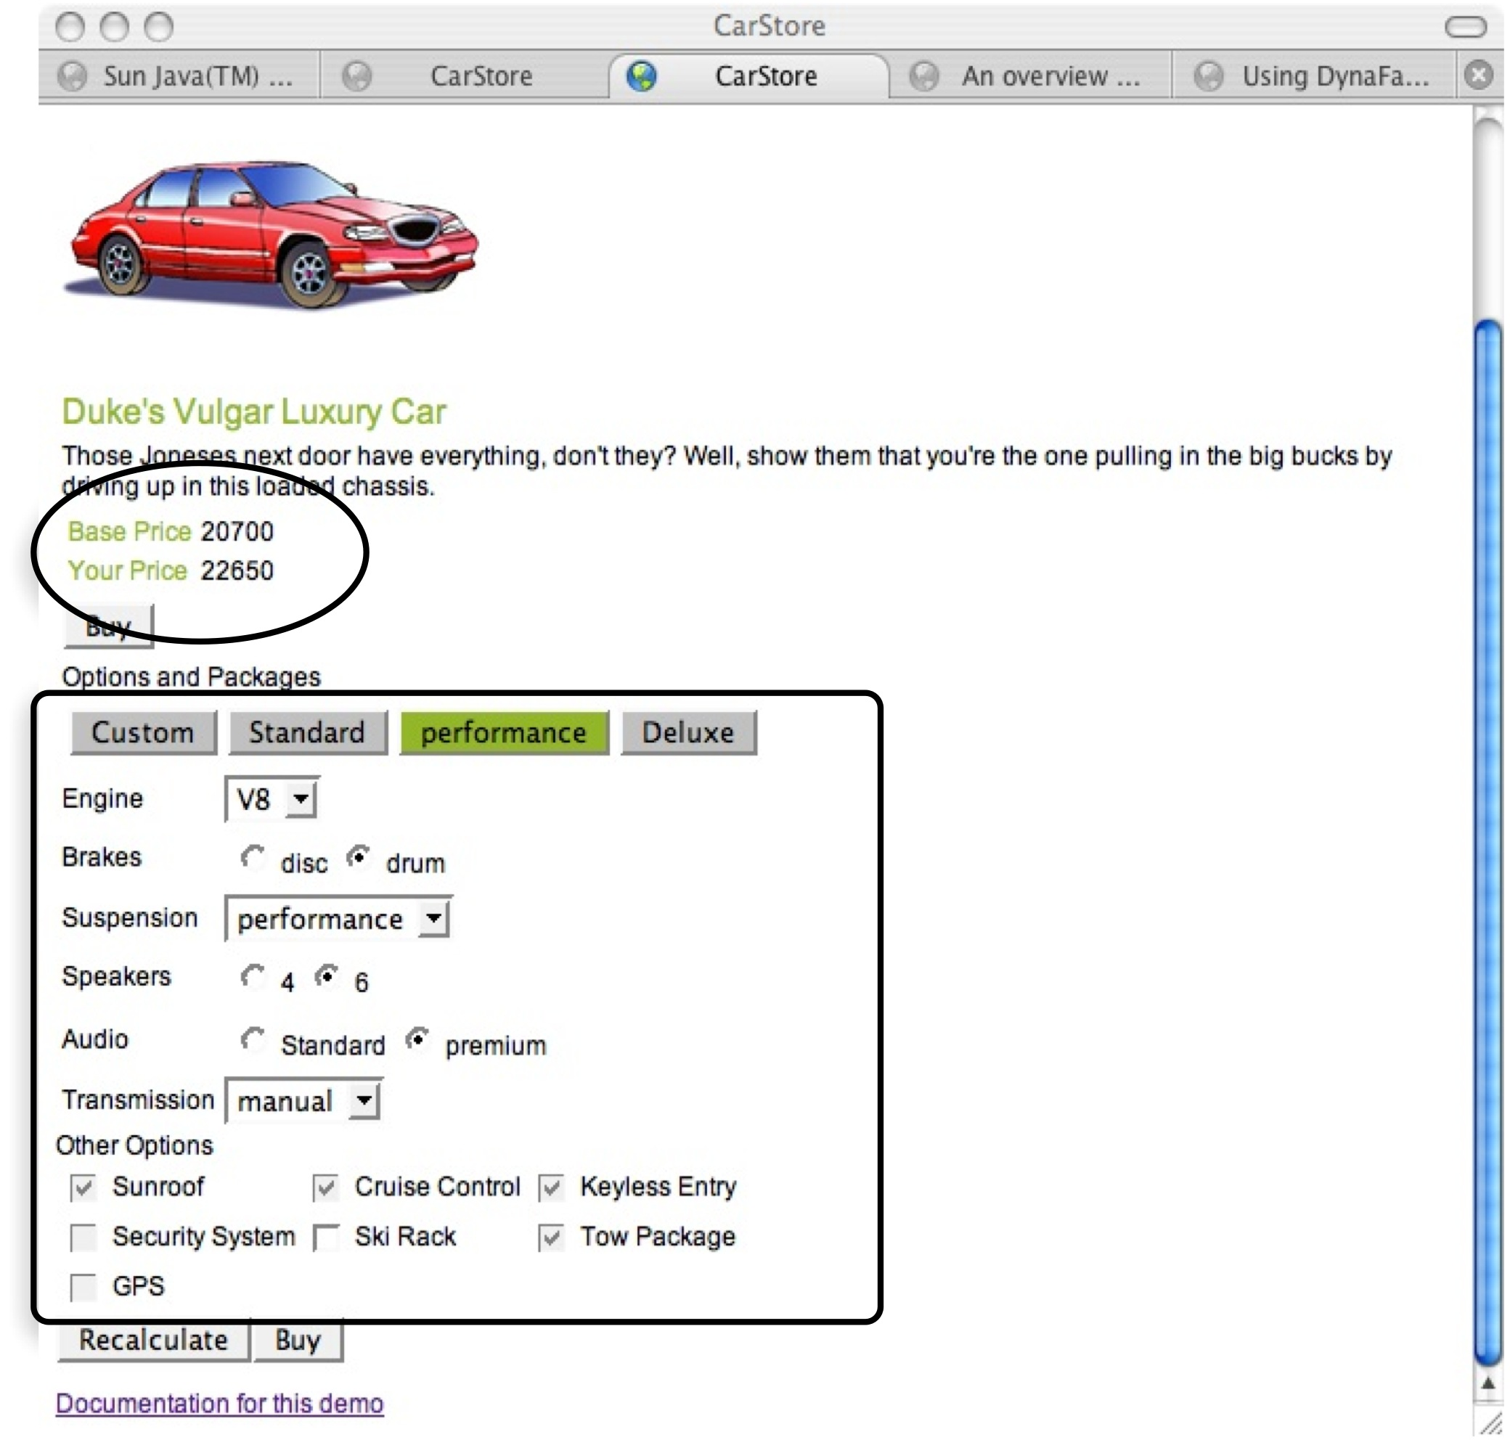
Views and Partial Views

Slide 7
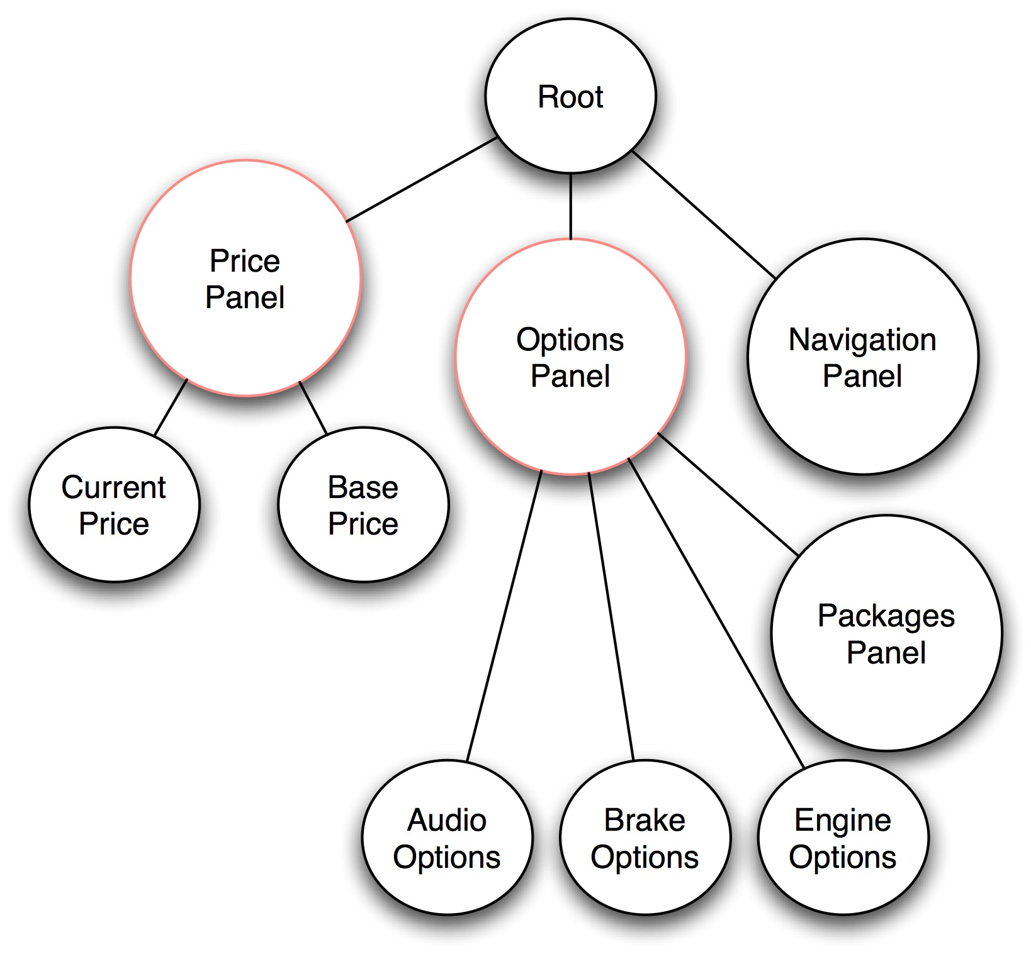
Views and Partial Views

Slide 8
DynaFaces and the JSF Lifecycle
Lifecycle Review
“execute”
portion of Lifecycle
“render”
portion of Lifecycle

Slide 9
DynaFaces Application Setup
web.xml sugar
Add an <init-param> element to your <servlet> element for the FacesServlet
<servlet>
<servlet-name>Faces Servlet</servlet-name>
<servlet-class>javax.faces.webapp.FacesServlet
</servlet-class>
<init-param>
<param-name>javax.faces.LIFECYCLE_ID</param-name>
<param-value>com.sun.faces.lifecycle.PARTIAL
</param-value>
</init-param>
<load-on-startup>1</load-on-startup>
</servlet>

Slide 10
DynaFaces Application Setup
Dependency Jars
Use the dynafaces-facelets-blank.war, or dynafaces-jsp-blank.war as a starter.
—OR—
Put in WEB-INF/lib
  jsf-extensions-dynafaces.jar
  jsf-extensions-common.jar
  shale-remoting.jar (and dependencies)
    commons-beanutils.jar
    commons-chain.jar
    commons-codec.jar
    commons-collections.jar
    commons-digester.jar
    commons-el.jar
    commons-fileupload.jar
    commons-logging.jar

Slide 11
DynaFaces — Usage Patterns
Several entry points
Work in progress!
Application
Application
AJAX Zones
Application
DynaFaces JavaScript Library
DynaFaces API (HTTP + XML Application)
AJAX View Root
AJAX Lifecycle
JSF Runtime

Slide 12
DynaFaces — Usage Patterns
Page Author
  Use AJAX enabled components
  Use AjaxZone tag to AJAXify regions of the page
  Use provided JavaScript library to AJAXify page elements and components
Component Author
  Use provided JavaScript library in custom components
  Write your own JavaScript that talks directly to the HTTP protocol and the XML application defined by DynaFaces
Increasing Complexity
Increasing Complexity

Slide 13
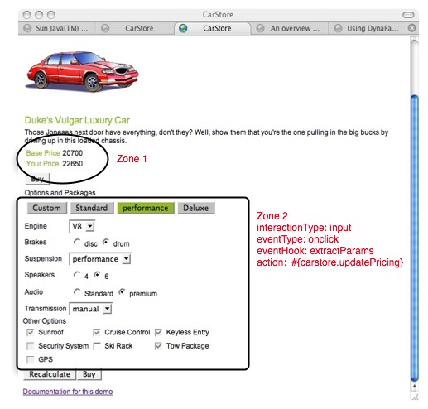
DynaFaces Usage Patterns
Using AjaxZones
The easiest way to AJAXify an existing application
Demarcate one or more AJAX zones within a page
Zones will refresh via AJAX, without full page refresh.
2. See update here
  Action in one zone
  causes reaction in another zone
1. Click something in here

Slide 14

Demonstrations

Slide 15
DynaFaces Usage Patterns
Using AjaxZones
<jsfExt:ajaxZone id="zone1"> <h:panelGrid columns="2">
Base Price <h:outputText binding="#{currentModel.basePrice}"/>
Your Price <h:outputText value="#{currentModel.currentPrice}"/> </h:panelGrid> </jsfExt:ajaxZone>
<jsfExt:ajaxZone id="zone2" action="#{carstore.currentModel.updatePricing}">
Option Packages <h:panelGrid columns="4">
<h:commandButton value="Custom" actionListener="#{carstore.choosePackage}"/>
<h:commandButton value="Standard"actionListener="#{carstore.choosePackage}"/>
</h:panelGrid> <h:panelGrid columns="2">
Engine <h:selectOneMenu binding="#{currentModel.components.engine}"/>
Breaks <h:selectOneRadio binding="#{currentModel.components.brake}"/>
Suspension <h:selectOneMenubinding="#{currentModel.components.suspension}"/>
Speakers <h:selectOneRadio binding="#{currentModel.components.speaker}"/>
</jsfExt:ajaxZone>

Slide 16
DynaFaces Usage Patterns
Using AjaxZones — available attributes
action (optional)
  MethodExpression to invoke when the request processing lifecycle in which this zone is being processed reaches its invokeApplication phase.
immediate (optional): Just like commandButton
inspectElement: (optional)
  User defined JavaScript function that takes an HTML element and returns true or false depending on whether or not this element should be AJAXified. The default inspectElement function will return true for every child of this zone that is an HTML input, button, or option tag.
eventType: (optional)JavaScript event to cause the AJAX request. If not specified, defaults to “click”.

Slide 17
DynaFaces Usage Patterns
Using AjaxZones — available attributes
collectPostData (optional)
  User defined JavaScript function called when the eventType event occurs. Extracts name=value pairs to send in AJAX request. If not specified, the following name=value pairs are sent
    The name=value pair of any input field within the zone.
    For any radio button or menu, the name=value pair of the currently selected choice.
    If the activated component that resulted in this callback being called is a button, the name=value pair for that button only. Any other buttons within the zone do not have their name=value pairs contributed to the AJAX request.
postReplace (optional)
  This optional attribute names a function to be called after the new content from the server for this zone has been installed into the view. Used for jMaki support.

Slide 18
DynaFaces Usage Patterns
Using AjaxZones — available attributes
replaceElement (optional)
  This optional attribute is or names a JavaScript function that will be called when the system needs to replace a chunk of markup in the view based on the return from the server. The default implementation is sufficient for most cases.
getCallbackData (optional)
  This optional attribute names a function to be called to provide a closure argument that will be passed to the ajax request and made available to the ajax response in the replaceElement or postReplace functions.

Slide 19
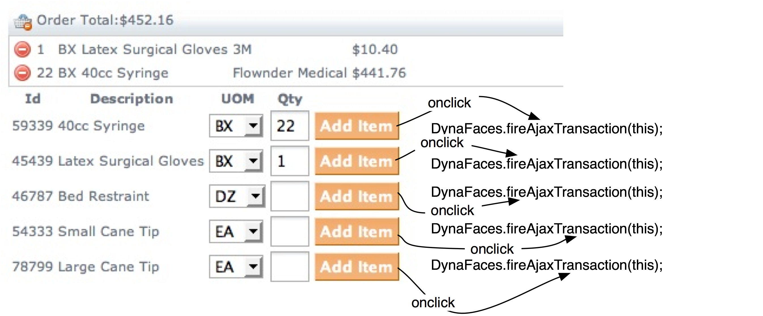
DynaFaces Usage Patterns
Using DynaFaces.fireAjaxTransaction
Defined in built-in JavaScript library.
When called, causes an AJAX transaction to the Faces server.
Many options for customizing the transaction.

Slide 20
DynaFaces Usage Patterns
Using DynaFaces.fireAjaxTransaction
<h:commandButton value="Add Item" action="#{orderEntry.addProduct}" onclick="new DynaFaces.fireAjaxTransaction(this);"/>
Useful when you want the AJAX transaction to happen as soon as the script is executed.
Default action just does a refresh of the whole view via AJAX, using JavaScript DOM methods to update the elements.
Can add options to choose exactly which subtrees get sent, processed, and re-rendered.

Slide 21
DynaFaces Usage Patterns
DynaFaces.fireAjaxTransaction General Form
Generally used in a tag attribute
<ANY_HTML_OR_JSF_ELEMENT
on|EVENT|="DynaFaces.fireAjaxTransaction(this,{|OPTIONS|});" />
Where
  ANY_HTML_OR_JSF_ELEMENT is any HTML element or JSF tag
  on|EVENT| is any JavaScript event type, such as onclick
  {|OPTIONS|} is an optional argument. If present, it is a JavaScript associative array containing any options desired for this transaction.
DynaFaces.fireAjaxTransaction() may be used from non event-handler JavaScript as well.

Slide 22
DynaFaces Usage Patterns
Using DynaFaces.fireAjaxTransaction
execute (optional)
  Comma separated list of client ids to be traversed on the “execute” portion of the JSF Request Processing Lifecycle (everything but render). If not specified, the value of the render option is used. “none” indicates that the view must not be traversed during the execute portion of the lifecycle.
render (optional)
  Comma separated list of client ids to be traversed on the “render” portion of the JSF Request Processing Lifecycle. If not specified it's up to the server to decide what to re-render. By default the whole view is re-rendered. “none” indicates that the view must not be rendered.
inputs (optional)
  Comma separated list of clientIds for which the value should be sent in the AJAX request. If not specified, all input components in the current form are submitted.

Slide 23
DynaFaces Usage Patterns
Using DynaFaces.fireAjaxTransaction — options
  postReplace (optional)
    User defined JavaScript function called after element replacement. Useful when integrating with jMaki. If not specified, any scripts present in the markup to be rendered are evaluated.
  replaceElement (optional)
    User defined JavaScript function called for element replacement. If not specified, default element replacement occurs.
  getCallbackData (optional)
    User defined JavaScript function, returns closure object that is passed to the replaceElement or postReplace functions.
  immediate (optional)
    boolean value that tells the server to set the immediate option, for this transaction only, on any input or command components in the traversal.

Slide 24
DynaFaces Usage Patterns
Using DynaFaces.fireAjaxTransaction — options
  asynchronous (optional)
    Should this transaction be asynchronous (the default) or synchronous
  xjson (optional)
    Any JSON data that should be sent along with the transaction, as the value of the X-JSON header
  closure (optional)
    Closure object that is passed to the replaceElement or postReplace functions.
  immediate (optional)
    boolean value that tells the server to set the immediate option, for this transaction only, on any input or command components in the traversal.

Slide 25
DynaFaces XML Application
<partial-response>
<components>
<render id="form:table"/>
<markup><![CDATA[Rendered content from component]]></markup>
<messages>
<message>The messages element is optional. If present,
it is a list of FacesMessage.getSummary() output
</message>
</messages>
</render>
<!-- repeat for the appropriate number of components -->
<messages><!-- global messages --></messages>
</components>
<state><![CDATA[state information for this view ]]></state>
</partial-response>

Slide 26
What to do with the XML response
For each <render> element within the <components> element:
  Get the CDATA element from inside the <markup> element inside the <render> element.
  Strip out any JavaScript
  Locate the corresponding DOM element by id.
  Replace the DOM element with the markup from the XML response.
  If desired, evaluate the JavaScript in the markup.
  If the <render> element has a <messages> element, render the messages for that DOM element appropriately.

Slide 27
What to do with the XML response (continued)
If there is a global <messages> element, render the messages within it appropriately.
Extract the CDATA from the <state> element and replace the value of the javax.faces.ViewState hidden fields with this value.

Slide 28
DynaFaces Usage Patterns
Using Direct HTTP Interaction
Write your own JavaScript to interact with the JSF server directly.
Requires understanding of HTTP basics and JavaScript XML manipulation techniques.
Requires understanding of JSF lifecycle (see following slides)
Usage pattern:
  Craft an HTTP Request with proper headers and data.
  Send the request to the JSF server over XmlHttpRequest.
  Server responds with XML Document in DynaFaces format.
  Manipulate the XML Document to update the DOM of the currently displayed page.

Slide 29
DynaFaces Usage Patterns
Using DynaFaces.fireAjaxTransaction — options
event (optional)
  If present, this must be the only option. Allows an arbitrary method of an arbitrary component in the view to be invoked, as if a FacesEvent had occurred.
closure (optional)
  The same intent as the getCallbackData function on AjaxZone, but in this case, the JavaScript object is just passed directly. This data is passed to the replaceElement or postReplace functions if specified.

Slide 30
HTTP Method and Headers
HTTP Method is generally POST, but can be GET if data is small enough to fit in the query string.
The following HTTP request headers are defined
  com.sun.faces.avatar.Partial
    Must be present and have a value of “true” (no quotes) on all AJAX requests. JSF lifecycle uses this to tell if the request is an AJAX request or not.
  com.sun.faces.avatar.Execute
    Equivalent to the “execute” option to DynaFaces.fireAjaxTransaction
  com.sun.faces.avatar.Render
    Equivalent to the “render” option to DynaFaces.fireAjaxTransaction

Slide 31
Headers (continued) and POST Data
HTTP Request Headers
  com.sun.faces.avatar.Partial
    Must be present and have a value of “true” (no quotes) on all AJAX requests. JSF lifecycle uses this to tell if the request is an AJAX request or not.
  com.sun.faces.avatar.Event
    Equivalent to the “event” option to DynaFaces.fireAjaxTransaction
  X-JSON
    JSON data sent to the server, and also returned in response
POST (or GET) Data
  Must include “javax.faces.ViewState”
  Should include name=value pairs for form data.

Slide 32
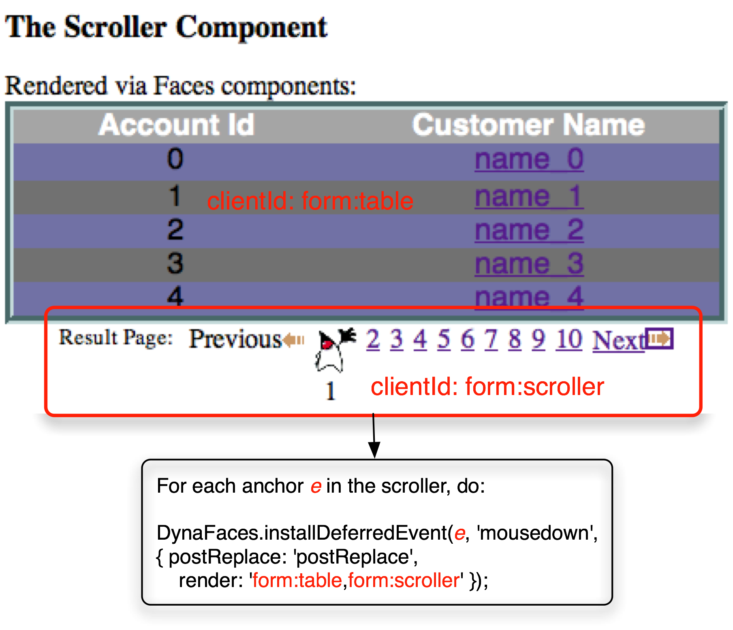

Slide 33
DynaFaces Usage Patterns
Using DynaFaces.installDeferredEvent
“Extends” DynaFaces.fireAjaxTransaction to provide deferred kickoff of AJAX transaction.
Defined in built-in JavaScript library. Used by AjaxZones.
Can be installed on any DOM element to cause an AJAX transaction to start when a given JavaScript event happens.
Options are the same as for DynaFaces.fireAjaxTransaction

Slide 34
DynaFaces Usage Patterns
Using DynaFaces.installDeferredEvent
<script type='text/javascript'>
document.forms[0].submit = function() {};
var a = $('form:scroller').getElementsByTagName('a');
$A(a).each(function(e) {
new DynaFaces.installDeferredEvent(e, 'mousedown',
{ postReplace: 'postReplace',
render: 'form:table,form:scroller });
});
</script>
Globally scoped script in the page.
Happens to use “prototype” library, but need not do so.
For each anchor element in the scroller, call new DynaFaces.installDeferredEVent(), passing the anchor element.

Slide 35
Demonstrations

Slide 36
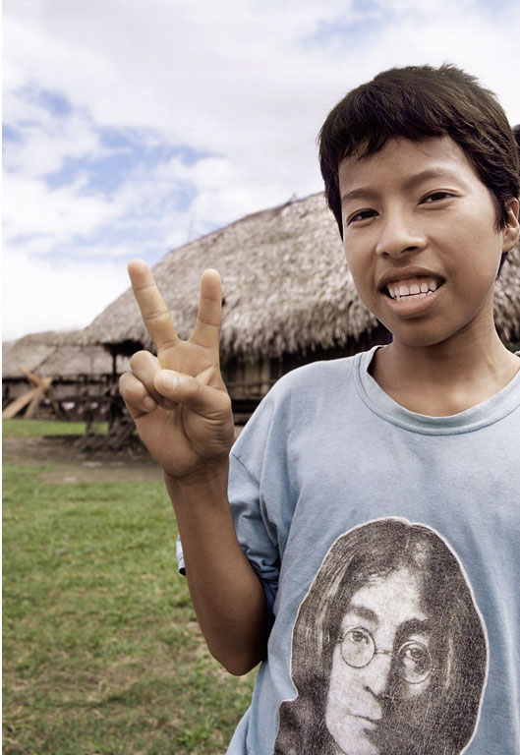
DynaFaces
Ed Burns
  ed.burns@sun.com

