Slide 1


Enterprise Grade Ajax with JavaServer™ Faces
Ed Burns
Senior Staff Engineer
Enterprise Java Platforms

Slide 2

Presentation Goals
Show that Ajax + JSF is the way to go
Show one concrete way of using Ajax + JSF
Lean how to evaluate an
Ajax + JSF solution for yourself

Slide 3

Terms
Enterprise Grade
  Robust, Scalable, Well Tested, Industry Proven
  Easy to Use
  Appropriate to Developer Skillset
  Good concept scalability
Ajax
  In a web application, using asynchronous transactions to the server to dynamically update the appearance and behavior of the view shown in the browser.

Slide 4

Agenda
Why JSF + Ajax?
  Web Application Musts
  Different approaches
  JSF Design Heritage
  JSF Features for Ajax
  Problems and Solutions
One Solution:
Project Dynamic Faces
Summary

Slide 5

All Web Applications Must Have...

Slide 6
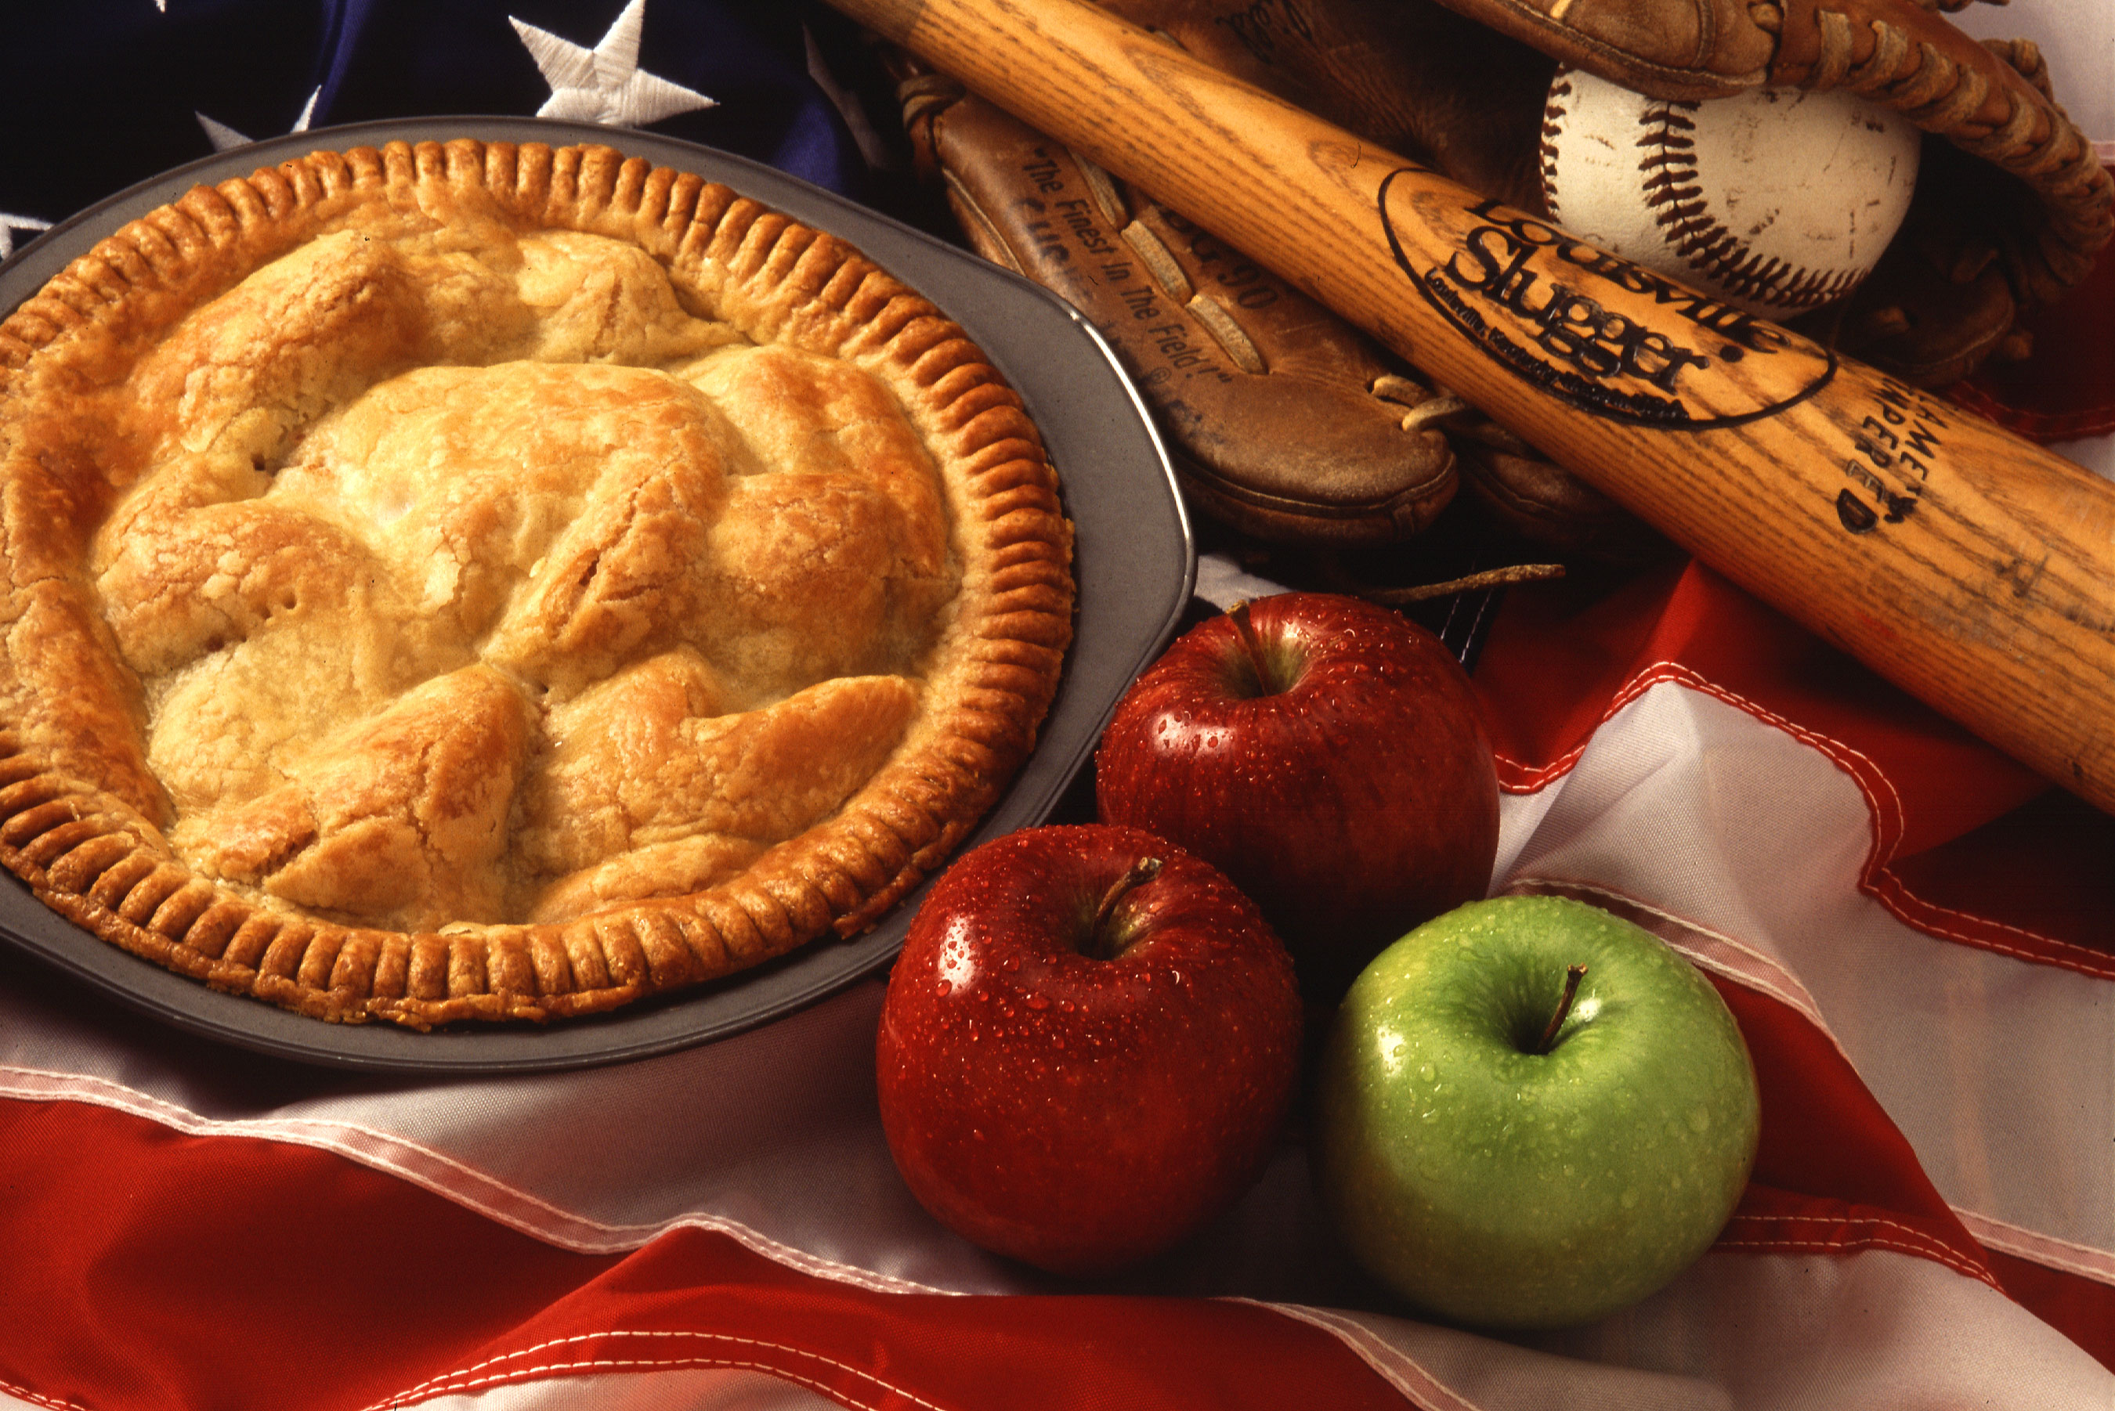
All Web Applications Must Have...
Data Conversion and Validation
Page Flow
Database integration
I18N, L10N, A11Y
Support CSS, Markup based layout
User Friendliness!

Slide 7

Approaches for using JSF + Ajax
In Order of Decreasing Complexity
“Naked” Ajax (Frank Zametti)
  You'll gain a deep understanding of Ajax techniques
  Have to handle all XmlHttpRequest interactions yourself. (SetTimeout anyone?)
  Have to handle cross browser quirks (Legendary pain)
  You'll end up writing a framework yourself anyway!
Use a JavaScript Framework (Dojo, DWR, etc)
  Many available, some really good
  Web app “Musts” provided by JSF still have to be integrated with the framework.

Slide 8
Approaches for using JSF + Ajax
In Order of Decreasing Complexity
JSF + DynaFaces
  No JavaScript knowledge required
  Can do more powerful stuff if you like JavaScript
  Only JSF + Ajax solution that correctly handles context sensitive Ajax component interaction.
  Currently only implemented with JSF 1.2
  Still in early access: needs more testing
Using Ajax enabled JSF Components
  Minimal Ajax awareness required
  Some nice components available, even for JSF 1.1
  If you can't find one, you'll have to write it yourself, best use DynaFaces

Slide 9
The Big Question
Is Ajax different enough from common web application UI practices that it warrants a completely different approach?
No.
Lots of people will still sell you stuff to learn Ajax, though!

Slide 10
One Possible Answer
JSF + Ajax
Use JSF for Web App “Musts”
Provide some extra usage contract to enable Ajax support
Several options currently
  DynaFaces
  IceFaces
  Ajax4JSF
  AjaxAnywhere
  Backbase

Slide 11
Why JSF + AJAX?
OO Design of JSF was ready for AJAX when AJAX wasn't cool.
Key Features of JSF that make it AJAX friendly
  Flexible and extensible component model
  Well defined Request Processing Lifecycle
  Flexible and extensible rendering model
Concepts that enable AJAX
  Encapsulation: ability to hide JavaScript from the page author, but show it to the component author
  State Management: easily keep client and server state in synch

Slide 12
Typical Ajax Problems Solved by Some JSF + Ajax Solutions
Cross Browser Differences: wrap a JavaScript Framework that abstracts them.
I18N, L10N: JSF Support Just works, even for Ajax
Script management and versioning: Apache Shale
“too chatty” XmlHttpRequest usage: batch events
Using XML for transport requires extra finesse for some common HTML elements, such as &nbsp;
Web app “Musts” handled naturally by JSF

Slide 13
The Best JSF + Ajax Solution
Project Dynamic Faces
Brings the power of AJAX to existing and future JSF developed applications.
Based on “Avatar” idea from Jacob Hookom, creator of Facelets, and shown at JavaOne 2006
Small footprint developer usage contract
Big Increase in Ajax capability

Slide 14

Demonstrations

Slide 15
Project Dynamic Faces
The Basic Idea
Expose the JSF Lifecycle to the browser via Ajax
  Allow operating on the entire view, or a part of it
  Allow controlling the Lifecycle via Ajax
  Allow the server to change appearance and behavior of current page

Slide 16
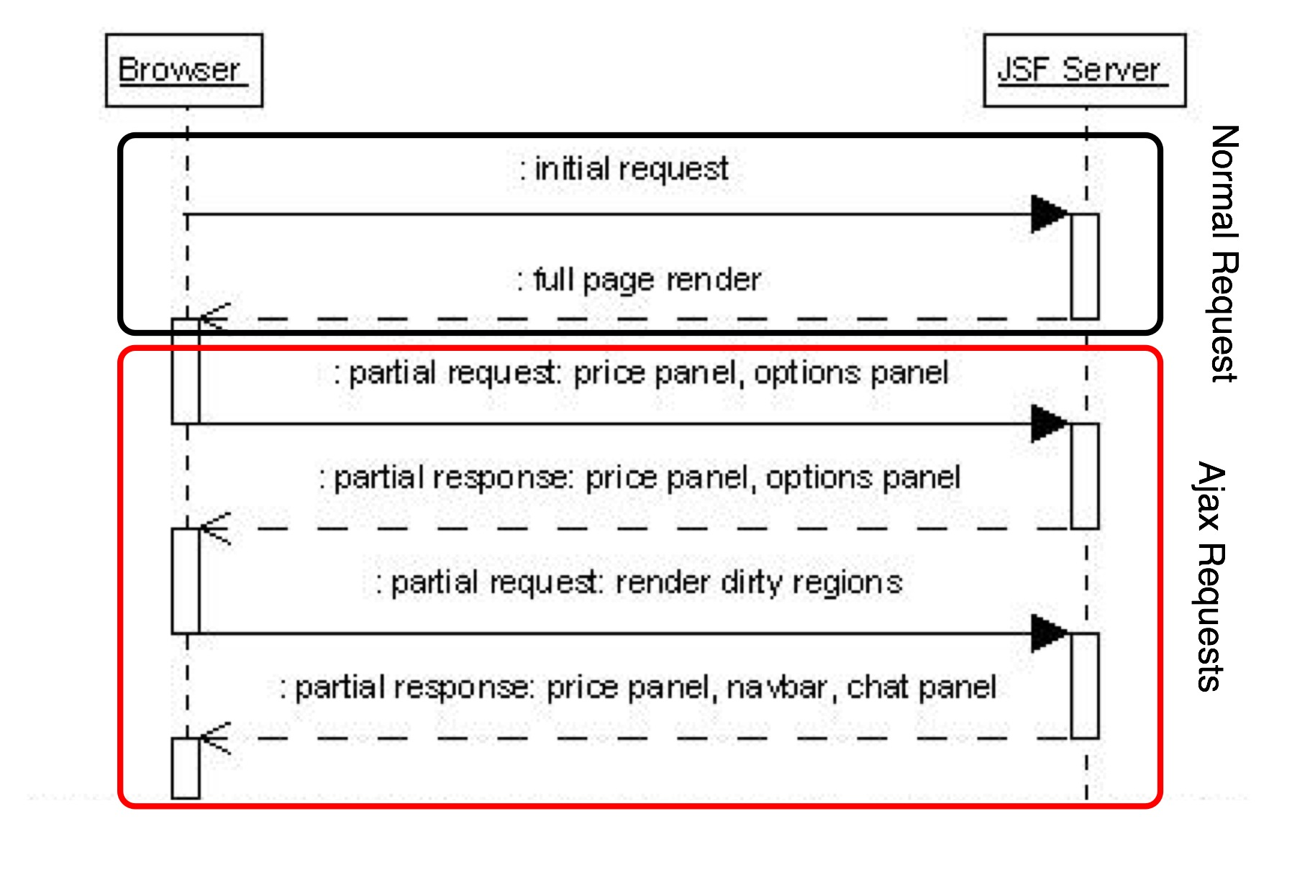
The Importance of the Lifecycle

Slide 17
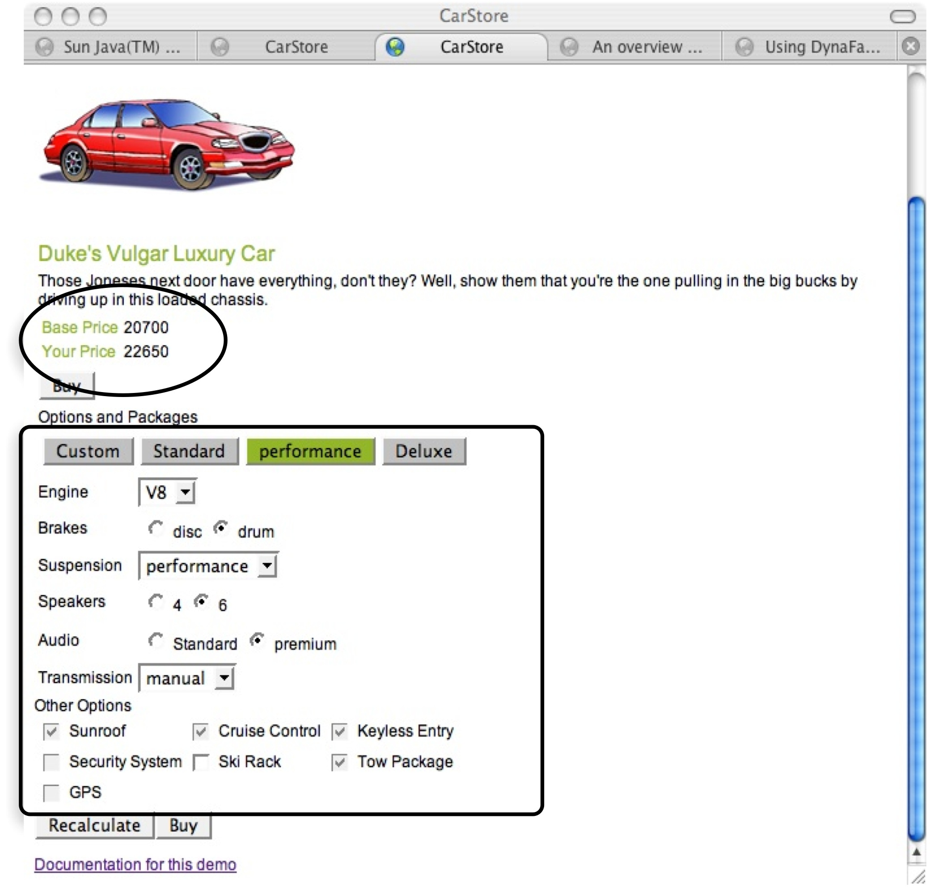
Views and Partial Views

Slide 18
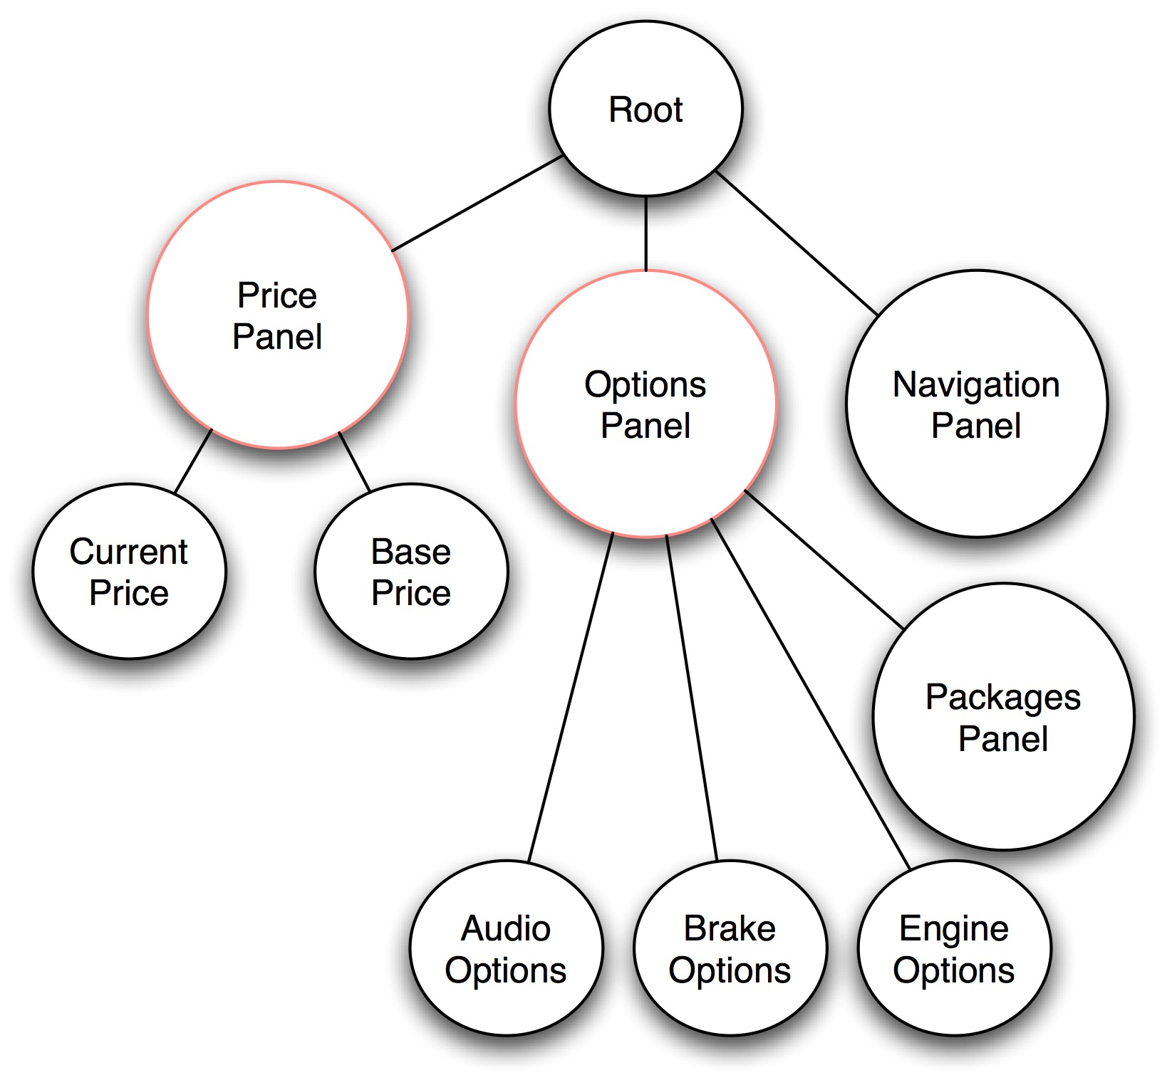
Views and Partial Views

Slide 19
DynaFaces — Usage Patterns
Page Author
  Use AJAX enabled components
  Use AjaxZone tag to AJAXify regions of the page
  Use provided JavaScript library to AJAXify page elements and components
Component Author
  Use provided JavaScript library in custom components
  Write your own JavaScript that talks directly to the HTTP protocol and the XML application defined by DynaFaces
Increasing Complexity
Increasing Complexity

Slide 20
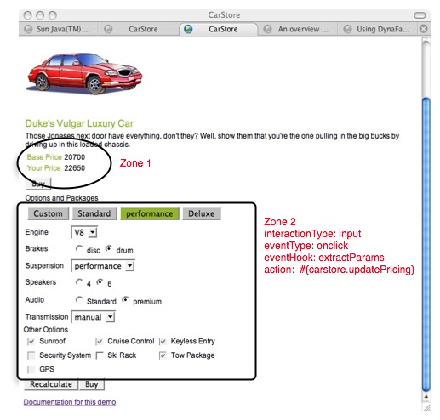
DynaFaces Usage Patterns
Using AjaxZones
The easiest way to AJAXify an existing application
Demarcate one or more AJAX zones within a page
Zones will refresh via AJAX, without full page refresh.
2. See update here
  Action in one zone
  causes reaction in another zone
1. Click something in here

Slide 21
Demonstration

Slide 22
DynaFaces Usage Patterns
Using AjaxZones
<jsfExt:ajaxZone id="zone1"> <h:panelGrid columns="2">
Base Price <h:outputText binding="#{currentModel.basePrice}"/>
Your Price <h:outputText value="#{currentModel.currentPrice}"/> </h:panelGrid> </jsfExt:ajaxZone>
<jsfExt:ajaxZone id="zone2" action="#{carstore.currentModel.updatePricing}">
Option Packages <h:panelGrid columns="4">
<h:commandButton value="Custom" actionListener="#{carstore.choosePackage}"/>
<h:commandButton value="Standard"actionListener="#{carstore.choosePackage}"/>
</h:panelGrid> <h:panelGrid columns="2">
Engine <h:selectOneMenu binding="#{currentModel.components.engine}"/>
Breaks <h:selectOneRadio binding="#{currentModel.components.brake}"/>
Suspension <h:selectOneMenubinding="#{currentModel.components.suspension}"/>
Speakers <h:selectOneRadio binding="#{currentModel.components.speaker}"/>
</jsfExt:ajaxZone>

Slide 23
DynaFaces Usage Patterns
Using AjaxZones — available attributes
action (optional)
  MethodExpression to invoke when the request processing lifecycle in which this zone is being processed reaches its invokeApplication phase.
immediate (optional): Just like commandButton
inspectElement: (optional)
  User defined JavaScript function that takes an HTML element and returns true or false depending on whether or not this element should be AJAXified. The default inspectElement function will return true for every child of this zone that is an HTML input, button, or option tag.
eventType: (optional)JavaScript event to cause the AJAX request. If not specified, defaults to “click”.

Slide 24
DynaFaces Usage Patterns
Using AjaxZones — available attributes
collectPostData (optional)
  User defined JavaScript function called when the eventType event occurs. Extracts name=value pairs to send in AJAX request. If not specified, the following name=value pairs are sent
    The name=value pair of any input field within the zone.
    For any radio button or menu, the name=value pair of the currently selected choice.
    If the activated component that resulted in this callback being called is a button, the name=value pair for that button only. Any other buttons within the zone do not have their name=value pairs contributed to the AJAX request.
postReplace (optional)
  This optional attribute names a function to be called after the new content from the server for this zone has been installed into the view. Used for jMaki support.

Slide 25
DynaFaces Usage Patterns
Using AjaxZones — available attributes
replaceElement (optional)
  This optional attribute is or names a JavaScript function that will be called when the system needs to replace a chunk of markup in the view based on the return from the server. The default implementation is sufficient for most cases.
getCallbackData (optional)
  This optional attribute names a function to be called to provide a closure argument that will be passed to the ajax request and made available to the ajax response in the replaceElement or postReplace functions.

Slide 26
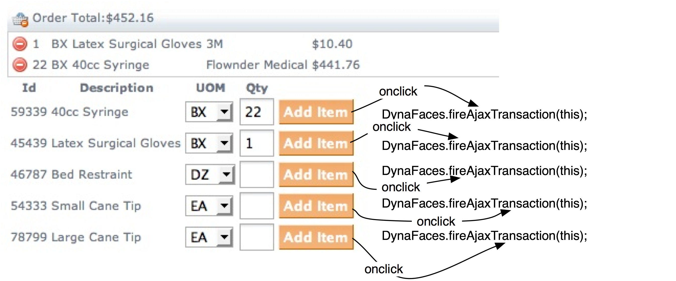
DynaFaces Usage Patterns
Using DynaFaces.fireAjaxTransaction
Defined in built-in JavaScript library.
When called, causes an AJAX transaction to the Faces server.
Many options for customizing the transaction.

Slide 27
Demonstration

Slide 28
DynaFaces Usage Patterns
Using DynaFaces.fireAjaxTransaction
<h:commandButton value="Add Item" action="#{orderEntry.addProduct}" onclick="new DynaFaces.fireAjaxTransaction(this);"/>
Useful when you want the AJAX transaction to happen as soon as the script is executed.
Default action just does a refresh of the whole view via AJAX, using JavaScript DOM methods to update the elements.
Can add options to choose exactly which subtrees get sent, processed, and re-rendered.

Slide 29
DynaFaces Usage Patterns
DynaFaces.fireAjaxTransaction General Form
Generally used in a tag attribute
<ANY_HTML_OR_JSF_ELEMENT
on|EVENT|="DynaFaces.fireAjaxTransaction(this,{|OPTIONS|});" />
Where
  ANY_HTML_OR_JSF_ELEMENT is any HTML element or JSF tag
  on|EVENT| is any JavaScript event type, such as onclick
  {|OPTIONS|} is an optional argument. If present, it is a JavaScript associative array containing any options desired for this transaction.
DynaFaces.fireAjaxTransaction() may be used from non event-handler JavaScript as well.

Slide 30
DynaFaces Usage Patterns
Using DynaFaces.fireAjaxTransaction
execute (optional)
  Comma separated list of client ids to be traversed on the “execute” portion of the JSF Request Processing Lifecycle (everything but render). If not specified, the value of the render option is used. “none” indicates that the view must not be traversed during the execute portion of the lifecycle.
render (optional)
  Comma separated list of client ids to be traversed on the “render” portion of the JSF Request Processing Lifecycle. If not specified it's up to the server to decide what to re-render. By default the whole view is re-rendered. “none” indicates that the view must not be rendered.
inputs (optional)
  Comma separated list of clientIds for which the value should be sent in the AJAX request. If not specified, all input components in the current form are submitted.

Slide 31
DynaFaces Usage Patterns
Using DynaFaces.fireAjaxTransaction — options
  postReplace (optional)
    User defined JavaScript function called after element replacement. Useful when integrating with jMaki. If not specified, any scripts present in the markup to be rendered are evaluated.
  replaceElement (optional)
    User defined JavaScript function called for element replacement. If not specified, default element replacement occurs.
  getCallbackData (optional)
    User defined JavaScript function, returns closure object that is passed to the replaceElement or postReplace functions.
  immediate (optional)
    boolean value that tells the server to set the immediate option, for this transaction only, on any input or command components in the traversal.

Slide 32
DynaFaces Usage Patterns
Using DynaFaces.fireAjaxTransaction — options
  asynchronous (optional)
    Should this transaction be asynchronous (the default) or synchronous
  xjson (optional)
    Any JSON data that should be sent along with the transaction, as the value of the X-JSON header
  closure (optional)
    Closure object that is passed to the replaceElement or postReplace functions.
  immediate (optional)
    boolean value that tells the server to set the immediate option, for this transaction only, on any input or command components in the traversal.

Slide 33
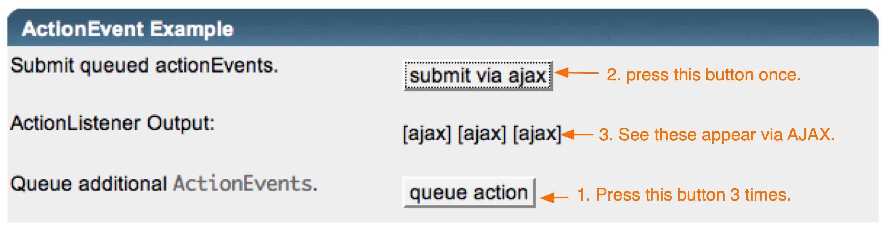
DynaFaces Usage Patterns
Dispatching JSF Events via Ajax
Allow queuing of arbitrary javax.faces.event.FacesEvent subclasses from JavaScript directly into JSF Lifecycle.
JavaScript classes for standard ValueChangeEvent and ActionEvent classes.
Use JavaScript “subclassing” for custom events.

Slide 34
Demonstration

Slide 35
DynaFaces Usage Patterns
Dispatching JSF Events via Ajax⎯ActionEvent
<script type='text/javascript'>
function queueEvent() {
var actionEvent = new DynaFaces.ActionEvent("ajax", DynaFaces.PhaseId.INVOKE_APPLICATION);
DynaFaces.queueFacesEvent(actionEvent);
return false;
}
</script>
<h:commandButton id="ajax" value="submit via ajax" onclick="DynaFaces.fireAjaxTransaction(this, { render: 'label'}); return false;" actionListener="#{bean.processAction}" />
<h:outputText id="label" value="#{requestScope.actionEvents}" />
<input type="submit" name="queueAction" id="queueAction" value="queue action" onclick="queueEvent(); return false;" />
Non-JSF button used to queue action events.
JSF commandButton used to fire the AJAX transaction. Requests re-render of the label component.
actionListener updates request scoped property actionEvents, which is output from the label component.

Slide 36
DynaFaces Usage Patterns
Dispatching JSF Events via Ajax-ValueChangeEvent
<script type='text/javascript'>
function queueEvent() {
var valueChangeEvent = new DynaFaces.ValueChangeEvent("input",
DynaFaces.PhaseId.UPDATE_MODEL_VALUES,
“oldValue”, “newValue”);
DynaFaces.queueFacesEvent(valueChangeEvent);
return false;
</script>
<h:inputText id="input" valueChangeListener="#{bean.valueChange}" />
<h:commandButton value="submit via ajax" onclick="DynaFaces.fireAjaxTransaction(this, { execute: 'input', render: 'label,input', inputs: 'input' }); return false;"/>
<h:outputText id="label" value="#{requestScope.valueChangeEvents}" />
<input type="submit" name="newValue" id="newValue" value="queue event"
onclick="queueEvent(); return false;" />
Non-JSF button used to queue value change events.
JSF commandButton to fire the AJAX transaction. Requests execution of input component, and re-render of the label component. The inputs attribute is used to cause only the input component to be submitted.
valueChangeListener updates request scoped property valueChangeEvents, which is output from the label component.

Slide 37
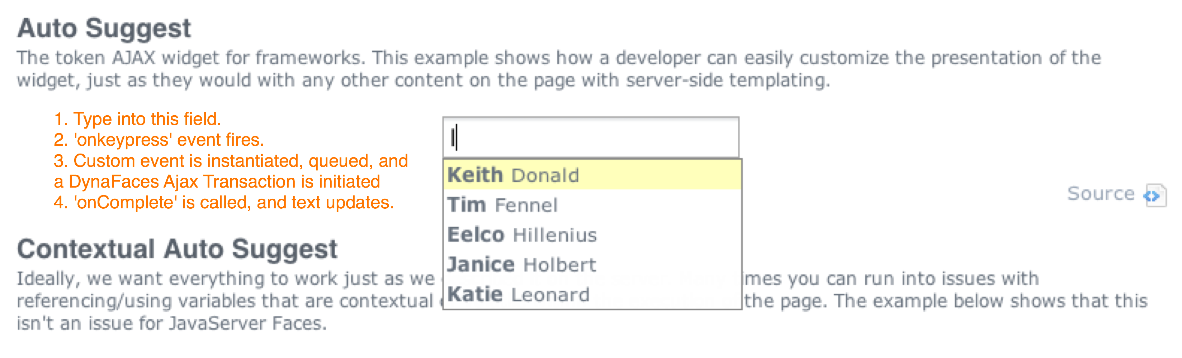
DynaFaces Usage Patterns
Dispatching JSF Events via Ajax-Custom Event Class
Uses JavaScript “subclassing” for custom events.
Combined with a custom component <e:serverSuggest />
This component overrides the standard UIComponent.broadcast(FacesEvent event) to look for an instance of SuggestEvent, from which it extracts the submitted information and dispatched to the Renderer.

Slide 38
Important Links
Project Glassfish
http://glassfish.dev.java.net
JSF-Extensions, DynaFaces
http://jsf-extensions.dev.java.net
Project jMaki
http://ajax.dev.java.net

Slide 39

Summary
JSF + Ajax makes perfect sense
Questions to ask yourself about JSF + Ajax solutions
  How steep is the learning curve?
  Is JavaScript knowledge required for productive use?
  How easy is partial page update?
  Is JavaScript accessible to advanced users?
Naturally, DynaFaces has good answers for these!
The Best of Both Worlds

Slide 40

JSF + Phobos
Ed Burns
  ed.burns@sun.com

