Slide 1


Project Dynamic Faces
World Class AJAX for
JavaServer™ Faces
Technology
Ed Burns
Senior Staff Engineer
Enterprise Java Platforms

Slide 2

Agenda
Why JavaServer Faces?
Why AJAX?
Why JSF and AJAX?
DynaFaces Introduction
  What is it?
  History and Current Status
DynaFaces Details
  Entry Points
  Managing Complexity
Demonstrations

Slide 3
Why JavaServer Faces?
You probably know why already, but just in case you don't...
Web apps have more reach than non web apps
JSF makes it easy to build Java Web apps
  Markup based UI construction
    Allows Browser Layout (CSS, HTML)
    Several view description languages to choose from: JSP, Facelets (XHTML or HTML)
  Hassle free data integration and transactionality
  Large selection of off the shelf components
  Use with or without tools

Slide 4
Why AJAX?
Web apps may have more reach than rich client apps, but traditionally have suffered in the richness department.
AJAX brings more richness without sacrificing very much reach.
It's the hot buzzword now, so it has to be good, right?

Slide 5
Why JSF and AJAX?
OO Design of JSF was ready for AJAX when AJAX wasn't cool.
Key Features of JSF that make it AJAX friendly
  Flexible and extensible component model
  Well defined Request Processing Lifecycle
  Flexible and extensible rendering model
Concepts that enable AJAX
  Encapsulation: ability to hide JavaScript from the page author, but show it to the component author
  State Management: easily keep client and server state in synch

Slide 6
Project Dynamic Faces (DynaFaces)
What is it?
Incremental improvement in JSF 1.2 runtime to enable first class AJAX support in JSF.
Extends the JSF lifecycle to work on AJAX requests.
Drop in JAR to any JSF 1.2 compliant container
One line of additional configuration in web.xml
Ready to use JavaScript library included

Slide 7
DynaFaces ― History, Current Status
Started as Avatar: an idea on Jacob Hookom's blog in September 2005.
Refined by Ed Burns, Jacob Hookom, and JSF developer community since then.
DynaFaces is an implementation of the Avatar idea.
Still experimental, currently in 0.1 SNAPSHOT release.

Slide 8
DynaFaces — Dependencies
Shale Remoting 1.0.3 (and all of its dependencies)
  commons-beanutils-1.7.0.jar
  commons-chain-1.0.jar
  commons-codec-1.2.jar
  commons-collections-2.1.jar
  commons-digester-1.6.jar
  commons-el-1.0.jar
  commons-fileupload-1.0.jar
  commons-logging-1.0.4.jar
  xml-apis.1.0.b2.jar
JSF 1.2 (and all of its dependencies)
  servlet-api-2.5.jar
  jsp-api-2.1.jar

Slide 9
DynaFaces — Entry Points
By Role
Page Author
  Use AJAX enabled components
  Use ajaxZone tag to AJAXify regions of the page
  Use provided JavaScript library to AJAXify page elements and components
Component Author
  Build composite components with AjaxZones
  Use provided JavaScript library in custom components
  Write your own JavaScript that talks directly to the HTTP protocol and the XML application defined by DynaFaces
Increasing Complexity
Increasing Complexity

Slide 10
DynaFaces — Entry Points
By Layer
Application
Application
AJAX Zones
Application
DynaFaces JavaScript Library
DynaFaces API (HTTP + XML Application)
AJAX View Root
AJAX Lifecycle
JSF Runtime

Slide 11

Demonstrations

Slide 12
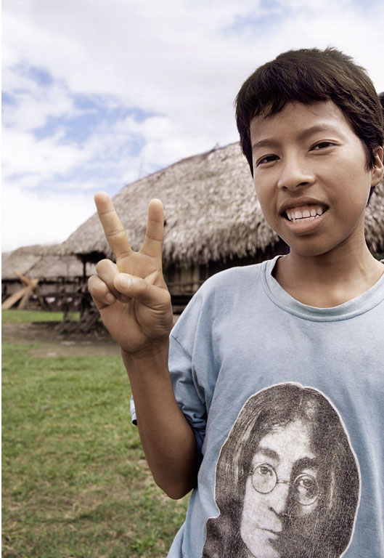
DynaFaces
Ed Burns
  ed.burns@sun.com

