Slide 1
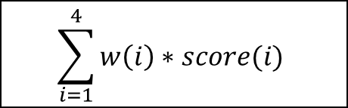
Benchmark
Dataset
Query Protein
HMMER
PSI-BLAST
Grey-PSSM
Feature express
PSSM-GLCM
Feature express
Grey Relation Analysis
score(1)
score(2)
score(3)
score(4)
W(1)
W(2)
W(3)
W(4)
top rank

