Slide 1
Using grey model to predict remote homology proteins
Weizhong Lin

Slide 2
Abstract
Protein remote homology detection is a challenging problem for drug development. Although there are a couple of methods to deal with this problem, the benchmark datasets based on which the existing models were trained and tested contained many high homologous samples due to the fact that the cutoff threshold was set at 95%. In this study, we reconstructed the benchmark dataset by setting the threshold at 40%, meaning none of the proteins included has more than 40% pairwise sequence identity with any other. Using the new benchmark dataset, we proposed a new method called PHom-GRA to detect the remote homologous proteins by integrating various ranking approaches via grey relational analysis. Rigorous cross-validations have indicated that the new predictor is superior to its counterparts in both enhancing successes rates and reducing computational cost.

Slide 3
Introduction
Detecting remote homology relationship among proteins plays one of the fundamental and central roles in computational proteomics. It is particularly useful for drug development.
Firstly, the benchmark datasets used in their studies had high similarity.
Secondly, the ranking algorithm used in those studies would spend a lot of time to training the learning model.

Slide 4
MATERIALS AND METHOD
the benchmark dataset was taken from Liu et al. [12]. It included 7329 proteins from 1070 different super families and 1824 families derived from SCOP database.
the program CD-HIT [33] was adopted to cut down those proteins that had ≥40% pairwise sequence identity to any other in the dataset.
Finally, we obtained 3128 proteins from 540 super-families and 777 families.

Slide 5
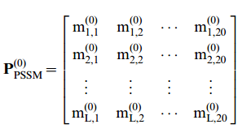

Sample Formulation
Given a protein P with L amino acid residues:
$$P=R_{1}R_{2}R_{3}⋯R_{i}⋯R_{L}$$
Grey-PSSM
By Psi-Blast we can get the Position Specific Scoring Matrix (PSSM):
（1）

Slide 6
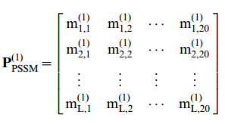

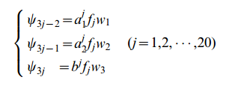

（2）
(3)

Slide 7

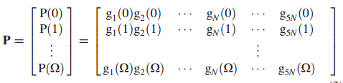

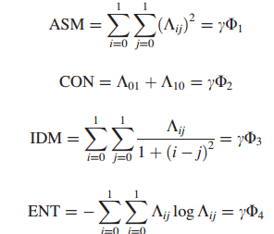
PCA-GLCM

Slide 9
RESULT AND DISCUSSION
Methods | ROC1 | ROC50
HMMER | 0.6981 | 0.7052
PSI-BLAST | 0.7113 | 0.7647
Phom-GRA(PSI-BLAST+PCA-GLCM) | 0.7138 | 0.7652
Phom-GRA(PSI-BLAST+Grey-PSSM) | 0.7110 | 0.7737
Phom-GRA(HMMER+Grey-PSSM+PCA-GLCM) | 0.7345 | 0.7895
Phom-GRA(PSI-BLAST+Grey-PSSM+PCA-GLCM) | 0.7371 | 0.7968
Phom-GRA(PS-BLAST+Grey-PSSM+PCA-GLCM+HMMER) | 0.7502 | 0.8057
[0.02 0.3 0.28 0.4

Slide 10
Conclusion
Experimental results disclosed that scores of ROC1 and ROC50 got by PHom-GRA were superior to those got by PSI-BLAST, or HMMER. An additional advantage was that PHom-GRA wasted much less the training time and computer memory.

