Slide 1
Packet4Good
Send or buy package for goodness…

Slide 2
Goal
One web portal to organize and send packages which are contains basic needs for human life to immigrants.
Based on two roles, one of civil society organizations and the others volunteer.
Civil society organizations determine the need packages according to certain categories and publish them on web portal.
Volunteers see published packages and choose one than prepare and send the package to desired addresses .
In addition,volunteers can buy any packages instead of preparing and sending packages if they want.
Package sample:
Baby-Small packet contains following;
1 shampoo, 1 diaper, 1 cleaning cloth, 2 socks, 2 athlete, 2 rompers…

Slide 3
Architecture
Based on Spring Cloud
Spring Boot
Spring Data
Spring Security
Spring MVC
Designed for Microservices Arch.
12 factor apps
Federated APIs

Slide 4
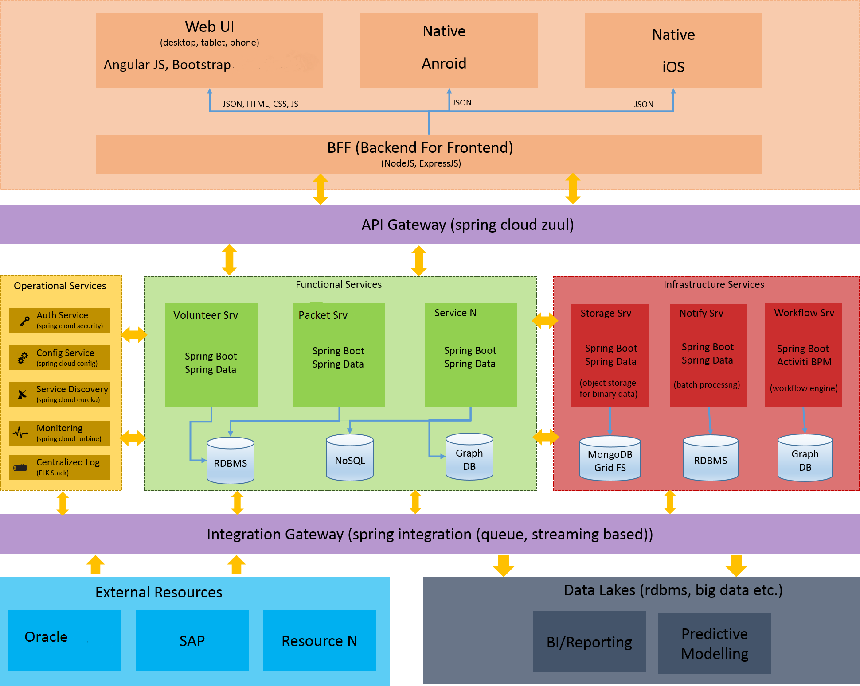
Architecture – Big Picture

